Slide 1
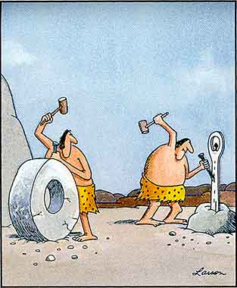
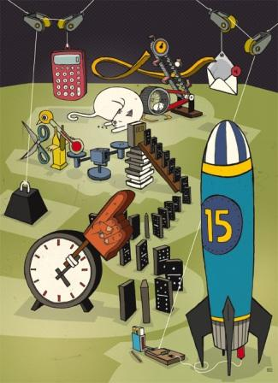
Invention and Innovation
Technological Design

Slide 2
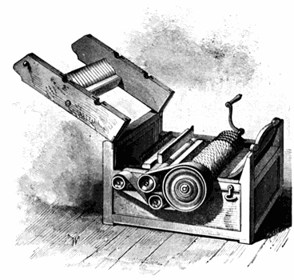
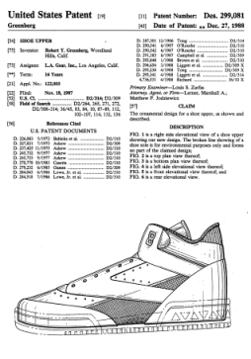
Intellectual Property
Utility Patents – processes, machines, products, and composition of matter (medicines)
20 years
Design Patents – new, original, or ornamental designs for products
20 years
Plant Patents – invented or discovered plant varieties
20 years

Slide 3
Intellectual Property
Trademarks – words, names, symbols, sounds, or colors distinguishing goods and services
Can be renewed forever
Copyrights – writings, music, and works of art
Life of the author, plus 70 years

Slide 4
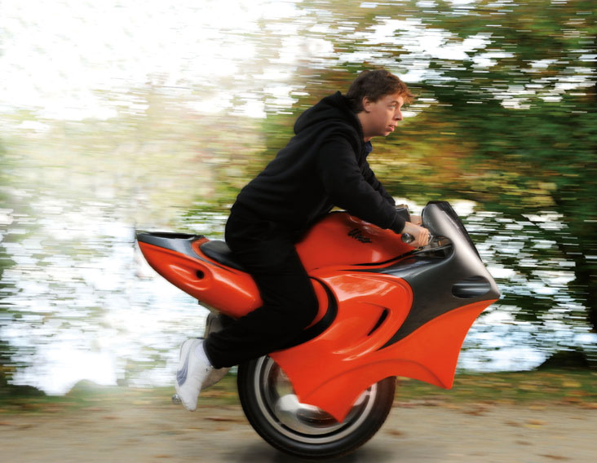
Discovery vs. Invention
Discovery – is made when something that naturally occurs is first noticed – scientific discoveries
Invention – is a new idea, process, or device
Devices and machines
Products
Processes

Slide 5
Invention & Innovation
Invention
Developing products/systems to solve human problems
Meeting human wants and needs
Innovation
Improving existing products/systems
Improving technological methods
Adaptation – developed when inventions are used for something other than the purpose for which they were intended

Slide 6
Why Design?
Design is to technology what inquiry is to science and reading is to language arts
Uses critical thinking
Promotes teamwork
Mirrors “real” world
Applies technical knowledge
Expands/utilizes creativity
Examines the technological impacts on society, cultures, and environment

Slide 7
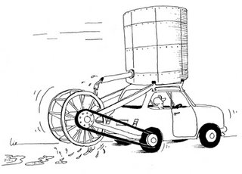
Research & Development
Pre-market innovation/development
Refining the product/system prior to marketing
Addressing wide-range of problems concurrently
Is the product reliable?
Is the product safe?
Does the product have market appeal?
Does the product add social value?
What are the potential harmful impacts
Ethical, environmental, social, political, ecological

Slide 8
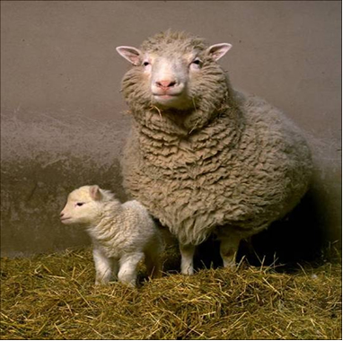
Experimentation
Following established procedures to solve a problem
Developing hypotheses, testing procedures, documentation procedures, etc.

Slide 9
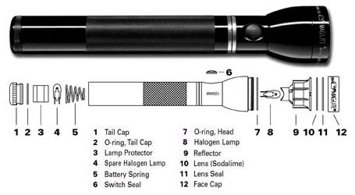
Troubleshooting
Identify faults/malfunctions in technological systems
Applying specialized knowledge to isolate causes
Repairing faults
Testing results of action

Slide 10
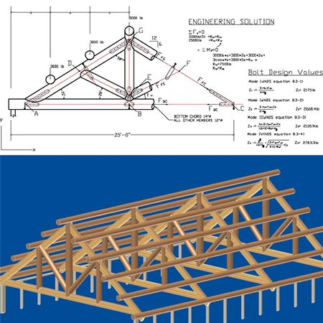
Engineering Design
Making products/systems under constraints
Ethics, safety, risks/benefits, reliability, etc.
Making compromise
Applying critical analysis
Applying technical knowledge
Using technological creativity
Developing teamwork skills

Slide 11
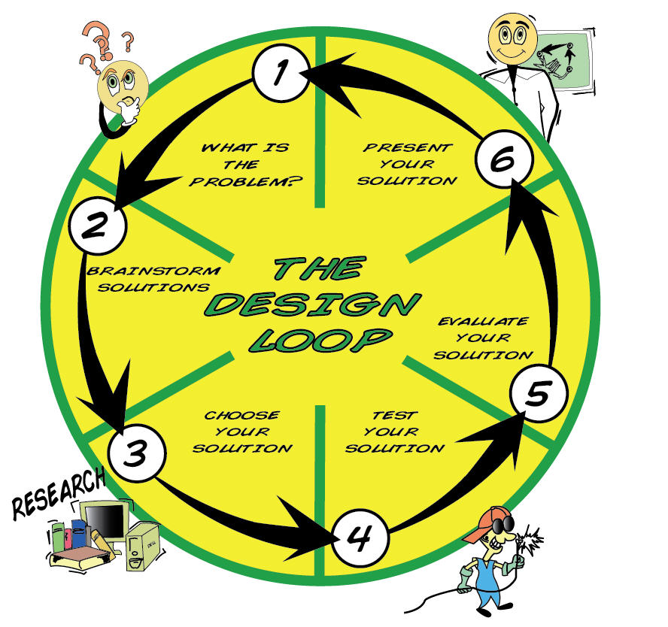
Design Process
Identify the Problem
Collect Information
Think Creatively
Experiment
Review

Slide 12
Why Invent?
Social Invention – created to help the inventor or others
make our life better and easier
Financial Invention – created to make money
Leisure Invention – created for the pleasure of inventing
games and toys

Slide 13
Assignment
Individual Design Problem
Due Tuesday October 15
Ideas
Reuse a product container/packaging
Relate it to something in your own life – holiday dilemma
Improve existing design
Easier to use
Add a feature
Present your design to the class

