Slide 1

Promoting Creativity in the Classroom

Slide 2

Teaching Creativity
On a piece of paper, draw nine dots like you see below:
Now see if you can connect the dots with four consecutive straight lines, without taking your pencil off the paper
You have one minute to complete the task.

Slide 3
Create: (kre at’)To bring into existence out of nothing; to originate; to make. The act of creating. Any original production of the human mind.

Slide 4
A hunch is creativity trying to tell you something. Frank Capra
Try it yourself: Come up with a fourth word that connects the first three
Time – Hair – Stretch
Manners – Round – Tennis
Ache – Hunter – Cabbage
Imagination is more important than knowledge. Albert Einstein

Slide 5
Teaching creativity
Students cannot be taught to be creative any more than seeds
can be taught to grow.
However, we can prepare the optimum environment for seeds to grow: Likewise we can create the optimum environment for creativity to flourish.
Here’s a riddle used in a recent study showing that people are more creative when they’re tired:
A man has married 20 women in a small town. All of the women are still alive and none of them are divorced. The man has broken no laws. Who is the man?

Slide 6
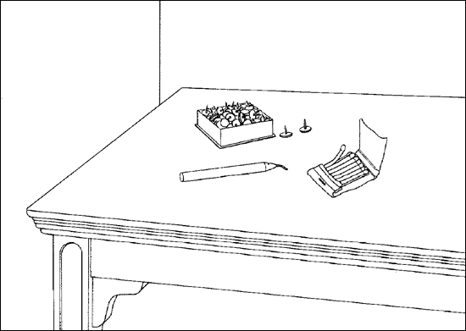
Teaching creativity
Creativity is no excuse for sloppy thinking.
Providing children with the best environment for creativity does not mean giving them absolute freedom without rules or guidance.
Affix the lit candle to the wall so that it will not drip wax onto the table below

Slide 7
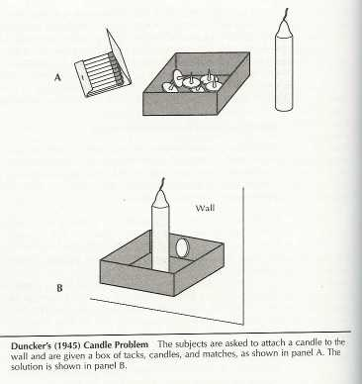
The Candle Problem is a classic test of creative problem solving developed by psychologist Karl Duncker in 1945

Slide 8
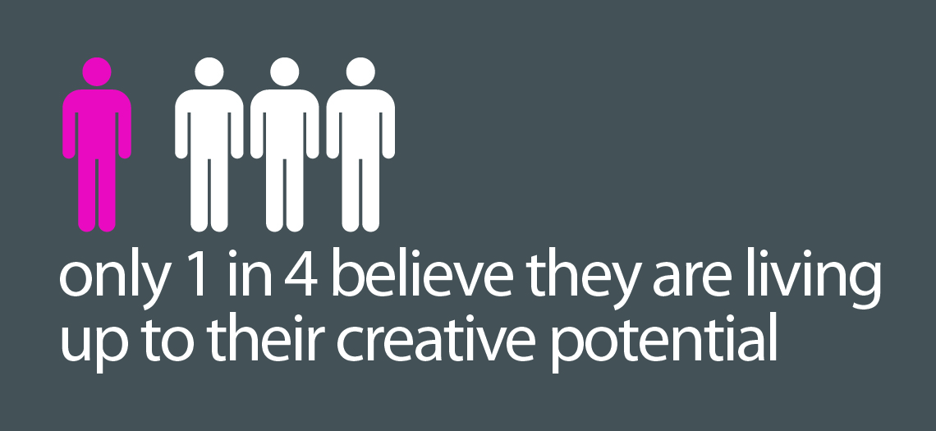

Slide 9
Teaching creativity
Why encourage creativity?
The opposite of creativity is repression.
Thoughts are only ours when we have thought them ourselves.
Creativity will influence future prosperity.
The more students practice, the more creative they will be.
Allows for the practice of divergent thinking.
  Most school assignments are convergent.

Slide 10
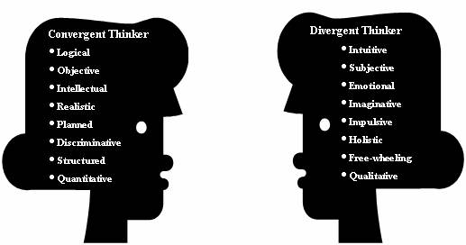
Divergent Thinking
Represents the potential for creative thinking and problem solving. It is not synonymous with actual creative behavior but has proven to be a good estimate of it. It is also useful as a construct or empirical research on creativity and in various applied settings

Slide 11
Creativity and Children
All children arrive at school with creative abilities
Schools are a thinly disguised conspiracy to quash creativity
Creativity is taught out of the student
To be creative, one must be willing to take a chance, and maybe be wrong!
STEM teachers must be constantly in search of opportunities to cover the content while allowing for student creativity—divergent thinking
  It is not enough for a curriculum activity to be fun for the students, without covering important content

Slide 12
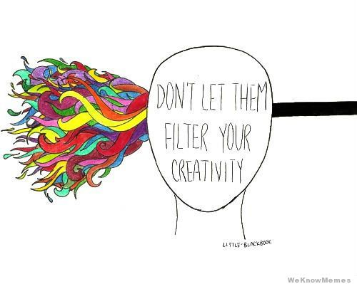

Slide 13
A Lesson that has Creativity at the Core
Provides Chances to:
View problems from many angles
Hear differing points of view
Take things apart/see how things work
Reason, analyze, and brainstorm
Adapt ideas of others/self
Add a new twist to old idea
Find new uses for old ideas
Simplify solutions to old problems & ideas
Explore “gut feelings”
Rearrange components of old solution to create new one
Combine previous ideas to create new one
Use the non-rational part of brains
Visualize and use mental imagery
Collaborate/learn from others
Apply basic ideas and concepts
Take risks and build self-confidence
Become more tolerant of the unknown
Become more open to new experiences

Slide 14
Thoughts from Re-imagine by Tom Peters
Need to develop a school that believes:
  Learning is natural
  Love of learning is normal
  Real learning is passionate learning
  Questions are more important than answers
  Creativity is more important than fact recognition
  Individuality more important than conformity
  Creative experiences build brain capacity

Slide 15
“The most important developments in civilization have come through the creative process, but ironically, most people have not been taught to be creative.” Robert Fritz

Slide 16
As teachers, we have one of the largest potential influences on children's willingness to take a risk and be creative.
We can support or thwart that creativity.

Slide 17
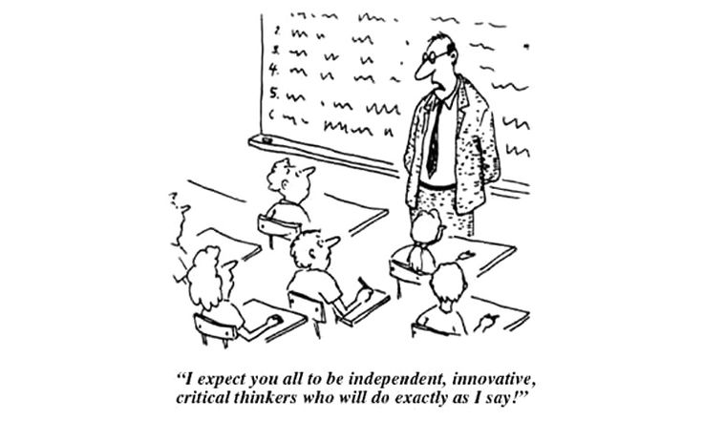

Slide 18
Creativity Literature Review
Creativity should not be confused with talent.
Everyone therefore has the potential to be creative.
The key component to stimulate creativity is motivation or ‘the inner spark’ (Amabile, 1996)
There is however a misconception that ‘creativity’ is just the process of creating something new (Pink, 2005)
Experiential learning is constructivist learning, where learners are active learners, constructing their own knowledge, rather than observing the teacher demonstrate (Itin, 1999)
Because experiential learning is active learning, learners more readily understand what they are learning and thus retain the knowledge to a greater degree than when merely having information presented to them by another.
The hands-on nature of experiential learning is highly motivating for learners.

Slide 19
Psychological Theories of Creativity
Psychoanalytic Theory
  Creative thought is the product of brain processing not accessible to conscious thought
Behavioral Theory
  Creative behavior results from environmental stimuli
  Appropriate awards can lead to creative behavior
Cognitive Approach
  Creative behavior stems from a capacity for making unusual and new mental associations of concepts
  Creative people create more “variations”
Self-Actualization
  Able to perceive reality accurately
  Compare cultures objectively
  Can look at things in a fresh, naïve, simple way
  Be happy and thus be creative!

Slide 20
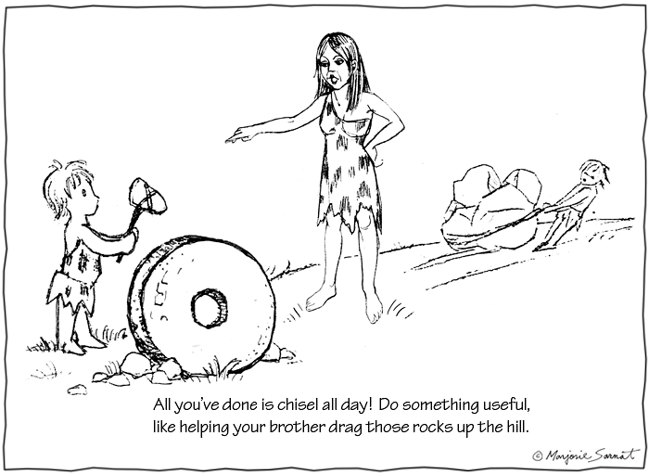

Slide 21
Perceptual Blocks to Creativity
Stereotyping – fit into some standard category
Tacit assumptions – impose artificial constraints
Saturation
  Focus too quickly on “obvious” problem
  Focusing too much on details
  Getting overwhelmed with data
Inability to see problem from other viewpoints
  Multiple objectives will be at play
  Must understand other’s values and objectives

Slide 22
Emotional Blocks to Creativity
Fear of taking a risk
  Risk aversion is a key decision analysis concept
  May be counterproductive to not offer “wild” ideas
Status quo bias
  Various levels of bias to current state of affairs
  Change can be hard to accept
Reality versus Fantasy
  Some people only want realistic solutions
  Such people are comfortable “in their box”
Judgment and Criticism
  Do not apply your values too soon in creative process
  Need to let ideas flow freely
Inability to Incubate
  Not well understood
  Accepted as a phase
  Are we always given time to incubate an idea?

Slide 23
Cultural Blocks to Creativity
Taboos
  Views of culturally accept behavior may block ideas
Humor
  Setting too formal: Good ideas can be obtained in an informal setting
  Informal setting with lots of joking can be effective
Reason and Logic prevails
  Overly analytical thinking (even though it is important)
Tradition and change
  Often a strong resistance to changes
  The status quo got the decision maker where they are

Slide 24
Environmental Blocks to Creativity
Non-supportive environment
Environment that dissuades humor and playfulness
Classroom is overly structured and routine
Autocratic teacher
  Teacher has all of the answers
Over focus on winning, competition and impressing teacher
Overly strict timelines
  Often a tight suspense can lead to good results

Slide 25
Brainstorming
Introduced in 1930s by Osborn
Based on idea of eliminating perceptual blocking filters
Two Principles:
    Defer judgment
    Quantity breeds quality
Four rules
    Rule out criticism
    Welcome freewheeling
    Seek large quantities of ideas
    Encourage combination and improvement of ideas
Works due to its synergistic effect
  Among participants
  Combining of ideas is not just additive
  Combine ideas to get new ideas
Generally regarded as a group technique based on a specific objective
  Specificity focuses the efforts
Useful in situations calling for idea generation rather than judgment

Slide 26
Checklists
Very simple means of generating ideas
Ask and list answers to series of questions. For instance
  Are there other uses?
  Can something be adapted?
  Can something be modified?
  Can components be re-arranged?
  Can components be combined?
  Can some substitution be made?
Osborn (1963) offered a series of idea spurring questions.

Slide 27
Osborn’s Questions for Checklists
Put to other uses?
  New ways to use as is
  Other uses if modified
Adapt?
  What else is like this?
  What other idea does this suggest?
  Does the past offer a parallel?
  What could I copy?
  Whom could I emulate?
Modify?
  New twist?
  Change meaning, color, motion, sound, odor, form shape?
  Other changes?
Magnify?
  What to add?
  More time? Greater frequency? Stronger? Higher?
  Longer? Thicker? Extra value? Plus ingredient?
  Duplicate? Multiply? Exaggerate?

Slide 28
Osborn’s Questions for Checklists (continued)
Minify?
  What to subtract? Smaller? Condensed? Minature?
  Lower? Shorter? Lighter? Omit? Streamline?
  Split up? Understate?
Substitute?
  Who else instead? What else instead? Other ingredient? Other material? Other process?
  Other power? Other place? Other approach? Other tone of voice?
Rearrange
  Interchange components? Other pattern? Other layout? Other sequence?
  Transpose cause and effect? Change pace? Change schedule?
Reverse?
  Transpose positive and negative? How about opposites?
  Turn it backward? Turn it upside down? Reverse roles?
  Change shoes? Turn tables? Turn other cheek?

Slide 29
What does Creativity Look Like in the Classroom?
Creative students are curious, question and challenge, and don’t always follow the rules.
They think laterally and make associations between things that are not usually connected.
They imagine, see possibilities, ask ‘what if?’, picture alternatives, and look at things from different view points.
They play with ideas, try alternatives and fresh approaches, keep open minds and modify their ideas to achieve creative results.
They reflect critically on ideas, actions and outcomes. They review progress, invite and use feedback, criticize constructively and make perceptive observations.

Slide 30
Teachers Who Encourage Creativity…
Give students extended, unhurried time to explore and do their best work.
Don’t interfere when students are productively engaged and motivated to complete tasks in which they are fully engaged.
Create an inviting and exciting classroom environment.
Provide students with space to leave unfinished work for later completion and quiet space for contemplation.
Provide an abundant supply of interesting and useful materials and resources.
Create a classroom climate where students feel mistakes are acceptable and risk-taking is encouraged.
Appropriate noise, mess and autonomy are accepted.

Slide 31
