Slide 1
Technical/Procedural Problem Solving Another Type of Problem Solving for STEM Learning

Slide 2
Problem Solving Categories
Design
Trouble-shooting
Invention/Innovation
Research and Development
Experimentation
Technical/Procedural

Slide 3
So Far, We’ve Focused on Design
While Design Problem Solving is the primary method used in STEM, in some cases you will need to use other methods.
Now we are going to focus on Technical/Procedural Problem Solving

Slide 4
Technical/Procedural Problem Solving
Form of problem solving that requires a student to follow a set of technical directions to accomplish a task. For example, students might be required to build an electronic device following precise directions of a technical nature and then, when the device is complete, the students must complete a series of experiments.
T/P Problem Solving is a lower level method of problem solving (Six Facets)

Slide 5
T/P Problem Solving & Six Facets
While Design Problem Solving is very effective in reaching the higher levels of the Six Facets (Applications, Perspective, Empathy, & Self-knowledge)
T/P Problem Solving can be a useful tool for reaching the first two levels of the Six Facets (Explanation & Interpretation)

Slide 6
Strategies for Solving T/P Problems
Typically don’t use the Design Process/Loop
T/P Problems require the student to:
Seek relationships and work out solutions
Follow step-by-step technical directions
Read a schematic drawing
Write technical directions
Understanding the systemic order of technical devices
T/P Problems requires that the learner have some prior background in the subject matter

Slide 8
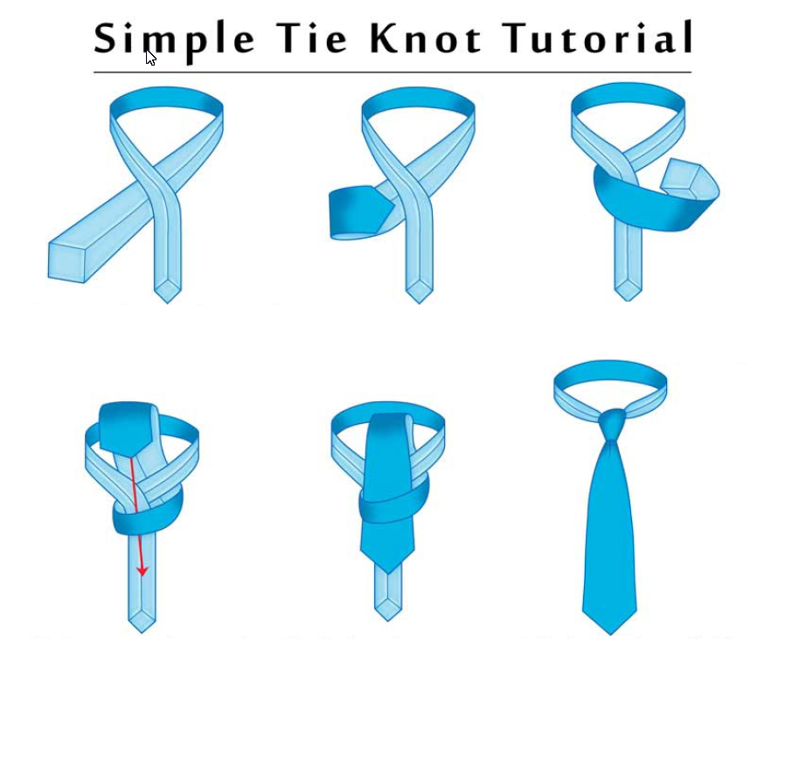

Slide 9
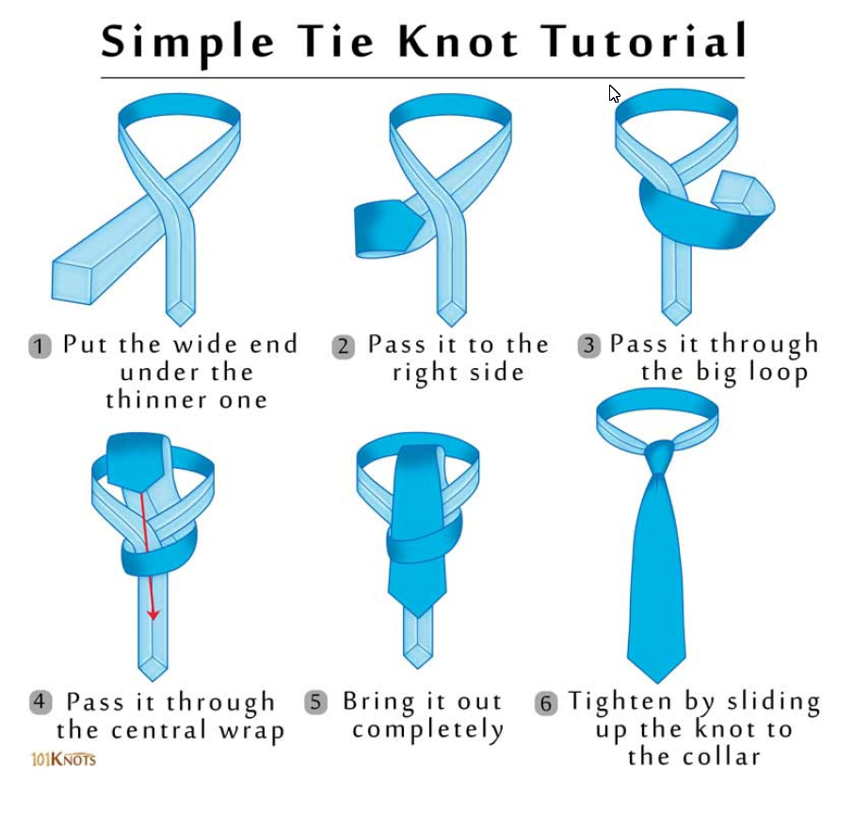

Slide 10
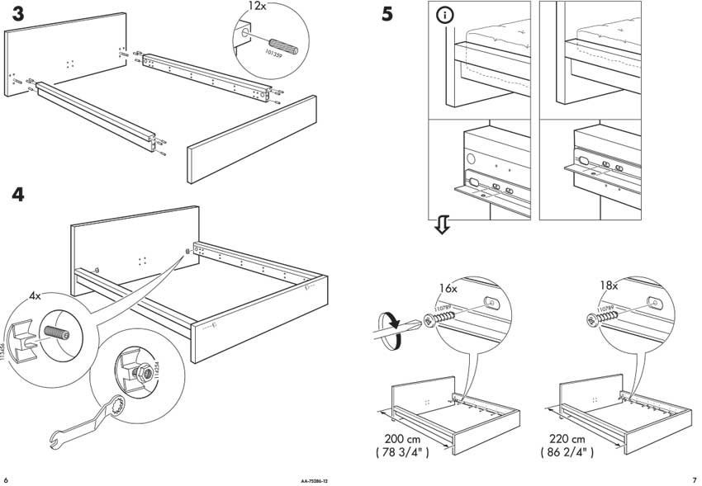
Technical/Procedural can be written using on pictures. However, this is difficult and often requires very technical skills. The best T/P directions include high quality images and written directions that are easy to understand and follow.

Slide 11
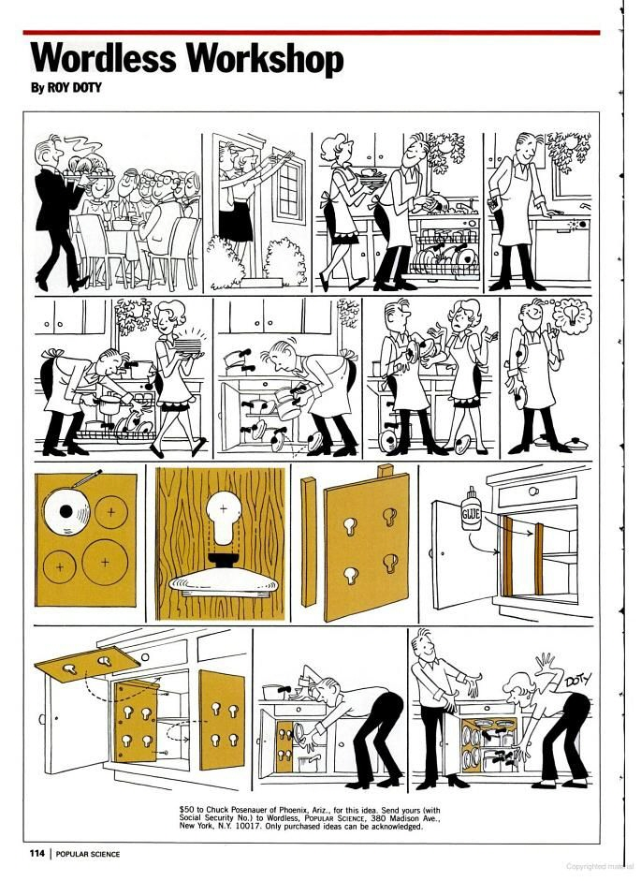

Slide 12
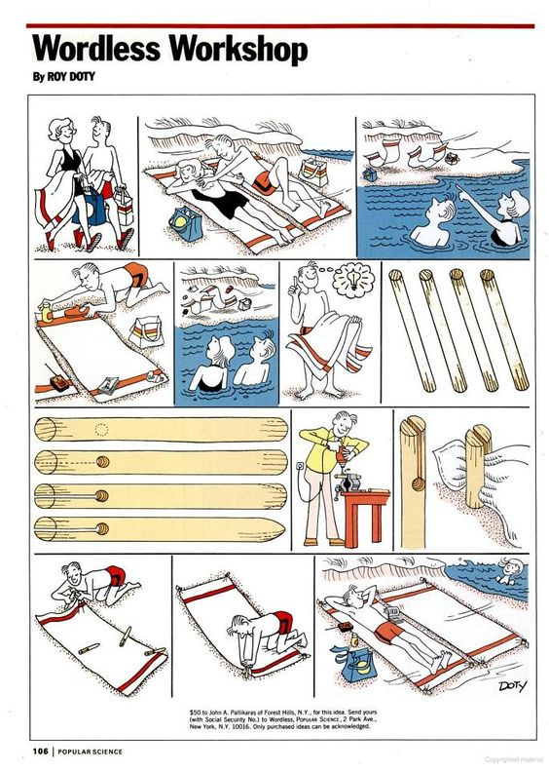

Slide 13
Writing a Technical/Procedural STEM Problem
-Good pictures and written directions to develop the technical product
-Detailed instructions on what the students will do after creating the product
– test – experiments – modifications - data collection
– this is where the content learning will occur.

