Slide 1
Remaking with Maker Tech
“Technology will not replace great teachers, but technology in the hands of great teachers
can be transformational” - George Couros

Slide 2
-Student Empowerment using tech
-Storytelling (through video games
-Video and Green Screen
-Robots - Petting Zoo/Storytelling/Story Creation
-Personal Story Creation
-Lego - (StoryStarter)
-Interactive MakeyMakey Stories
-Design with Floorplanner

Slide 3
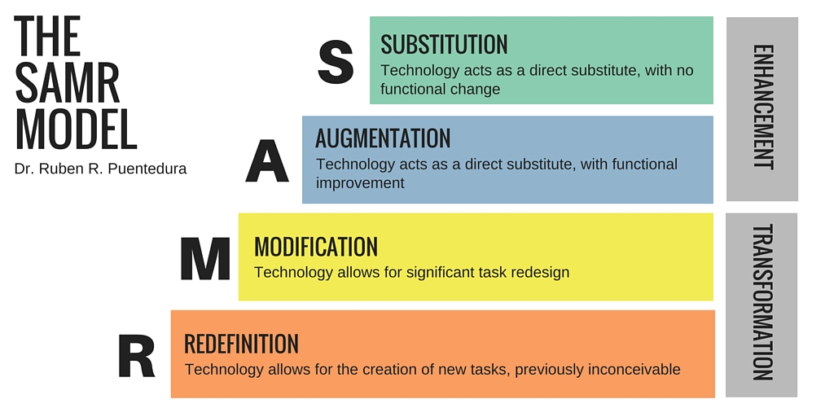

Slide 4
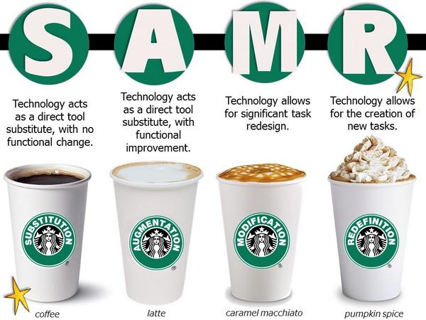

Slide 5
Challenge:
Some kids don’t like to read…it is really hurting their ability to be world changers like you. Choose a favorite book and persuade other kids that reading your book is important.
(Students chose a book, made notes of important things to share, wrote a script, got peer feedback, chose a crew to help with filming, and finished with these videos.)

Slide 8
Natalyn’s Band
Natalyn's Genius Hour project began with this question, "How do you make a band?" Natalyn researched songs, instruments, auditions... wrote a song, tinkered and made instruments, held auditions, and directed this amazing music video.

