Slide 1
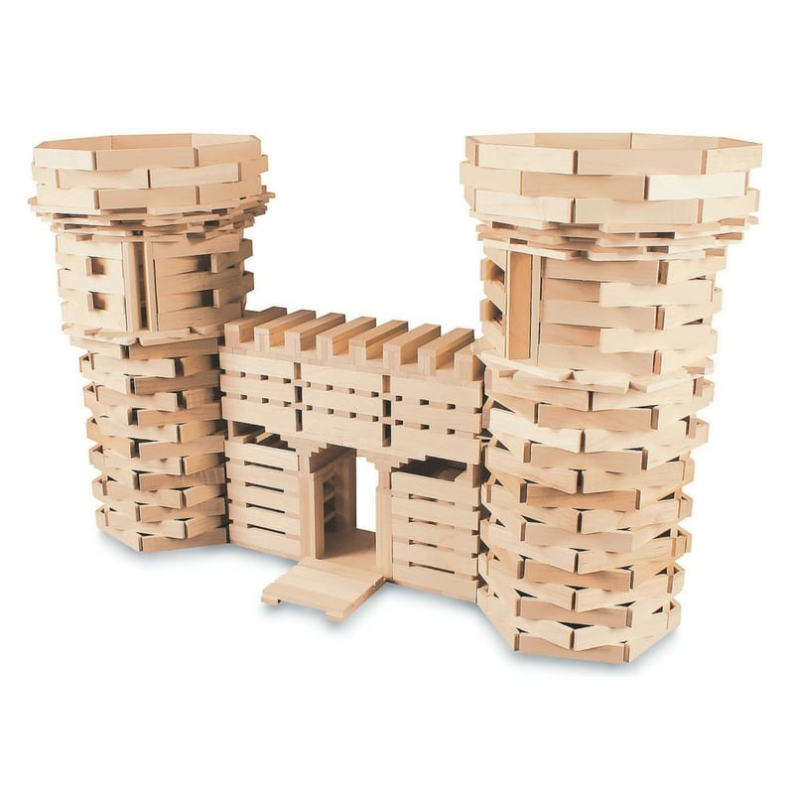
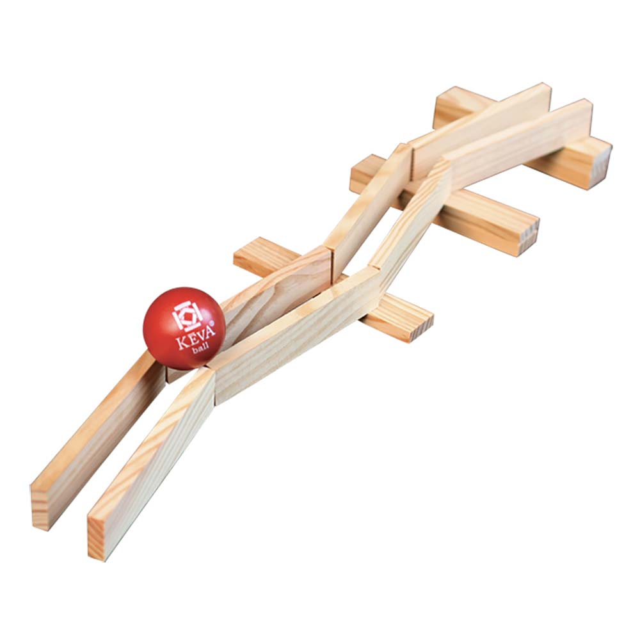
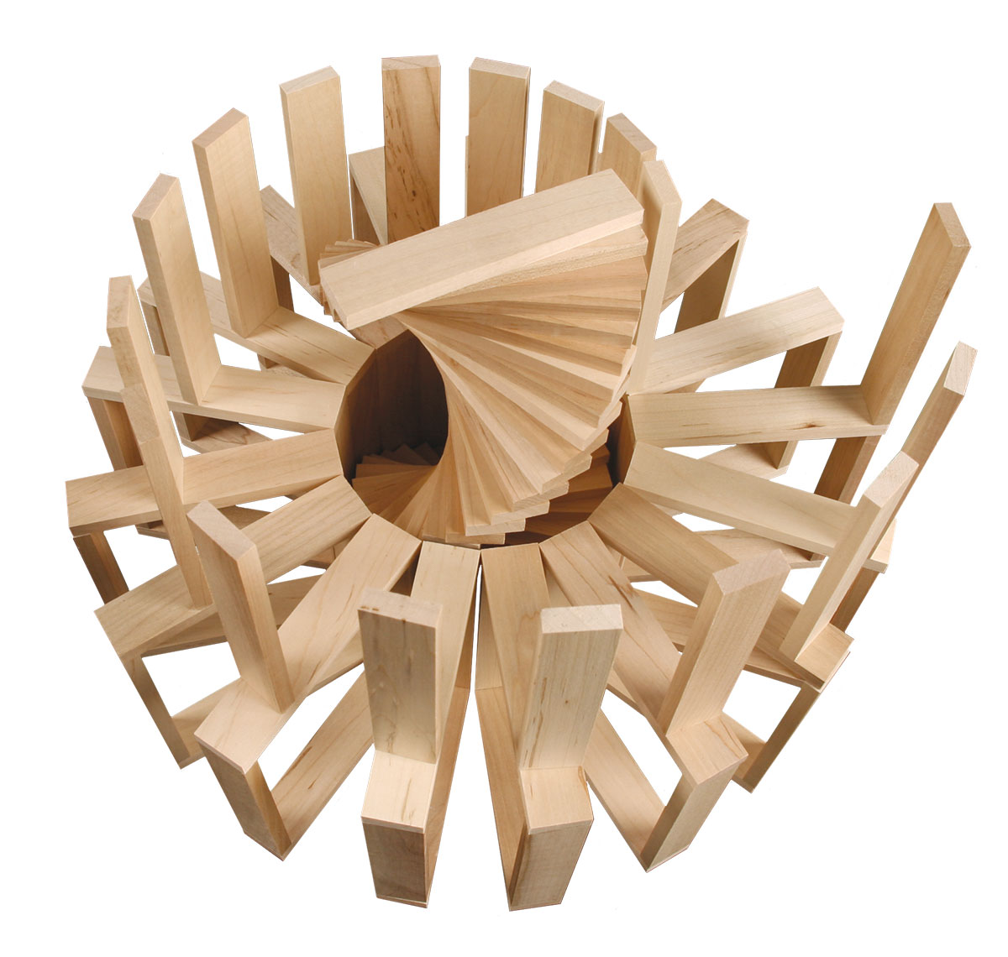
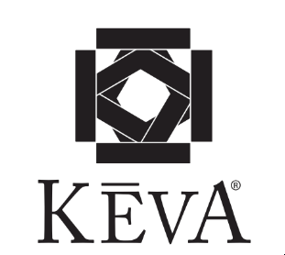

Slide 2
Introductions – Getting to Know You
Big Idea – People have different perspectives
Spell your name with KEVA
Conduct a gallery walk around the classroom to look at the different ideas

Slide 3
Introductions – Getting to Know You
Create a model with KEVA
that demonstrates to the class your favorite activity or hobby

Slide 4
Symmetry Challenge – with a partner
Big Ideas – Symmetry is an important part of the designed world. It is important to be able to work with others.
Create a line of symmetry (3 or 4 blocks)
-Take turns building off of the line of symmetry (3 or 4 blocks).
-The second team member follows the lead of the first.

Slide 5
Symmetry Challenge – with a partner
Big Ideas – Symmetry is an important part of the designed world. It is important to be able to work as a team.
Create a line of symmetry (3 or 4 blocks)
-Take turns building off of the line of symmetry (3 or 4 blocks).
-The second team member follows the lead of the first.
*Discuss divergent and convergent thinking

Slide 6
Creating Patterns
Big Idea – Patterns are repeatable. It is important to be able to work as a team.
-Individually create a pattern that is repeatable.
-Each person at the table will vote (1-2-3-point) at the pattern that they believe will be the most repeatable.
-Work as a team to repeat the selected pattern across your team’s table.

Slide 7
Vacation Resort – using a character card
Big Idea – empathy, teamwork, modeling with Keva
Each table will be given a character card. As a team develop a vacation resort for that character.
Conduct a gallery walk around the classroom to look at the different ideas

Slide 8
Ramona Quimby
The younger of two daughters in the Quimby family.
She is eight years old and in the third grade at Cedarhurst Elementary School in Portland, Oregon.
She is proud of her age, and seeks to act like a "grown-up" whenever possible. She resents being treated like a child at times, particularly when she is expected to play with or entertain younger children.
Ramona is a bright and creative girl.
She is good at drawing and enjoys reading.
She has an unlucky tendency to be involved in minor accidents that draw attention to her, and for which she feels she is often blamed. She tries to avoid these situations, but her efforts are sometimes frustrated by her bad luck.
She is eager to please her teacher, but also indignant when she thinks her teacher is treating her unfairly.
Ramona is an observant person, noticing small details

Slide 10
Team Challenge
Big Ideas – repeating a pattern, teamwork, empathy, senses
Collaborate with a partner to create a pattern with 20 total blocks (partner one – 2 blocks, partner two – 3 blocks)
Race to see who finishes the pattern first.
Try with your non-dominate hand
Try it with one eye closed
Try it without certain senses (earmuffs, no talking)

Slide 12
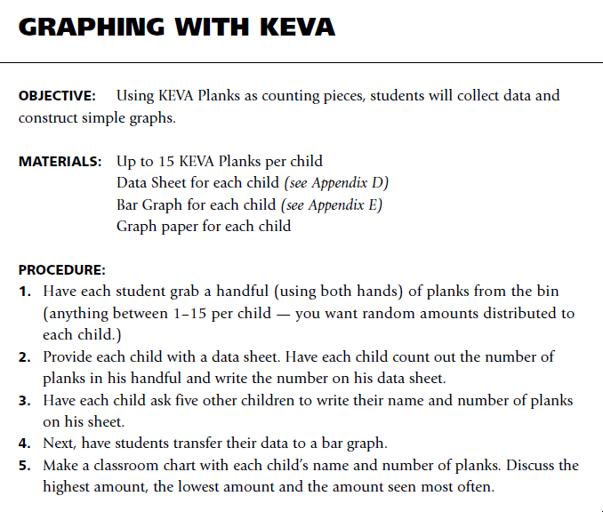

Slide 13
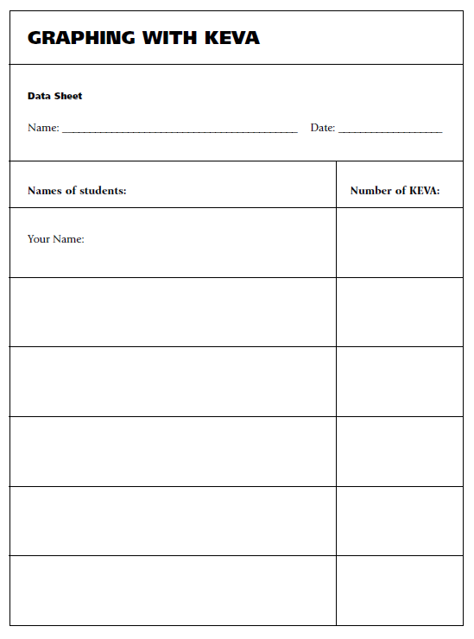
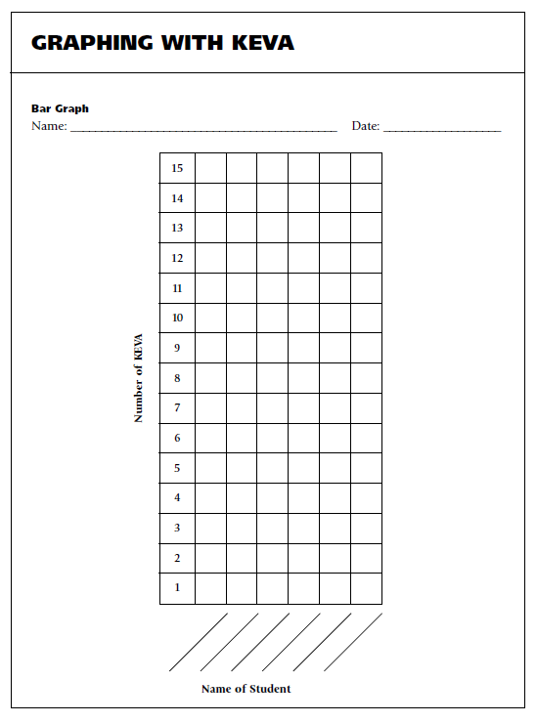

Slide 14
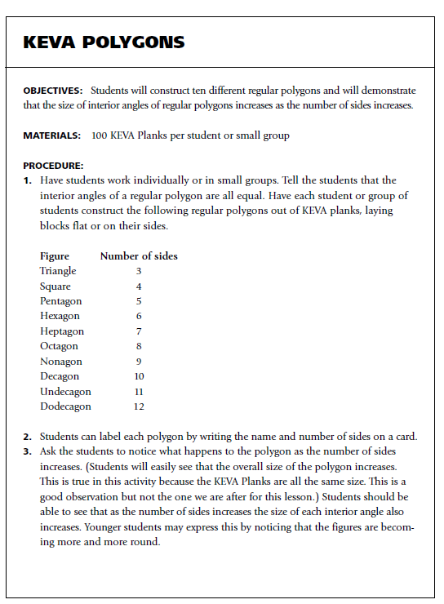

Slide 15
