Slide 1
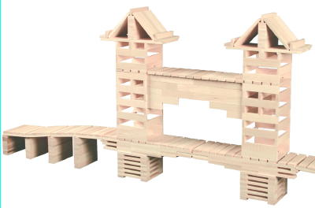
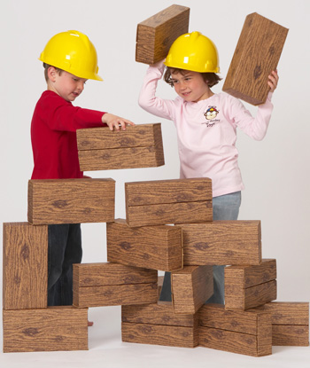
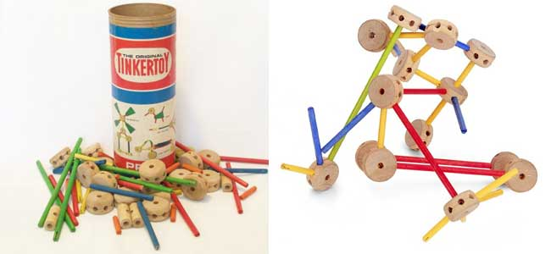
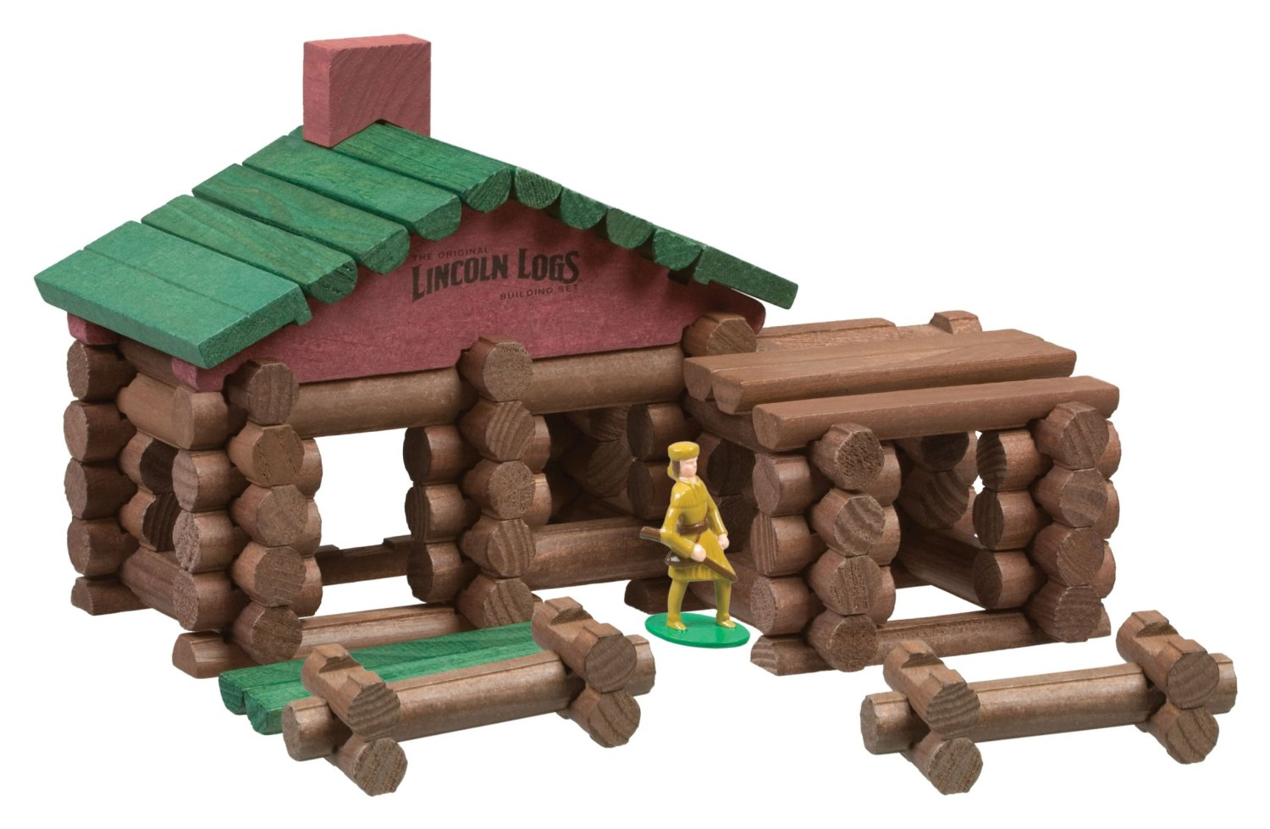
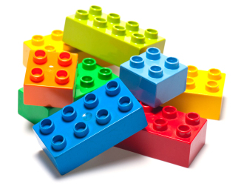
Using Blocks and Construction Toys for Teaching STEM Content

Slide 2
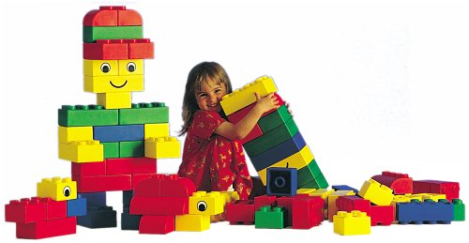
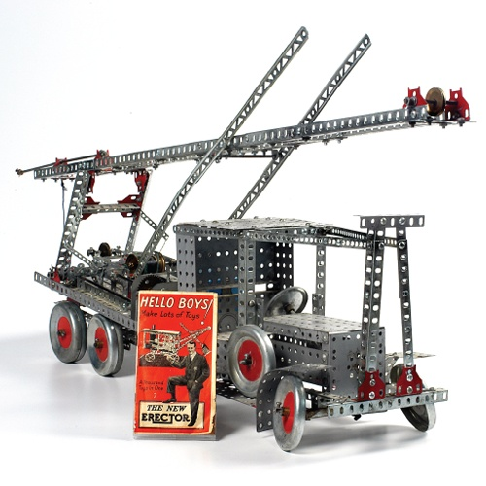
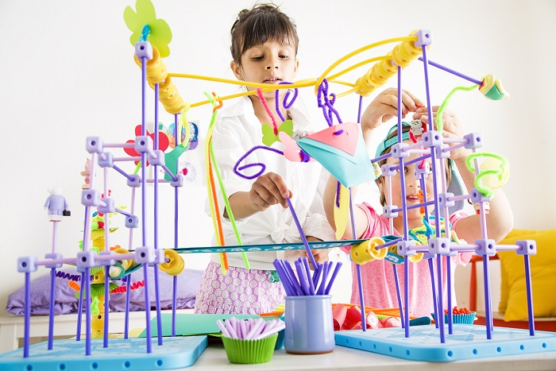
What are We Talking About?
Legos and/or Mega Bloks
K’nex
Lincoln Logs
Keva Planks
Goldie Blocks
Tinker Toys
Unit Blocks
Erector Sets
Others

Slide 3
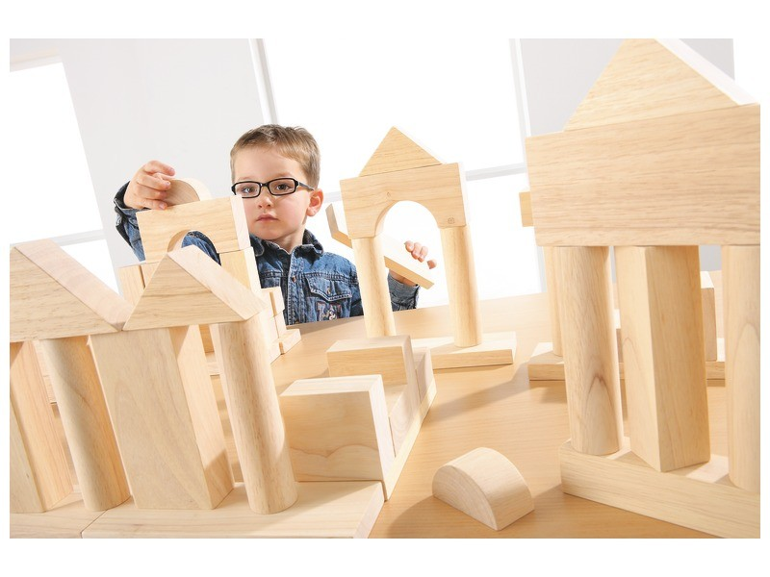
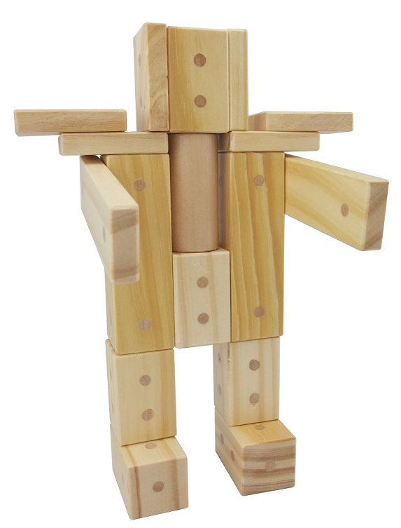
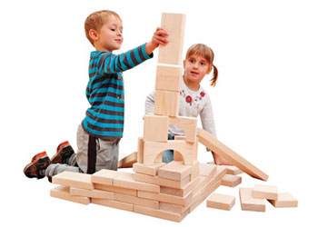
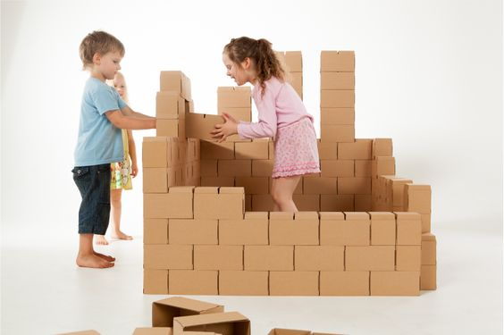
Construction Blocks are not as Flashy as Robots
But, they encourage and augment vastly higher levels of problem solving and creativity
Construction blocks:
Build motor skills
Build hand-eye coordination
Build spacial skills
Develop capacity for creative/divergent thinking
Build social skills
Build language skills
And, they’re cheap!

Slide 4
Moreover, Research Suggests that:
Construction block time is correlated with advanced math skill development
Children who show more interest in construction:
Build more sophisticated structures and perform better on tests of spatial intelligence
Are better able to use mental imagery (the mind’s eye)
Increased spatial/math performance continues into high school
Recreating structures leads to increased capacities for math and word problems

Slide 5
More Research
The use of construction blocks, leads to:
Stronger divergent problem solving skills (convergent = 1 answer, divergent = multiple answers).
More creativity than students who focus on convergent play (i.e., puzzles)
Friendlier, more social and cooperative students
Students who use construction blocks tend to develop higher quality friendships later in life
Children with Autism make larger strides when using CB’s than they do when coached with social stories

Slide 6
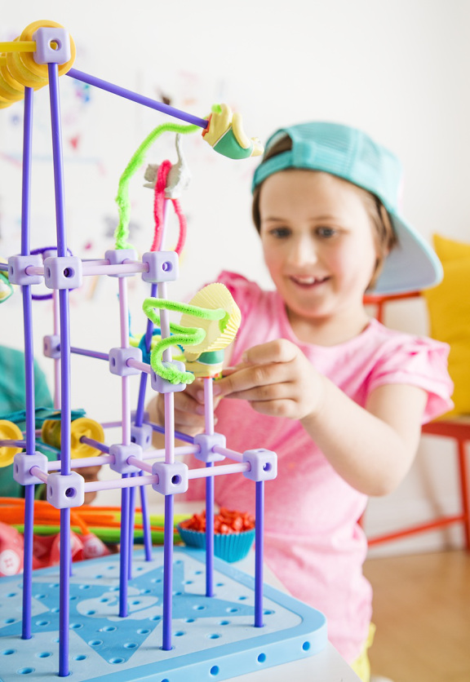
Results
Children who use CB’s tend to score higher in tests of:
Vocabulary
Grammar
Verbal comprehension
Creativity
Problem solving
Spatial reasoning
Mathematics
And, they watch less TV

Slide 7
Mimicking Professional Challenges
Children building structures face the same physics challenges that architects, engineers, scientists face!
Large numbers of engineers attribute their interest in CB’s as a first motivation to enter the field
Recent study of high achieving STEM graduates (from college) noted that this group was far more likely than the average American to have extensive backgrounds with hands-on crafts and hobbies, including: woodworking, crafting, sewing, etc.

Slide 8
Correlation Does Not Equal Causation
Children with strong spatial skills are probably drawn to CB’s, that alone can’t prove that the “block time” caused the difference
However, if you tested all children, then taught lessons using CB’s, then tested again, you could determine whether CB’s led to increases in spatial skill performance.
Numerous studies have proven this causation through long-term research:
Wolfgang et al., 2003
Casey, et al., 2008
Grissmer, et al., 2013
Verdine, et al., 2013

Slide 9
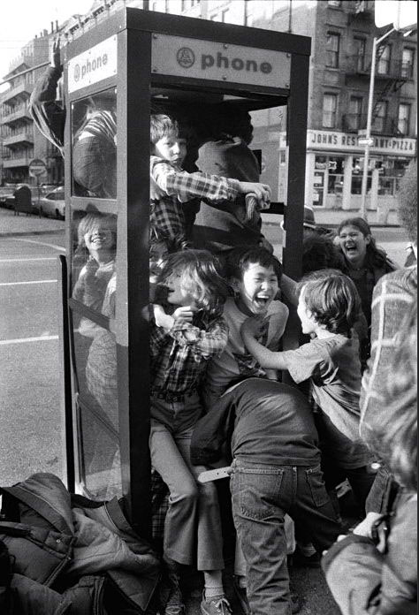
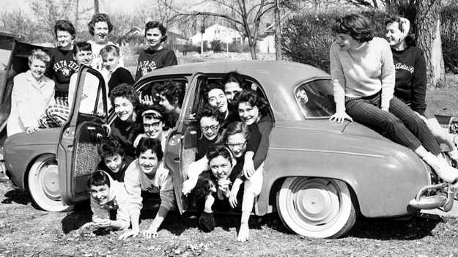
Colleges and universities have long been recognized as institutions that launch crazy fads. I the 1950’s and 1960’s, stuffing as many people as possible into a phone booth was very popular on college campuses. While it was an absurd trend, it did require a great deal of creativity, collaboration, and problem-solving ability.

Slide 10
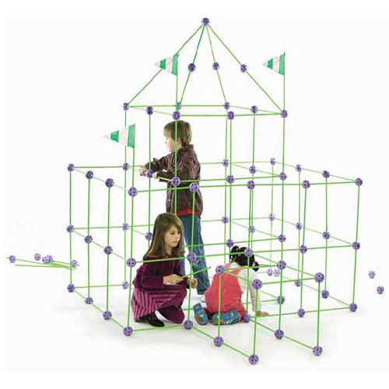
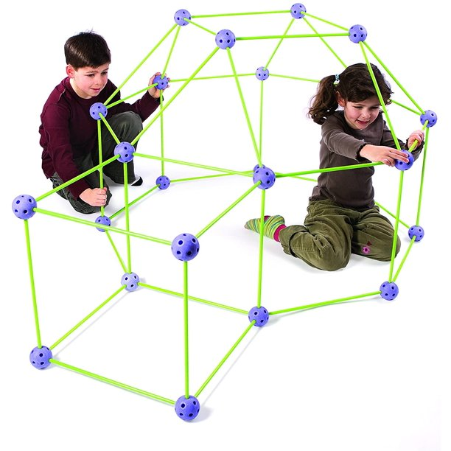
Scenario:
In the spirit of phone booth stuffing—and, to test your levels of creativity, cooperative spirit, understanding of area, and problem-solving ability, use the Crazy Fort® building materials to build a fort that will enclose your entire team.
Challenge:
Work as a member of a design team to build a fort that will enclose your entire team. Then calculate the area of the fort. Use your creative abilities to make the largest fort possible.
Essential Question: How can we determine the area of a space enclosed in a scale model structure?
Limitations:
The completed fort must have walls and a roof.
The connector ball arrows must always point upwards
Materials must not be cut or bend
Twist the green sticks to insert and remove from the connector balls
The structure must enclose your entire problem-solving team
If you can fit more than your team, and you have volunteers; build the biggest fort in class!
Big Ideas:
The area of a space can be determined by multiplying the side lengths of a volume.
Area models can represent the inner size of an object
The perimeter of an object can be calculated using the side lengths

Slide 11
History of Construction Blocks in Education
The natural world has provided abundant building materials (Stones, Sticky burdock, Twigs) which have been connected to learning.
Evidence of this has been dated back to Plato (429-347 B.C.)
U.S. and European manufacturers began making wooden blocks as a sideline to their main woodworking or printing business.
The first centers on the building unit focused on letters, words, or narratives. The second addressed the act of building and constructing. The third focused on cultural heritage and modeling specific architecture.
The advancement of blocks can be seen in electronics as well. Lego Mindstorms uses programmable bricks to control simple robotics.
It is important to remember that we cannot understand until we take apart, examine, and rebuild. Children need an environment with open-ended materials and teachers who understand, encourage, build on, and even participate in this basic and complex mode of learning.

Slide 12
Construction blocks have probably been in schools for more than 100 years, but there is still rich potential for using building blocks as a learning tool. The idea that something so simple can be used to teach complex STEM ideas is only beginning to be understood.

Slide 13
What big ideas from at least two STEM disciplines are integrated in this design challenge?
you don’t need to memorize your standards, but when asked, you should be able to speak to the main concepts and content.
Does the problem and/or challenge require the use, application, or practice from these big ideas?
is the integration of your main concepts and content from your standards obvious?
Do you believe that the scenario and challenge would be engaging (super fun and challenging) for your students?
does this make you excited?
Is the engineering design challenge engaging (fun and challenging) for you – the teacher?
have you constructed possible solutions to examine the possibility, feasibility, enjoyment?
does the challenge require direct application of content – this might lead to ideas for how you might assess the activity?
would the challenge provide the expected outcomes - what do you expect the students to know, be able to do, and value?
have you taken pictures of multiple exemplary potential solutions developed by you or your team?

