Slide 1
Welcome to STEM 4043/5023
Creativity and Innovation
in STEM Education
Dr. Vinson Carter

Slide 2
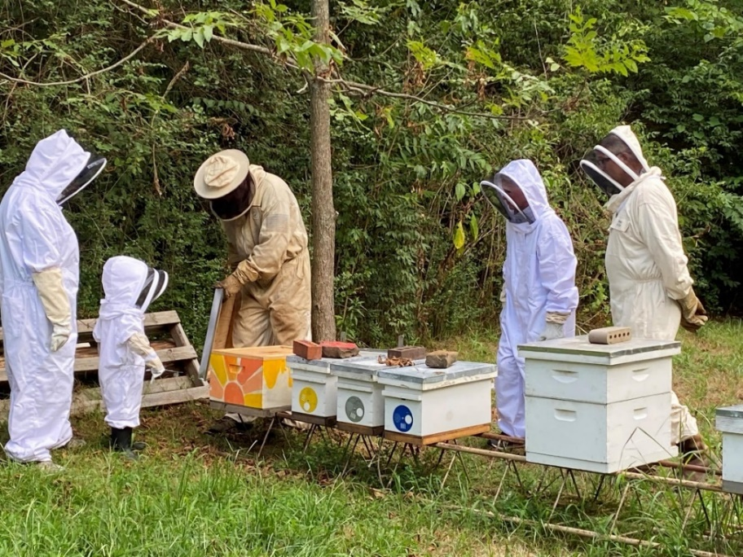
About me ….

Slide 3
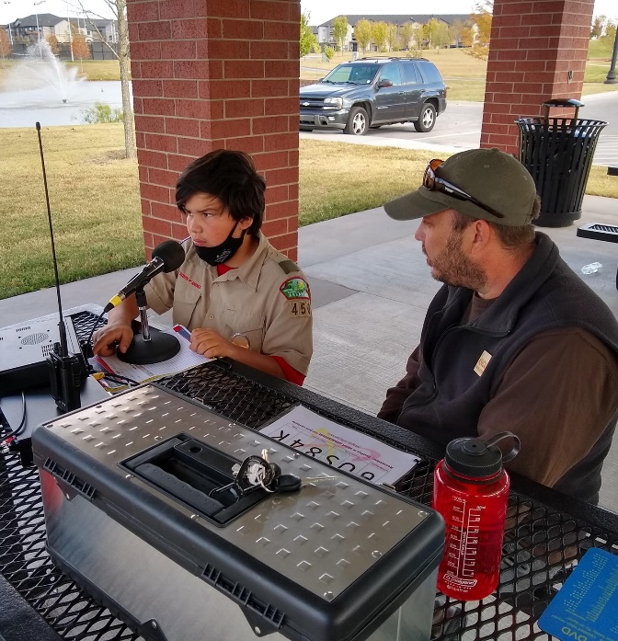
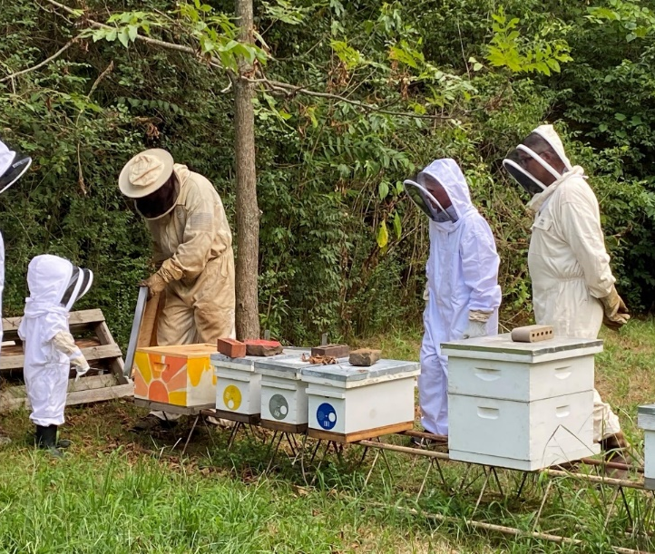
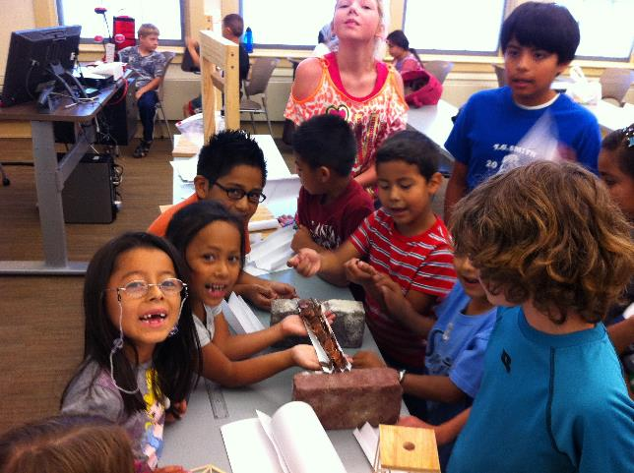
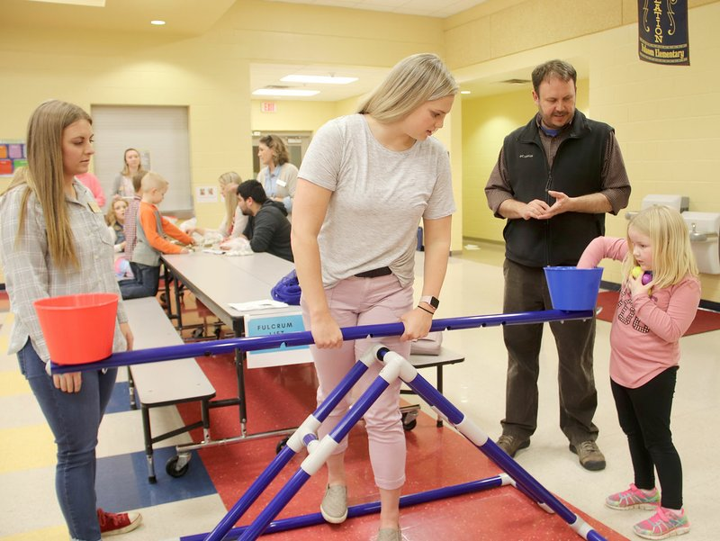
About me ….
Public School Teacher – 6 years
Teacher Educator – 15 years
Informal Teaching Areas
Sunday School
Beekeeping
Amateur Radio
Tinkering and Making

Slide 5
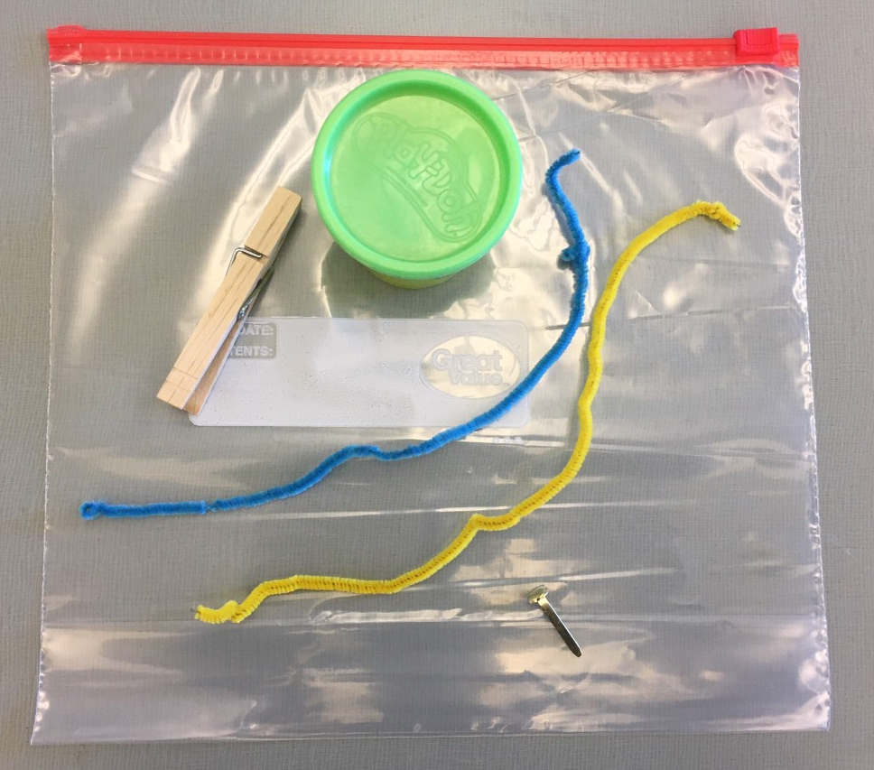
Making and Tinkering Toolbox

Slide 6
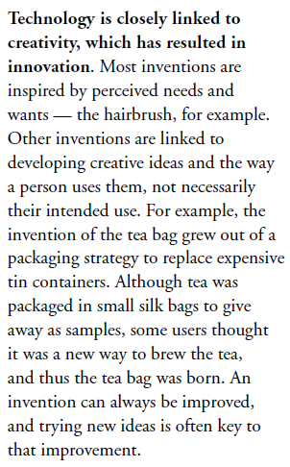
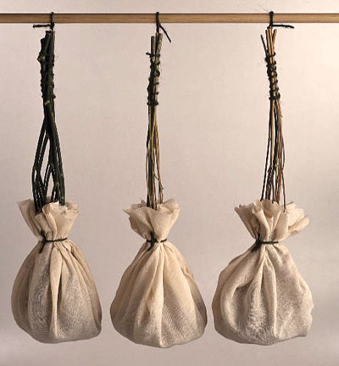
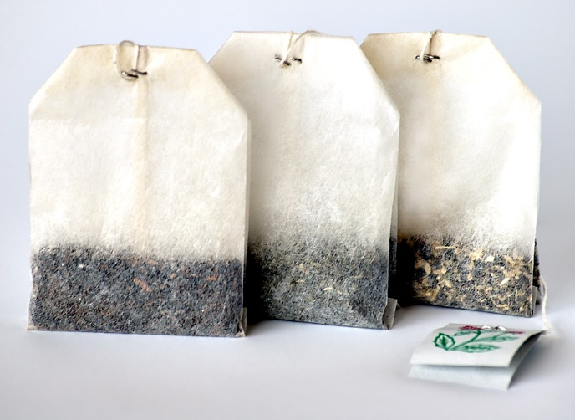
The Nature of Technology

Slide 7
Technological and Engineering Literacy For All Students

Slide 8
Technology Shapes Our Lives
We are all doing things we never imagined
We are absolutely “hooked” on technology
Few people understand technology

Slide 9
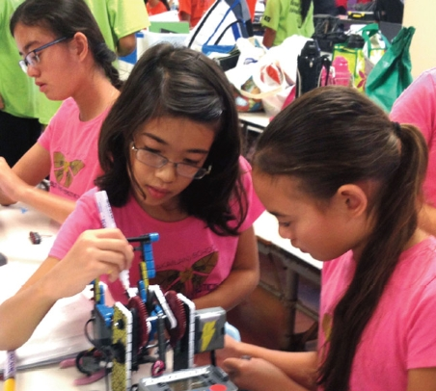
The Problem
Graduating technologically and engineering illiterate students
“Haves” and “have-nots”
Global competition
Competition for careers
High-stakes testing
Escalating rate of change
Isolated classrooms

Slide 10
Standards for Technological and Engineering Literacy: The Role of Technology and Engineering in STEM Education

Slide 11
Some Clarification
Technology is the modification of the natural environment in order to satisfy perceived human needs and wants.
Technological literacy is the ability to use, manage, assess, and understand technology.
Engineering is the use of scientific principles and mathematical reasoning to optimize technologies in order to meet needs that have been defined by criteria under given constraints.

Slide 12
What Can Technologically
and Engineering and Literate People Do?
Evaluate technological and engineering information
Form opinions about technology and engineering
Assess technological and engineering value (or the lack of value)
Exhibit a level of comfort with technology and engineering
Neither afraid, nor infatuated
Understand how technology is created (making and doing)
Understand how technology and engineering shapes society and is shaped by society

Slide 13
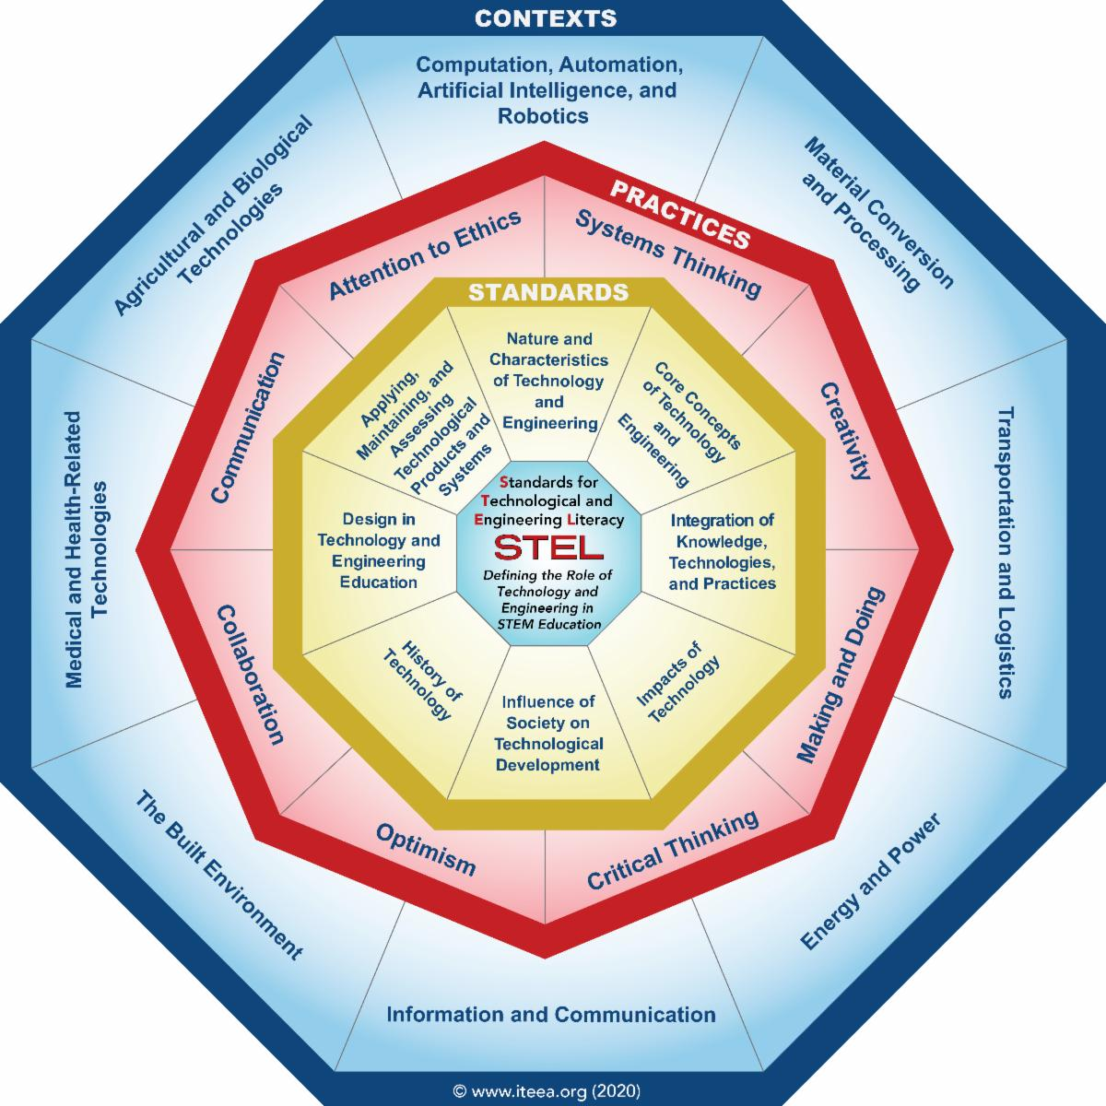

Slide 14
Why use engineering design to teach about technology?
Design is to technology and engineering as inquiry is to science and reading is to language arts
Delivers critical thinking and innovation
Allows for the application of technical and engineering knowledge
Expands levels of creativity
Examines the technological and engineering impacts on society, cultures, and environment

Slide 15
What are the primary concepts taught through the use of engineering design in the classroom?
Working as a Team
Defining the problem
Brainstorming
Conducting Researching
Generating Ideas
Identifying Criteria
Specifying constraints
Exploring possibilities
Selecting Approaches
Developing Proposals
Making a Model/prototype
Evaluating a design using specifications
Assessing a Solution
Refining a design
Creating or making products
Communicating results

Slide 16
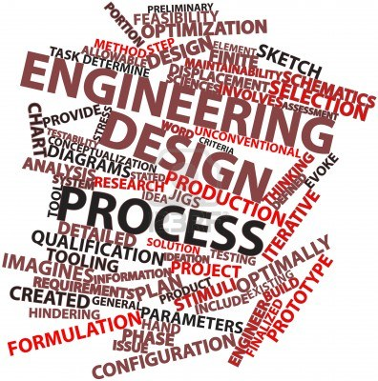
Methods Used to Deliver Engineering Design
Engineering design is delivered in the classroom using technological problem solving.
Design Problem Solving
Invention/Innovation
Research & Development
Experimentation
Troubleshooting

Slide 17
Creativity
Creativity- the use of the imagination or original ideas, especially in the production of an artistic work… inventiveness, innovation, originality.
Can be nurtured
Can be measured

Slide 18
Anytime we are faced with a problem or dilemma with no learned or practiced solution, some creativity is required (Torrance, 1962; 1988; 1995)
Creativity is a vital ingredient in meeting the challenges of a continuous life cycle, a cycle in which growth and change are the norm from conception throughout life. A life filled with growth and change requires a conscious effort to think creatively. To develop creativeness, the mind needs to be exercised as well as filled with materials out of which ideas can be formed. The richest fuel for ideation is firsthand experience (Osborn, 1963).
Creativity is the ability to see a situation in many ways and to continue to question until satisfaction is reached (Goff, 1998).

Slide 19
Torrance Test
We will take a test of creativity often given to children.
Once I hand out the assessment, you will have 3 minutes to draw as many pictures as you can. The goal is to draw as many, and as many creative pictures as you can in the time allotted. Pictures should also have a title or description.

Slide 21
Creativity- Four Categories of Divergent Thinking
Fluency- how many ideas you can come up with in a short period of time
Originality- how uncommon your ideas are
Flexibility- how many areas your ideas cover
Elaboration- level of detail in responses

Slide 22
What does this have to do with STEM Education?
The ideas of Fluency and Flexibility = Brainstorming
These are skills that can be practiced
Tension between fluency and originality

Slide 23
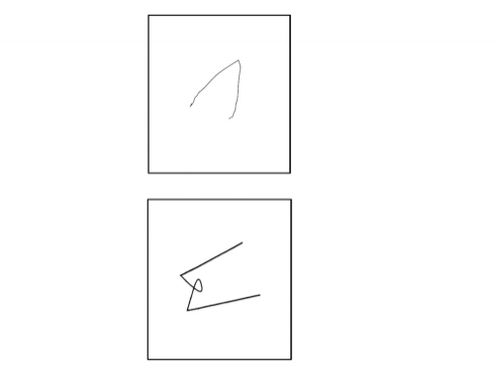
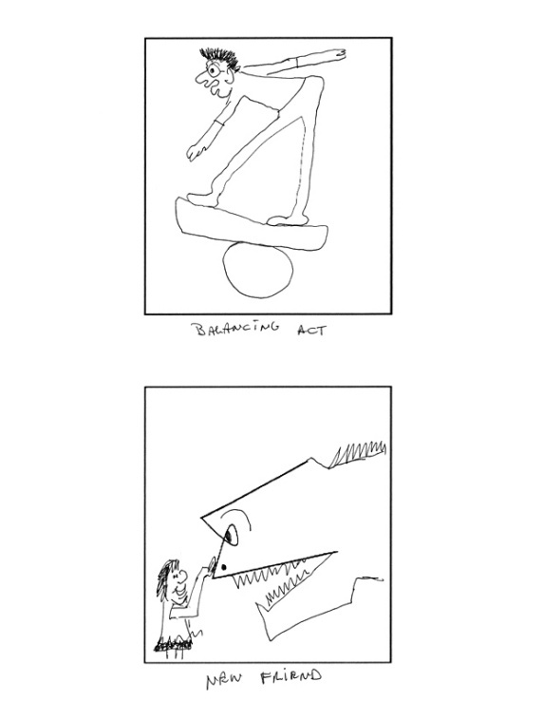
Other Fun Exercises
Guilford Alternative Uses Test- 2 min. to think of as many uses as possible for a paper clip
Incomplete Figures- these are on GT screens

