Slide 1
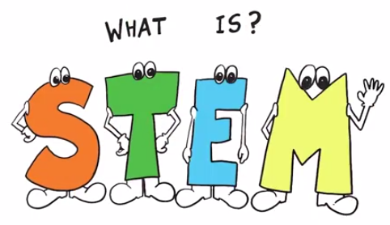
STEM 40303
Introduction to Education

Slide 2
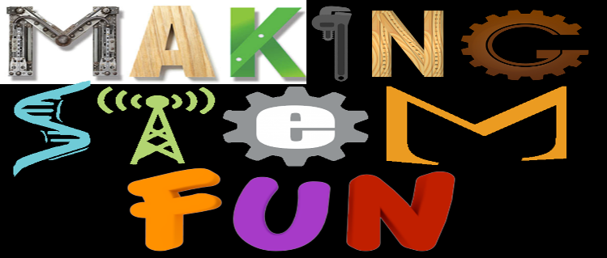
AGENDA
Welcome
Introductions & Building Relationships through Team-Building Activities
What do you know about STEM?
Course Information (Syllabus, Calendar, Weekly Expectations)
Discussion… Intro to STEM Education- The What and the Why!

Slide 3

Land | Water

Slide 4
When you catch the ball –
Tell us where your right thumb landed (land or water)
Name
Where are you from or where do you call home?
What are you studying?
Fun fact about yourself or something that will help us remember you.

Slide 5
STEM = Science, Technology, Engineering & Mathematics
Science – Discover and Describe
    A search to gain a better understanding of life (What is…?)
    The study of the natural world
Technology – Invent and Innovate
    How to improve the natural world
    Any product made by humans to meet a want or need
Engineering – Control, Modify, and Design
    Use of materials, processes, and systems (What could be?)
    The design process that kids use to solve problems
Mathematics –Symbolic Language to Represent Reality
    Make sense of the world with numbers
    The language of numbers, shapes & quantities that seems to irrelevant to many students

Slide 6
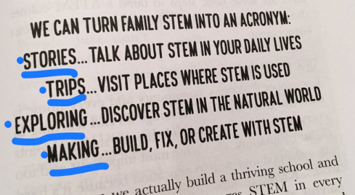

Why the STEM Acronym?
Teaching with Intention – Making Connections

Slide 7
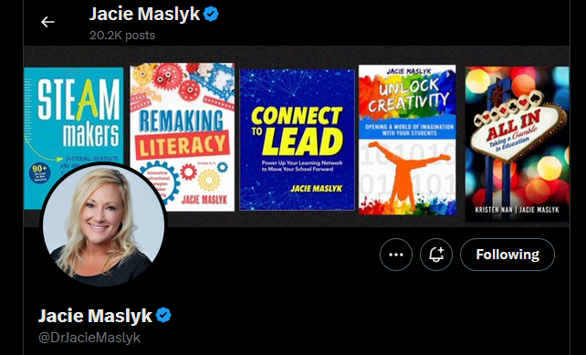
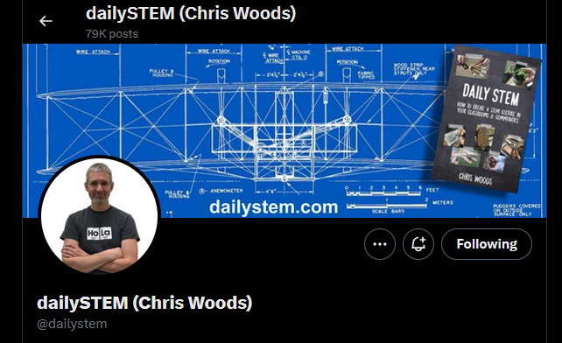
STEM Mindset
Having a STEM removes the traditional barriers erected between the four disciplines of Science, Technology, Engineering & Mathematics by integrating them in the classroom.
This semester we will learn about creating a STEM culture in your future classroom

Slide 8
The Problem Facing STEM Education
Just as the nation’s economic engines and national security measures have come to rest squarely on the shoulders of science, technology, engineering, and mathematics (STEM), American students are recoiling from these disciplines in record numbers. Only 16% of American high school seniors are proficient and interested in a STEM career. The United States is trailing behind other industrialized nations in math (25%) and science (17%).

Slide 9
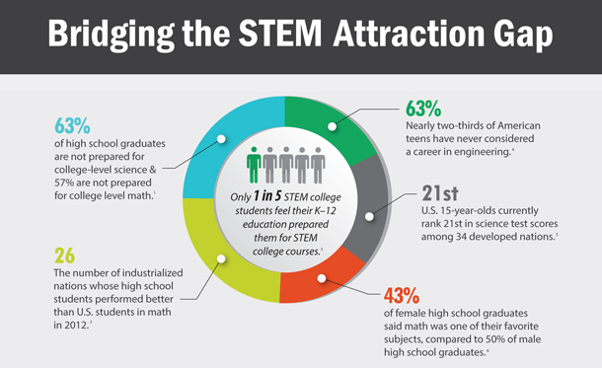

Slide 10
Rising to the Challenge
The problems we face in the 21st century are complex. We need a generation of diverse problem solvers that are able to tackle the big challenges and to invent the solutions, products and even sectors that will define this century. This will remain just an aspiration unless today’s students are inspired and guided by an equally powerful group of science, technology, engineering and math (STEM) teachers.

Slide 11
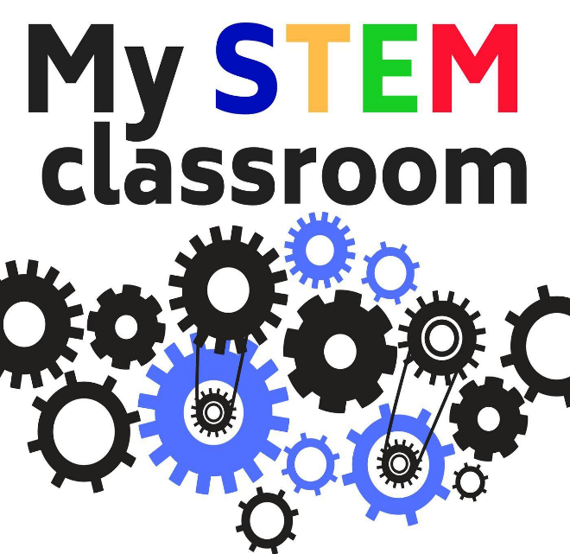
Current State OF STEM Education in Today’s Schools
Many students not receiving an adequate STEM experiences that are interdisciplinary.
STEM specialization is often the focus for charter and magnet high schools.
STEM content areas are often not taught everyday in many schools
  29% of K-5 teachers report teaching science two or fewer days per week

Slide 12
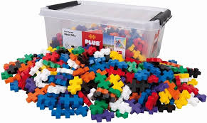
Design Challenge
Using construction blocks, design an award that you would give to the best teacher that you ever had in school or the teacher that inspired you to become a teacher.

Slide 13
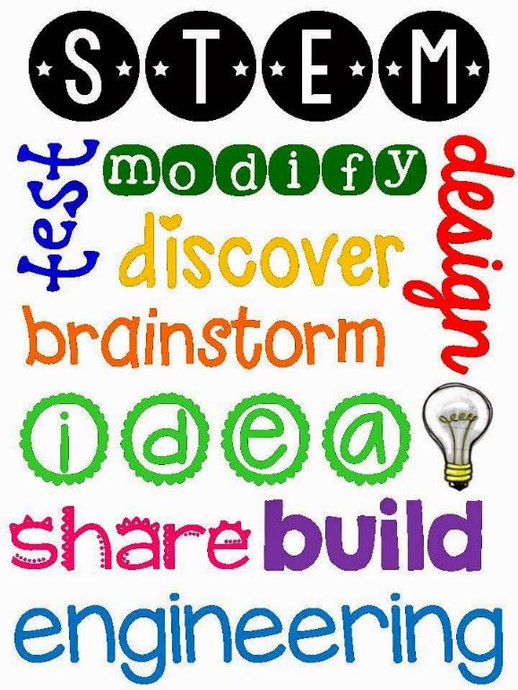
STEM Education Needs to be the Focus in Today’s Schools…
PK-12 Education is not focusing on solving real world problems. The emphasis is on solving problems correctly—not creatively!
  20+ year process of minimizing creativity
  Tests, grades, college admission, degrees, etc. are emphasized
Teachers are rewarding skills that are not helping our students become problem solvers.
  Logical thinkers
  Factual competence
  Math and science skill
Experiences that require collaboration, critical thinking, problem solving, innovation, creativity and engagement are KEY aspects of STEM Education!

Slide 14

A Need for Growing a Strong STEM Workforce:
Developing Tomorrow’s Leaders & Problem Solvers
Sixty percent of U.S. employers are having difficulties finding qualified workers to fill vacancies at their companies.

Slide 15
Skills that Prepare for Life
STEM prepares students for life, regardless of the profession they choose. STEM teaches students how to think critically and how to solve problems — skills that can be used throughout life.

Slide 16
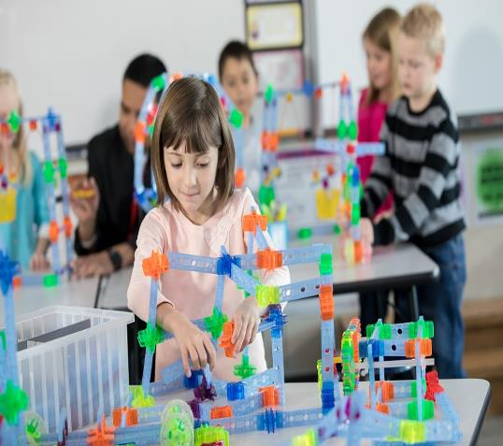
The Critical Aspect of STEM
Improved STEM programs can create individuals capable of new solutions and better decisions.
  Increased science and math capability is not enough
  Experiences centered on design, innovation, engineering, and technology increase creativity, inventiveness, ingenuity, and imagination capabilities
These characteristics are fostered in STEM- centered learning experiences.
The STEM Challenge

Slide 17
What We Need in Schools
Interdisciplinary experiences in STEM content areas
More engagement/ less lecture and skill/drill
More ill-structured problem solving
More strategies that cause students to seek STEM-based content answers
More underrepresented populations engaging in STEM
More collaborative learning experiences

Slide 18
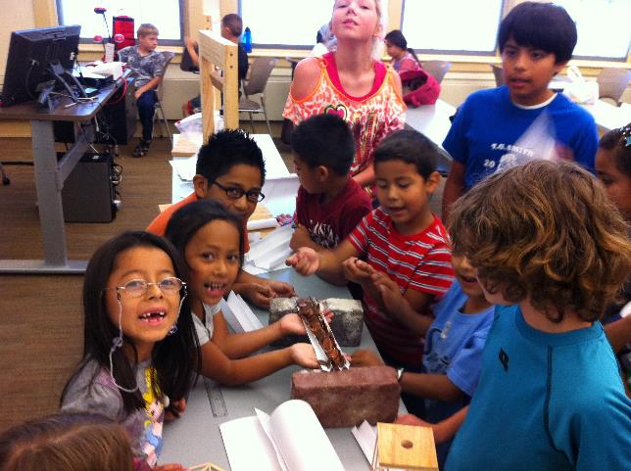
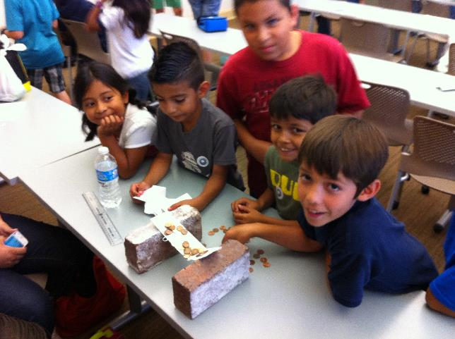
STEM doesn’t have to be expensive!

Slide 19
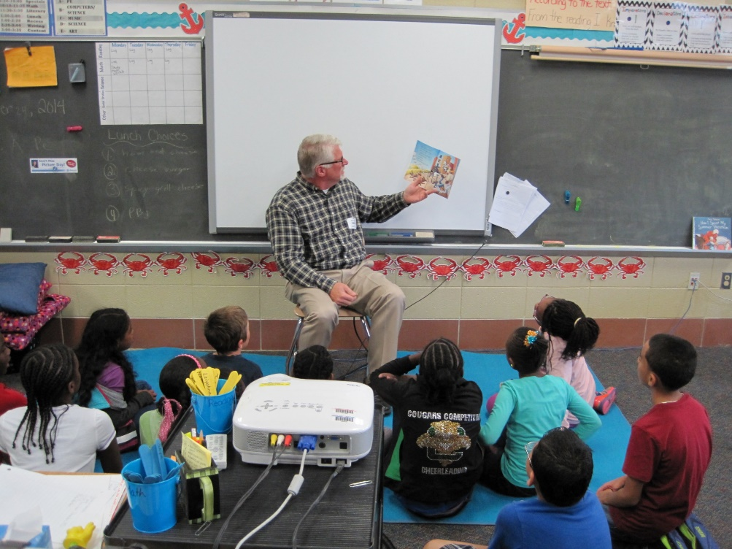
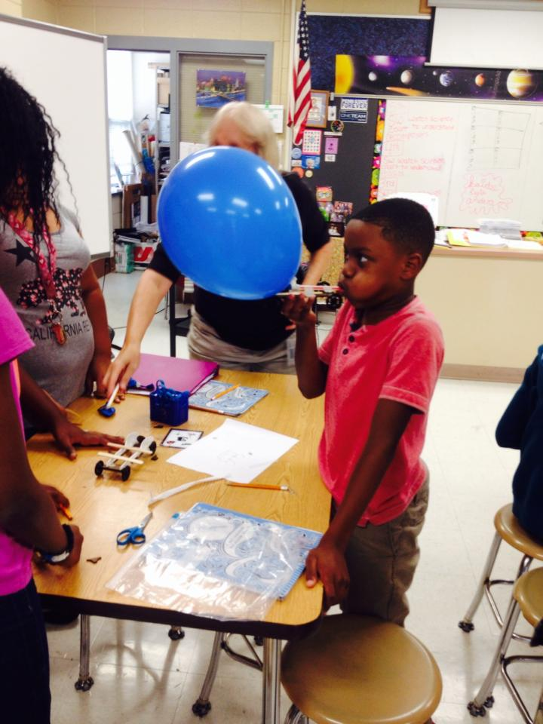
Integrating Literature with STEM

Slide 20
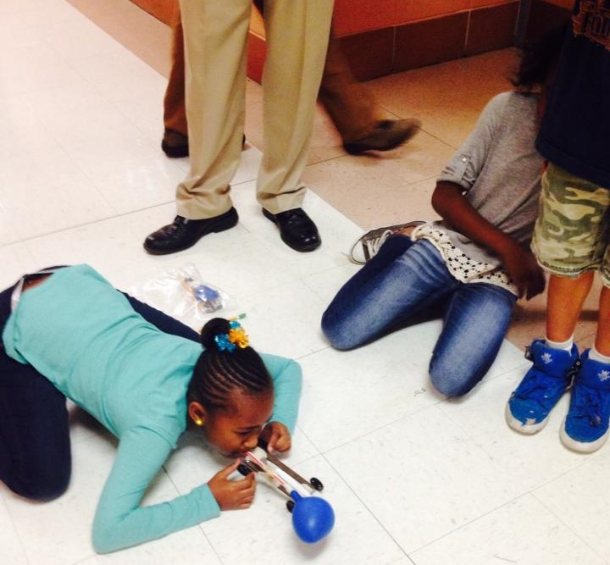
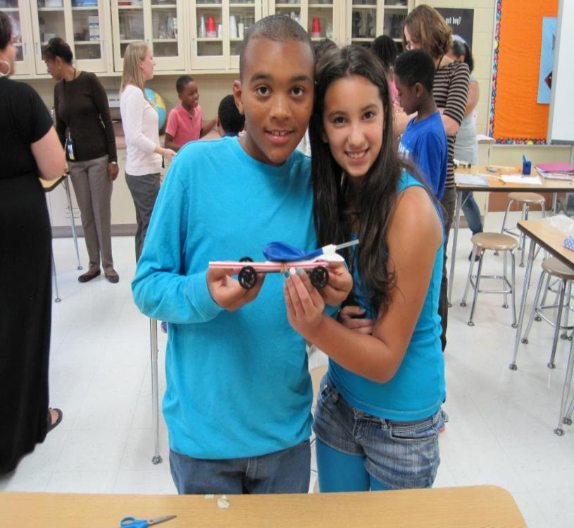
Implementing STEM Design Challenges

Slide 21
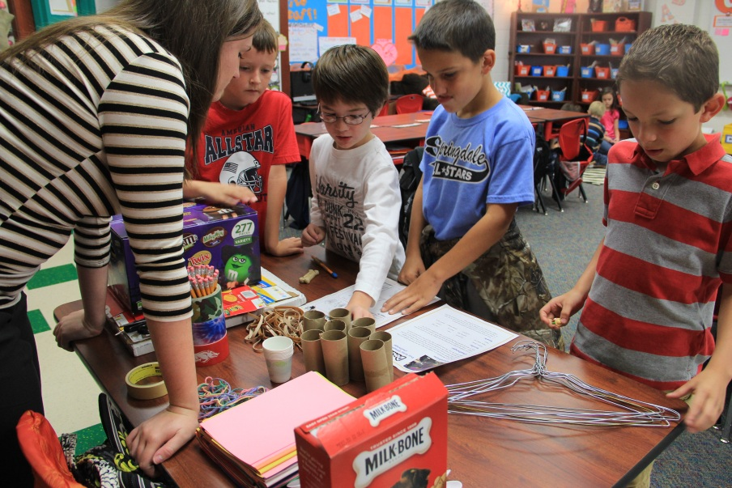
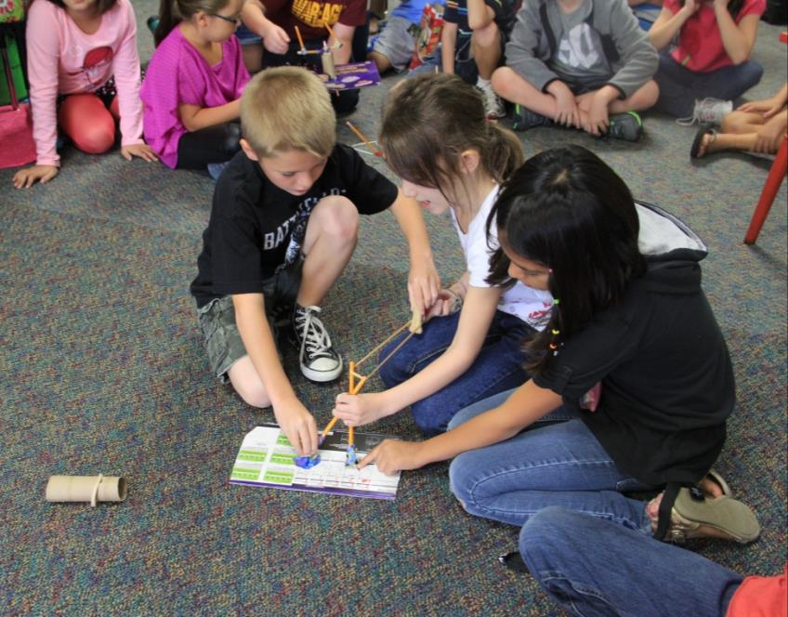
Project Based Learning & STEM in Action

Slide 22
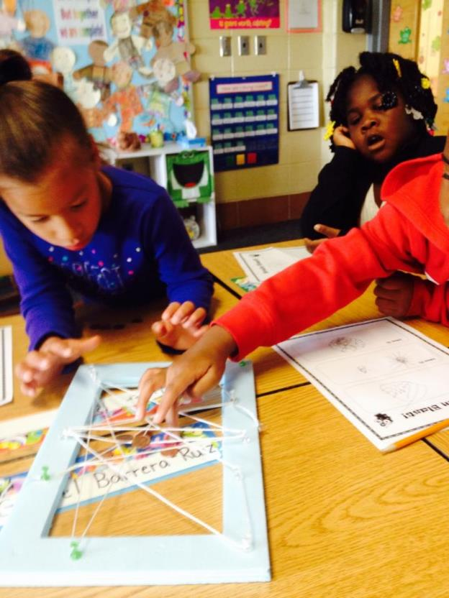
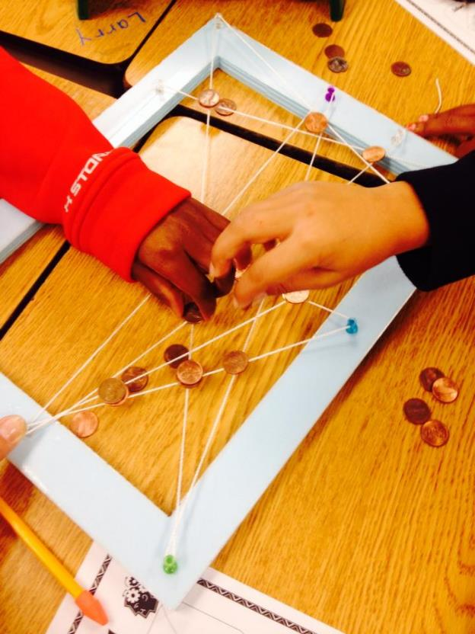
Collaboration
Engagement

Slide 23
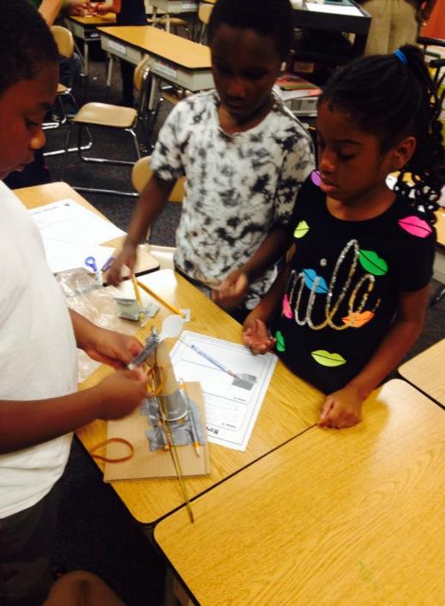
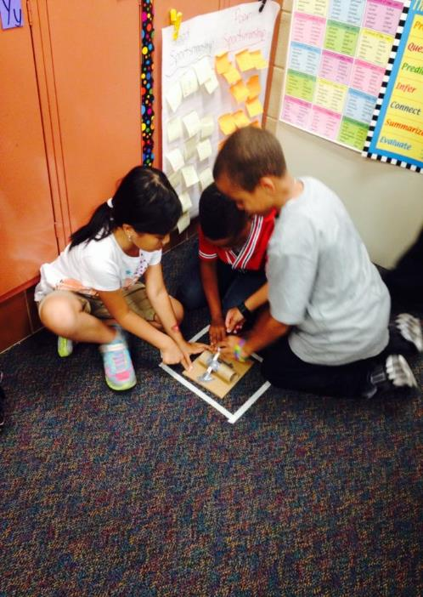
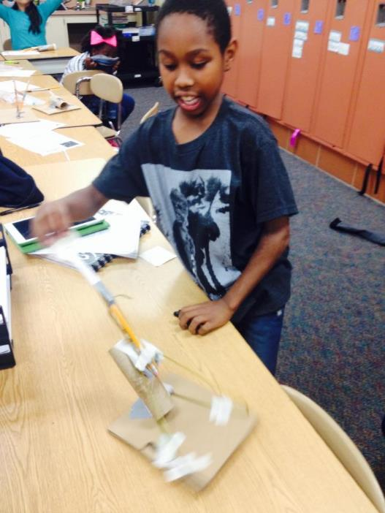
Creativity, Imagination and Invention

Slide 24
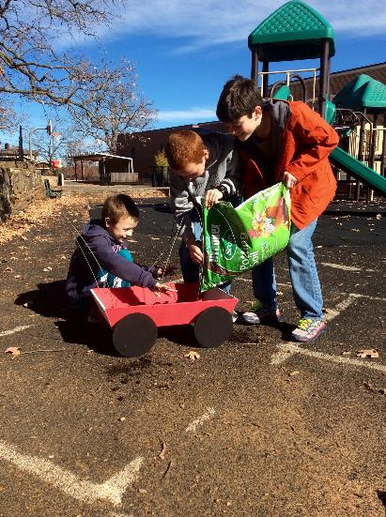
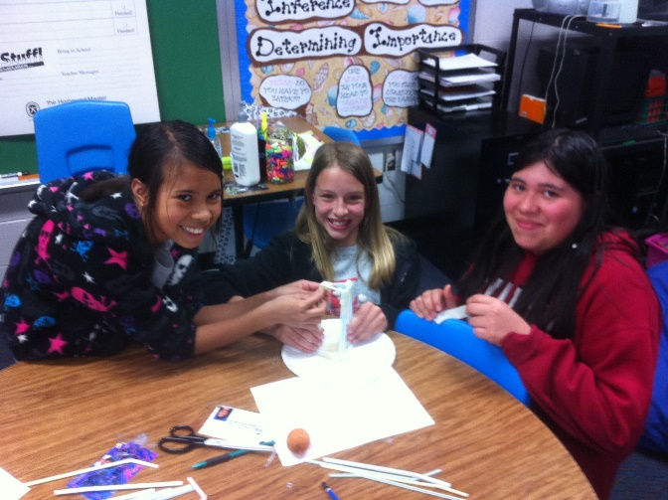
Innovation and Communication

Slide 25
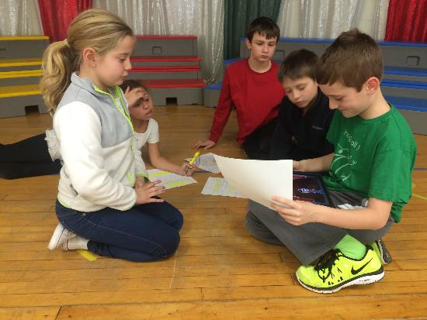
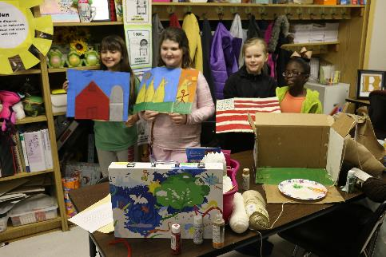
Leadership & Responsibility
Problem Solving & Critical Thinking

Slide 26
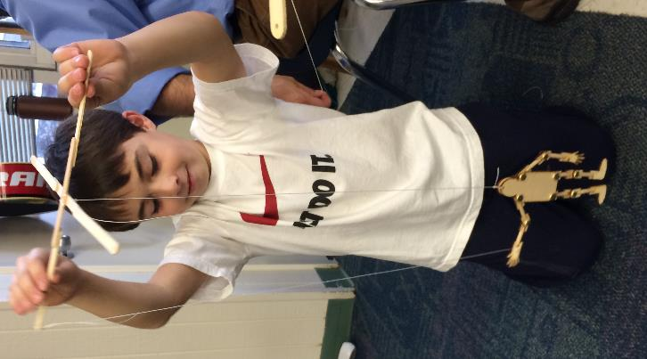
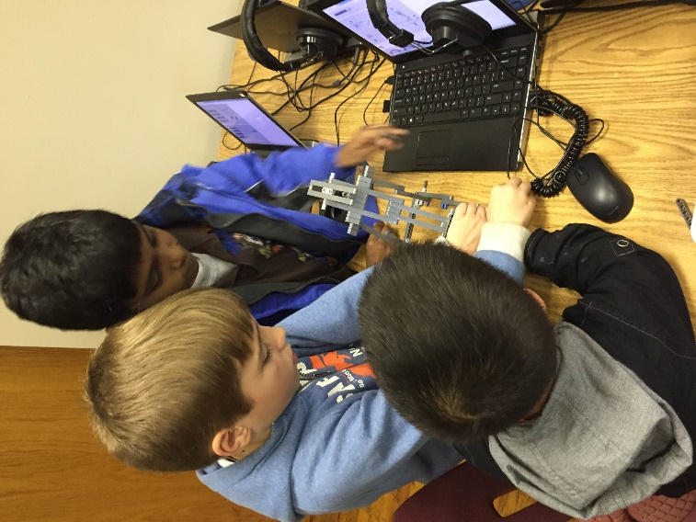
Developing &Testing STEM Inventions

Slide 27
A Tall Order
Preparing the next-generation to succeed in life is a tall order. And, we will substantially fail if we don’t teach children how to think critically and solve ill-structured problems.
"We must help teachers rise to the challenge of the new standards, increase their impact and find new ways to work together, learn together and tackle the STEM teaching challenge together."

Slide 28
How do we Change the Status Quo?
Awareness of the challenge
  Too many Americans don't see the real-life value of STEM Education
The U.S. economic advantage is centered on our ability to innovate/create new ideas
  Integrated STEM education can support this type of thinking
Innovation is what allows the U.S. to compete
  Creating new marketable ideas begins with STEM education

Slide 29
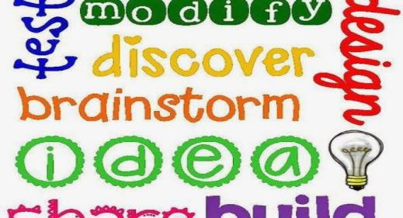
What do STEM Teachers Do?
STEM teachers pose problems and combine problem solving with project-based learning across disciplines.
Developing students’ critical thinking, communication, assessment, and inquiry skills.

Slide 30
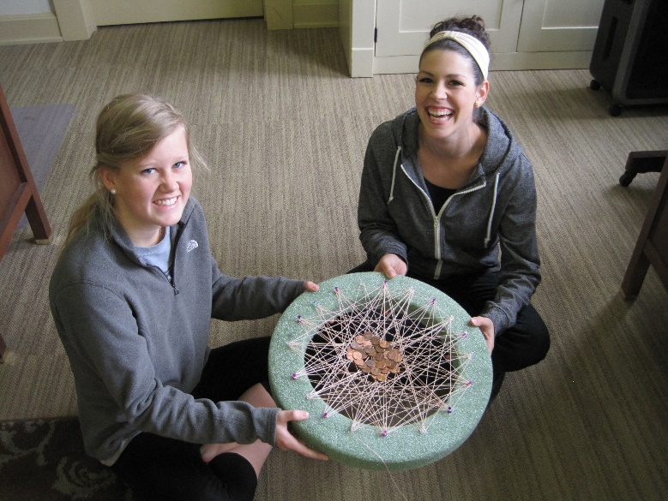
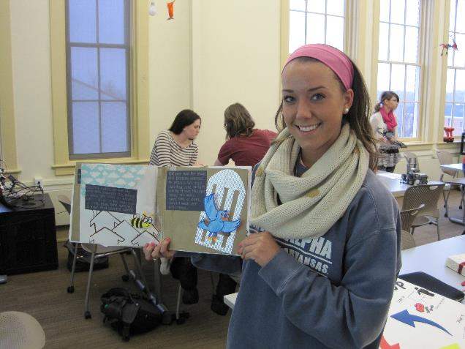
Teachers Candidates
Designing STEM Lessons

Slide 31
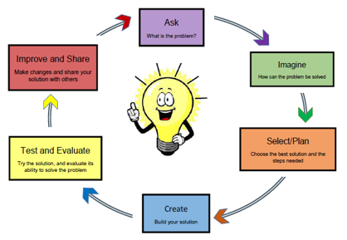
The Inclusion of Engineering Design
Why is this important?
  Invention and innovation
  Generate & research ideas
Source of Ideas?
  Interrogating our Personal Bank of Knowledge (Mental Warehouse)
  Existing Common Body of Knowledge
Quality of the Design?
  Different points of view

Slide 32
Using Real-World Problems
Real-world problem-solving is the essence of STEM lessons. Solving real-world problems causes students to use/expand higher-order thinking skills.
Identifying creative, real-world problems for students is the essence of STEM teaching.

Slide 33
Good STEM Lessons…
Accomplish these things:
Apply math/science through authentic, hands-on learning
Include the use/creation of technology
Require the use of the engineering design loop
Require collaborative teamwork
Emphasize math/science/technology standards
Address real-world problems

Slide 34
What do Students Gain?
Creativity – Thinking on their feet, ‘outside the box.’
Confidence – Building confidence needed to thrive in a competitive workplace.
Problem Solving –Without realizing it, students are consistently challenged to solve problems. This develops skills in reasoning and understanding.

Slide 35
What do Students Gain?
Focus – Balancing listening/contributing involves a great deal of concentration/focus.
Communication – Defending ideas/theories is a core skill and one that is required throughout life.
Receiving Constructive Feedback – Feedback is part of learning/part of life (not everyone gets a trophy!)

Slide 36
What do Students Gain?
Collaboration – Students work together, share responsibility, and compromise with others to accomplish a common goal.
Dedication – Students practice developing healthy work habits (on-time, prepared, respecting the contributions of others).
Accountability – Understanding that their actions affect other people.

