Slide 1
Science
4-PS3-2 Make observations to provide evidence that energy can be transferred from place to place by sound, light, heat, and electric currents.
Technology and Engineering
Standards for Technological and Engineering Literacy
Standard 3: Integration of Knowledge, Technologies, and Practices
Demonstrate how simple technologies are often combined to form more complex systems.
Standard 7: Design in Technology and Engineering Education
Apply tools, techniques, and materials in a safe manner as part of the design process.
Standard 8: Applying, Maintaining, and Assessing Technological Products and Systems
Follow directions to complete a technological task.
Use appropriate symbols, numbers, and words to communicate key ideas about technological products and systems.
Identify why a product or system is not working properly.
Mathematics
Additionally, you will identify and integrate another appropriate Mathematics and/or Social Studies or English Language Arts standard/s.
* Big Idea – Energy can be transferred through an electrical circuit
* Big Idea – It is important to be able to follow directions to complete a project
*Big Idea – Troubleshooting is an important skill to understand why a
device or system is not working properly

Slide 2
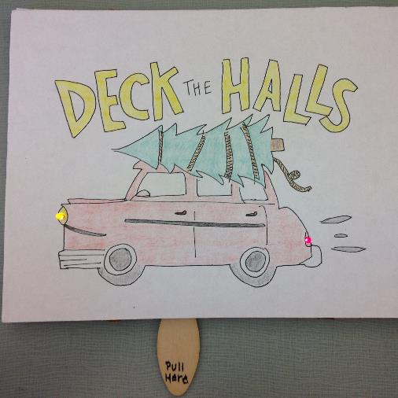
Key Vocabulary for Electricity
*Your Technical/Procedural Directions Should Focus on these concepts -
Transfer of Energy - Electrical Pathway – Electron Flow - Circuit
DC Power Source – Coin Battery (3V) – Energy
  Anode (+)
  Cathode (-)
Conductors
Insulators
LED – Light Emitting Diode - Illuminate
Switch – Control - Open Circuit/Closed Circuit

Slide 3
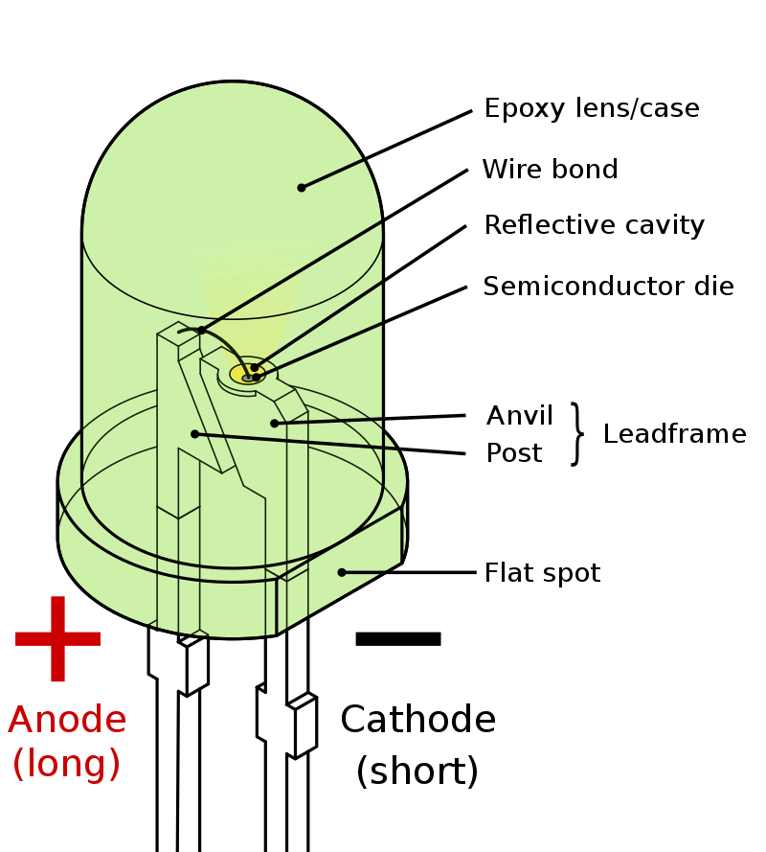
LED – Light Emitting Diode – Illuminate
A light-emitting diode (LED) is a semiconductor device that emits light when current flows through it. Electrons in the semiconductor recombine with electron holes, releasing energy in the form of photons.

Slide 4
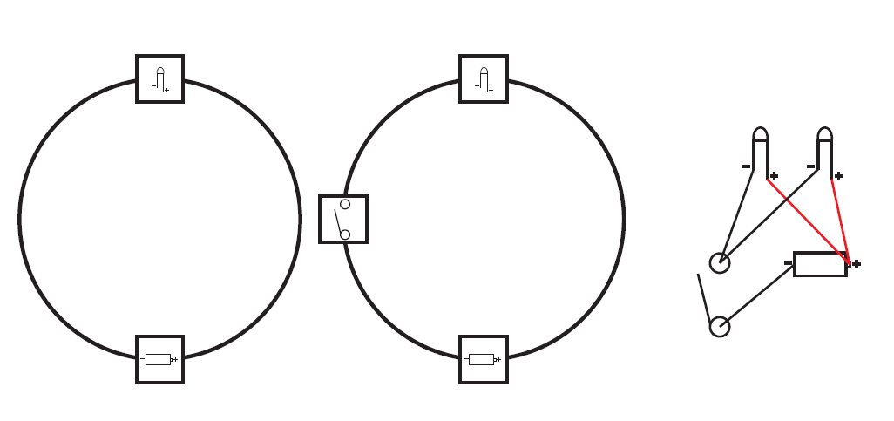

Slide 5
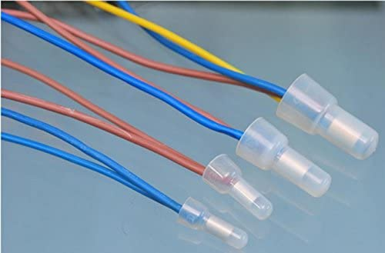
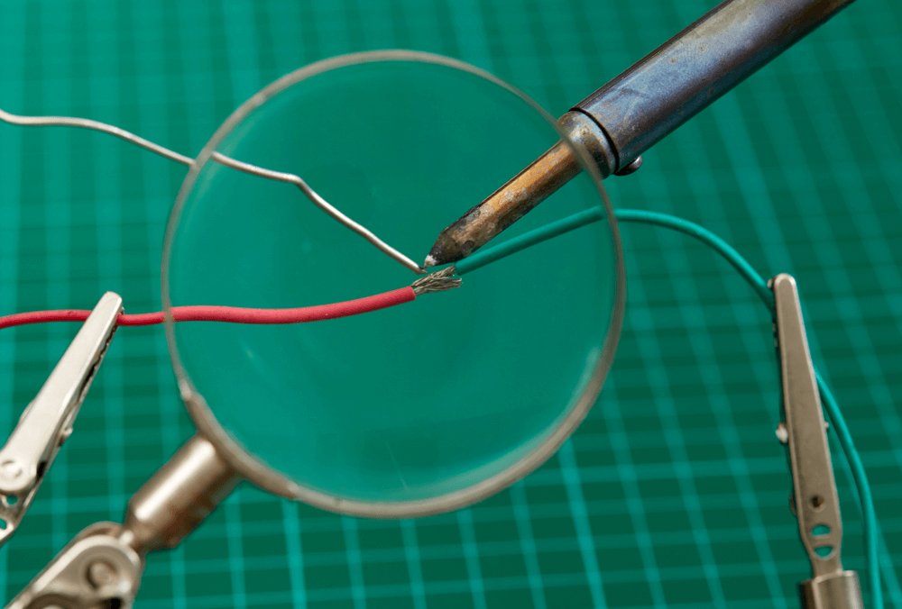
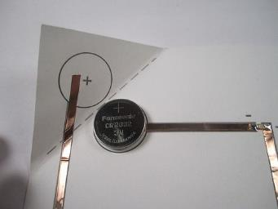
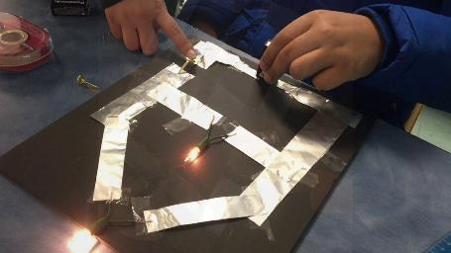
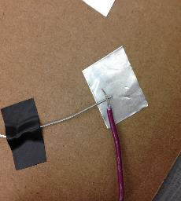
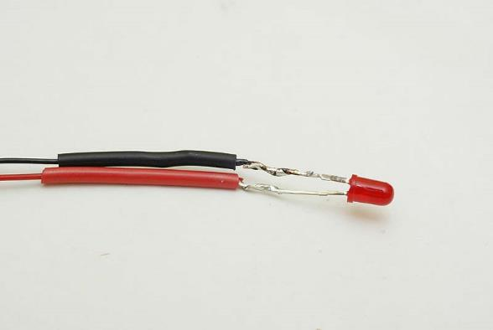
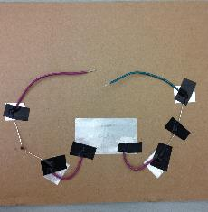
Making Good Connections
Crimp Connections
Soldering
Using Duct/Copper Tape

Slide 6
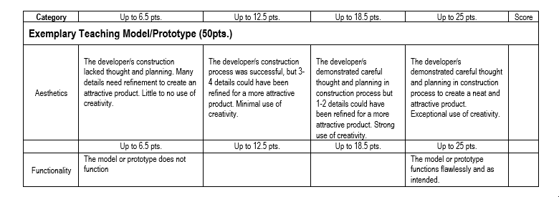

Slide 7
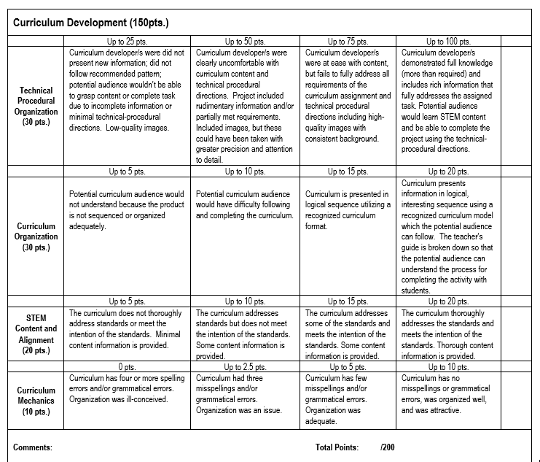

Slide 8
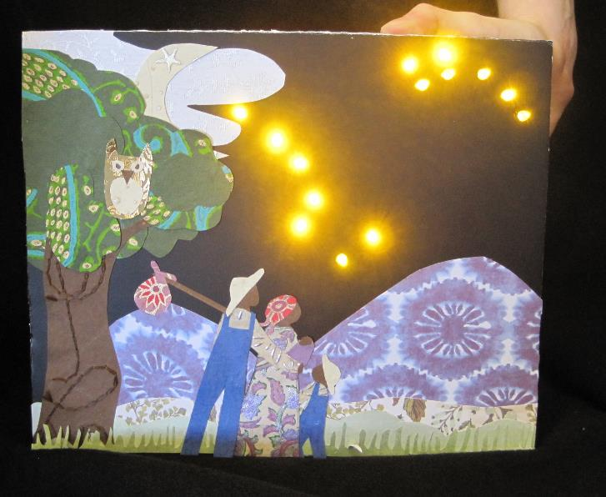
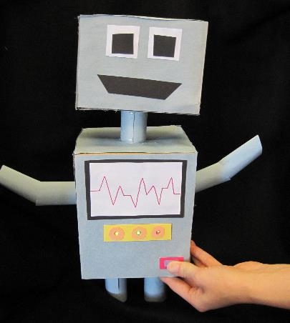
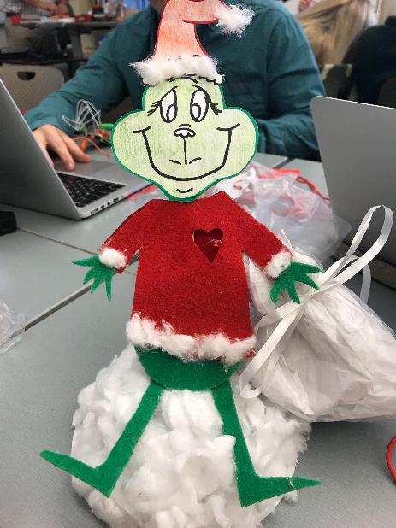
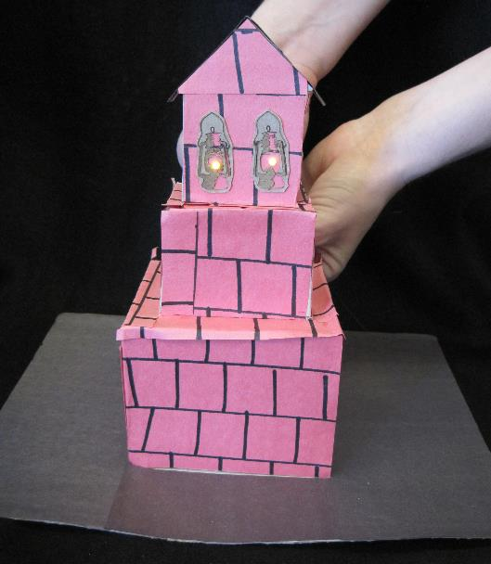
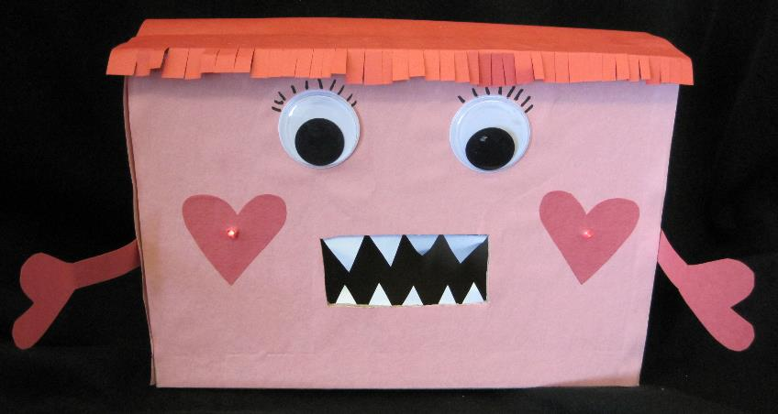

Slide 9
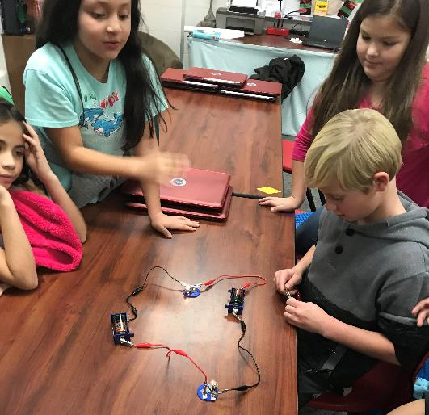
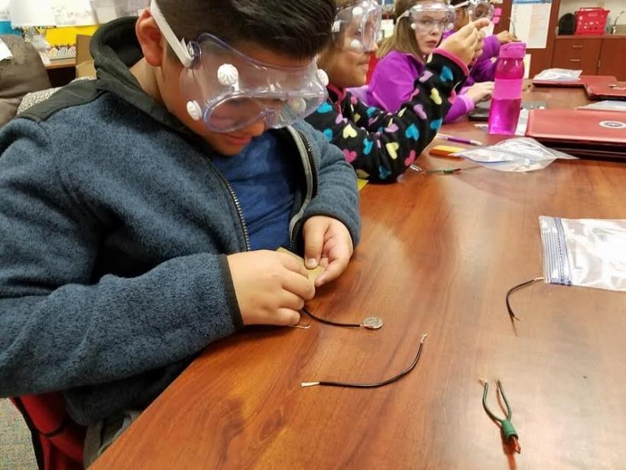
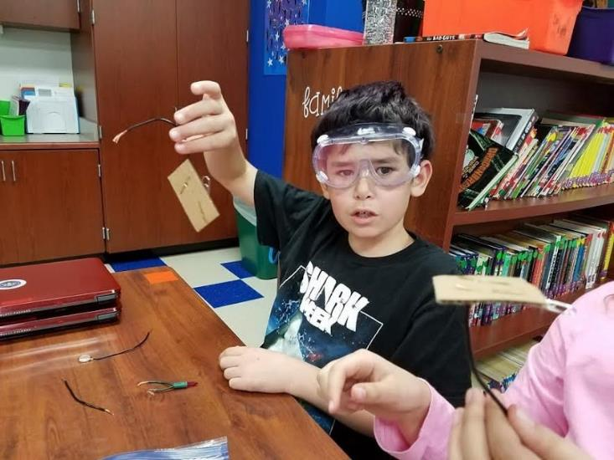
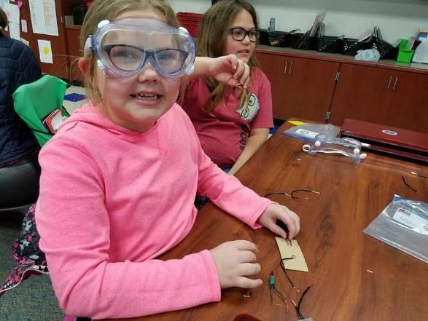

Slide 10
