Slide 1
How would you…. -define technology? -explain why you chose this definition?

Slide 2
Broadly speaking, technology is how people modify the natural world to suit their own purposes. From the Greek word techne, meaning art or artifice or craft, technology literally means the act of making or crafting, but more generally it refers to the diverse collection of processes and knowledge that people use to extend human abilities and to satisfy human wants and needs.

Slide 3
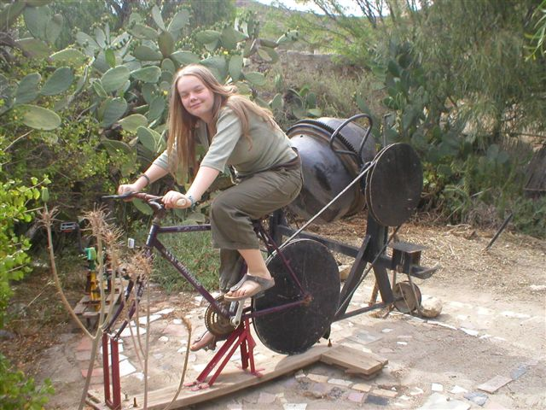
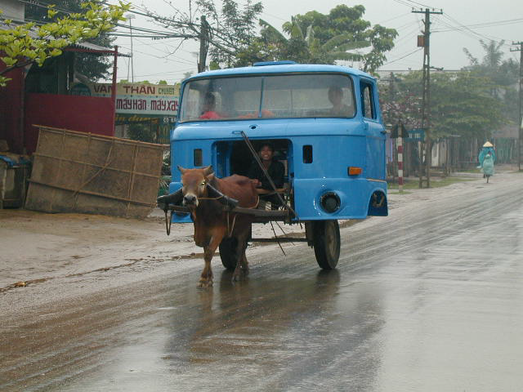
The Social & Cultural Side of Technology

Slide 4
Role of Technology in Society
We live in a human-made world
Technology is the modification of the natural world
Technology is the act of creating
Technology is complex
Technology has been a powerful force in shaping cultures

Slide 5
Myths About Technology
Technology = Computers
The more technology the better…….
The light bulb - social influences
What else?

Slide 6
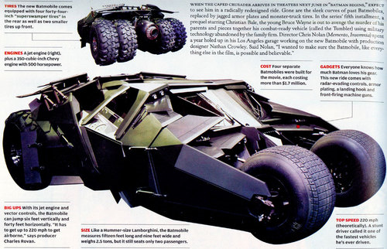
Technology & Progress
Most people define progress through technological innovation
Travel: Buggy to a Space Shuttle
Weaponry: Musket to a nuclear weapon
Communications: Quill Pen to computer
Is new always better?
When is it not?
Is more better?
When is it not?
Is less better?
When is it not?

Slide 7
Technology Defines Society
History is recorded through technology
Iron Age, Bronze Age, Industrial Age
Technology shapes the human environment
Our values are reflected in the technologies we use
Skyscrapers, Interstate roadways
Nature becomes a smaller part of human existence
Most people live in homes/apartments
Work/shop in large buildings
Drink from public water systems
Rely on newspapers, radios, television, Internet

Slide 8
Society Determines the Role of Technology
Human wants and needs
The steam engine
Forests gone
Need for coal
Too much water in mines
The gasoline automobile
The typewriter
Nuclear power

Slide 9
Many Believe that Technology is Desirable
Advances in medicine
Clean water/available electricity
Good transportation systems
Good communications systems
Automated manufacturing brings products
we desire

Slide 10
Other Effects of Technology are Less Than Desirable
Traditional ways displaced (Sunday Dinner)
Inequalities magnified (Dinner in Dallas)
Harmful side-effects
Asbestos, x-rays, chemicals
Unknown side-effects
The cotton gin, Eli Whitney’s musket
Cultural trade-offs
Trading TV for caribou hunting

Slide 11
The Effects of Technology
Technology can be helpful or harmful
Can have unintended consequences
Is neither good, nor bad
Technology poses ethical questions
Technology causes change (political, environmental, cultural, ethical, etc.)
Technology can cause natural disasters or prevent them
Different cultures place different value on technological devices/systems (a good knife)

Slide 12
The Effects of Technology
The implementation of technology introduces conflicting arguments (natural gas fracking)
Societies may limit or expand the powers of technology (nuclear power)
Throughout history, new technologies have resulted from the demands of people
Cultural priorities are reflected in the technologies that they use
Decisions regarding the implementation of technology involve the weighing of trade-offs and optimization

Slide 13
A Give and Take Relationship
Technology is the engine of history
Changes in technology are followed by cultural changes
Technology is created to fill cultural needs and wants
Some consequences of technological development are not intentional

Slide 14
A Give and Take
Relationship (Continued)
We tend to relinquish control to technology
Technology begets technology
The rate of technological development is dependent upon previous development
We live in a technologically sophisticated world, but we are not sophisticated!
Technology prevents and causes isolation

Slide 15
OBSERVATIONS
We are extremely dependent on technology
Most people have an unquestioning faith in technology to solve our problems
The use of technology changes society
Self-sufficient, self-centered, isolated
Loss of traditions and rituals
Effects are often delayed, unintentional, unrelated to expectations

Slide 16
Evaluating New Technology
If developed, will it help us maintain or destroy traditions?
Will it isolate people further or bring them together?
Can it be abused or misused?
Who stands to gain the most?
Who stands to lose the most?

Slide 17
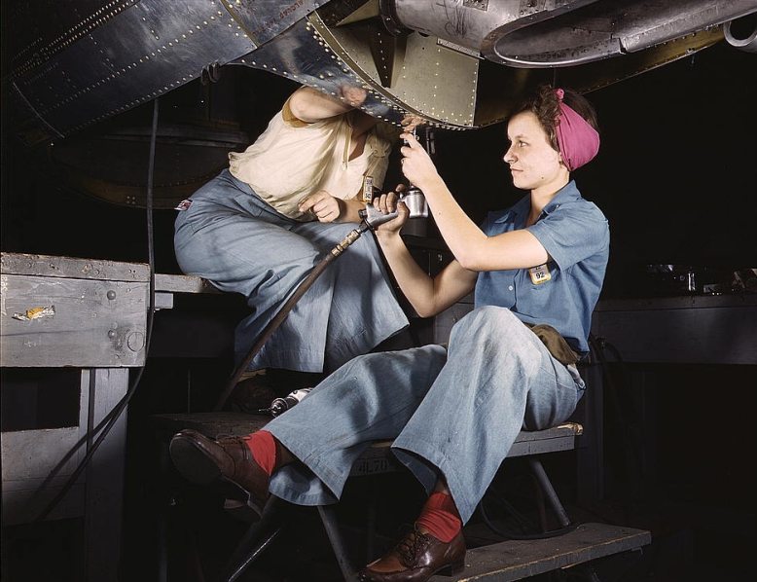
An Example
In the 19th century, gender roles were clearly defined: men conducted business, had a job, did government, did the outside chores; women stayed at home, nurtured children, cooked, washed and ironed clothes, cleaned the house. Maids were common.
In the 20th century, roles have not changed much, but now 60% of women work outside the home

Slide 18
More Examples: Technology & Change
115 Years ago:
47 was the average life expectancy
14% of homes in America had a bathtub
8% of homes in America had a telephone
A 3-minute call from Denver to NYC cost $11
The U.S. had 144 miles of paved roads and 8,000 cars
The maximum speed limit in most cities was 10 mph
The average wage in the U.S. was 22 cents per hour and the average worker made $200 per year
95% of all births took place at home

Slide 19
Technology & Change (Continued)
115 Years ago:
90% of all physicians had no college education
Most women washed their hair once each month and used egg yokes for shampoo
The American flag had 45 stars
Drive-by shootings were a major problem in many western cities (teenagers galloping through town shooting from horseback)
The population of Las Vegas Nevada was 30
10% of all Americans could not read or write
Plutonium, insulin, antibiotics, Scotch tape, crossword puzzles, canned beer, iced tea, and a million other products had not been invented

Slide 20
Let’s Face it! Technology Rules
We buy things that we do not need
And, pay for things that we do not want
As a society, we are not very savvy when it comes to purchasing and using technology
We buy on impulse
We discard on impulse
We allow technology to control our lives
In ways that we would never allow another human to control our lives!

Slide 21
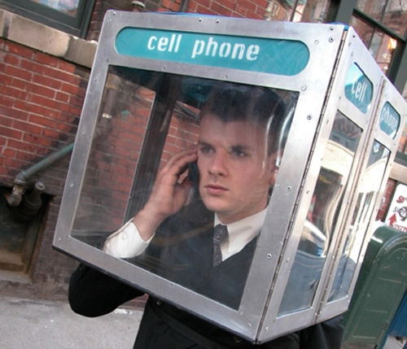
Technology is Pervasive
Technology is becoming:
Faster
Smaller
More Invasive
More in Control of our lives
More Dangerous
More Indispensable
A Larger Threat

Slide 22
Does Technology = Progress?
We have largely relinquished control of our lives to technology
In the Western World, success is largely based on Gross National Product
GNP: A measure of all economic activity--positive or negative. (the sale of technology)
For example: If a plane crashes and the airline is forced to purchase a new one, we all profit through an increased GNP
Obviously, increased GNP should not always be used as a measure of our “quality of life.”

Slide 23
A Final Thought on the Subject
A Perfect Example:
When NASA first started sending up astronauts, they quickly discovered that ballpoint pens would not work in 0 gravity. To combat this problem, NASA scientists spent a decade and $12 billion developing a pen that writes in zero gravity, upside down, underwater, on almost any surface including glass and at any temperature ranging from below freezing to over 300 C.
The Russians used a pencil.

Slide 24
Homework
Complete Philosophy of Technology Assignment
Find a philosophical quote about technology
Credible source– Use APA format
Know about the person you quote
Be able to explain the quote in an elevator speech

Slide 25
For Example:
"Technological progress has merely provided us with more efficient means for going backwards.“ -Aldous Huxley
Reference
Progress quotes. (2015). Retrieved from http://www.successories.com/iquote/category/2439/prog ress-quotes/89
Aldous Huxley (1984-1963) was an English writer best known for his novel Brave New World. Huxley examined issues around emerging technologies and their effect on society.
-Prepare an elevator speech that gives us the quote, information about the person, and explains the meaning of the quote. For example...

