Slide 1
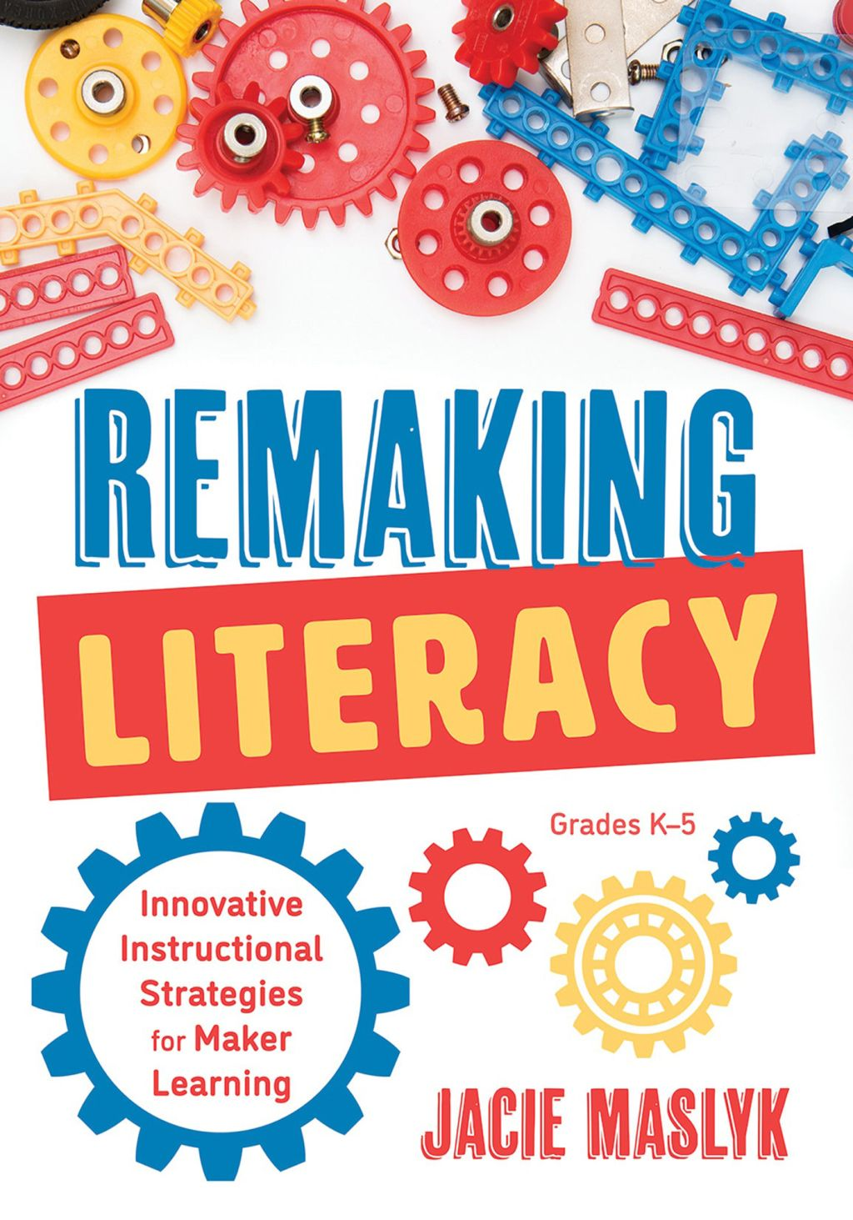
Welcome to STEM 40403/50203
Creativity and Innovation
in STEM Education
Dr. Vinson Carter

Slide 2




Slide 3
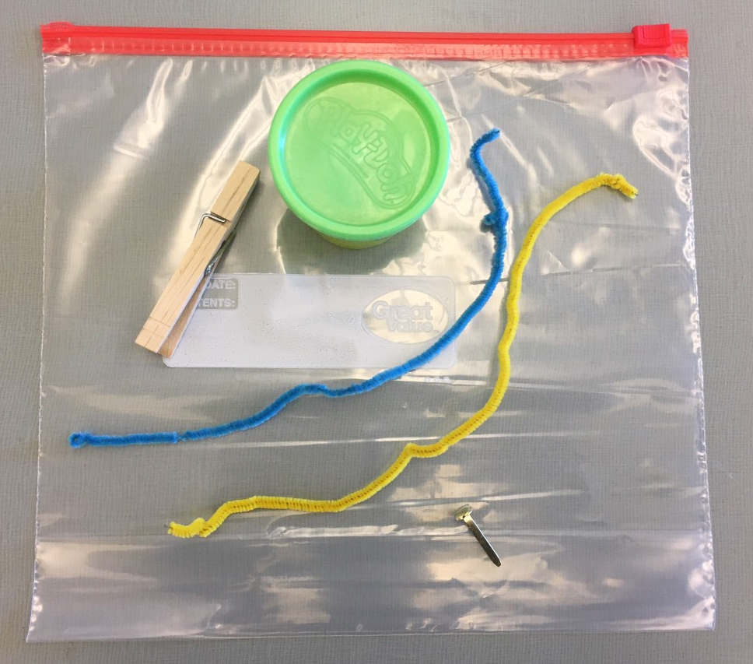
Making and Tinkering Toolbox

Slide 4
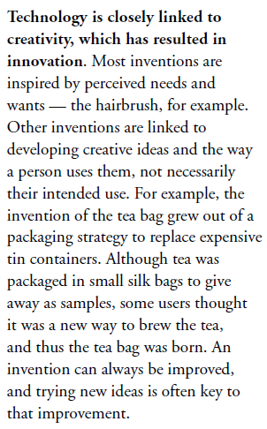
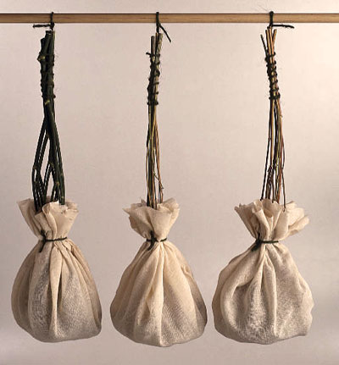
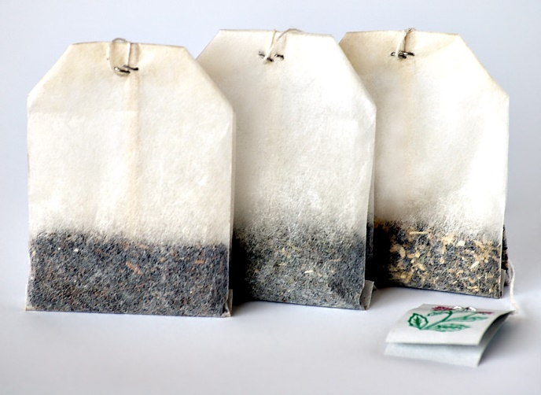
The Nature of Technology

Slide 5


Technological and Engineering Literacy
For All Students

Slide 6



Technology Shapes Our Lives
We are all doing things we never imagined
We are absolutely “hooked” on technology
Few people understand technology

Slide 7
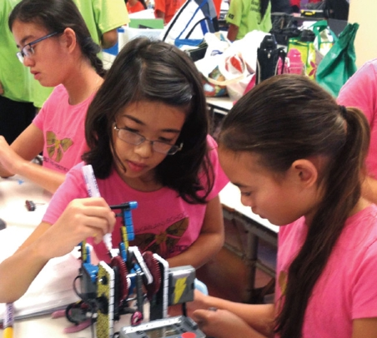
The Problem
Graduating technologically and engineering illiterate students
“Haves” and “have-nots”
Global competition
Competition for careers
High-stakes testing
Escalating rate of change
Isolated classrooms

Slide 8


Standards for Technological and Engineering Literacy: The Role of Technology and Engineering in STEM Education

Slide 9
Some Clarification
Technology is the modification of the natural environment in order to satisfy perceived human needs and wants.
Technological literacy is the ability to use, manage, assess, and understand technology.
Engineering is the use of scientific principles and mathematical reasoning to optimize technologies in order to meet needs that have been defined by criteria under given constraints.

Slide 10
What Can Technologically
and Engineering and Literate People Do?
Evaluate technological and engineering information
Form opinions about technology and engineering
Assess technological and engineering value (or the lack of value)
Exhibit a level of comfort with technology and engineering
  Neither afraid, nor infatuated
Understand how technology is created (making and doing)
Understand how technology and engineering shapes society and is shaped by society

Slide 11
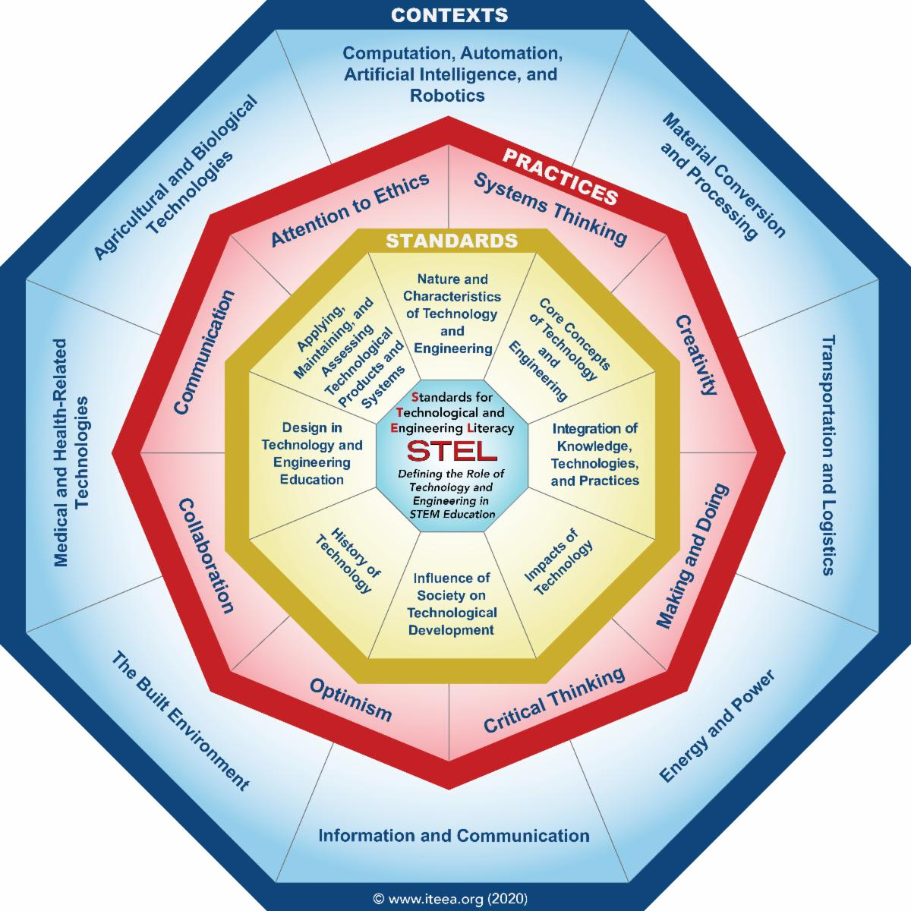

Slide 12
Why use engineering design to teach about technology?
Design is to technology and engineering as inquiry is to science and reading is to language arts
Delivers critical thinking and innovation
Allows for the application of technical and engineering knowledge
Expands levels of creativity
Examines the technological and engineering impacts on society, cultures, and environment

Slide 13
What are the primary concepts taught through the use of engineering design in the classroom?
Working as a Team
Defining the problem
Brainstorming
Conducting Researching
Generating Ideas
Identifying Criteria
Specifying constraints
Exploring possibilities
Selecting Approaches
Developing Proposals
Making a Model/prototype
Evaluating a design using specifications
Assessing a Solution
Refining a design
Creating or making products
Communicating results

Slide 14
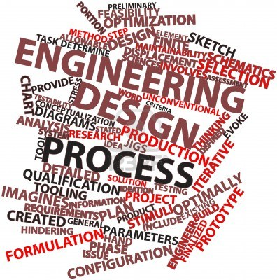
Methods Used to Deliver Engineering Design
Engineering design is delivered in the classroom using technological problem solving.
  Design Problem Solving
  Invention/Innovation
  Research & Development
  Experimentation
  Troubleshooting

Slide 15
Creativity
Creativity- the use of the imagination or original ideas, especially in the production of an artistic work… inventiveness, innovation, originality.
Can be nurtured
Can be measured

Slide 16
Anytime we are faced with a problem or dilemma with no learned or practiced solution, some creativity is required (Torrance, 1962; 1988; 1995)
Creativity is a vital ingredient in meeting the challenges of a continuous life cycle, a cycle in which growth and change are the norm from conception throughout life. A life filled with growth and change requires a conscious effort to think creatively. To develop creativeness, the mind needs to be exercised as well as filled with materials out of which ideas can be formed. The richest fuel for ideation is firsthand experience (Osborn, 1963).
Creativity is the ability to see a situation in many ways and to continue to question until satisfaction is reached (Goff, 1998).

Slide 17
Torrance Test
We will take a test of creativity often given to children.
Once I hand out the assessment, you will have 3 minutes to draw as many pictures as you can. The goal is to draw as many, and as many creative pictures as you can in the time allotted. Pictures should also have a title or description.

Slide 18
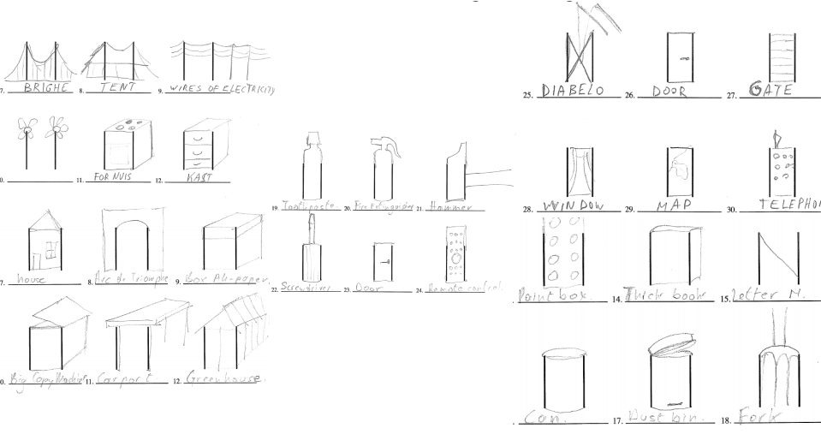

Slide 19
Creativity- Four Categories of Divergent Thinking
Fluency- how many ideas you can come up with in a short period of time
Originality- how uncommon your ideas are
Flexibility- how many areas your ideas cover
Elaboration- level of detail in responses

Slide 20
What does this have to do with STEM Education?
The ideas of Fluency and Flexibility = Brainstorming
These are skills that can be practiced
Tension between fluency and originality

Slide 21
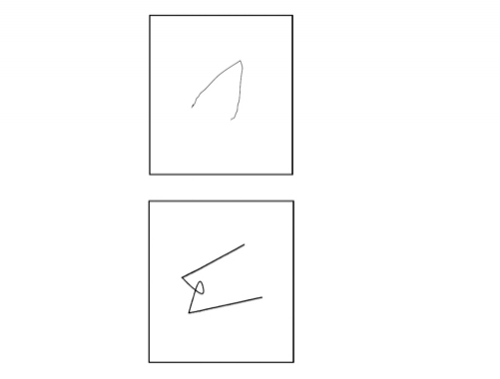
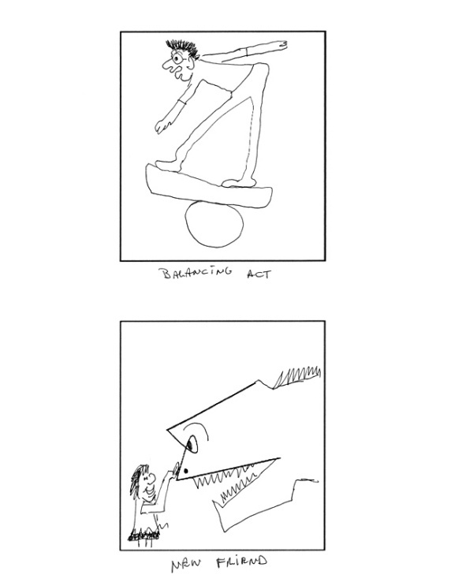
Other Fun Exercises
Guilford Alternative Uses Test- 2 min. to think of as many uses as possible for a paper clip
Incomplete Figures- these are on GT screens

