Slide 1
Moving Along the Tracks
MagLev Design Challenge

Slide 2
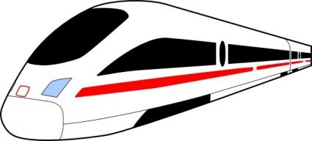
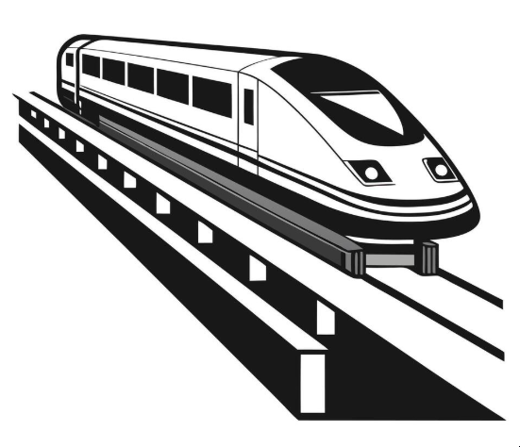
Maglev technology, or magnetic levitation, uses magnetic forces to suspend and propel vehicles without traditional wheels or rails. This allows for high speeds and smooth travel. There are two main types: Electromagnetic Suspension (EMS) and Electrodynamic Suspension (EDS). EMS uses electromagnets to attract or repel the train, while EDS uses electromagnetic induction to levitate and propel the train.
Maglev Technology
Levitation - Maglev trains use strong magnets to levitate above a guideway, eliminating friction between the train and the track.
Propulsion - The magnetic field created by the guideway interacts with the magnets on the train, propelling it forward.
Speed - Maglev trains can achieve high speeds, with some reaching over 600 km/h (373 mph).
Efficiency - By reducing friction, maglev trains are more energy-efficient than conventional trains.
Applications
Beyond high-speed rail, maglev is also being explored for urban transportation, freight, and industrial applications.
Future Potential
Maglev technology holds promise for future transportation systems, including potential for high-speed travel in evacuated tubes.

Slide 3

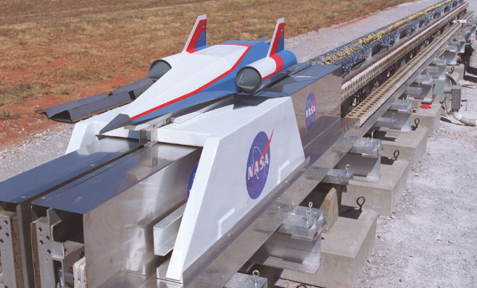
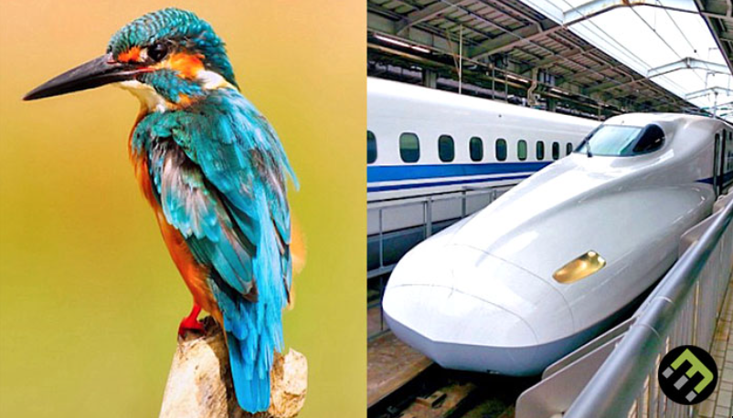
Biomimicry and MagLev technology
https://twitter.com/i/status/1911935490271723687
Future advances using MagLev technology
https://twitter.com/i/status/1909539308069175678

Slide 4
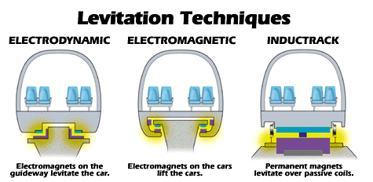
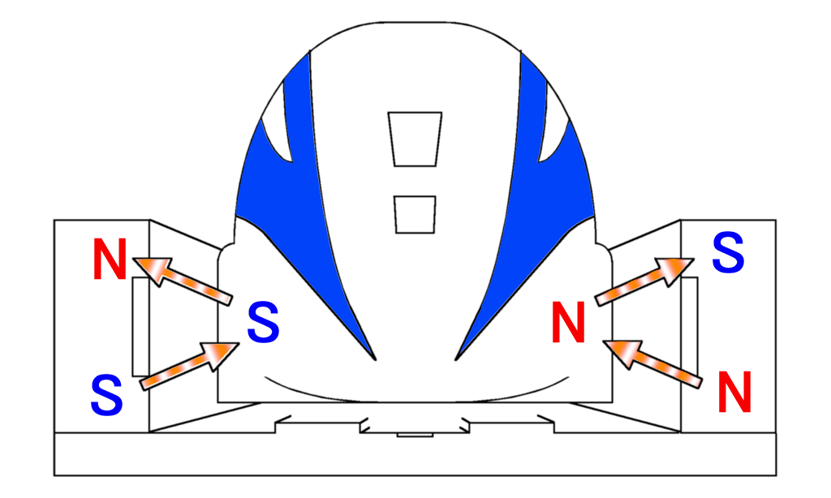

Slide 5
3rd Grade Physical Sciences (PS)
The PS performance expectations in third grade help students formulate answers to the questions, “How do equal and unequal forces on an object affect the object?” and “How can magnets be used?” Students determine the effects of balanced and unbalanced forces on the motion of an object and the cause and effect relationships of electric or magnetic interactions between two objects not in contact with each other. Students are then able to apply their understanding of magnetic interactions to define a simple design problem that can be solved with magnets.
3-PS2-3 - Ask questions to determine cause and effect relationships of electric or magnetic interactions between two objects not in contact with each other.
3-PS2-4 - Define a simple design problem that can be solved by applying scientific ideas about magnets.

Slide 6
Science and Engineering Practices
Students are expected to demonstrate grade-appropriate proficiency in
  asking questions and defining problems,
  developing and using models,
  planning and carrying out investigations,
  analyzing and interpreting data,
  constructing explanations and designing solutions,
  engaging in argument from evidence, and
  obtaining, evaluating, and communicating information.
Students are expected to use these science and engineering practices to demonstrate understanding of the disciplinary core ideas.
Standards for Technological and Engineering Literacy: The Role of Technology and Engineering in STEM Education

Slide 7
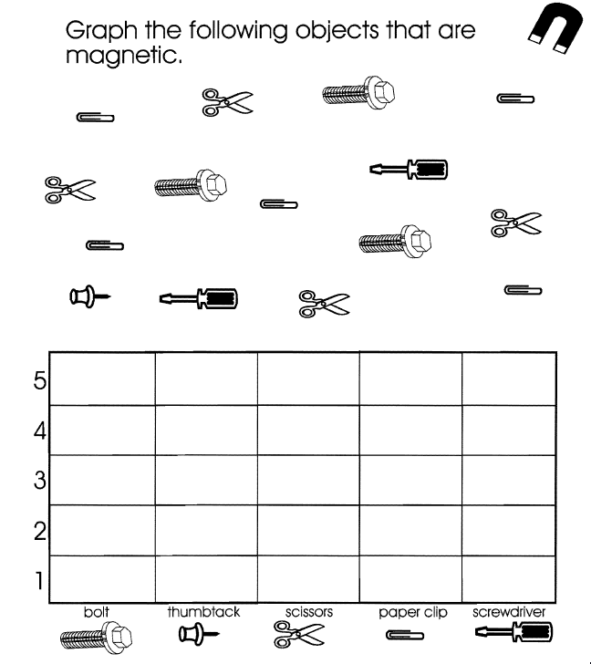
Mathematics
Classroom Store – keeping a budget - counting money
Train schedules and keeping time
Collecting, displaying, and using data - graphing
Recognizing patterns
Solving word problems related to materials and trains

