Slide 1
TEED 41003 Engineering Design for Technology Education: Capstone
The Capstone experience is typically completed by senior students within the TEED major and is designed to elicit opportunities for educational reflection and synthesis of knowledge and skills as well as preparation for student teaching.
Analysis of engineering design, focus on design processes, physical and computer modeling, & materials processing.

Slide 2
Industrial Technology (7-12) Licensure
Praxis Information - http://test.uark.edu/.
This fall you need to take the Praxis II – Subject Matter
Technology and Engineering Education - Test Code – 5053
Qualifying Score – 144
*Praxis II – Principles of Learning & Teaching – 7-12
Test Code – 5624
Qualifying Score – 157
*You will be discussing this in Dr. Deaton’s classes

Slide 3
STL - STEL
CCSS
NGSS
ACE
ADE
DESE
DCTE
STEM
CTE
ITEEA
ACTE
ATEE
ETE
PLTW
EBD
EITE
AMI
TTPGTAIE
The Teacher’s Pocket Guide to Acronyms in Education

Slide 4
STL - Standards for Technological Literacy – revised summer 2020 as the STEL - Standards for Technological and Engineering
CCSS - English Language Arts and Mathematics - Common Core State Standards
NGSS - Next Generation Science Standards
ADE - AR Department of Education
DESE – Division of Elementary and Secondary Education
DCTE – ADE Division of Career and Technical Education
STEM – Science, Technology, Engineering, & Mathematics
CTE – Career & Technical Education
ITEEA - International Technology & Engineering Educators Association
ACTE – Association for Career & Technical Education
ATEE - Arkansas Technology & Engineering Educators
ETE - Engineering & Technology Education
PLTW - Project Lead the Way
EBD – Engineering by Design
EITE – Exploring Industrial Technology Education
AMI – Alternative Methods of Instruction

Slide 5
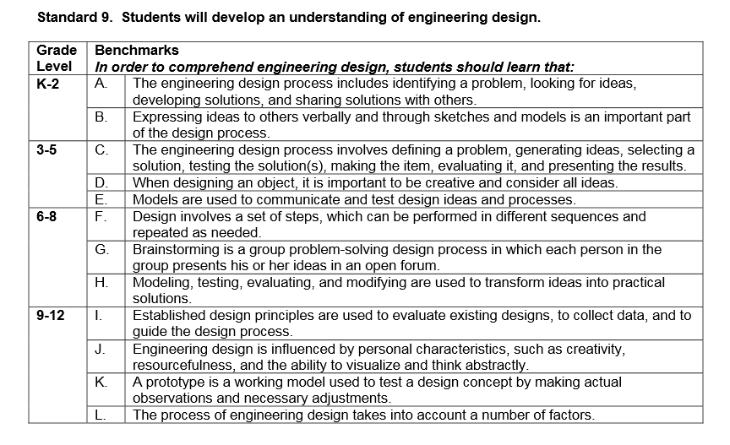


Slide 6

Standard 7:
Design in Technology
and Engineering Education

Slide 7
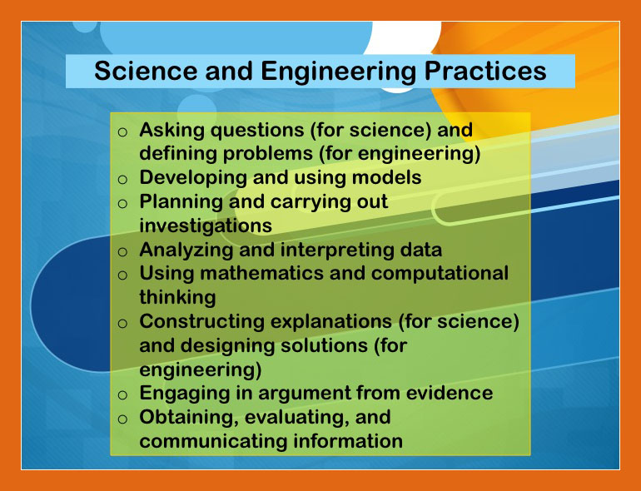

Slide 8
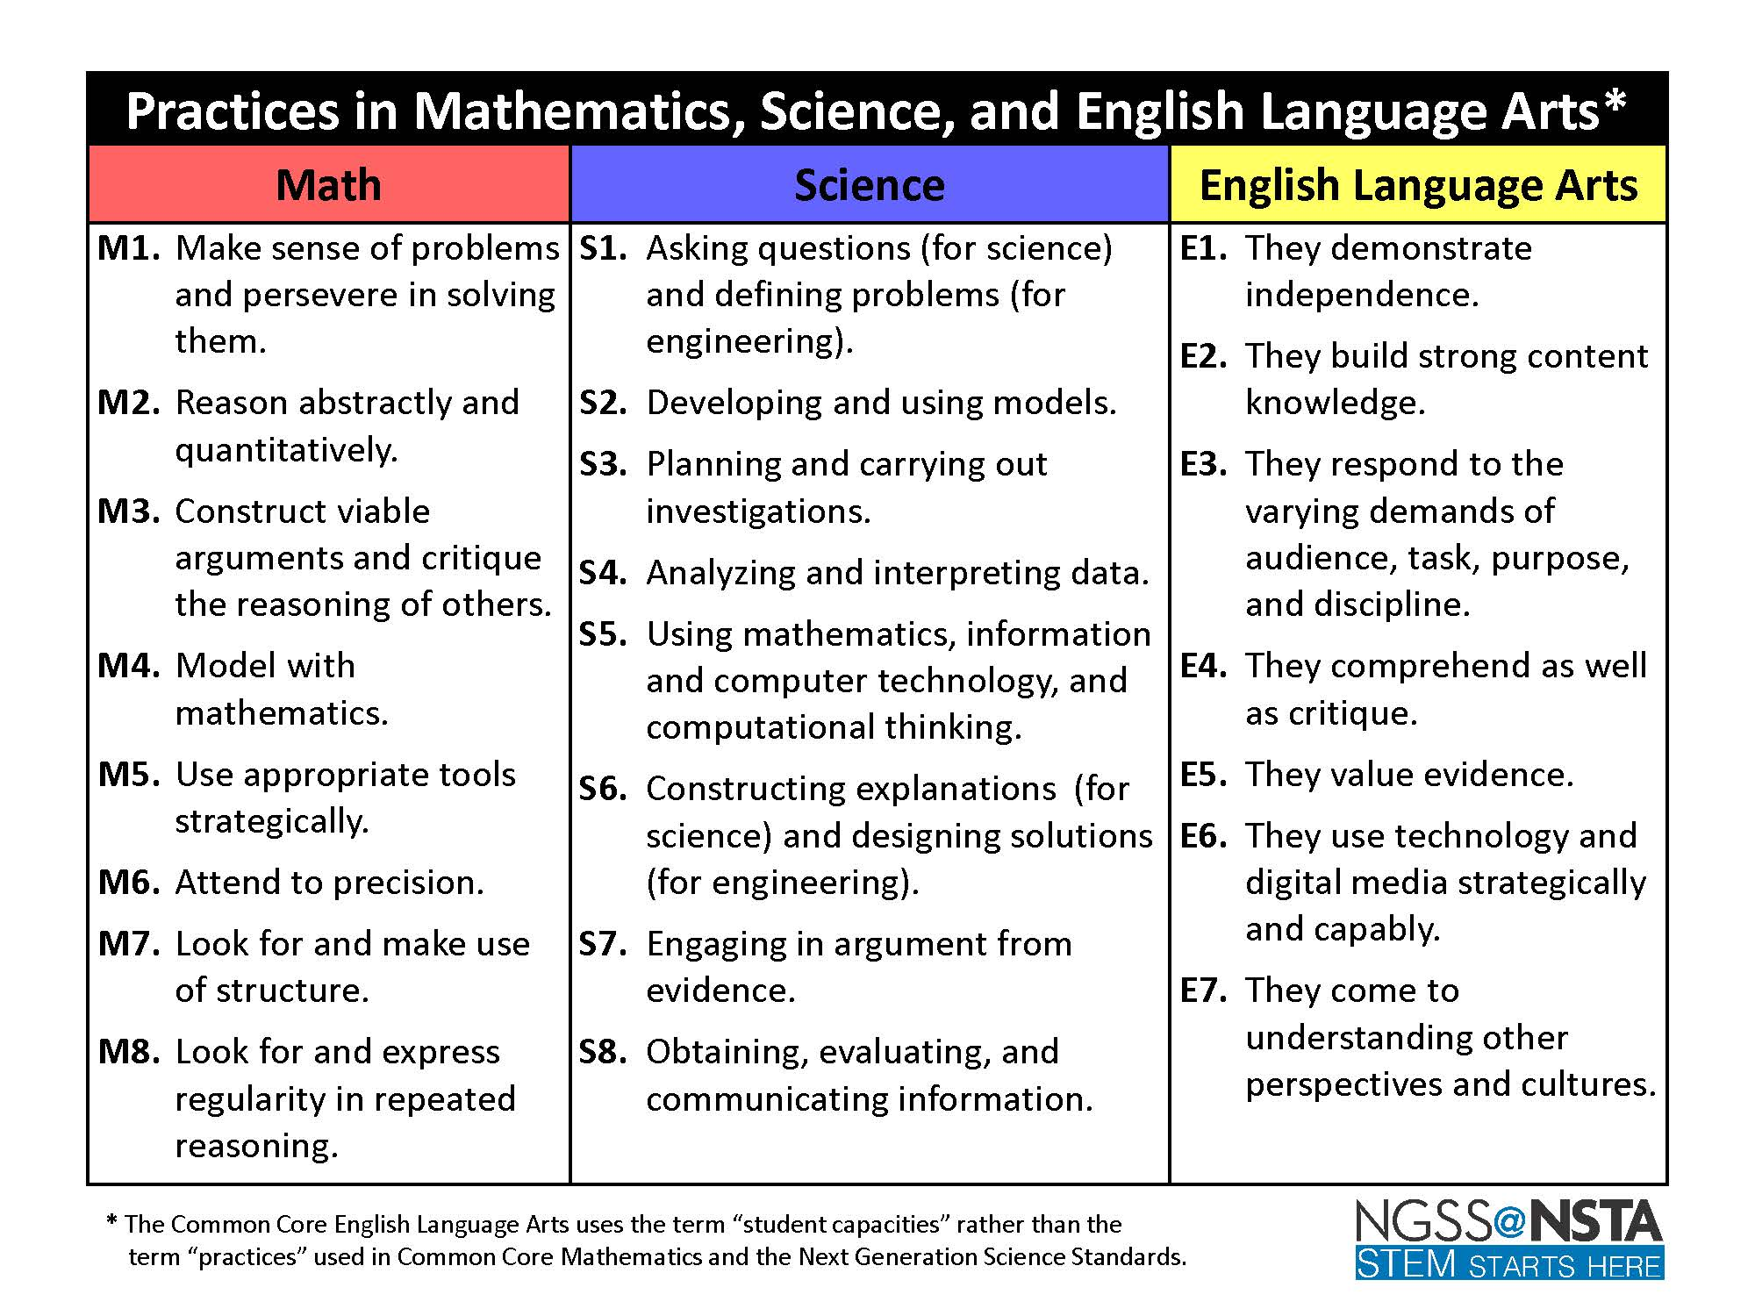

Slide 9
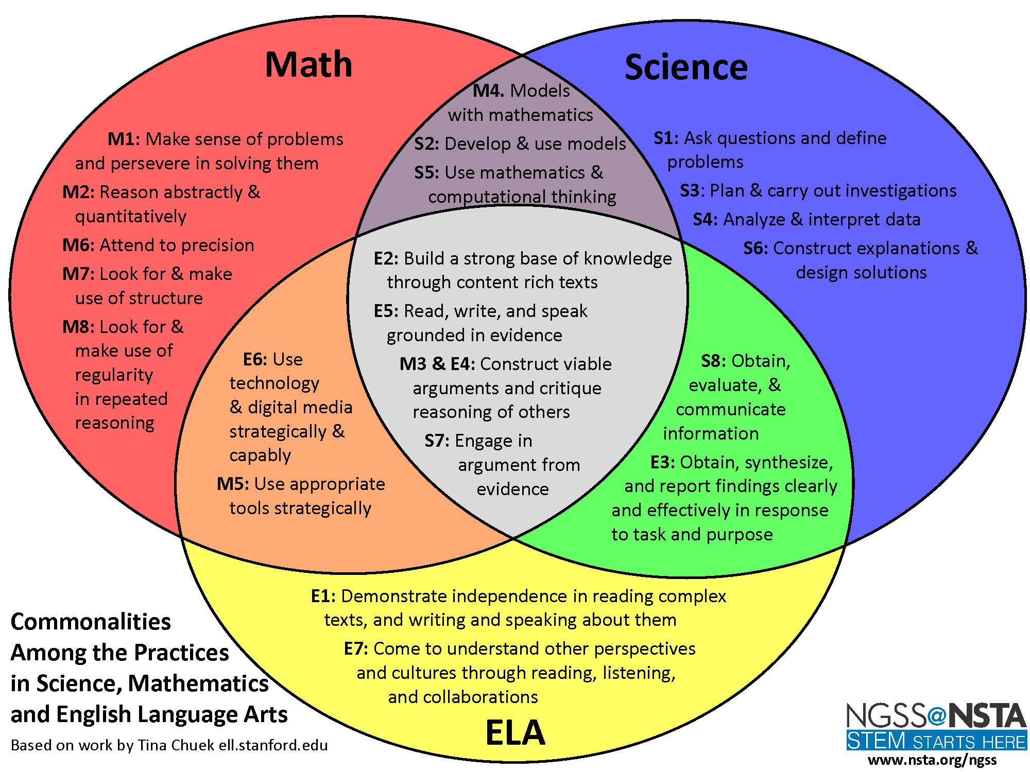

Slide 10
Placements –
Caleb – Don Tyson School of Innovation – Emily Cook – ecook@sdale.org
Dawson – Springdale High School – Rebecca Wallis – rwallis@sdale.org
Over the next two weeks – send an introduction email and make a visit to the school – gather information.
For Example –
Mrs. Wallis
Class schedule – Fall and Spring – frameworks/standards needed
Software
CorelDraw – need specifics - https://www.coreldraw.com/en/licensing/education/
Vex - https://www.vexrobotics.com/iq/downloads
Loggerpro – specifics needed
Multisim - https://www.multisim.com/pricing/
VLS control panel
CAM – spefics needed
GoGardian – this will be the school’s LMS
CTSO
No CTSO but they do hold big brother stem events where elementary/middle schoolers come up and do STEM with them.
Additional info
Currently a PLTW school but will stop using it next year

