Slide 1
Consider the past and you shall know the future!
-- Chinese Proverb

Slide 2
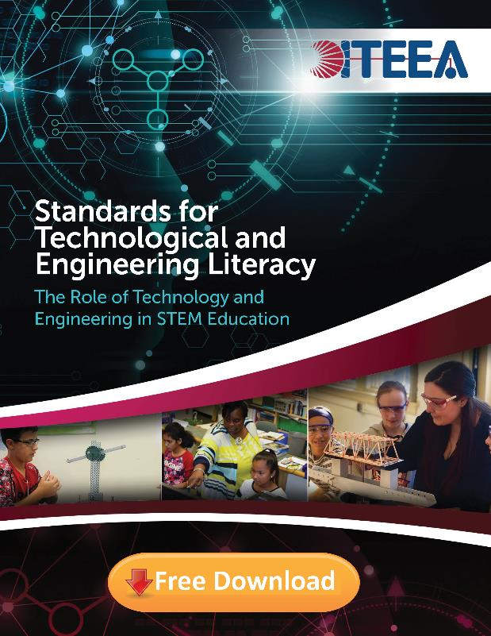
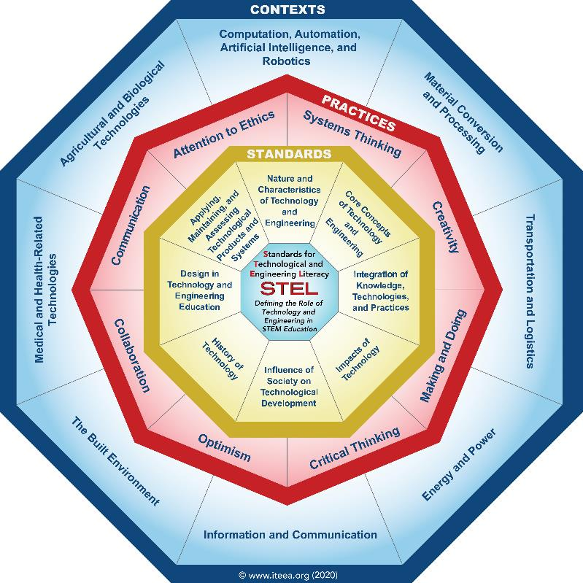


Slide 3
Before Learning about the Standards for Technological & Engineering Literacy: The Role of Technology and Engineering in STEM Education (2020), It is helpful to look at past curriculum developments, trends, and projects in the field of Technology Education.

Slide 4
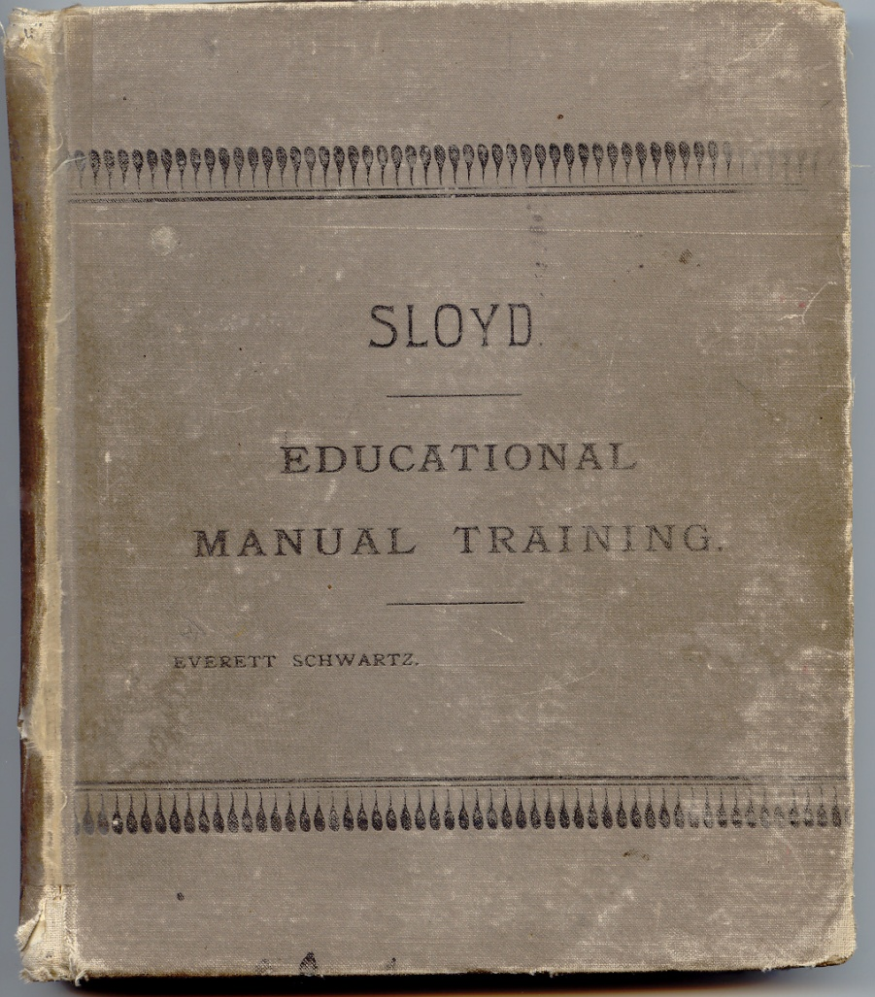
Popular Names Associated with The Discipline of Technology & Engineering Education Included:
Manual Training: 1870’s
Manual Arts: 1890’s
Industrial Arts: early 1900’s to 1990’s
Industrial Technology
Technology Education: -- Mid 1980’s to Early 2000’s
Technology & Engineering Education: -- Early 2000’s - Present
1893

Slide 5
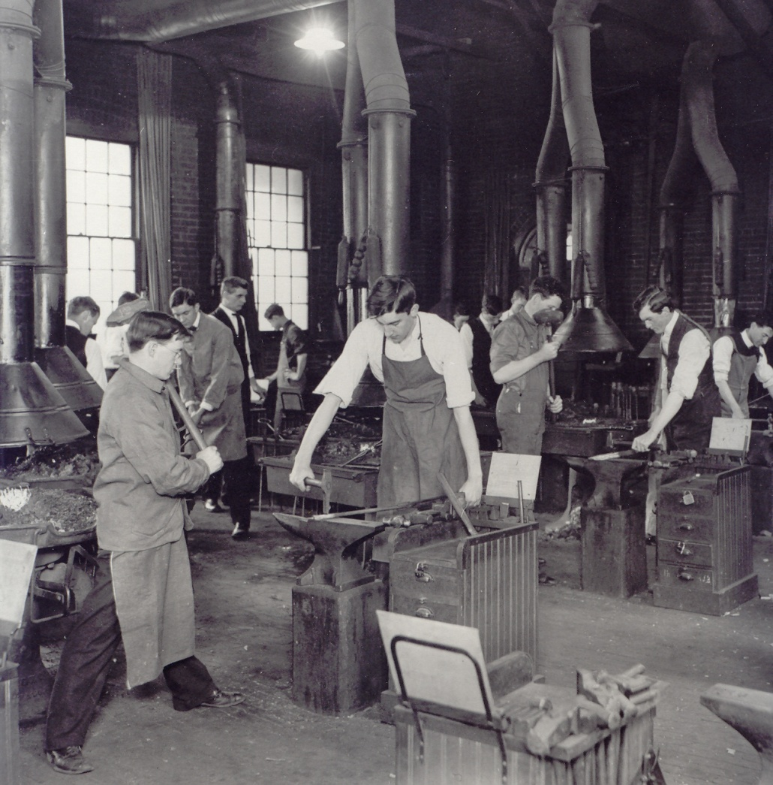
The Classic Industrial Arts Definition:
“Industrial arts is a study of the changes made by man in the forms of materials to increase their values, and of the problems of life related to these changes” (Bonser and Mossman, 1923).

Slide 6
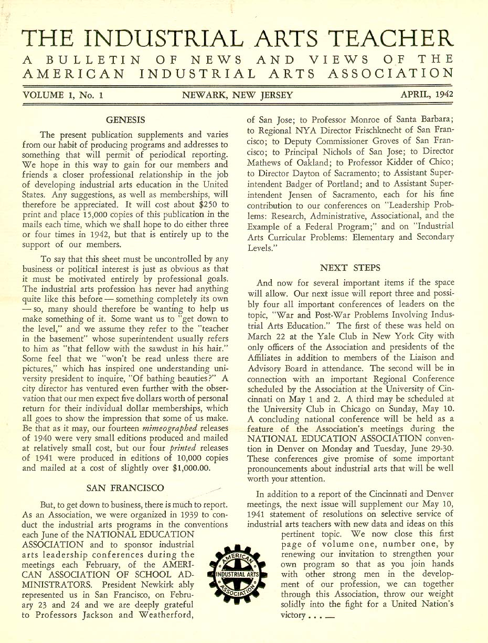
In 1939, the American Industrial Arts Association (AIAA) was Founded.
Today, it is known as the International Technology & Engineering Educators Association (ITEEA).
AIAA 1st Journal - 1942

Slide 7
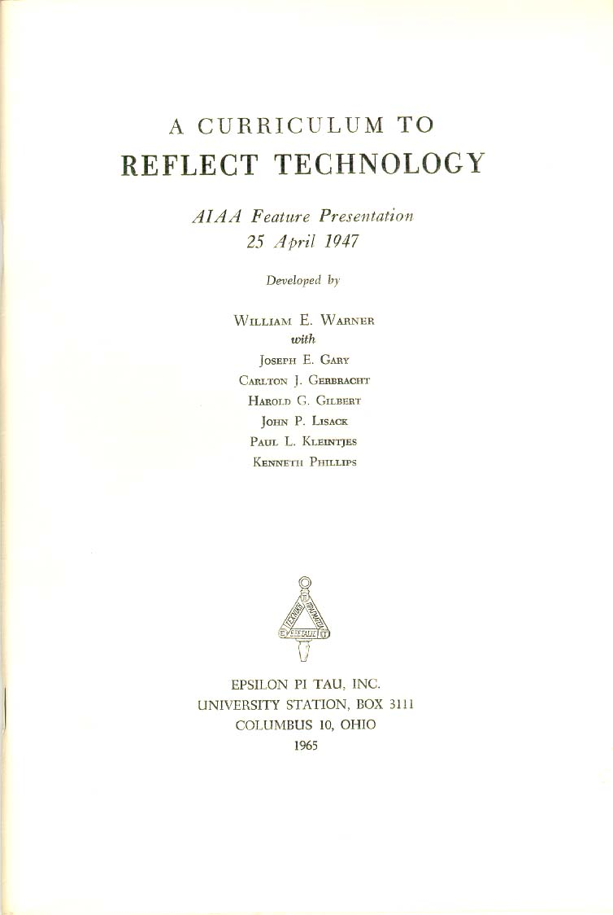
1947: A Curriculum to Reflect Technology
Content:
Power
Transportation
Manufacturing
Construction
Communication
Management
An early use of the term Technology!
Notes:
Here we see one of the first uses of the term technology and thoughts about what our content should be.
The content represented the “technology” of the day. For example, in communications, students would study such topics as: letterpress, telegraphy, teletype, television and complete activities where they would: interpret Morse code, tune a transmitter or print a roll of film.

Slide 8
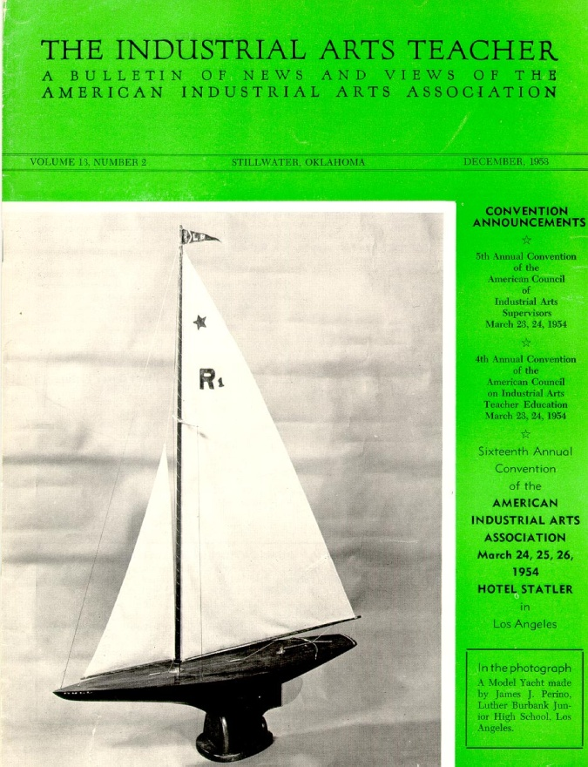
A Curriculum to Reflect Technology
Industrial Arts Defined:
Industrial Arts as a general and fundamental school subject in a free society is concerned with providing experiences that will help persons of all ages and both sexes to profit by the technology, because all are involved as consumers, many as producers, and there are countless recreational opportunities for all. -- William E. Warner (1947)
Notes:
Industrial arts defined with reference to technology.

Slide 9
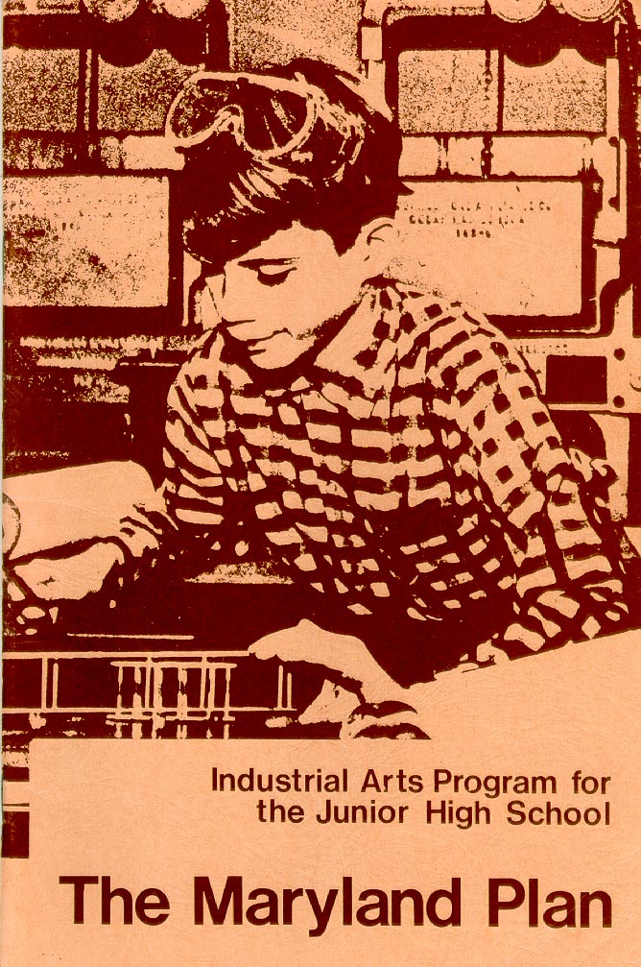
The Maryland Plan (1950’s) -- Don Maley
A Study of Technology and Industry with their Implications for Man and Society.
-- 1970 Pamphlet
Notes:
The Maryland Plan was developed in the 1950’s at the University of Maryland under the direction of Dr. Donald Maley.

Slide 10
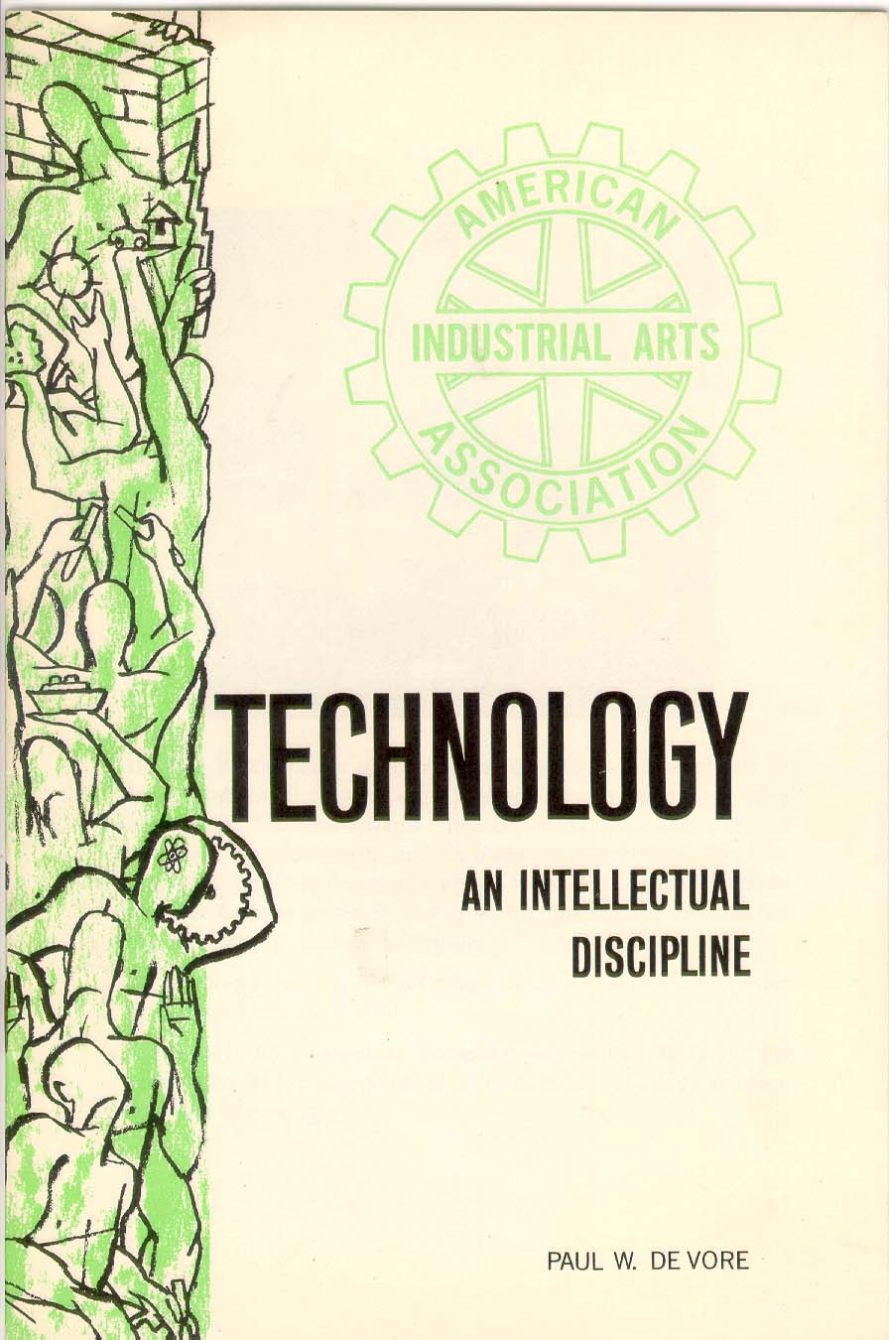
Technology: An Intellectual Discipline (1964) -- Paul DeVore
Educate the youth of today for a culture dominated by technology.
Notes:
Again, studying “Technology” is the field of industrial arts is talked about.

Slide 11
The Industrial Arts Curriculum Project – IACP (Late 1960’s) -- Don Lux and Willis Ray
Development of an in-depth rationale and structure for a body of knowledge called Industrial Technology.
Based on this body of knowledge, the content for Junior High Industrial Arts courses were identified:
The World of Construction (1st Year)
The World of Manufacturing (2nd Year)

Slide 12
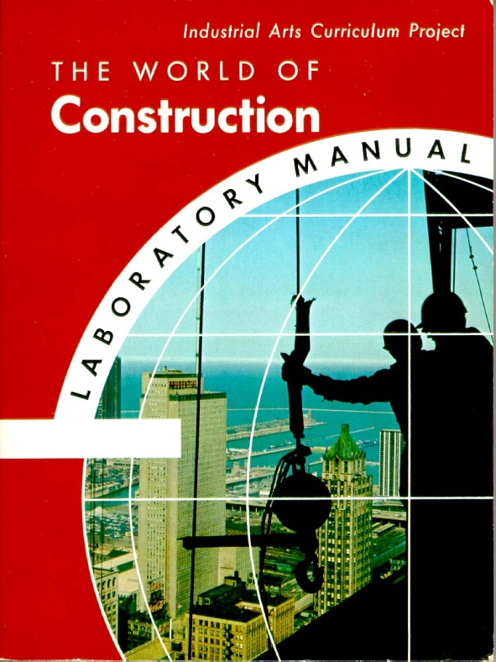
The World of Construction & The World of Manufacturing
Complete Educational Program:
Textbooks
Laboratory Manuals
Workbooks
Teacher’s Guides
Motion Picture Films & Filmstrips
Models & Demonstration Devices

Slide 13
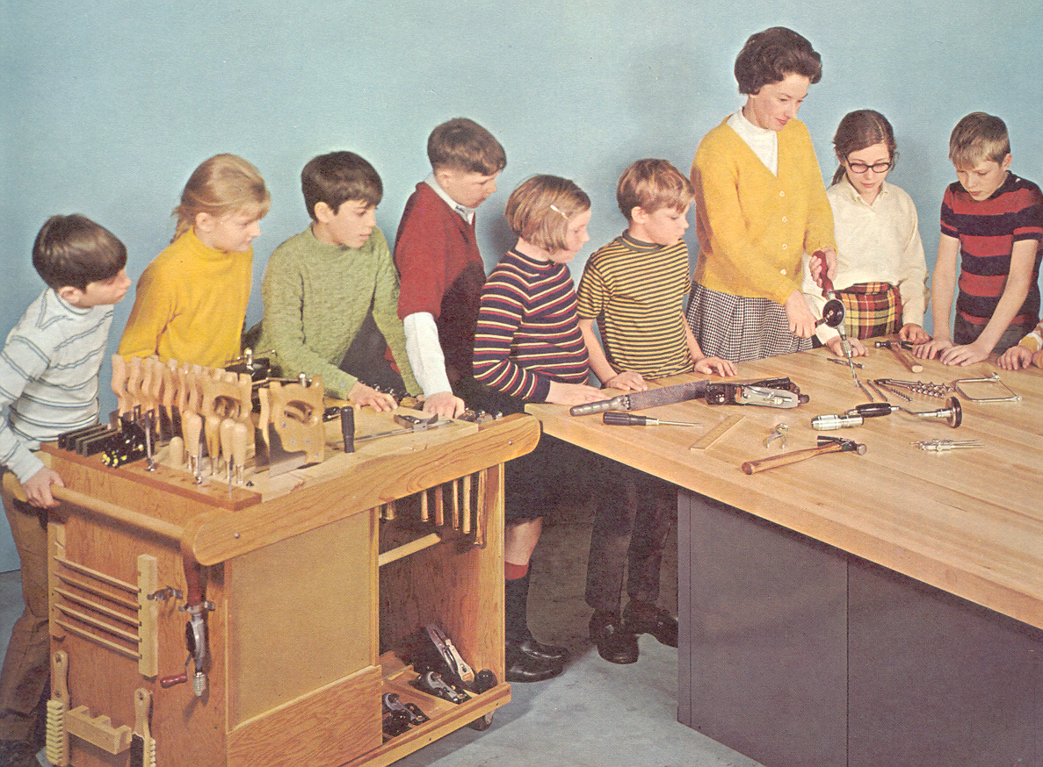
In the 1950 and 60s, students enrolled in Industrial Arts, learned how to “safely” use power and hand tools to make projects.

Slide 14
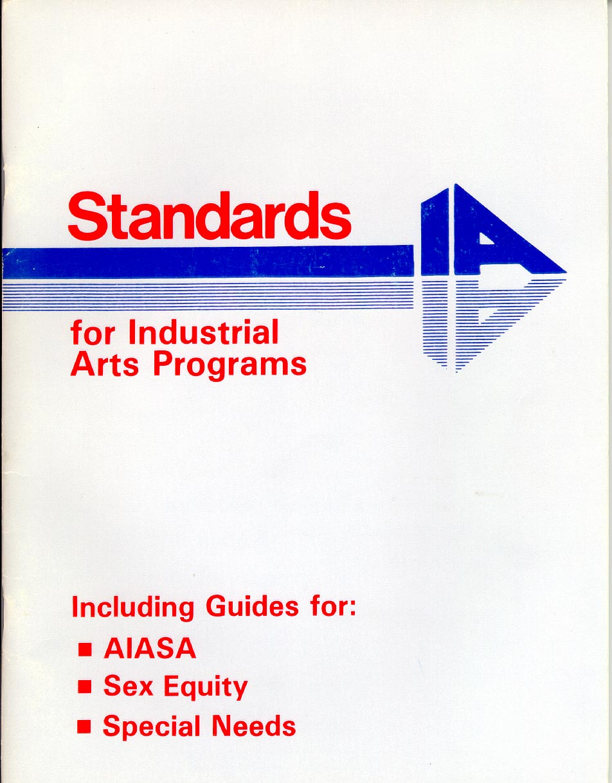
The Standards Project (1978 - 1981)
-- Virginia Polytechnic Institute
10 Standards developed to evaluate Industrial Arts Programs
3 additional guides dealing with: Student Associations, Sex Equity & Special Needs

Slide 15
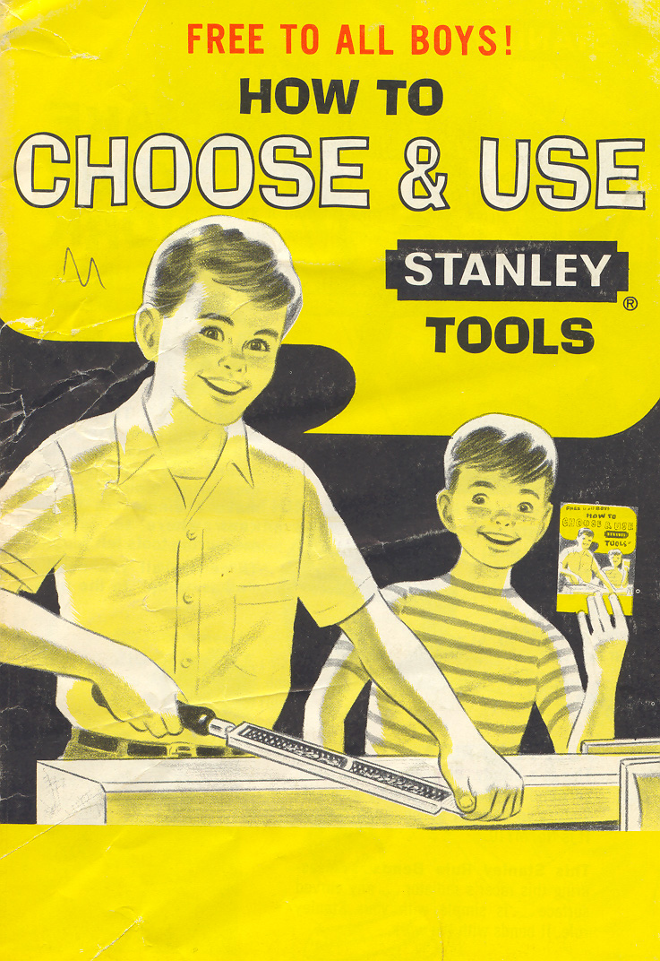
10 Standard Topics Used to Evaluate
Industrial Arts Programs:
Philosophy
Instructional Program
Student Populations Served
Instructional Staff
Administration and Supervision
Support Systems
Instructional Strategies
Public Relations
Safety and Health
Evaluation Process

Slide 16
Jackson’s Mill Industrial Arts Curriculum Theory (1981) -- J. Hales & J. Snyder
Manufacturing
Construction
Communication
Transportation

Slide 17
"Industrial Arts is a comprehensive educational program concerned with technology, its evolution, utilization, and significance; with industry, its organization, personnel, systems, techniques, resources, and products; and their social/cultural impact"
-- (Snyder and Hales, n.d., p. 1).

Slide 18
A Conceptual Framework for Technology Education (1990) -- E. Savage & L. Sterry
Technology is a body of knowledge and the application of resources using a systematic approach (the technological method) to produce outcomes in response to human needs and wants.

Slide 19
A Conceptual Framework for Technology Education (1990) -- E. Savage & L. Sterry
Technological knowledge can be classified as:
Bio-Related Technology
Communication Technology
Production Technology
Transportation Technology

Slide 20
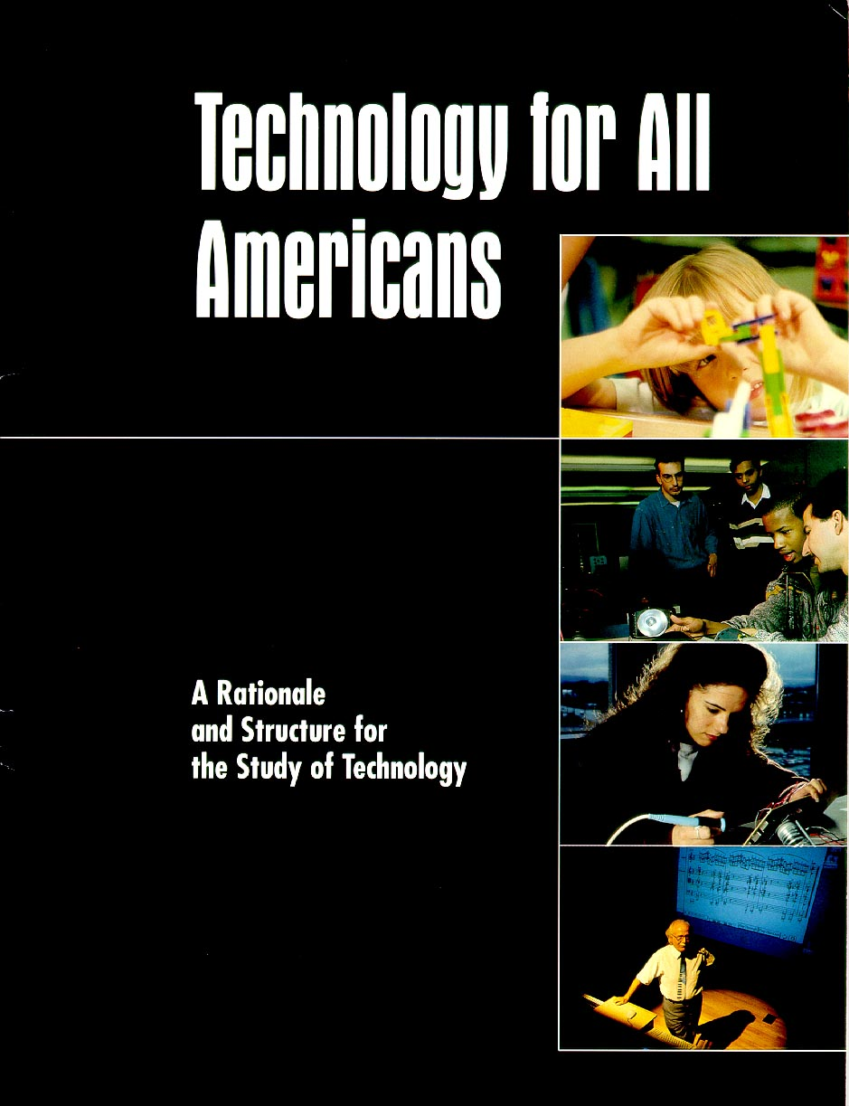
The Technology For All Americans Project (1994 – 1996)
Technology is Human Innovation in Action. It involves the generation of knowledge and processes to develop systems that solve problems and extend human capabilities

Slide 21
Developed by the ITEA’s Technology for All Americans Project, the Rationale & Structure provided a new vision for the study of technology.
It made a challenge to all concerned to take action to establish technology education STANDARDS and make technological literacy an educational priority.
Funded by National Science Foundation (NSF) and National Aeronautics and Space Administration (NASA) and
Administered by ITEA

Slide 22
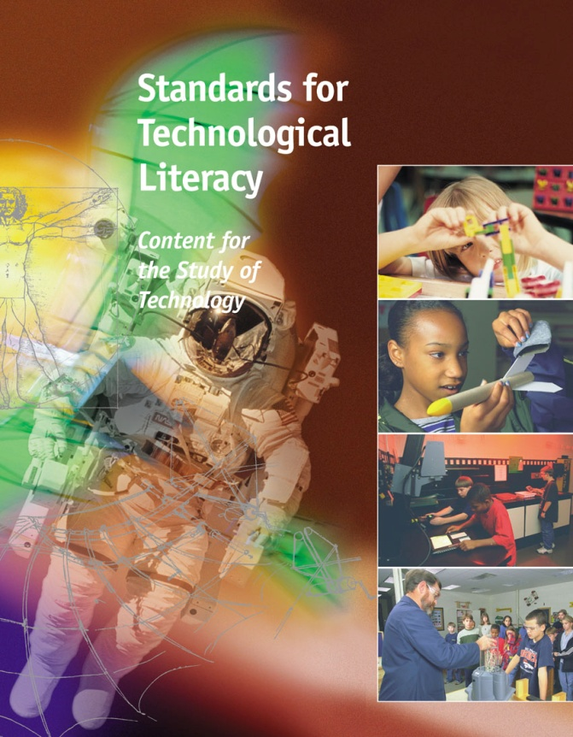
Released in the Spring of 2000 by the International Technology Education Association (ITEA) and its Technology for All Americans Project, the Standards for Technological Literacy: Content for the Study of Technology (STL) were developed to assist curriculum developers as they develop K-12 technology education curricula.

Slide 23
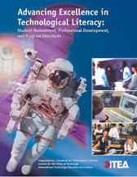
Released in 2003 by the International Technology Education Association (ITEA) and its Technology for All Americans Project,
Advancing Excellence in Technological Literacy: Student Assessment, Professional Development, and Program Standards (AETL) identifies criteria for student assessment, professional development, and programs that facilitate student attainment of technological literacy.

Slide 24
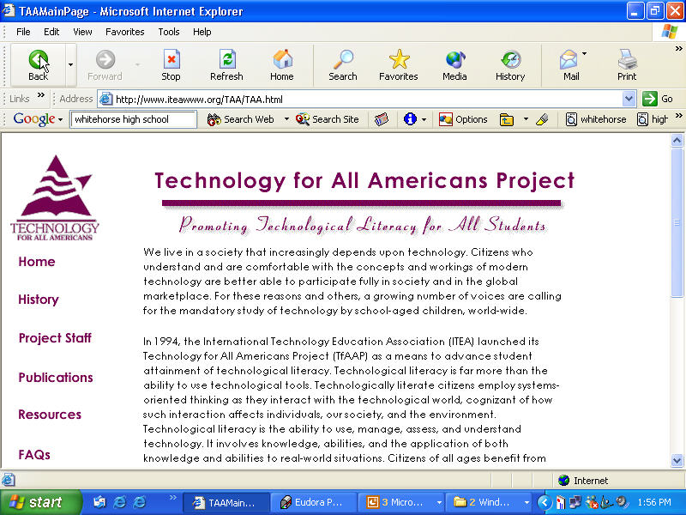
www.iteawww.org

Slide 26
History of ITEEA
1939 - American Industrial Arts Association (AIAA).
1947 - AIAA held its first conference in Columbus, Ohio. The theme “A Curriculum to Reflect Technology.”
1985 - AIAA Members voted to change name to the International Technology Education Association (ITEA).
2000 – ITEA releases Standards for Technological Literacy: Content for the Study of Technology
2011 - ITEA Members voted to change the name to the International Technology and Engineering Education Association (ITEEA).
2020 – ITEEA releases Standards for Technological and Engineering Literacy: The Role of Technology and Engineering in STEM Education

Slide 27

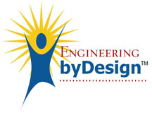

The Future?
Engineering and Technology Education
http://www.pltw.org
http://www.iteea.org/EbD
http://www.engineeringk12.org

