Slide 1
Product Design – Creating Technology
Broadly speaking, technology is how people modify the natural world to suit their own purposes.
From the Greek word techne, meaning art or artifice or craft, technology literally means the act of making or crafting.
More generally it refers to the diverse collection of processes and knowledge that people use to extend human abilities and to satisfy human wants and needs.

Slide 2
Qualities of a Product
Shape
Size
Function
Color
Texture
Use
Pattern
Aesthetics

Slide 3
The design of a product is an unquestioned determinant of its marketplace success.
Good designs attract consumers to a product, communicate to them, and add value to the product by increasing the quality of the usage experiences associated with them.

Slide 4
Good designers are…
holistic thinkers who draw information from a broad understanding of manufacturing processes and techniques to create the most innovative and cost-competitive products possible.
willing to ask dumb or outrageous questions that may spark an idea or create a new twist that will transform an entire project. More product breakthroughs come from information gathering sessions than anywhere else.

Slide 5
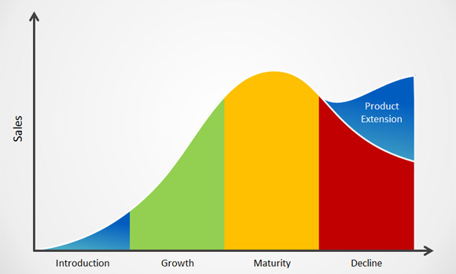
The Product Life Cycle

Slide 6
Manufacturing Techniques
Concurrent engineering which allows engineers to be heavily involved in the design process
Design for manufacturability which describes a process that allows production workers the opportunity to have input into the design of the product
Early vendor involvement is a phrase used to describe the inclusion of sales and marketing persons in design of products
Lean manufacturing describes the overall downsizing of the personnel involved in the production of new products.

Slide 7
Concurrent Design
Attempts to incorporate various factors related to product life cycle (manufacturability, quality, ease of use, aesthetics, etc.) early in the development of the product.
Allows the manufacturers to attempt to perform all activities related to design simultaneously rather than in series as is the case in tradition design projects resulting in the reduction of the duration of the design project, cost savings, and better quality for the final design.
The major purpose of concurrent design is to improve the overall quality of the product while reducing costs and development time.

Slide 8
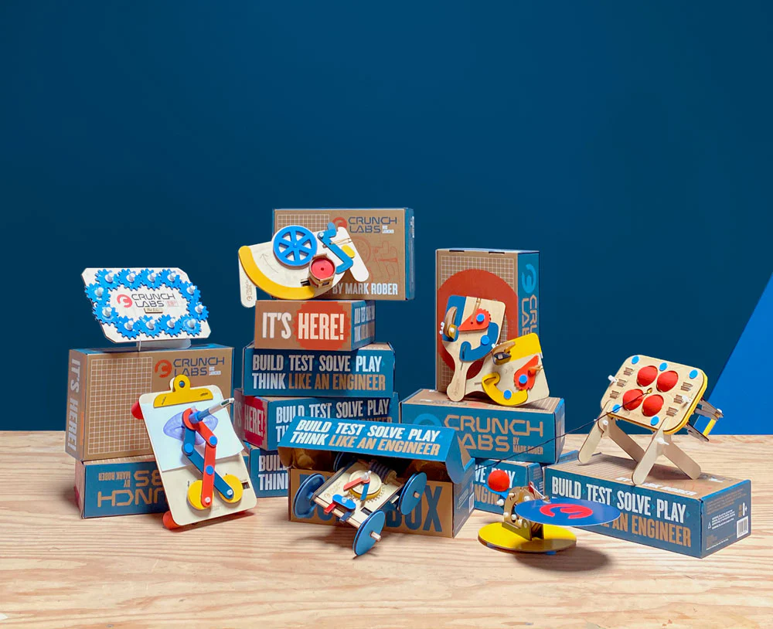

Slide 9
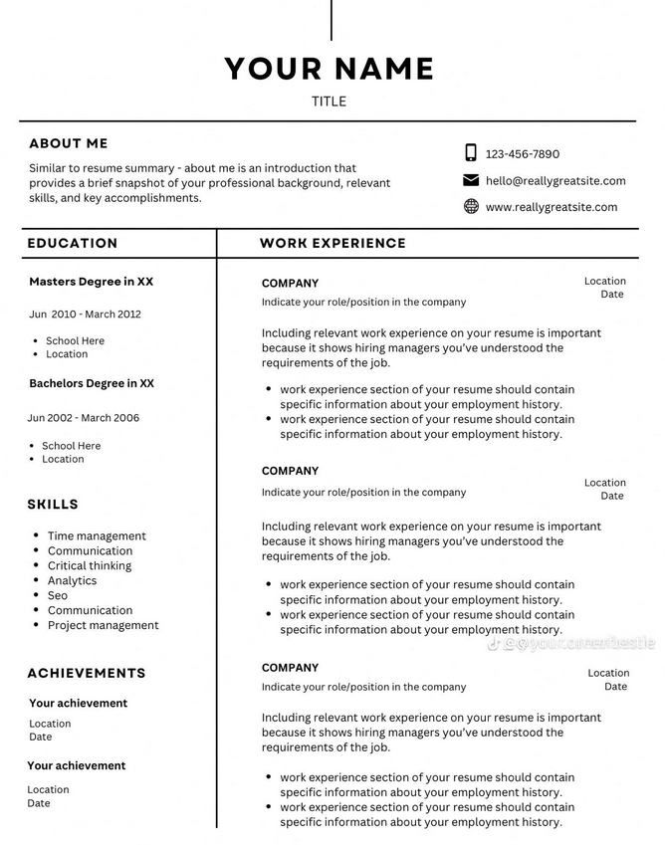

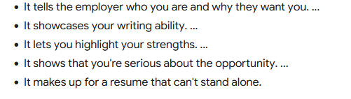

Slide 10
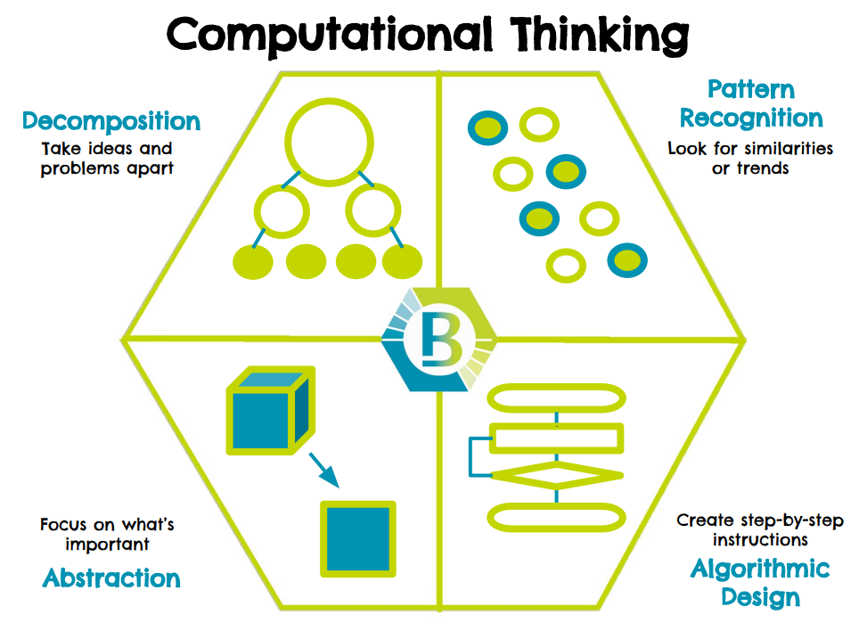

Slide 11
Core Components of Computational Thinking
Decomposition invites students to break down complex problems into smaller, simpler problems.
Pattern recognition guides students to make connections between similar problems and experience.
Abstraction invites students to identify important information while ignoring unrelated or irrelevant details.
Lastly, students use algorithms when they design simple steps to solve problems.

