Slide 1
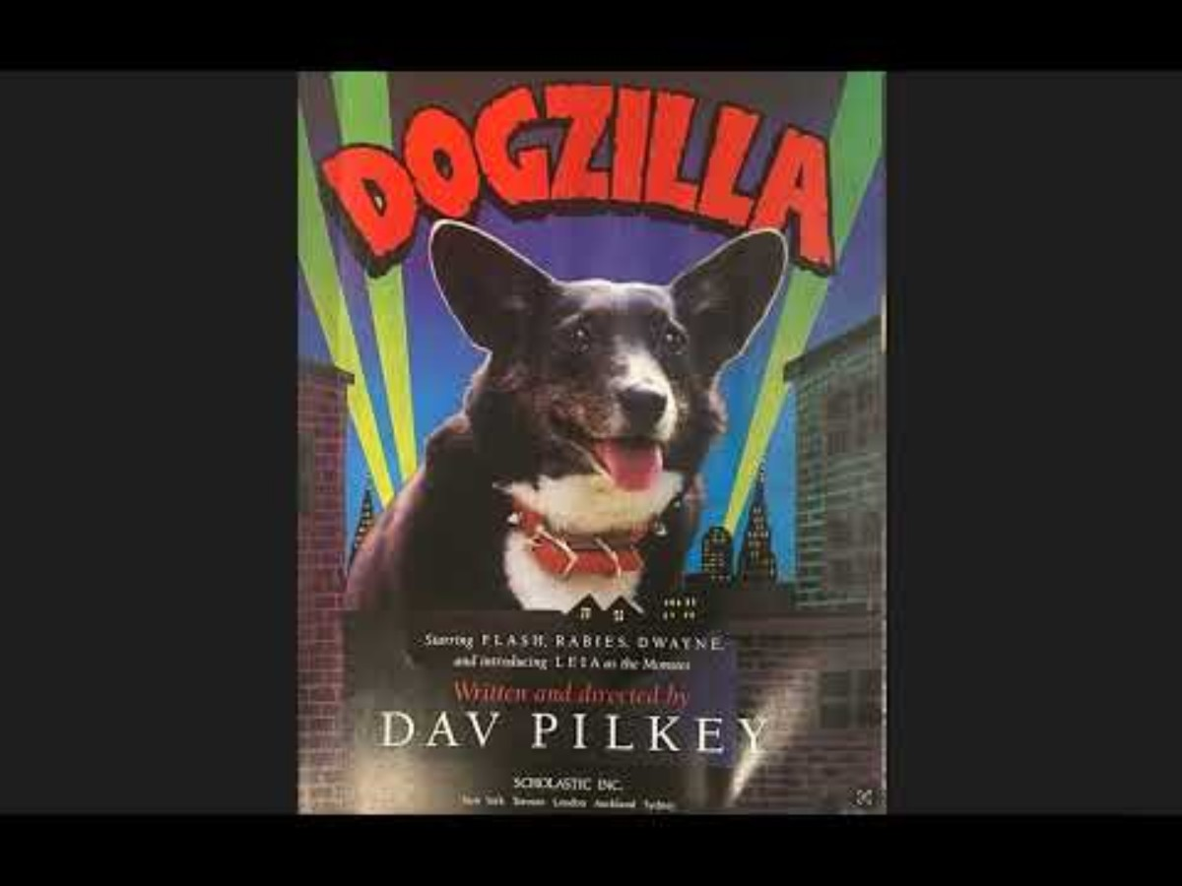

Slide 2
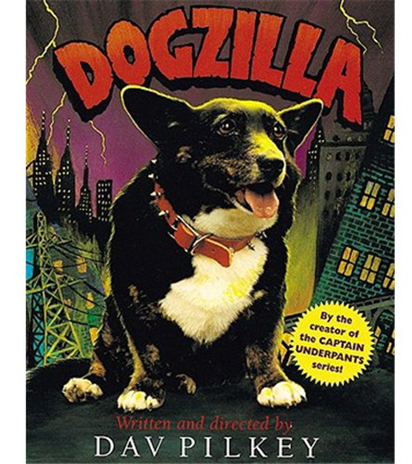
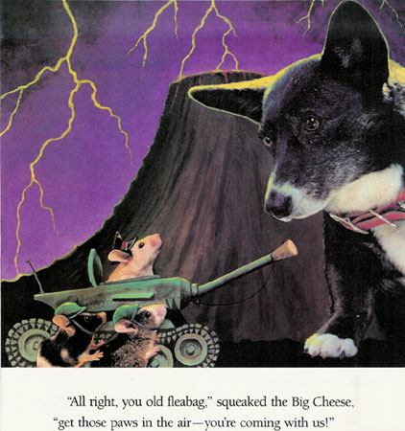

Slide 3
The Dog Treat Slinger Design Challenge provides a hands-on experience for students to explore balanced and unbalanced forces in a real-world context.
Understanding Balanced and Unbalanced Forces
Balanced Forces:
  When the dog treat is resting on the launcher before being flung, it experiences balanced forces. Gravity pulls it down, but the launcher (e.g., spoon, rubber band mechanism) pushes up with an equal force, keeping it stationary.
  If students design a mechanism where a force is applied but nothing moves (e.g., a poorly constructed slinger where forces cancel out), they will experience firsthand how balanced forces prevent motion.
Unbalanced Forces and Motion:
  When students activate their slinger (e.g., by releasing a stretched rubber band), an unbalanced force is applied to the treat, causing it to accelerate in a particular direction.
  The greater the force applied (e.g., by increasing tension in a rubber band or using a lever mechanism), the farther the treat will travel.
  Friction and air resistance will eventually slow down the treat, demonstrating how opposing unbalanced forces influence motion.

Slide 4
Engineering Design and Experimentation
Trial and Error: Students will test different designs and observe how varying forces (e.g., different rubber band strengths, lever lengths) affect the distance of the launched treat.
Data Collection and Predictions: By recording how far their treat travels and creating a line plot, they can identify patterns and predict future motion.
Iterative Improvements: Observing when their launcher fails (e.g., not enough force or too much resistance) helps students refine their understanding of how forces interact.
Scaling for Older Grades - students will develop a concrete understanding of how balanced and unbalanced forces affect motion, strengthening their ability to analyze and predict force-related interactions in everyday life.
Newton’s Laws in Action
Newton’s First Law (Inertia): The treat remains at rest until an unbalanced force propels it forward.
Newton’s Second Law (F = ma): The force applied by the launcher affects the acceleration of the treat, helping students see how stronger forces result in farther launches.
Newton’s Third Law (Action-Reaction): As the launcher pushes the treat forward, the treat exerts an equal and opposite force on the launcher.

Slide 5
The Dog Treat Slinger Design Challenge integrates math through measurement, data collection, financial literacy, and graphical representation, helping students develop key mathematical skills.
Measurement & Data Analysis
Measuring Distances
  Students will use rulers or measuring tapes to record how far their dog treat is launched.
  They will measure in inches, using halves and quarters, aligning with the 3rd-grade math standard (AR.Math.Content.3.MD.B.4) for measuring lengths with fractional units.
Creating a Line Plot
  After multiple trials, students will plot their data on a line plot, marking distances along a number line.
  This allows them to visually compare different launch distances and recognize patterns in their results.

Slide 6
Data Interpretation & Predictions
Identifying Trends: Students will analyze their line plot to determine:
  Which design features resulted in longer launches?
  How much variation exists between trials?
Using Data to Make Predictions: By identifying the range and average of their launch distances, they can predict
how small adjustments (e.g., increasing tension or changing angles) might impact performance.
Budgeting & Computational Math
Budget Constraints: Since students have a $10.00 budget, they must:
  Add and subtract to stay within budget.
  Compare material costs to make cost-effective design choices.
Multiplication & Division: If students decide to buy multiple units of a material, they could apply multiplication.
Decimals & Money Management: Handling cents and dollars introduces real-world decimal operations.

Slide 7
How much money will it cost to bring my idea to life?
Materials Available | Amount | Total Needed | Total Amount Spent on Each Item
Rubber band | .25¢
Paper | .25¢
12” masking tape | $1.00
6” duct tape | $2.00
Small cups | .50¢
Pencils/small dowel rods | $1.00
Clothes hanger | $2.00
Plastic spoons | $2.00
12” string | $1.00
Cardboard piece (6” X 6”) | $1.00
Total Amount Spent:

Slide 8
10
9
8
7
6
5
4
3
2
1
Credit(s) | 1 | 2 | 4 | 1 | 1 | 1 | 1 | 1 | 1
 | Rubber Band | 12” Masking Tape | 6” Duct Tape | Small Cup | Pencil or Dowel Rod | Wire Clothes Hanger | Plastic Spoon | 12” String | Cardboard Piece

Slide 9
How could I assess this design challenge?
Science
3-PS2-1 - Plan and conduct an investigation to provide evidence of the effects of balanced and unbalanced forces on the motion of an object.
3-PS2-2 - Make observations and/or measurements of an object’s motion to provide evidence that a pattern can be used to predict future motion.
Standards for Technological and Engineering Literacy
Standard 2: Core Concepts of Technology and Engineering
  L. Create a new product that improves someone’s life.
Standard 5: Influence of Society on Technological Development
  E. Explain how technologies are developed or adapted when individual or societal needs and wants change.
Math
AR.Math.Content.3.MD.B.4
Generate measurement data by measuring lengths using rulers marked with halves and fourths of an inch
Show the data by making a line plot, where the horizontal scale is marked off in appropriate units— whole numbers, halves, or quarters
Challenge/Book for context
Guided by the story of Dogzilla - Your challenge is to help the mice of Mousopolis by building them a machine that can fling dog treats as far away from the city as possible while still remaining easy enough for a mouse to operate (meaning the least amount of human interaction). Your team will be given a budget of $10.00 to complete the project.
Results/Deliverables
In your designated teams, design and create a machine using the materials given that effectively launches a dog treat as far as possible from the machine. Each design will be tested in a competition to see which machine would best be suited for the mice of Mousopolis. Each team will turn in the following items:
Design journal including a completed budget
Completed machine
Line-plot created from testing data

Slide 10
I could I use AI to develop a rubric to assess the design challenge –
Prompt -
Create a rubric for 3rd grade students for the following engineering design challenge and selected results/deliverables
(Insert standards)
Please make sure that it aligns with the following target standards
(Insert standards)
Continue to prompt changes until the challenge, deliverables, and standards align.

Slide 11
