Slide 1
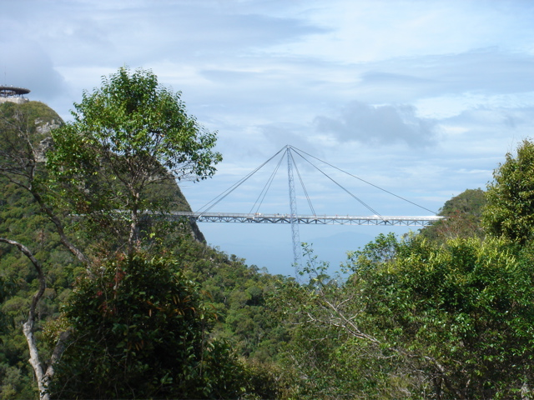
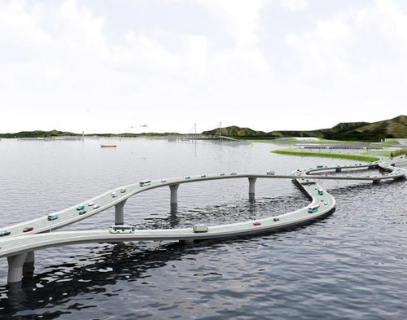
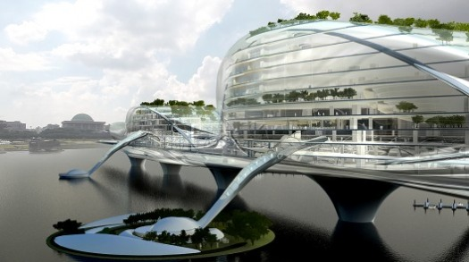
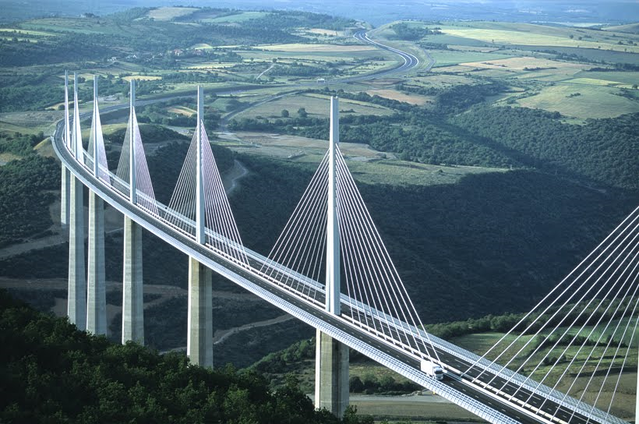
Engineering Structures

Slide 2
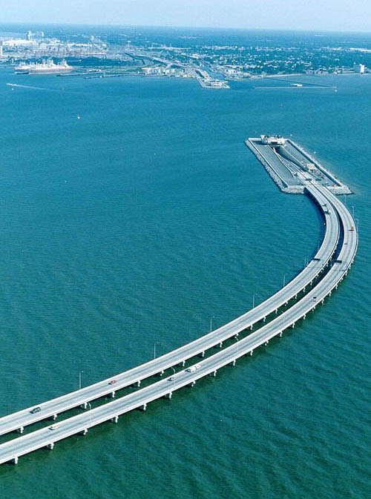
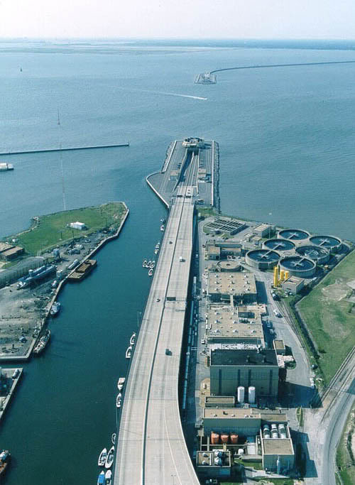

Slide 3

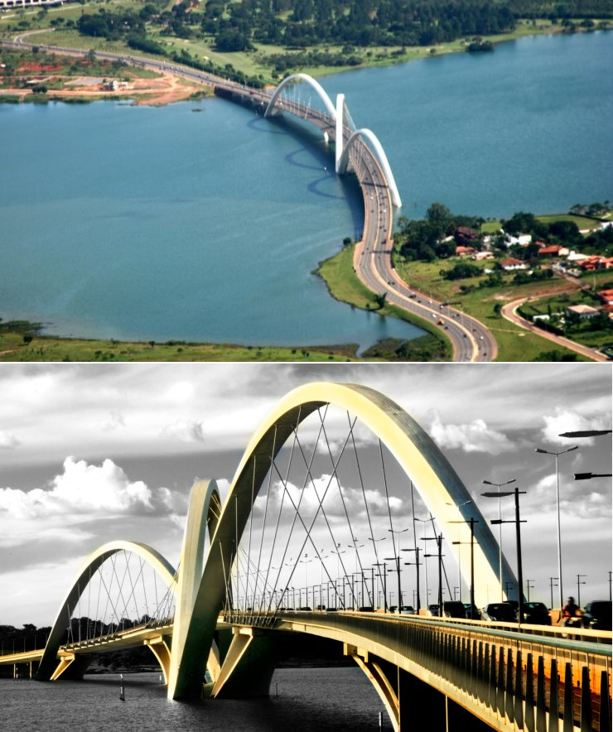
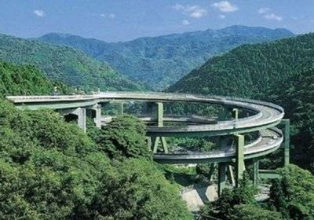

Slide 4
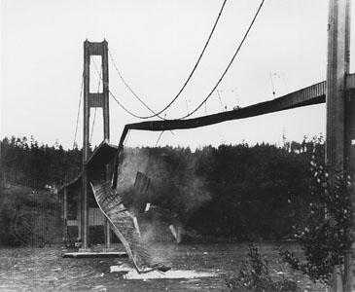
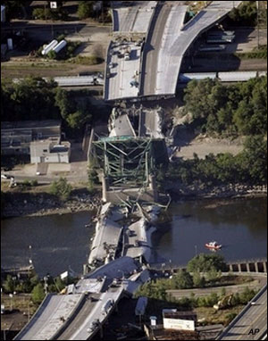
Tacoma Narrows Bridge Collapse
“Gallopin Gertie”
I-35
Bridge Collapse

Slide 5
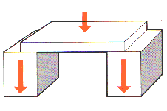
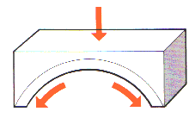
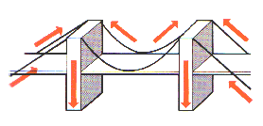
3 Types of Bridges
Beam
Arch
Suspension (cable-stay)

Slide 6
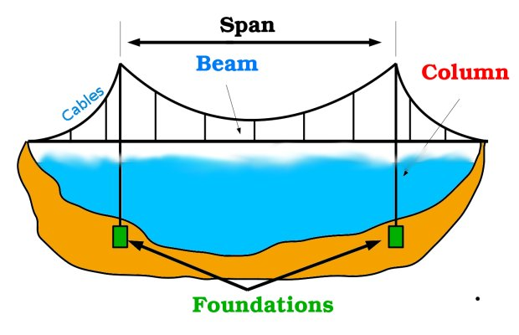
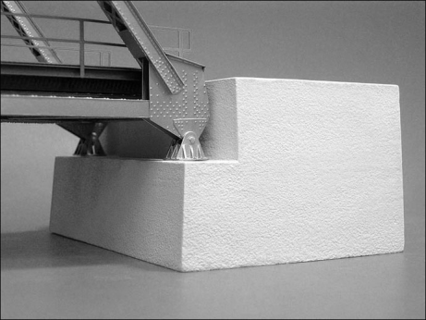
Key Terms
Span – the distance a bridge must go over without support
Abutment – the structure that supports the end of the bridge

Slide 7
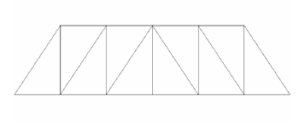
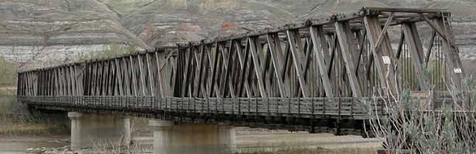
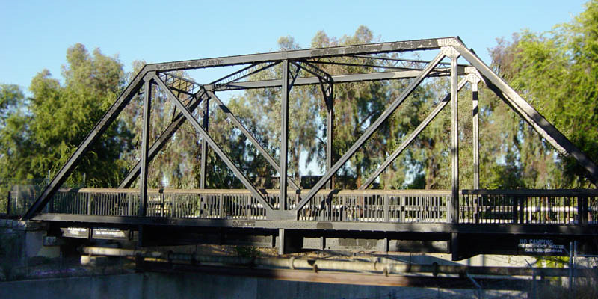
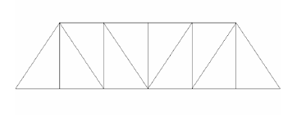
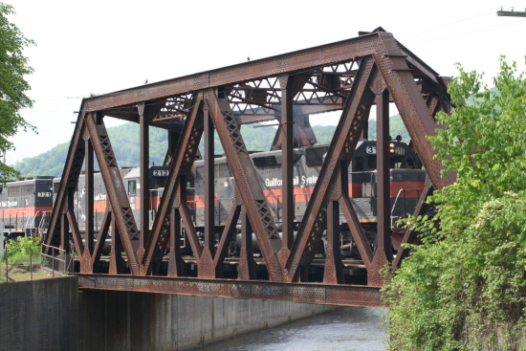
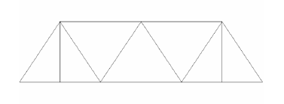
Typical Beam (Truss) Bridges
Howe Truss
Pratt Truss
Warren Truss

Slide 8
Physical Forces
Compression - A pressing force that squeezes a material so that it becomes more compact.
Example - The weight of the building on its lower columns caused a great deal of compression, causing buckling.

Slide 9
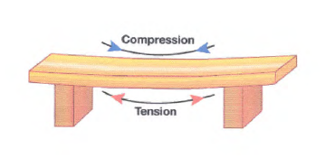
Physical Forces
Tension - A stretching force that pulls on a material.
Example - The vertical cables of suspension bridges must remain in tension at all times because of the continuous weight of the roadway and cars. Snapping will occur if the tension becomes to great.

Slide 10
Truss Strength
A single beam spanning any distance experiences compression and tension
  The top has more compression
  The bottom has more tension
For any bridge to be strong all parts must be tied together allowing all the parts to work together to share the load

Slide 11
Load
Load is the force applied to a structure
  Live Load – weight of objects placed on the structure (cars, trucks, trains, etc.)
  Dead Load – weight of the materials that make up the bridge (beams, road bed, etc.)

Slide 12
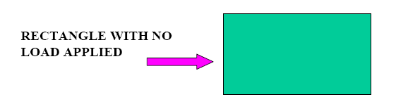
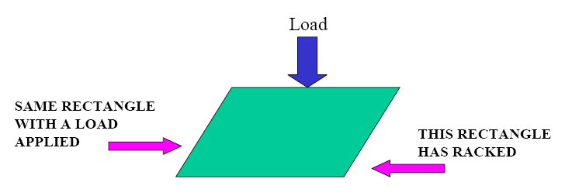
Racking
Racking occurs when a force is applied to a rectangular geometric shape.

Slide 13
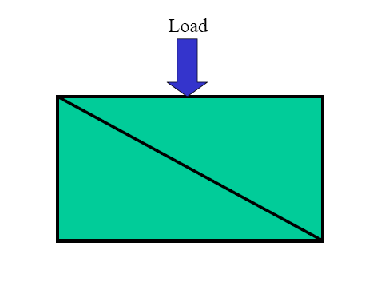
The Solution to Racking
You can overcome the racking problem by including diagonals.
A triangle is the strongest geometric shape when vertical forces are applied

Slide 14

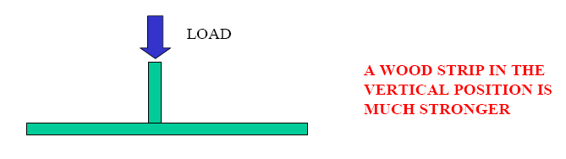
Joinery
Joinery is where 2 or more pieces of wood meet
When designing and building a bridge you must consider the forces that are acting upon each of the bridges components

Slide 15
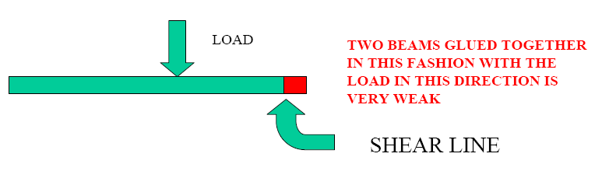
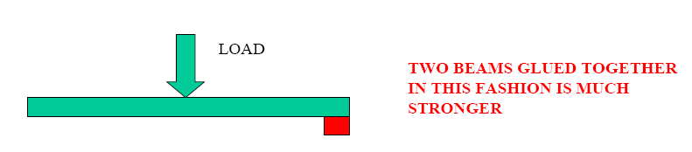
Shear
Shear is stress that is applied parallel or tangent to the face of material.

Slide 16
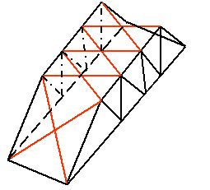
Lateral Bracing
Lateral bracing is also critical to a bridge’s design and ability to carry a load.
Lateral bracing serves to break the top chord into smaller sections, giving it more strength.
Think of it as the truss on top of your bridge.

Slide 17
Resources
http://www.garrettsbridges.com/design/trussdesign
http://168.170.14.135/webs/teachers/bstreeter/Engineering/Notes.pdf
http://www.garrettsbridges.com/design/lateral-bracing

