Slide 1
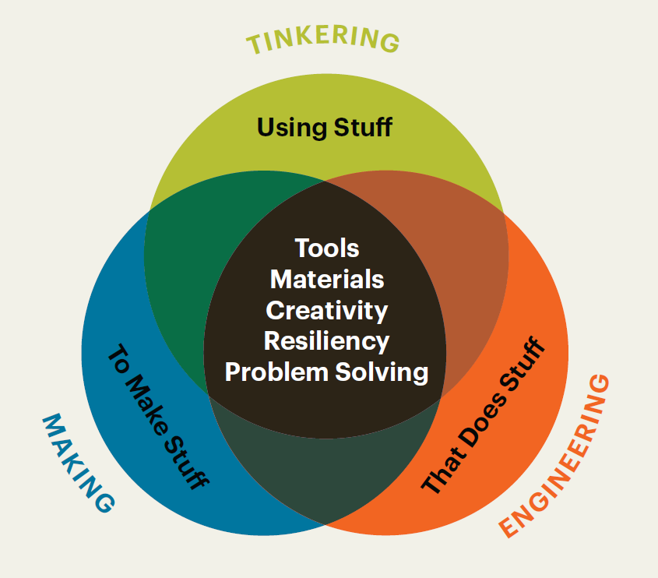
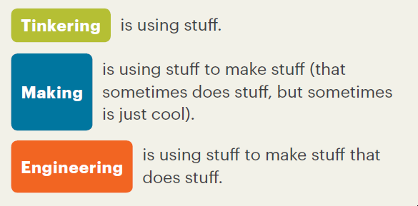
What You Need to Know About Tinkering, Making, and Engineering, NAEYC, Adapted from the Boston Children’s Museum, Tinker Kit: Educators’ Guide (2016)

Slide 2
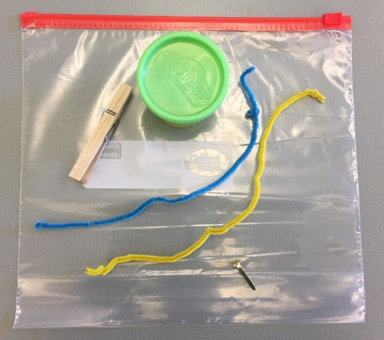
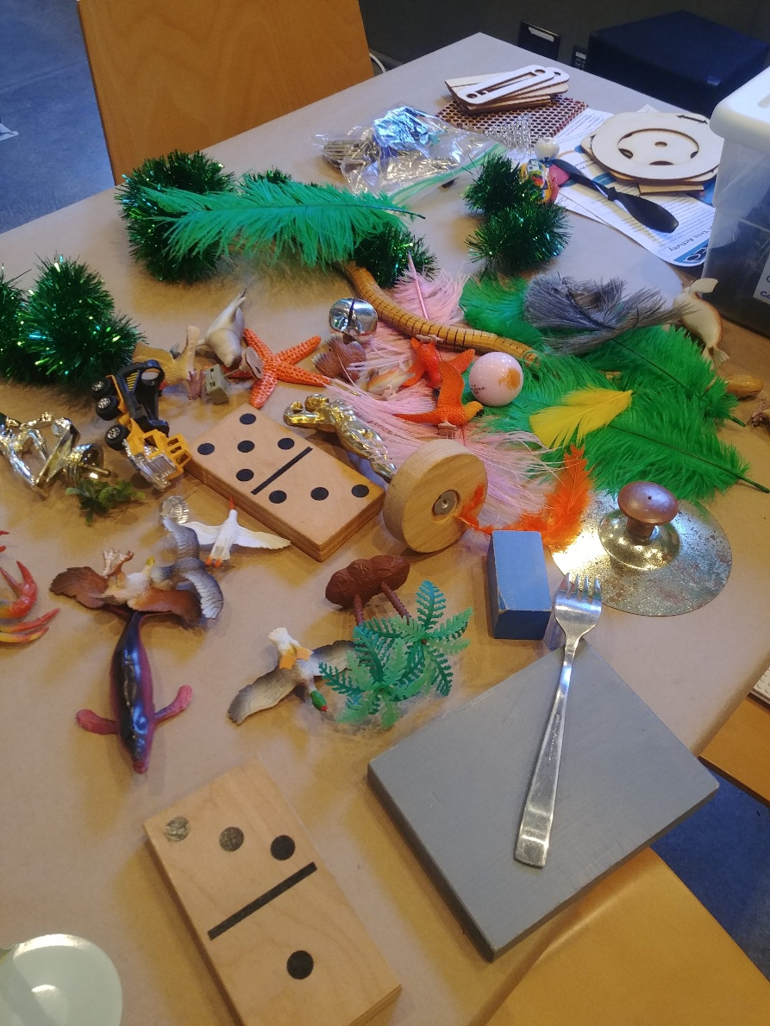
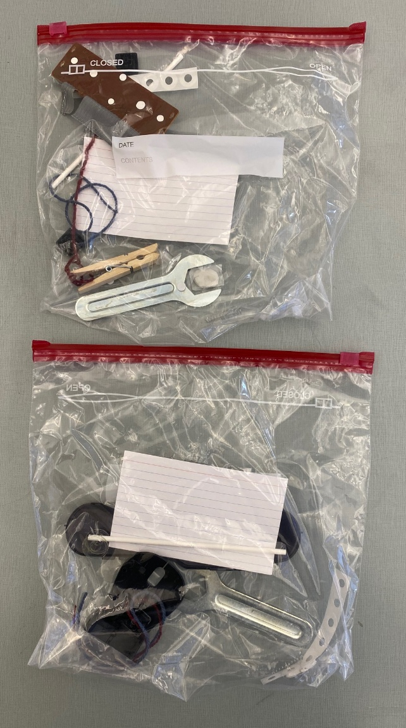
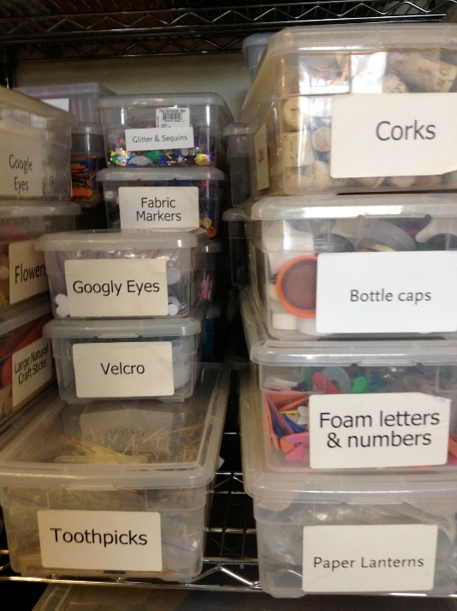
Making and Tinkering Bag/Toolbox

Slide 3
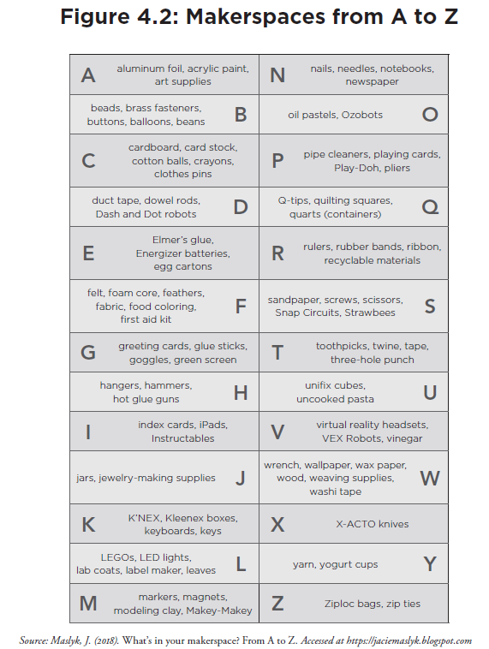
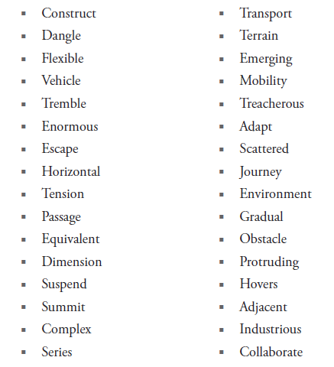
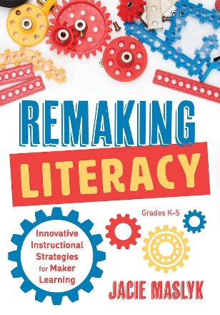
Making Supports Student Skill Building
and Vocabulary Acquisition

Slide 4
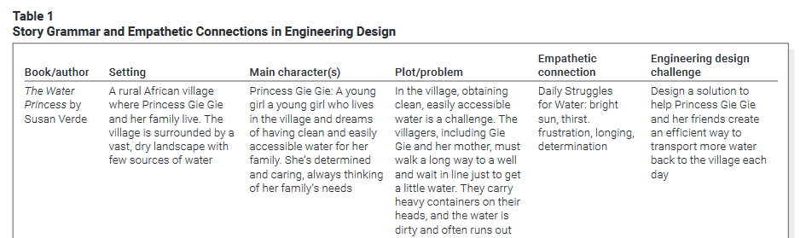
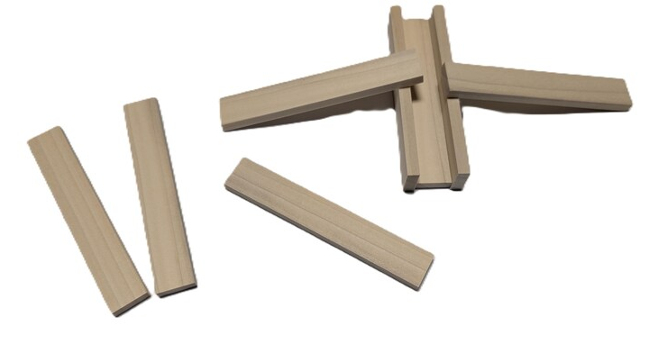
How could you model this using KEVA and a ping pong ball?

Slide 5
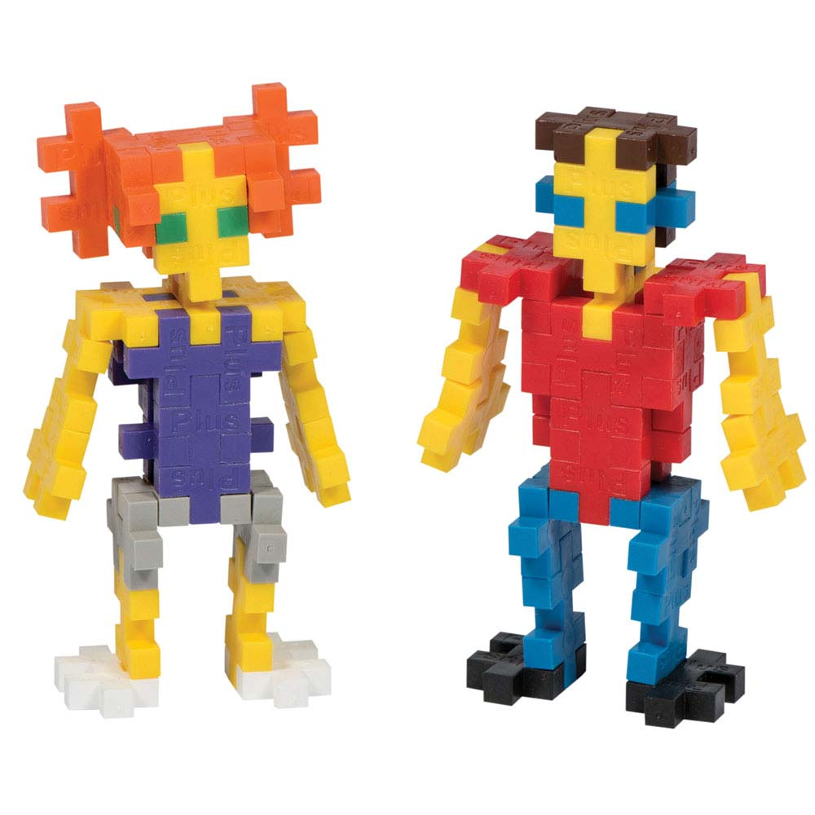
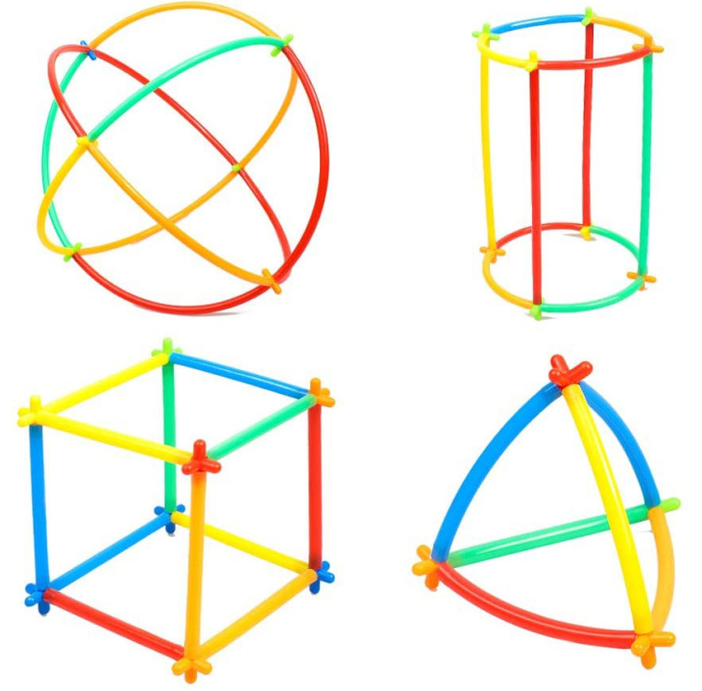
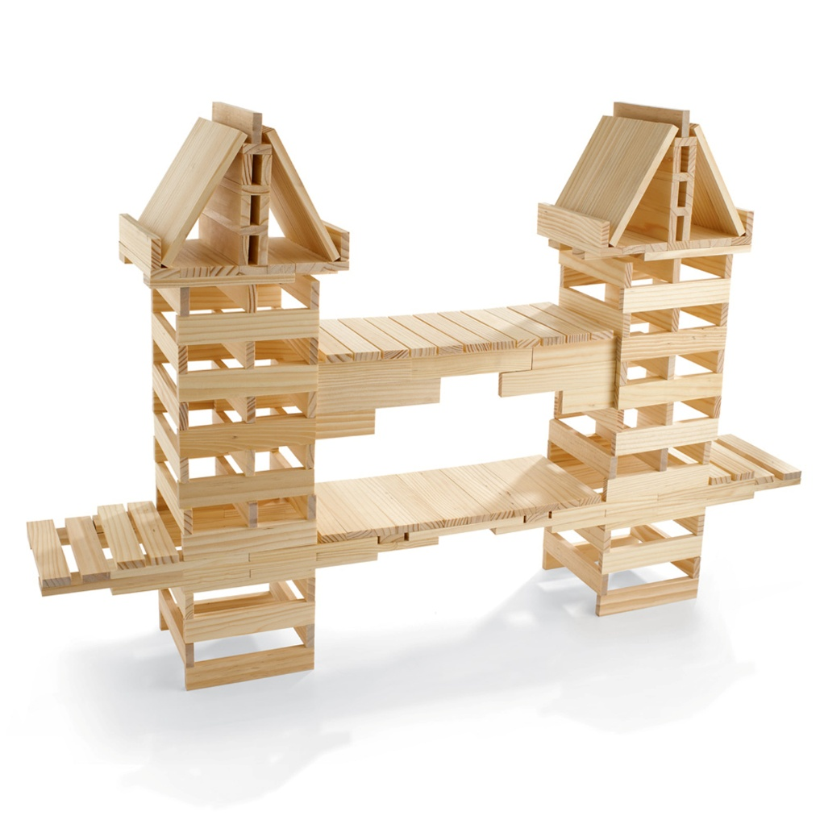
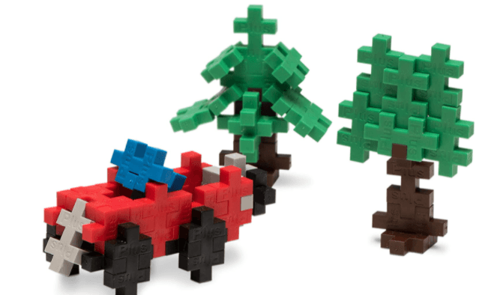



Construction Blocks

Slide 6
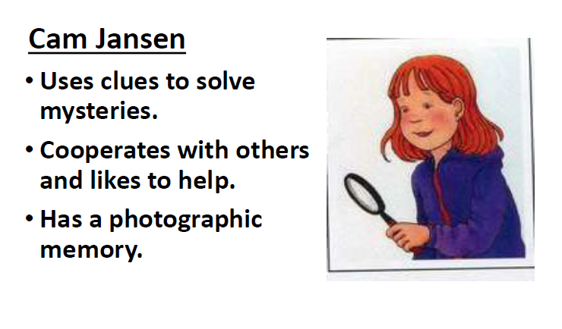
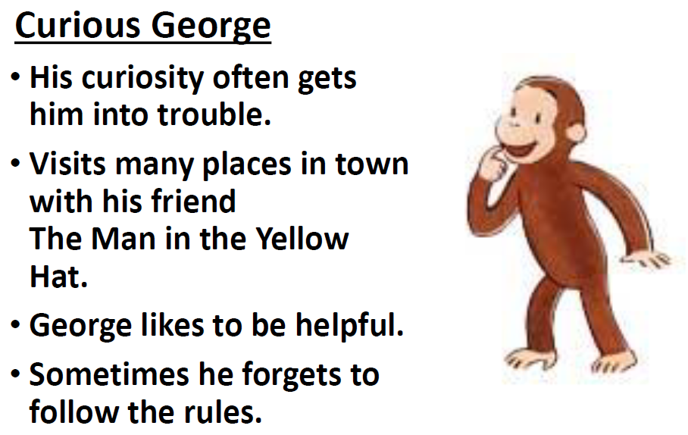
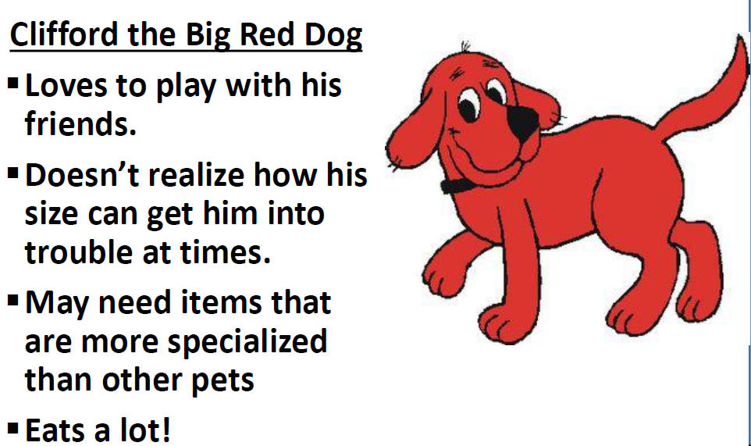
Character Cards

Slide 7
Character Cards can also be a great way to blend engineering design quick challenges (making/tinkering) and story grammar -
Story Grammar includes ……
The various integral components or elements of a story and the relationships among these parts. Typically, they include the character, setting, problem/conflict, plot, and resolution. Story grammar elements support the essential text structure for most narratives.
The grammar of the story is how the story is told and includes such things as plot, suspense, climax, and characters.
A framework including the basic elements of a story and the rules that explain the relationship between these elements.

Slide 8
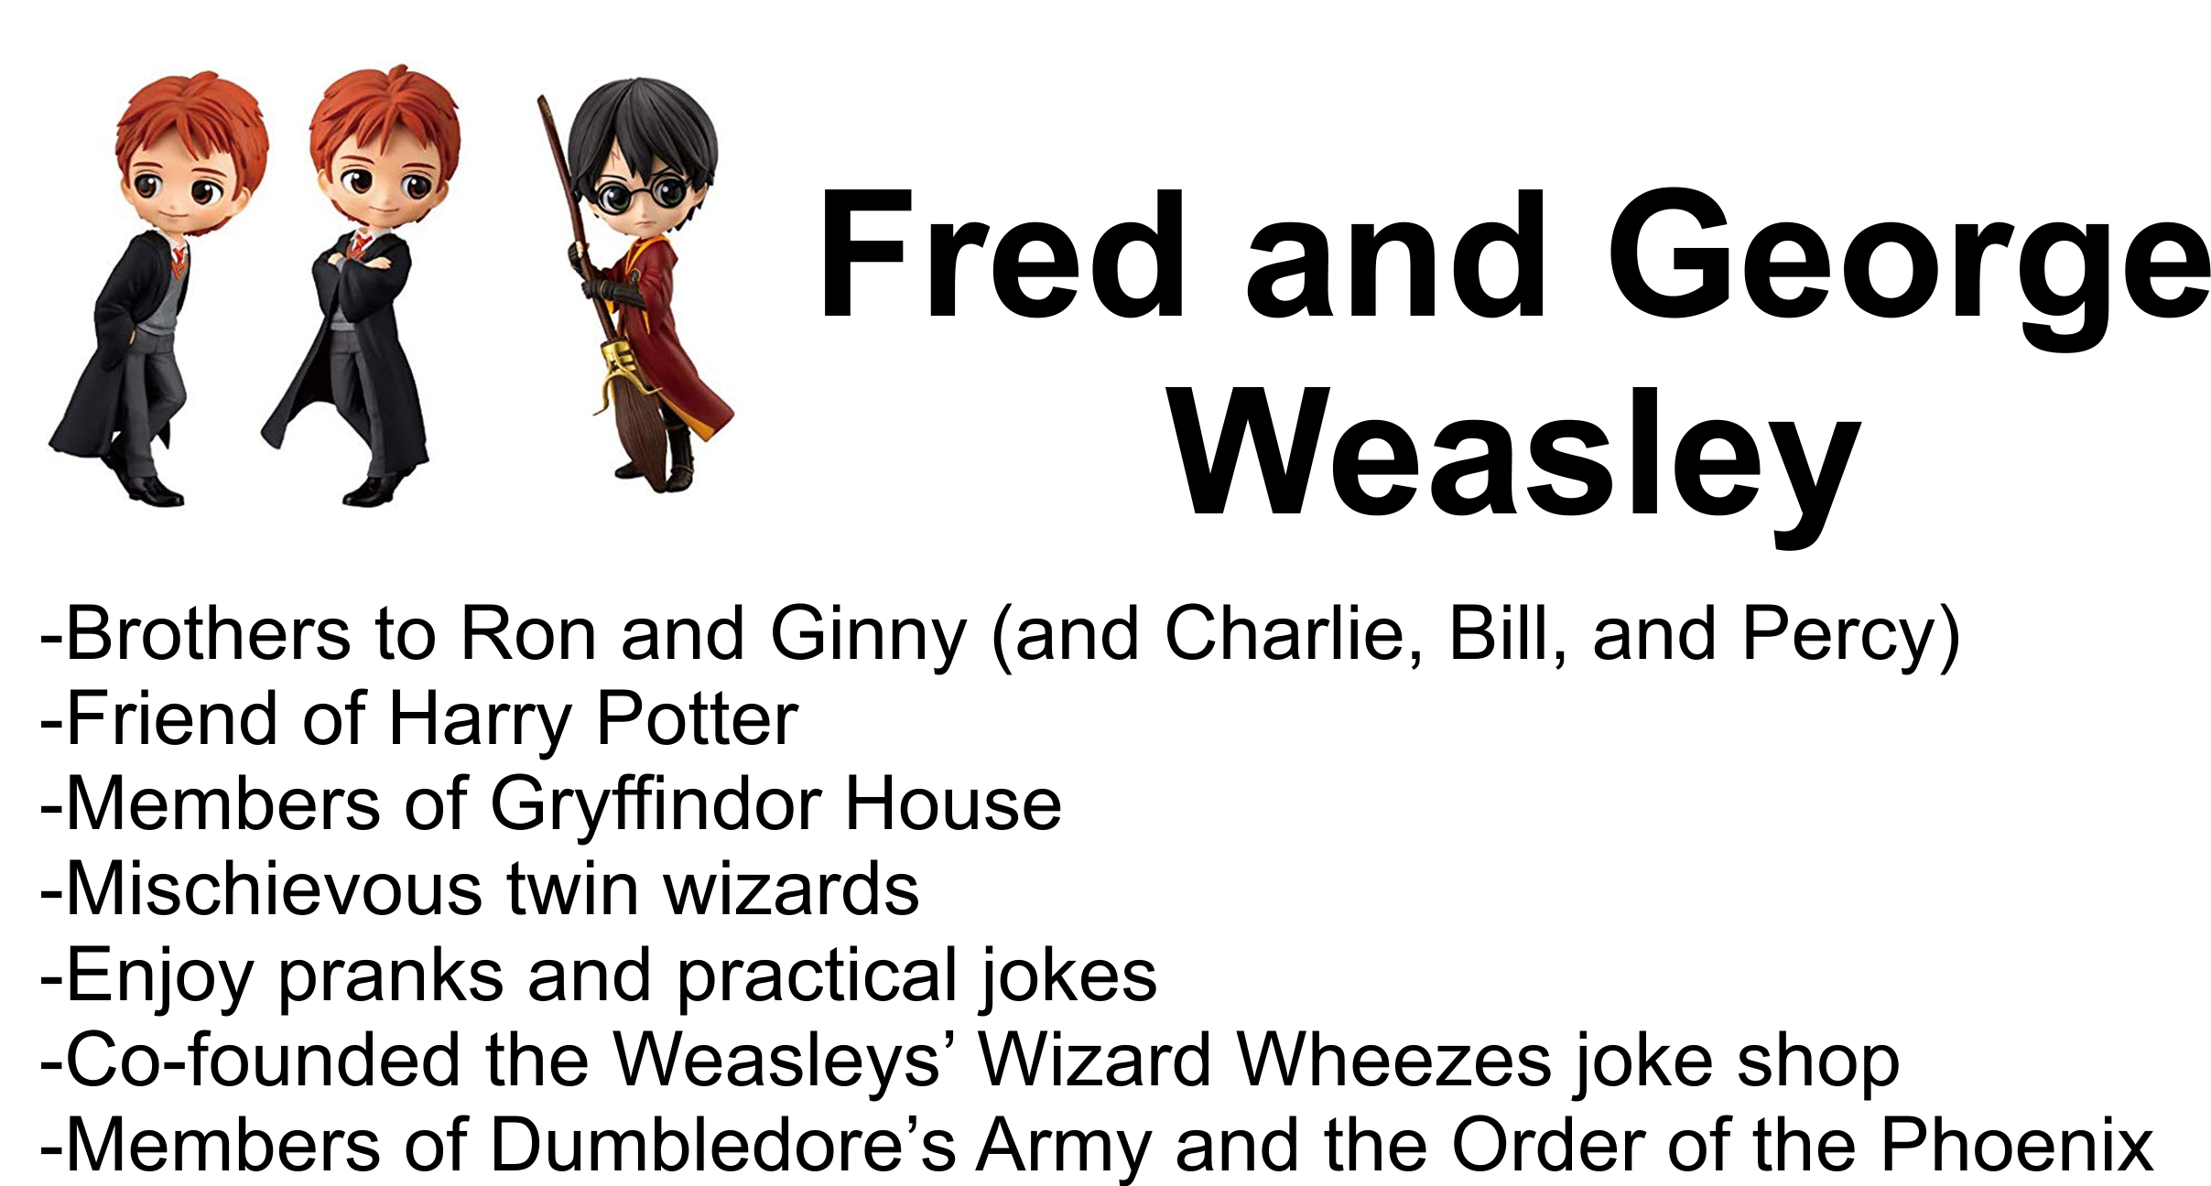

Slide 9
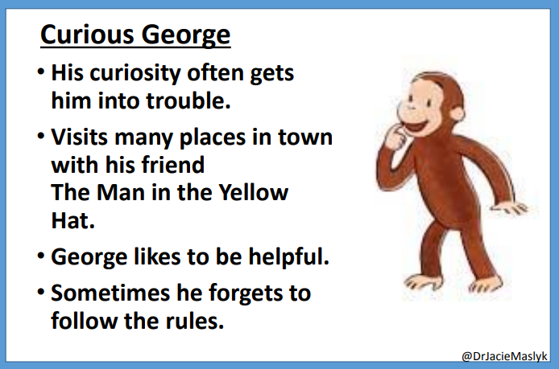
Character Card
Engineering Design Challenge
*developing empathy
How can you use the materials in your making and tinkering bag to improve your character’s life or to help them?
What could we create to help Curious George?

Slide 10
Character Card Quick Challenges
Home
Design a home, hideout, or space to relax for the character.
Recreation
Design an item or place that the character could play, exercise and have fun.
Accessories
Design an accessory that might enhance the look or comfort of your character.
Transportation
Design a mode of transportation that would work for your character.
Tools
Design a tool or gadget that would help your character solve a problem.
Free Choice
Design any of the above items.

