Slide 1
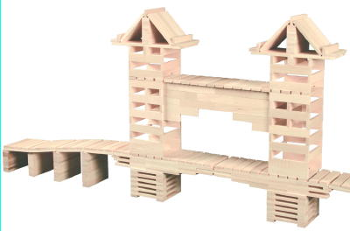
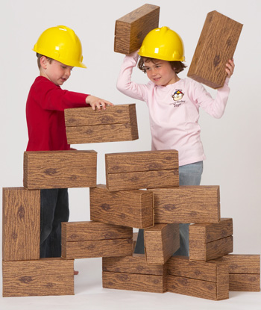
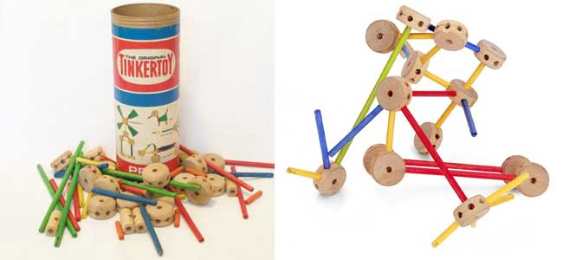
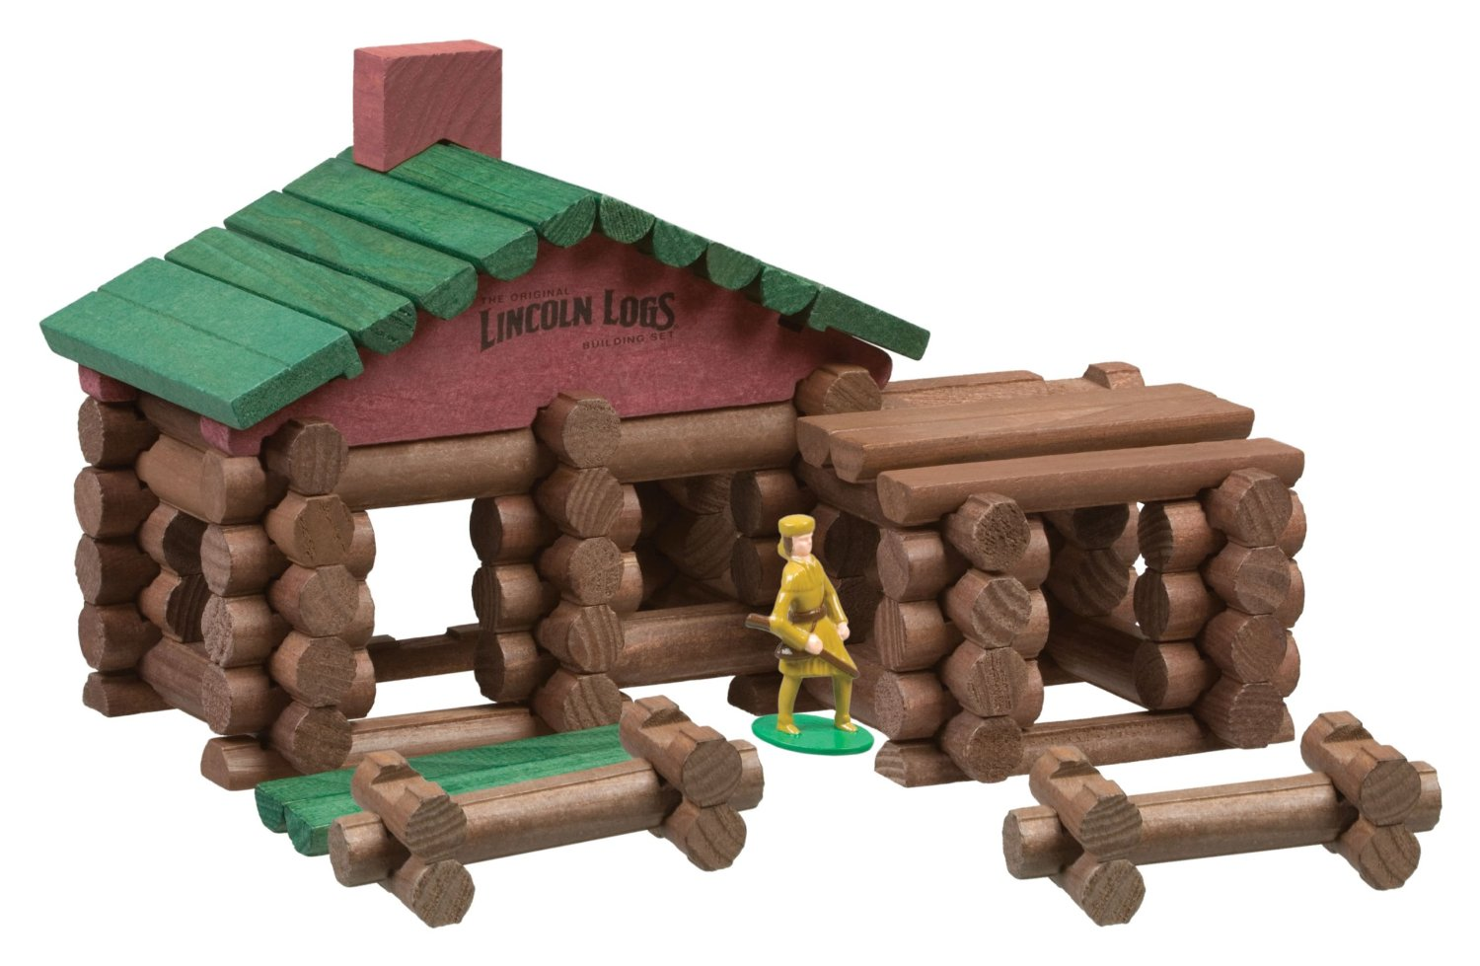
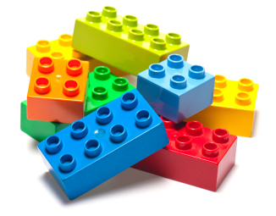
Using Blocks and Construction Toys for Teaching STEM Content

Slide 2
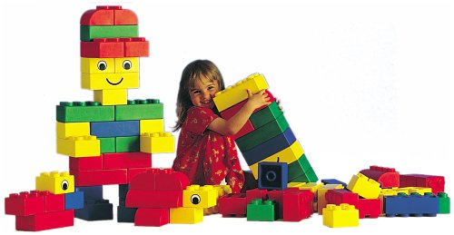
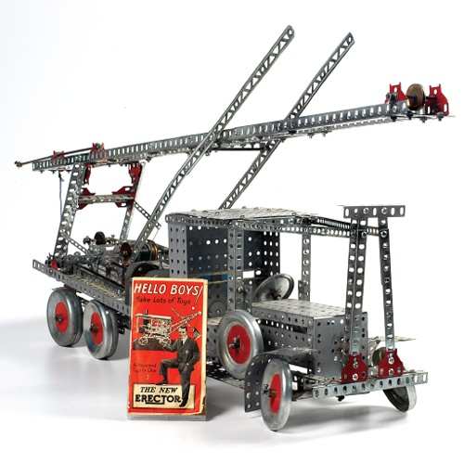
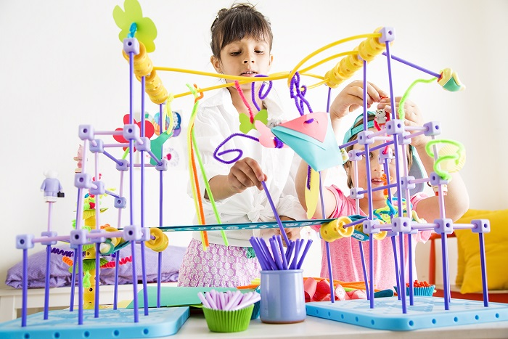
What are We Talking About?
Legos and/or Mega Bloks
K’nex
Lincoln Logs
Keva Planks
Goldie Blocks
Tinker Toys
Unit Blocks
Erector Sets
Others

Slide 3
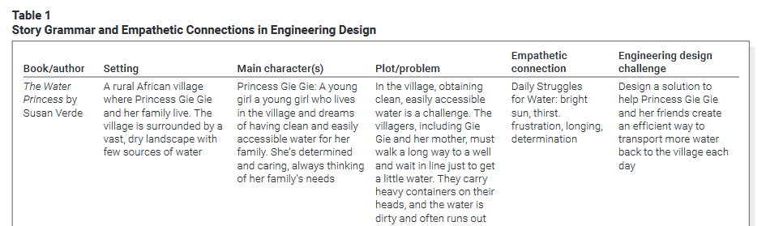
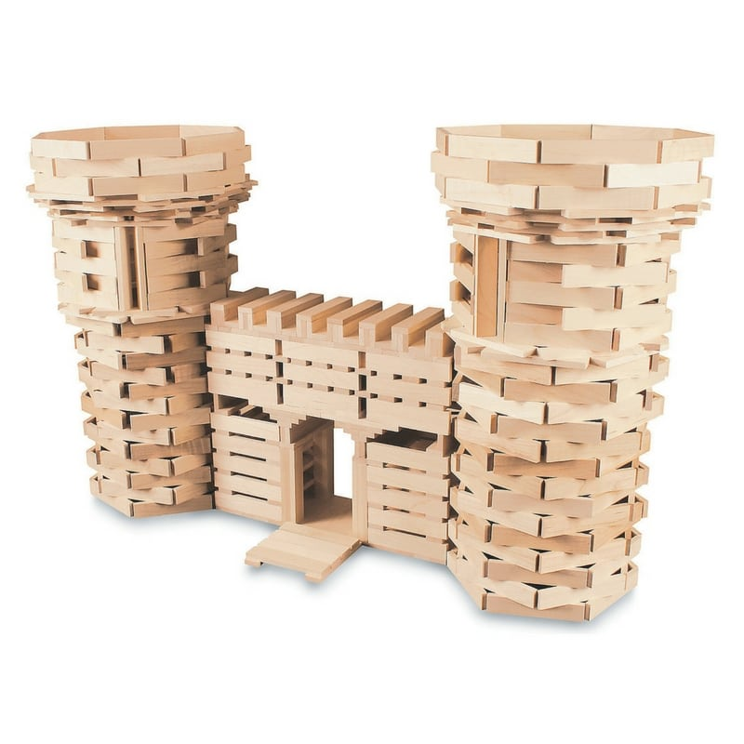
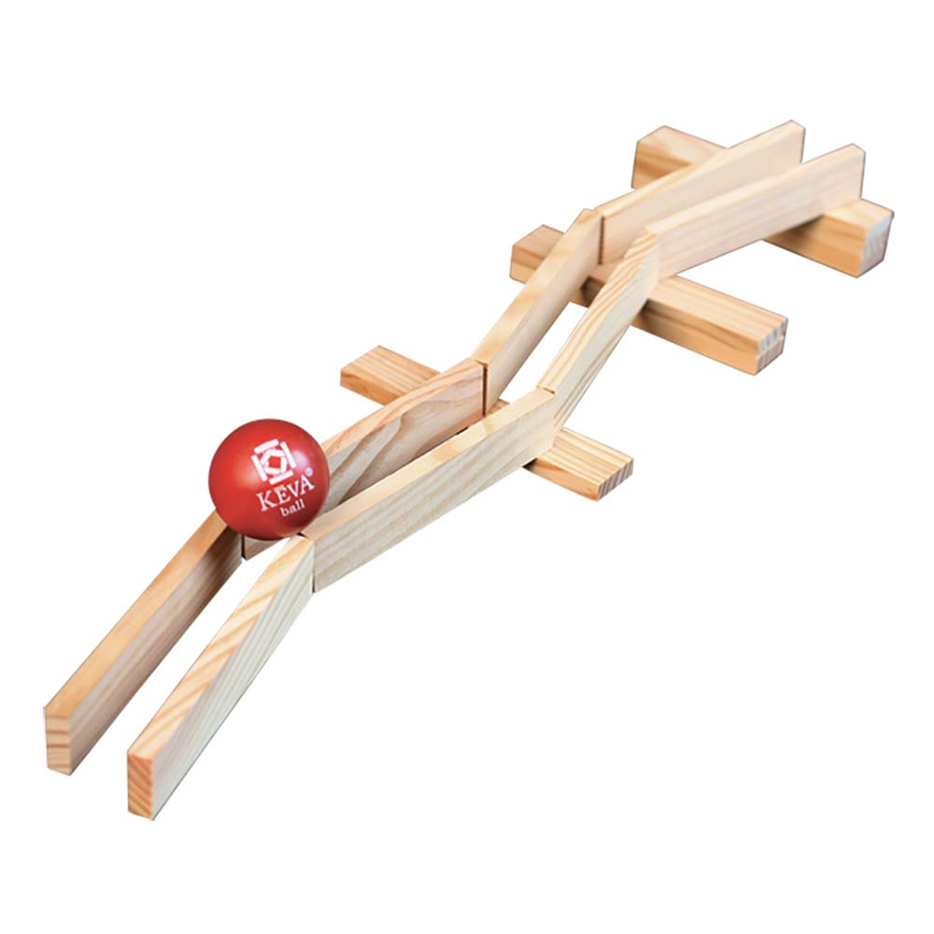
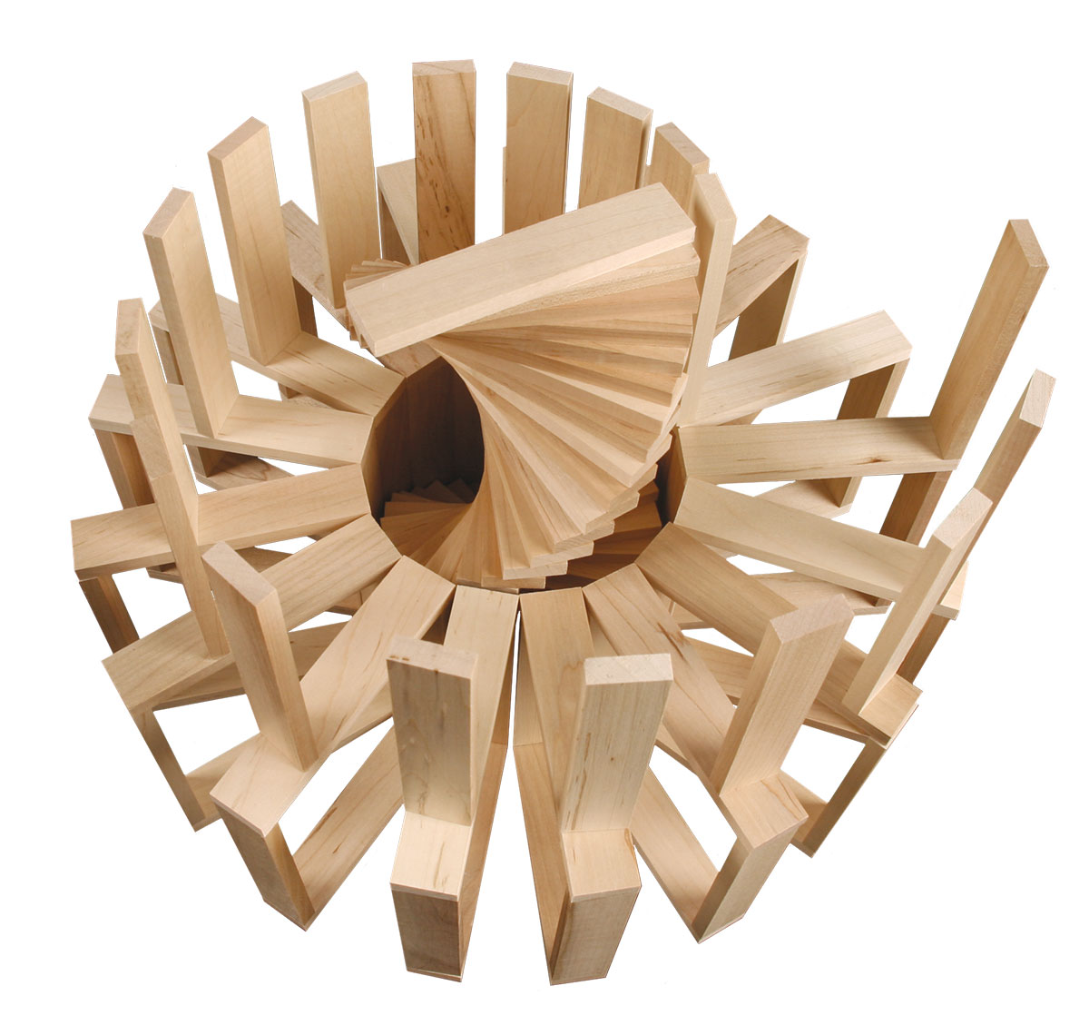
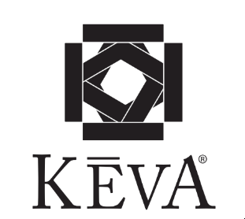

Slide 4
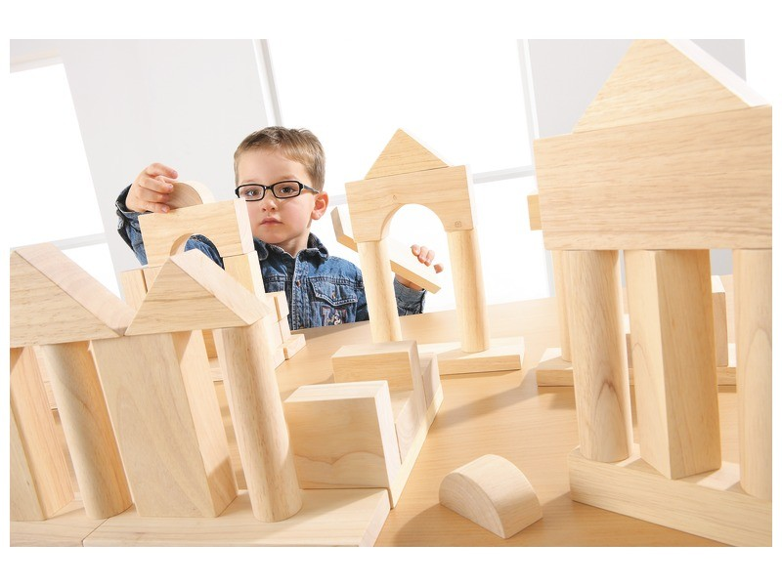
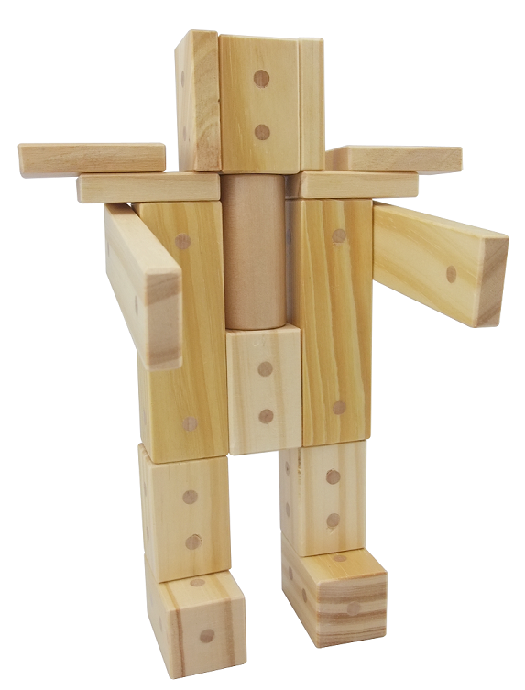
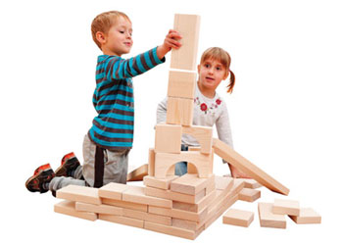
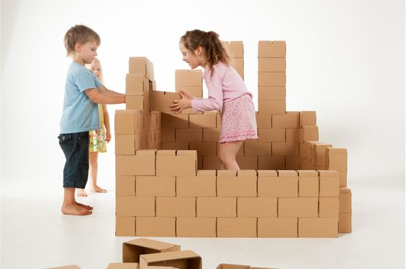
Construction Blocks are not as Flashy as Robots
But, they encourage and augment vastly higher levels of problem solving and creativity
Construction blocks:
  Build motor skills
  Build hand-eye coordination
  Build spacial skills
  Develop capacity for creative/divergent thinking
  Build social skills
  Build language skills
  And, they’re cheap!

Slide 5
Moreover, Research Suggests that:
Construction block time is correlated with advanced math skill development
Children who show more interest in construction:
  Build more sophisticated structures and perform better on tests of spatial intelligence
  Are better able to use mental imagery (the mind’s eye)
  Increased spatial/math performance continues into high school
  Recreating structures leads to increased capacities for math and word problems

Slide 6
More Research
The use of construction blocks, leads to:
  Stronger divergent problem solving skills (convergent = 1 answer, divergent = multiple answers).
  More creativity than students who focus on convergent play (i.e., puzzles)
  Friendlier, more social and cooperative students
  Students who use construction blocks tend to develop higher quality friendships later in life
  Children with Autism make larger strides when using CB’s than they do when coached with social stories

Slide 7
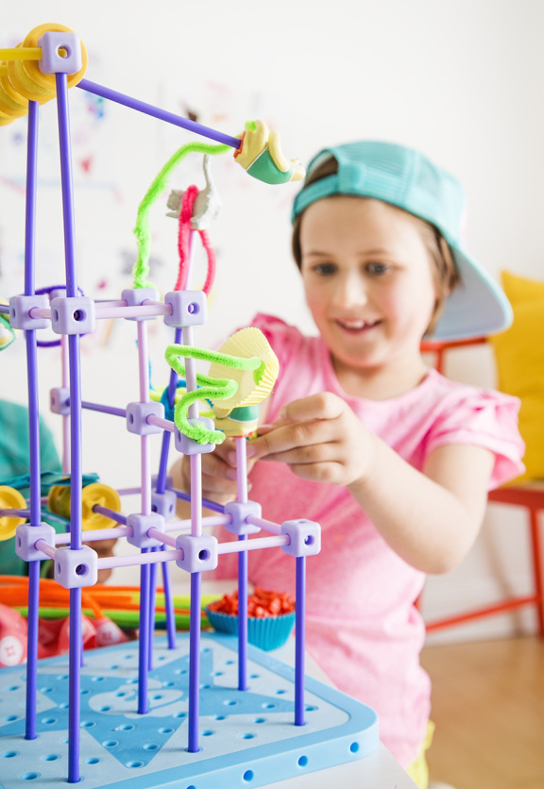
Results
Children who use CB’s tend to score higher in tests of:
  Vocabulary
  Grammar
  Verbal comprehension
  Creativity
  Problem solving
  Spatial reasoning
  Mathematics
  And, they watch less TV

Slide 8
Mimicking Professional Challenges
Children building structures face the same physics challenges that architects, engineers, scientists face!
Large numbers of engineers attribute their interest in CB’s as a first motivation to enter the field
Recent study of high achieving STEM graduates (from college) noted that this group was far more likely than the average American to have extensive backgrounds with hands-on crafts and hobbies, including: woodworking, crafting, sewing, etc.

Slide 9
Correlation Does Not Equal Causation
Children with strong spatial skills are probably drawn to CB’s, that alone can’t prove that the “block time” caused the difference
However, if you tested all children, then taught lessons using CB’s, then tested again, you could determine whether CB’s led to increases in spatial skill performance.
Numerous studies have proven this causation through long-term research:
  Wolfgang et al., 2003
  Casey, et al., 2008
  Grissmer, et al., 2013
  Verdine, et al., 2013

Slide 10
Construction blocks have probably been in schools for more than 100 years, but there is still rich potential for using building blocks as a learning tool. The idea that something so simple can be used to teach complex STEM ideas is only beginning to be understood.

Slide 12
Introductions – Getting to Know You
Big Idea – People have different perspectives
Spell your name with KEVA
Conduct a gallery walk around the classroom to look at the different ideas

Slide 13
Introductions – Getting to Know You
Create a model with KEVA
that demonstrates to the class your favorite activity or hobby

Slide 14
Symmetry Challenge – with a partner
Big Ideas – Symmetry is an important part of the designed world. It is important to be able to work with others.
Create a line of symmetry (3 or 4 blocks)
  -Take turns building off of the line of symmetry (3 or 4 blocks).
  -The second team member follows the lead of the first.

Slide 15
Symmetry Challenge – with a partner
Big Ideas – Symmetry is an important part of the designed world. It is important to be able to work as a team.
Create a line of symmetry (3 or 4 blocks)
  -Take turns building off of the line of symmetry (3 or 4 blocks).
  -The second team member follows the lead of the first.
*Discuss divergent and convergent thinking

Slide 16
Creating Patterns
Big Idea – Patterns are repeatable. It is important to be able to work as a team.
  -Individually create a pattern that is repeatable.
    -Each person at the table will vote (1-2-3-point) at the pattern that they believe will be the most repeatable.
  -Work as a team to repeat the selected pattern across your team’s table.

Slide 17

The younger of two daughters in the Quimby family.
She is eight years old and in the third grade at Cedarhurst Elementary School in Portland, Oregon.
  She is eager to please her teacher
She is proud of her age (being 8yrs old) but tries to act like a "grown-up" whenever possible.
  She resents being treated like a child at times, particularly when she is expected to play with or entertain younger children.
Ramona is a bright and creative girl.
  She is good at drawing and enjoys reading.
  Ramona is an observant person, noticing small details
She has an unlucky tendency to be involved in minor accidents that draw attention to her, and for which she feels she is often blamed.
  She tries to avoid these situations, but her efforts are sometimes frustrated by her bad luck.

Slide 18
Vacation Resort – using a character card
Big Idea – empathy, teamwork, modeling with Keva
Each table will be given a character card. As a team develop a vacation resort for that character.
Conduct a gallery walk around the classroom to look at the different ideas

Slide 20
Team Challenge
Big Ideas – repeating a pattern, teamwork, empathy, senses
Collaborate with a partner to create a pattern with 20 total blocks (partner one – 2 blocks, partner two – 3 blocks)
Race to see who finishes the pattern first.
Try with your non-dominate hand
Try it with one eye closed
Try it without certain senses (earmuffs, no talking)

Slide 22
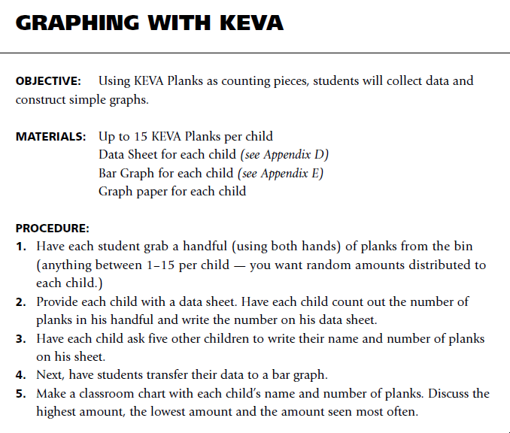

Slide 23
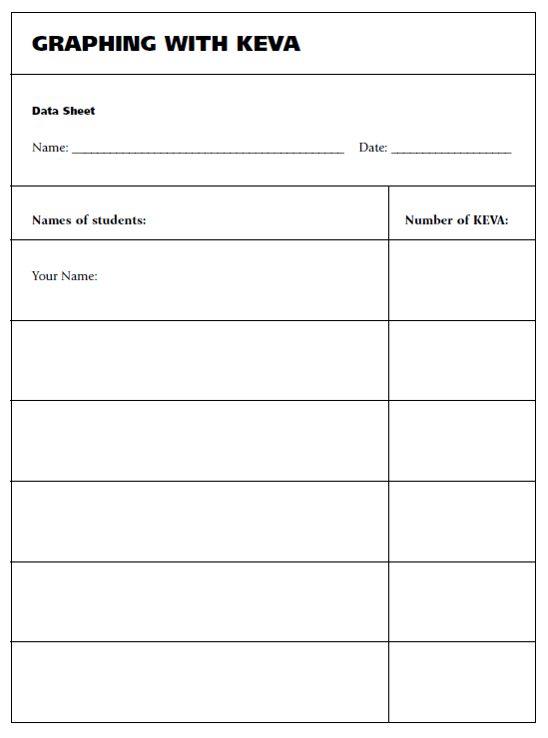
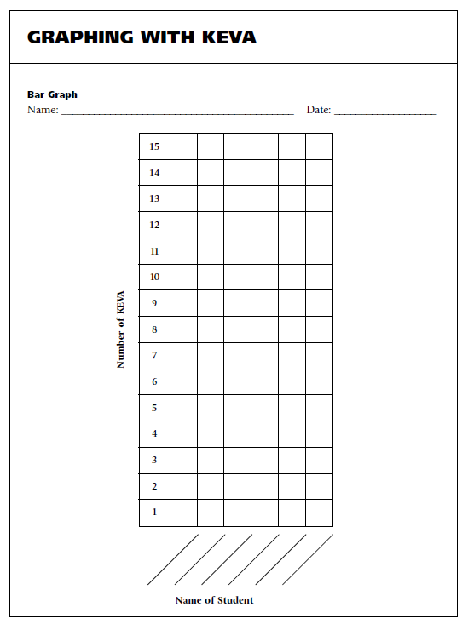

Slide 24
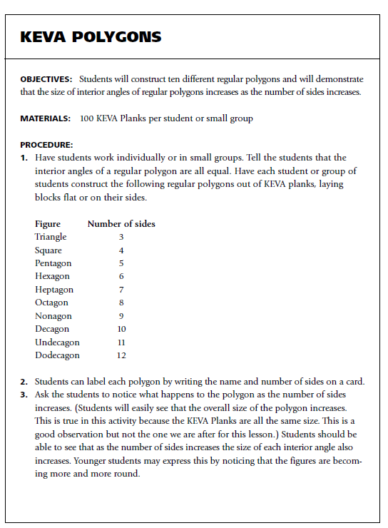

Slide 25
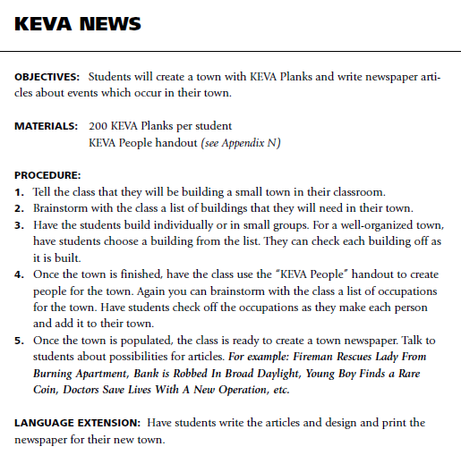
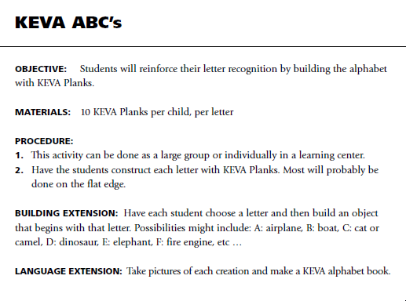

Slide 26

How could you model this with KEVA planks?

Slide 27
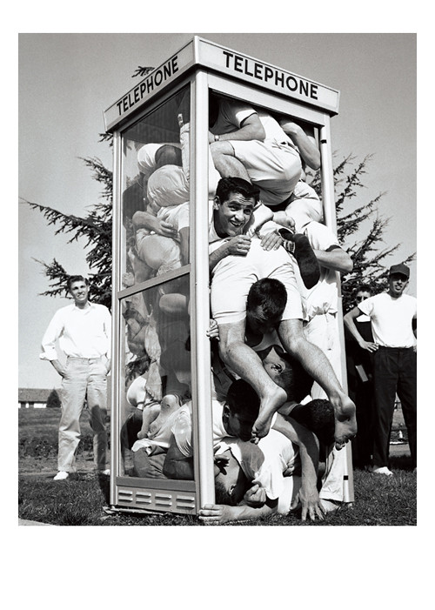
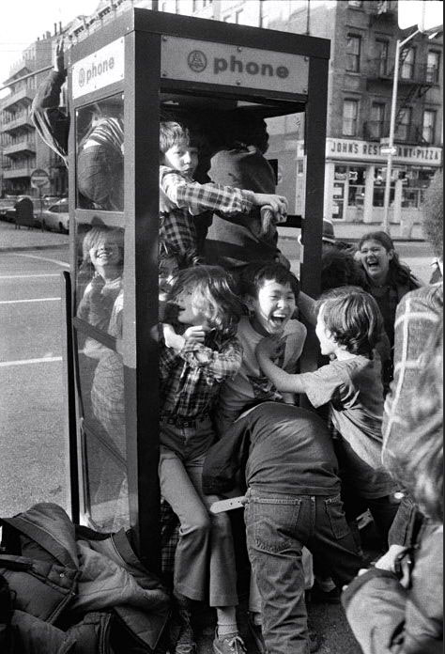
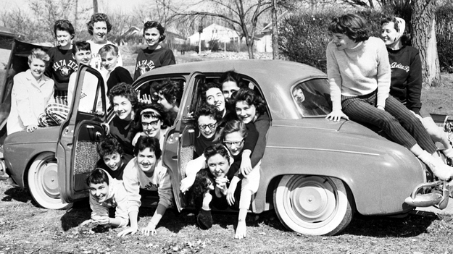
Colleges and universities have long been recognized as institutions that launch crazy fads. I the 1950’s and 1960’s, stuffing as many people as possible into a phone booth was very popular on college campuses. While it was an absurd trend, it did require a great deal of creativity, collaboration, and problem-solving ability.

Slide 28
As a team calculate the –
Perimeter of your fort ______________________
Area of your fort ____________________
Volume of your fort ___________________

Slide 29
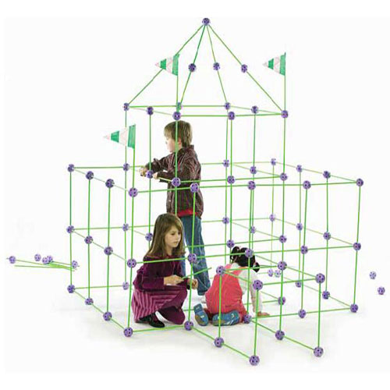
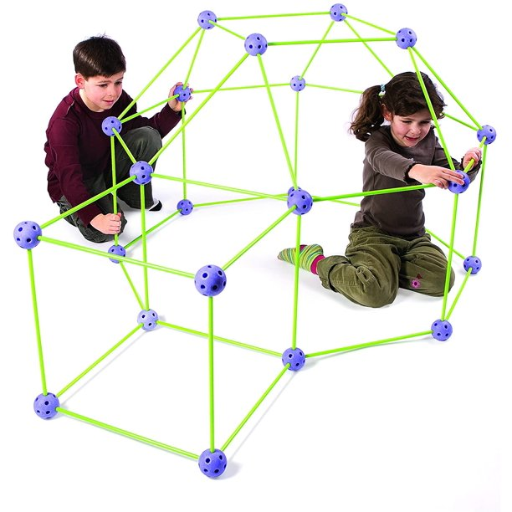
Scenario:
In the spirit of phone booth stuffing—and, to test your levels of creativity, cooperative spirit, understanding of area, and problem-solving ability, use the Crazy Fort® building materials to build a fort that will enclose your entire team.
Challenge:
Work as a member of a design team to build a rectangular fort (with a flat roof) that will enclose your entire team. Then calculate the perimeter, area, and cubic volume of the fort.
Essential Question: How can we determine the area of a space enclosed in a scale model structure?
Limitations:
The completed fort must have walls and a roof.
The connector ball arrows must always point upwards
Materials must not be cut or bend
Twist the green sticks to insert and remove from the connector balls
The structure must enclose your entire problem-solving team
If you can fit more than your team, and you have volunteers; build the biggest fort in class!
Big Ideas:
The area of a space can be determined by the length and width of a model.
Area models can represent the inner size of a space

Slide 30
History of Construction Blocks in Education
The natural world has provided abundant building materials (Stones, Sticky burdock, Twigs) which have been connected to learning.
  Evidence of this has been dated back to Plato (429-347 B.C.)
U.S. and European manufacturers began making wooden blocks as a sideline to their main woodworking or printing business.
The first centers on the building unit focused on letters, words, or narratives. The second addressed the act of building and constructing. The third focused on cultural heritage and modeling specific architecture.
The advancement of blocks can be seen in electronics as well. Lego Mindstorms uses programmable bricks to control simple robotics.
It is important to remember that we cannot understand until we take apart, examine, and rebuild. Children need an environment with open-ended materials and teachers who understand, encourage, build on, and even participate in this basic and complex mode of learning.

Slide 31
What big ideas from at least two STEM disciplines are integrated in this design challenge?
  you don’t need to memorize your standards, but when asked, you should be able to speak to the main concepts and content.
Does the problem and/or challenge require the use, application, or practice from these big ideas?
  is the integration of your main concepts and content from your standards obvious?
Do you believe that the scenario and challenge would be engaging (super fun and challenging) for your students?
  does this make you excited?
Is the engineering design challenge engaging (fun and challenging) for you – the teacher?
  have you constructed possible solutions to examine the possibility, feasibility, enjoyment?
  does the challenge require direct application of content – this might lead to ideas for how you might assess the activity?
  would the challenge provide the expected outcomes - what do you expect the students to know, be able to do, and value?
  have you taken pictures of multiple exemplary potential solutions developed by you or your team?

