Slide 1
Integrating Literacy and Engineering Instruction

Slide 2


Slide 3

The International Technology and Engineering Educators Association (ITEEA) outlines eight Standards for Technological and Engineering Literacy (STEL) to guide education in technology and engineering.
These standards, detailed in the 2020 publication Standards for Technological and Engineering Literacy: The Role of Technology and Engineering in STEM Education, provide a framework for fostering technological and engineering literacy across all grade levels.

Slide 4
STEL - 1 - Nature and Characteristics of Technology and Engineering
Understanding the scope, core concepts, and relationships between technology, engineering, and other disciplines.
STEL - 2 Core Concepts of Technology and Engineering
Exploring systems, processes, and resources integral to technology and engineering.
STEL - 3 - Integration of Knowledge, Technologies, and Practices
Applying interdisciplinary knowledge and processes to solve problems and innovate.
STEL – 4 - Impacts of Technology
Analyzing the positive and negative effects of technology on individuals, society, and the environment.

Slide 5
STEL - 5 - Influence of Society on Technological Development
Examining how societal needs, values, and demands shape technological advancements.
STEL – 6 - History of Technology
Understanding the historical development and evolution of technology and engineering.
STEL – 7 - Design in Technology and Engineering Education
Engaging in design processes to develop solutions to problems using critical thinking and creativity.
STEL – 8 - Applying, Maintaining, and Assessing Technological Products and Systems
Using, managing, and evaluating technological products and systems effectively and safely.

Slide 6
Standard 6: History of Technology
Grades PreK-2
A. Discuss how the way people live and work has changed throughout history because of technology.
Grades 3-5
B. Create representations of the tools people made, how they cultivated food, made clothing, and built shelters to protect themselves.
Grades 6-8
C. Compare various technologies and how they have contributed to human progress.
D. Engage in a research and development process to simulate how inventions and innovations have evolved through systematic tests and reﬁnements.
E. Verify how specialization of function has been at the heart of many technological improvements.

Slide 7
You will individually develop and present an integrated STEM education design challenge that is directly connected to a piece of children’s literature used in the elementary or middle grades (2 grade or above). Step one - select a grade level (2 grade or above) and a minimum of one science (life, earth/space, or physical), one mathematics, and one STEL (standard and benchmark). Step two - consider a children's book (picture book or chapter book) that could be used to guide an engineering design challenge. Before getting started, confirm that your book selection and design challenge is an original idea. Please do not develop an activity that is commonly found in schools such as a foil/penny boat challenge, egg drop, 3 Little Pigs – blowing a structure with a hairdryer, 3 Billie Goats Gruff - bridge, or other common design challenge. If you can do a web search for the name of your book and design challenge (STEM challenge, engineering design challenge, etc.) and the idea can be found, it is not original. If your first choice doesn't work, find another book. Step three - Reading Writing a STEM Design Brief and Developing Big Ideas and Essential Questions Step four - Complete the Lit-based Curr. Rough Draft – Part 1 - no more than one two pages

Slide 8

Curriculum Standards
Science – Structure and Properties of Matter
2-PS1-1 Plan and conduct an investigation to describe and classify different kinds of materials by their observable properties (color, texture, hardness, and flexibility)
2-PS1-2 Analyze data obtained from testing different materials to determine which materials have the properties that are best suited for an intended purpose
Another possibility -
2-PS1-4 Construct an argument with evidence that some changes caused by heating or cooling can be reversed and some cannot.

Slide 9
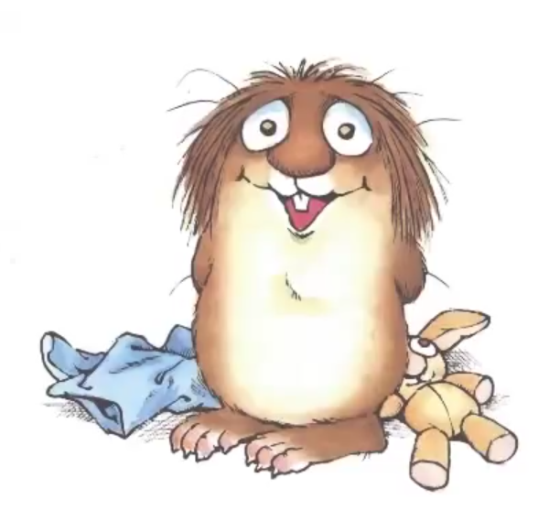
Curriculum Standards (cont.):
Technology and Engineering Education
Standard 2: Core Concepts of Technology and Engineering
b. Safely use tools to complete tasks.
c. Explain that materials are selected for use because they
possess desirable properties and characteristics.
d. Develop a plan in order to complete a task.
e. Collaborate effectively as a member of a team.
Social Studies - Economics
E.1 Students will understand the impact of economic decision-making.
E.1.2.6 Explain the role of money in making exchange easier.

Slide 10
Curriculum Standards (cont.):
Math
Measurement and Data
AR.Math.Content.2.MD.A.1 - Measure the length of an object by selecting and using appropriate tools such as rulers, yardsticks, meter sticks, and measuring tapes
Working with time and money
AR.Math.Content.2.MD.C.7 - Tell and write time from analog and digital clocks to the nearest five minutes, using a.m. and p.m.
AR. Math.Content.2.MD.C.8 - Solve word problems involving dollar bills, quarters, dimes, nickels, and pennies, using $ and ¢ symbols appropriately

Slide 11

Curriculum Standards (cont.):
English Language Arts
Oral Language
2.CC.1.OL: Participate in collaborative conversations following class
created discussion guidelines to expand upon conversations.
2.CC.2.OL: Ask and answer questions about what a speaker says to
gather additional information and clarify understanding.
Presentation
2.CC.5.P: Speak audibly in collaborative communication and presentations.
Writing
2.W.4.P: Produce clear and coherent writing, using precise language, relevant details and descriptions, and grade-appropriate conventions.

Slide 12
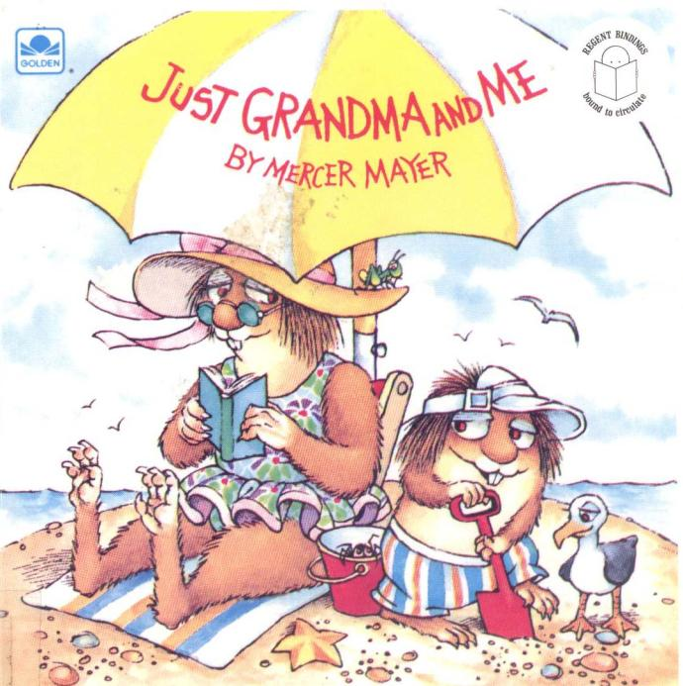

Slide 13
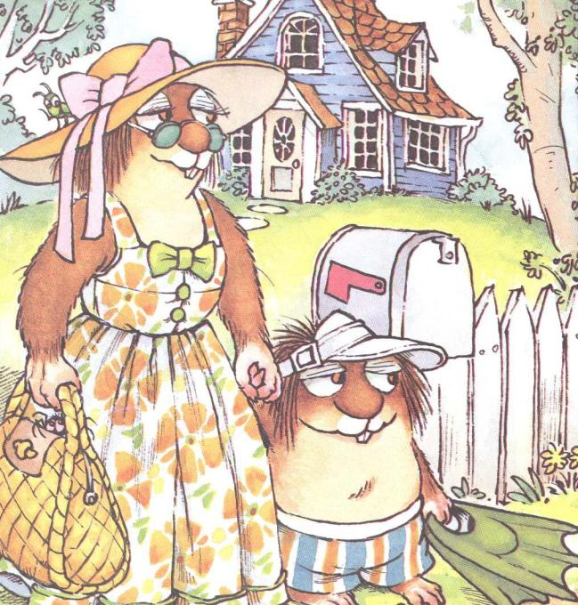

Slide 14
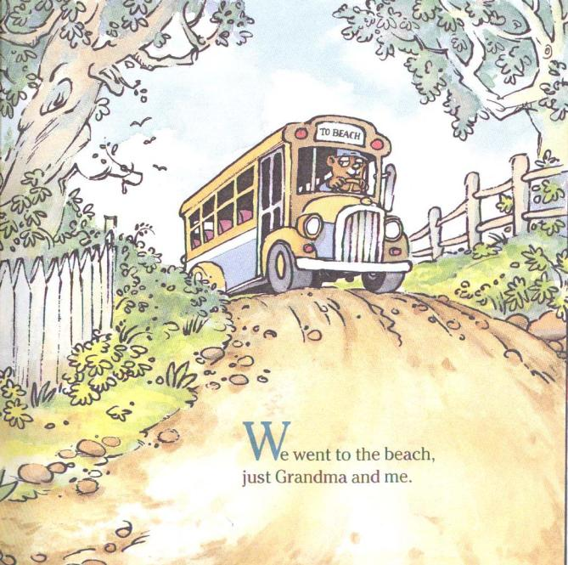

Slide 15


Slide 16


Slide 17
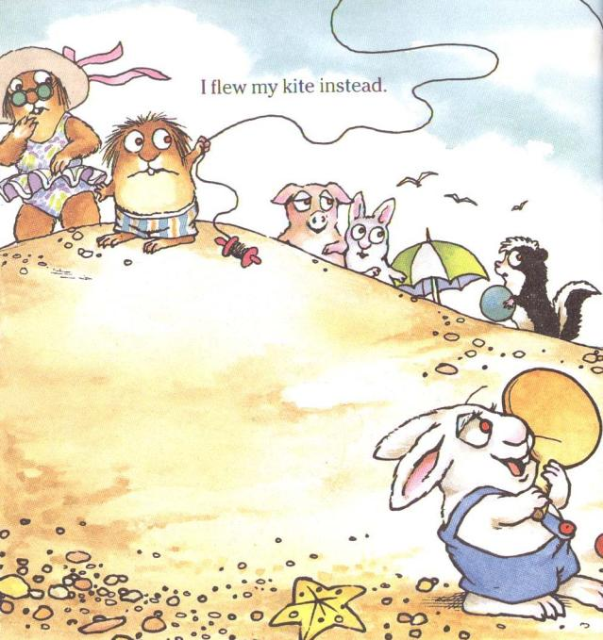

Slide 18
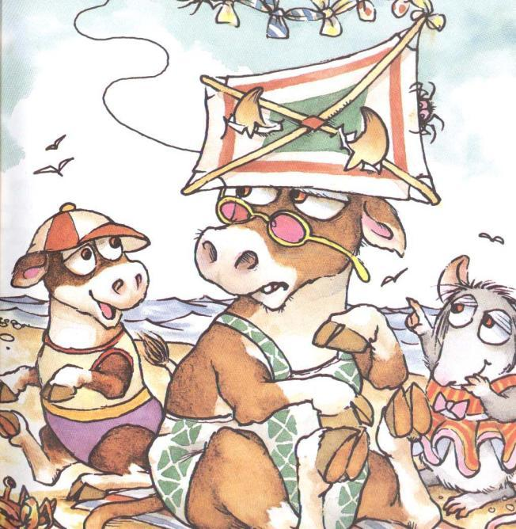

Slide 19
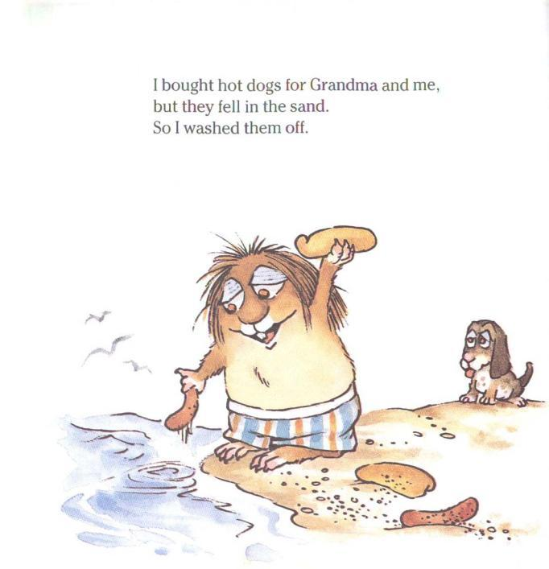

Slide 20
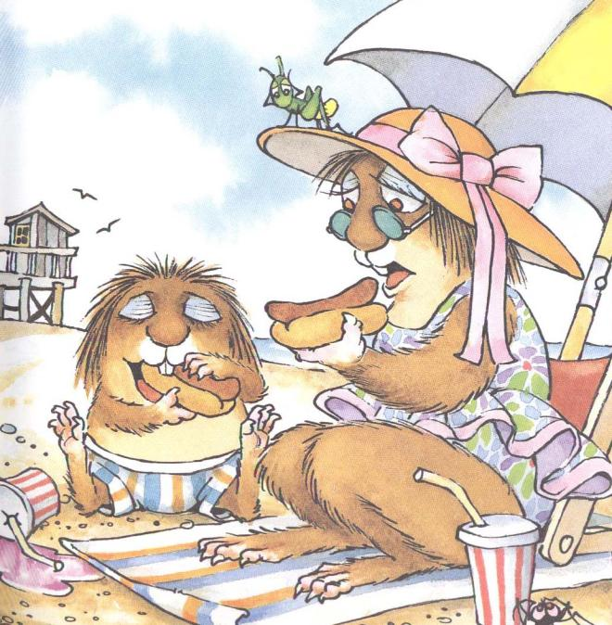

Slide 21
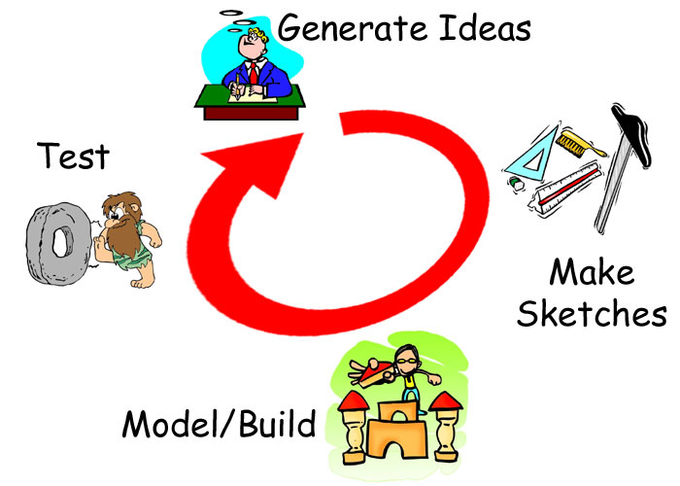
What is the problem here?

Slide 22

Main Ideas from the Standards
Materials – structure and properties
Describing – understanding intended purpose - strength, flexibility, hardness, texture, and absorbency
*heating and cooling (maybe?)
Measuring
Counting
Creating a simple budget
Using credits or money
Working as a team
Designing and making your thinking visible to others
What experiences could I create for students to ‘master’ or practice these ideas from the standards?

Slide 23


The Hot Dog Carrier
2nd Grade
Scenario
Little Critter and his grandmother
go to the beach. (Book: Just Grandma
and Me by Mercer Mayer) While at the beach, Little Critter and Grandma get hungry. Little Critter goes to get lunch but drops the hotdogs and buns in the beach sand on his way back to the beach blanket where his Grandma is sitting.

Slide 24
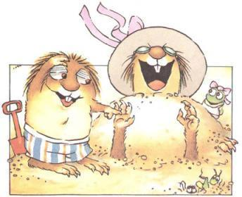
Challenge
Little Critter and Grandma don’t
want to eat gritty sand covered hotdogs. How could you design and build a hotdog carrier that will keep the hot dogs and buns warm and sand free when Little Critter carries them to the beach blanket. Little critter is small so the carrier should be as small and light weight as possible. You have a budget of $2.00 to create your carrier.

Slide 25
Big Ideas
Materials have distinct properties
The properties of materials influence how we use them in everyday life.
A budget helps us keep track of how much money we can spend.
Essential Questions
How do the properties of a material help determine what we use it for?
What tools and methods can we use to observe and describe materials accurately?
Why is it important to keep a budget?

Slide 26

Evaluation:
Test your hot dog carrier and refine your design.
Evaluate and record your solution in your Design Journal.
-understanding of properties of materials
-measuring/counting
-working as a team
Present and demonstrate your solution to the class.

Slide 27

Assessment Rubric
Rating: 5 = Excellent/1 = Needs Improvement
Design Journal
A. Design sketch 5 4 3 2 1
B. Documentation of problem solving 5 4 3 2 1
C. Self-evaluation 5 4 3 2 1
Hot Dog Carrier
D. Investigation and analysis of materials 5 4 3 2 1
E. Size and weight of carrier 5 4 3 2 1
F. Cost of the carrier 5 4 3 2 1
G. Heat Maintenance (maybe) 5 4 3 2 1
H. Function 5 4 3 2 1
Team
H. Organization 5 4 3 2 1
I. Cooperation 5 4 3 2 1
J. Presentation 5 4 3 2 1

Slide 28
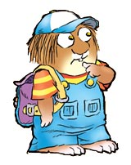
Limitations (requirements parameters or constraints) :
Work with a partner or group to develop a plan and create a hot dog carrier that
keeps the hot dogs warm
keeps the hot dogs from falling on the ground
is no larger than 12"x12"x12“
weighs less than 1 pound
Complete a Design Journal to document your thinking and your team’s development of the solution.
Presentation to the class

Slide 29

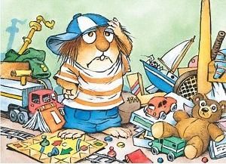
Materials/Tools/Resources:
Styrofoam trays – 50¢
Egg cartons - 50¢
Cardboard tubes - 25¢
12” yarn - 10¢
12” string - 10¢
Plastic margarine tubs – $1.00
1 pipe cleaners - 10¢
12” X 12” cardboard - 50¢
Paper fasteners - 25¢
Plastic knives/spoons - 50¢
12” X 12” aluminum foil - 25¢
Tape/glue – as needed
Tools – Rulers, scissors

Slide 30
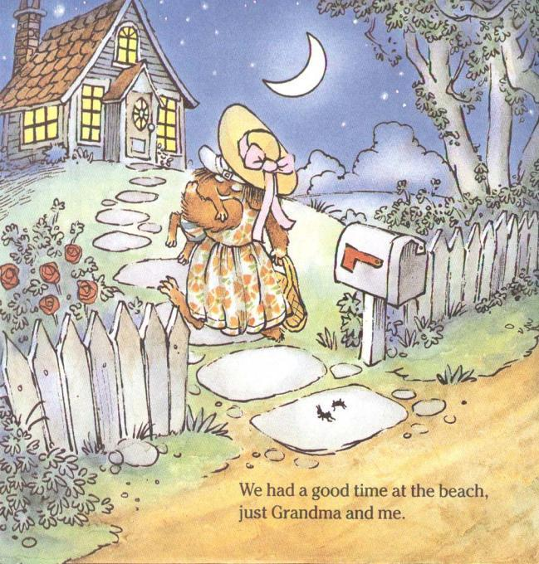

Slide 31
How could you create reflective questions in your engineering design journal?
For example: Looking at the data collected during our Materials Investigation, what items will float?

Slide 32
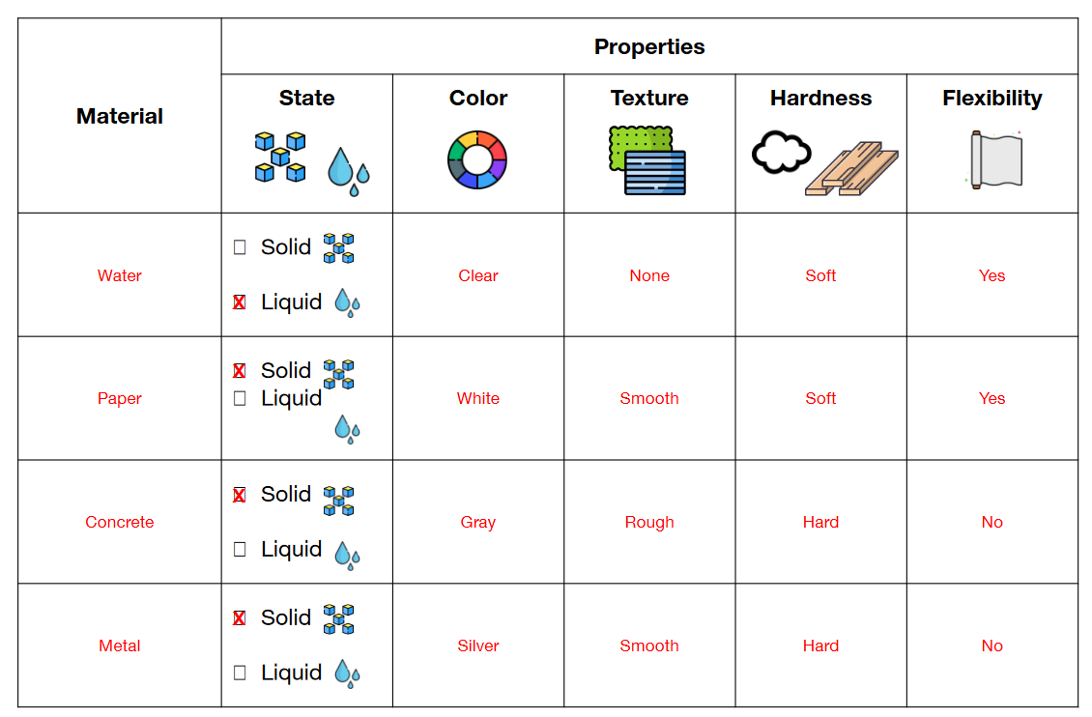
2-PS1-1 Plan and conduct an investigation to describe and classify different kinds of materials by their observable properties (color, texture, hardness, and flexibility)
2-PS1-2 Analyze data obtained from testing different materials to determine which materials have the properties that are best suited for an intended purpose
The Traditional Worksheet

Slide 33
Materials Investigation as Part of the Engineering Design Journal -
Material | Color | Texture | Hardness | Flexibility | Buoyancy (will this material float?) | What other observable properties did you find?
Styrofoam Tray
Egg Cartons
Cardboard Tube
Yarn
Masonry Line
Plastic Tub
Fuzzy Stick (pipe cleaner)
Paper Fastener (brad)
Aluminum Foil
Masking Tape

Slide 34
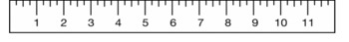
AR.Math.Content.2.MD.A.1 - Measure the length of an object by selecting and using appropriate tools such as rulers, yardsticks, meter sticks, and measuring tapes
Material | Length | Inches | CM | What other measurement data could you collect from your material (width, height, etc.)? | Cost per item
Styrofoam Tray
Egg Cartons
Cardboard Tube
Yarn
Masonry Line
Plastic Tub
Fuzzy Stick (pipe cleaner)
Paper Fastener (brad)
Aluminum Foil
Masking Tape

Slide 35
How can you document evidence that ensures that the students get intentional practice with the content/vocabulary of your target standards?
What else? How do you know that your students truly understand the intent of the standards?

Slide 36
Before getting started, confirm that your book selection and design challenge is an original idea. Please do not develop an activity that is commonly found in schools such as a foil/penny boat challenge, egg drop, 3 Little Pigs – blowing a structure with a hairdryer, or other common design challenge. If you can do a web search for the name of your book and design challenge (STEM challenge, engineering design challenge, etc.) and the idea can be found, it is not original.

Slide 37
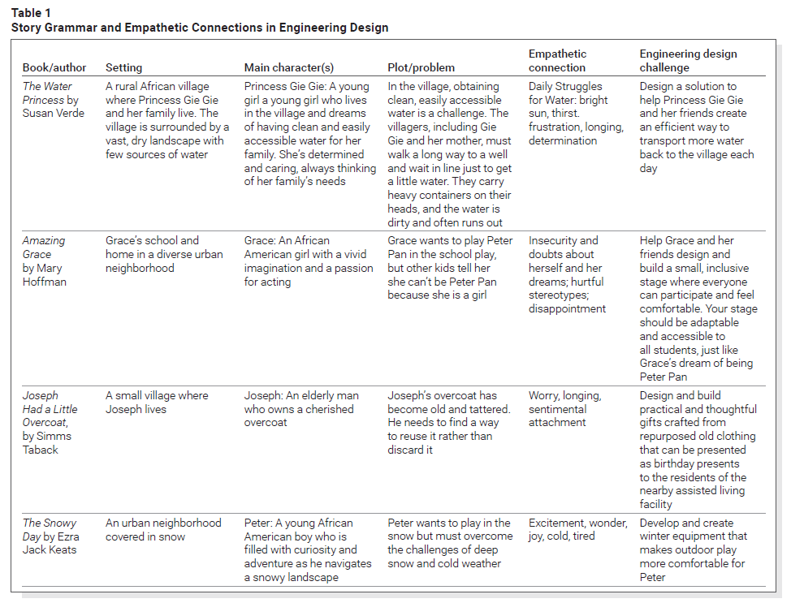
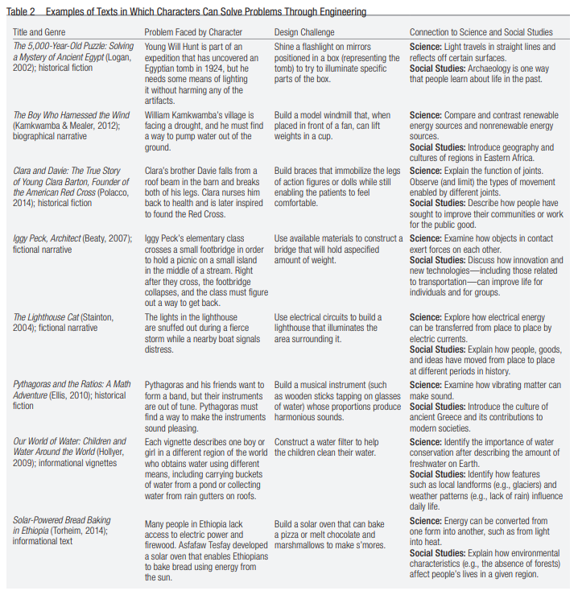
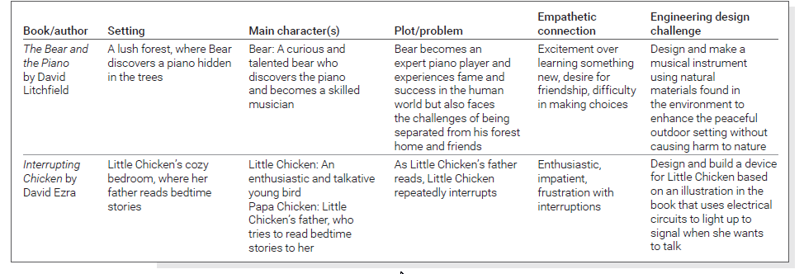
Obviously, we want to void the books mentioned in our readings this semester

Slide 38
Would letting older students (5th /6th grade) create their own essential questions from the big idea help students feel more in control of their learning and connect to the lesson more?
Why couldn't you encourage the students to help develop big ideas and essential questions? This could even happen in younger grades.
When you plan your lessons, the standards will guide you in your Big Idea and Essential Questions.
Whatever grade level you teach, the standards will match the developmental appropriateness for that age level.
Each standard will be "unpacked" to guide you in understanding the major concept to be delivered (big idea) and the overreaching question(s) that guide the learning (essential questions).

