Slide 1


Slide 2
Computational thinking is a structured, four-part problem-solving process used to break down complex issues into manageable, logical steps, similar to how computer scientists solve problems.
It involves decomposition, pattern recognition, abstraction, and algorithm design to create solutions that can be automated or executed by a human or machine

Slide 3
Core Components of Computational Thinking
Decomposition invites students to break down complex problems into smaller, simpler problems.
Pattern recognition guides students to make connections between similar problems and experience.
Abstraction invites students to identify important information while ignoring unrelated or irrelevant details.
Lastly, students use algorithms when they design simple steps to solve problems.

Slide 4
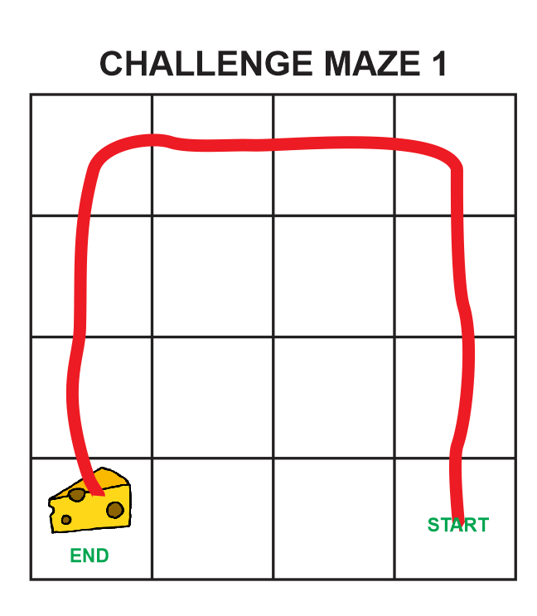
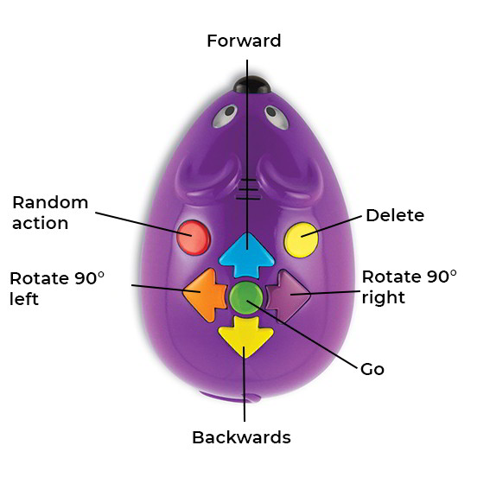

Slide 6
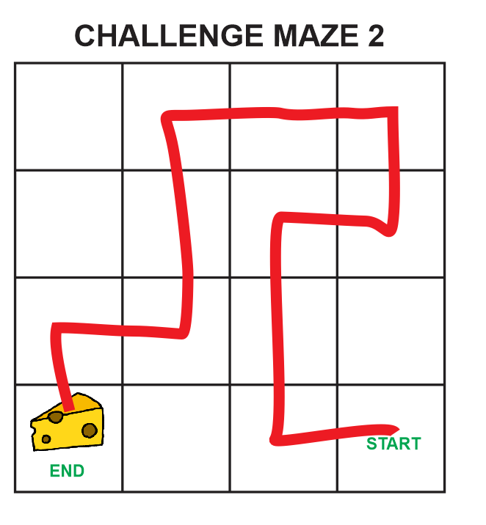

Slide 7
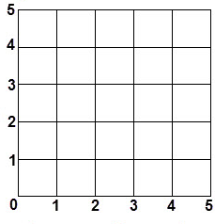

(3,2)
Coordinate Plane
Systems

Slide 8

How could we connect this back to children’s literature?

Slide 9




Slide 10
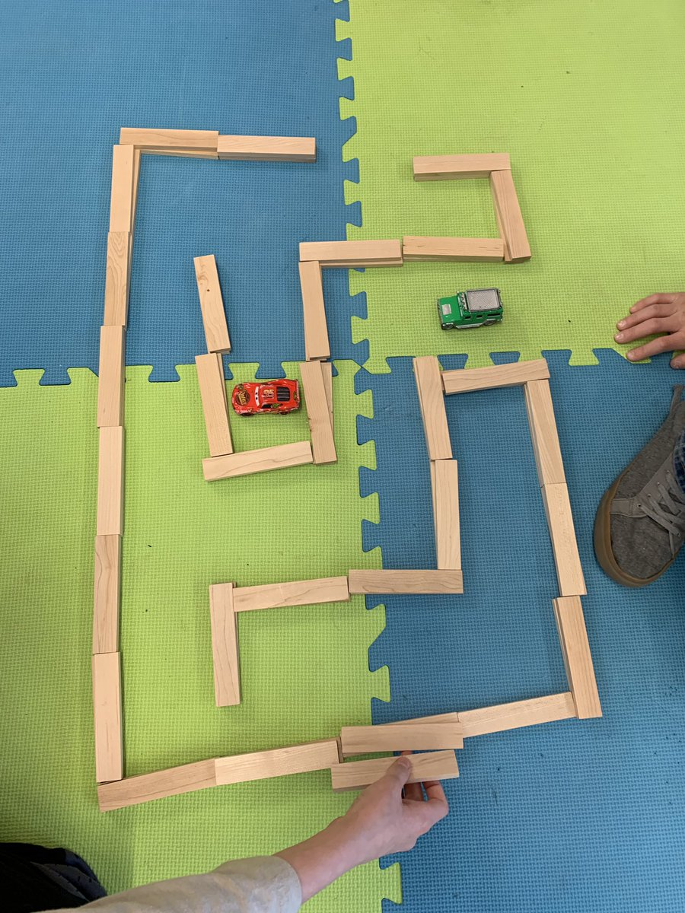
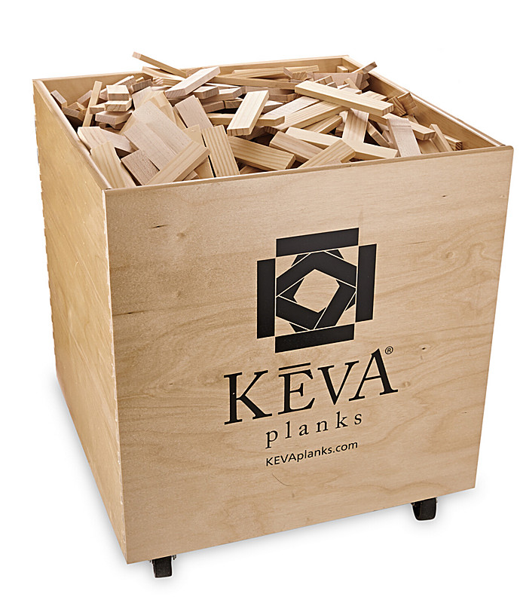
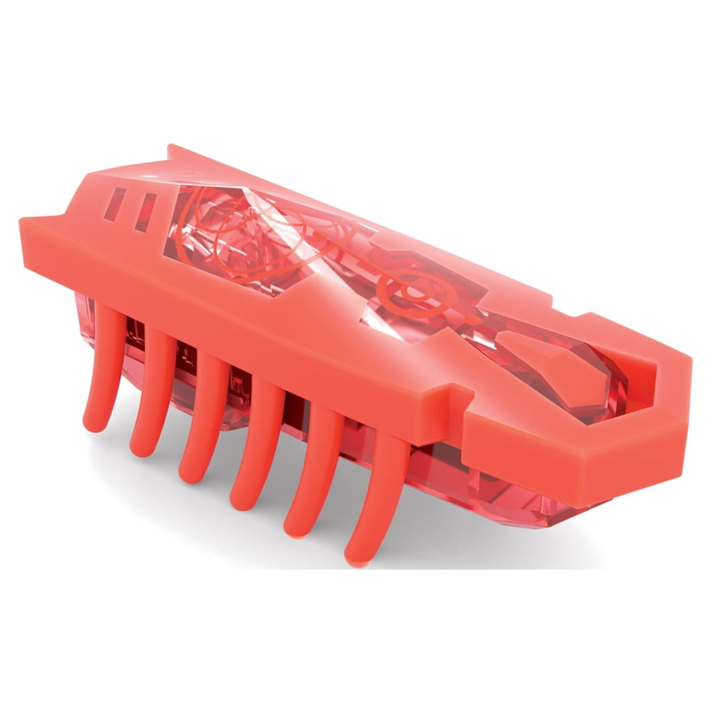
+

Slide 11
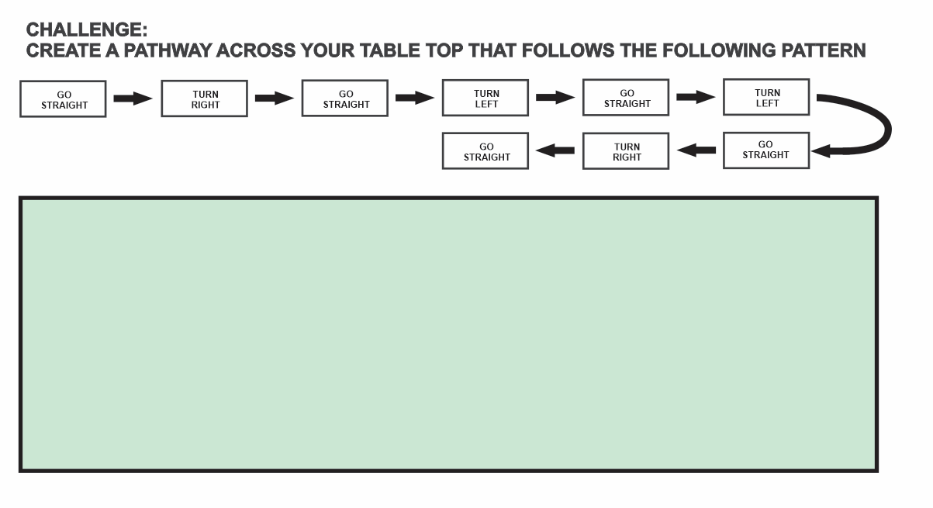

Slide 12
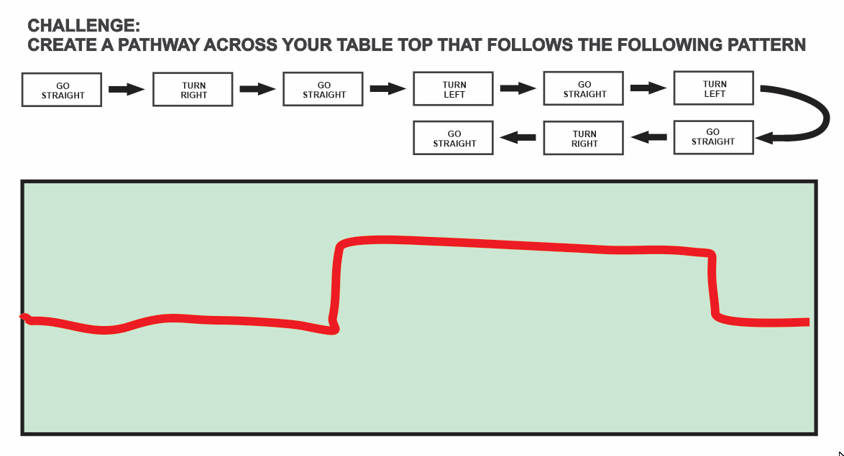

Slide 13
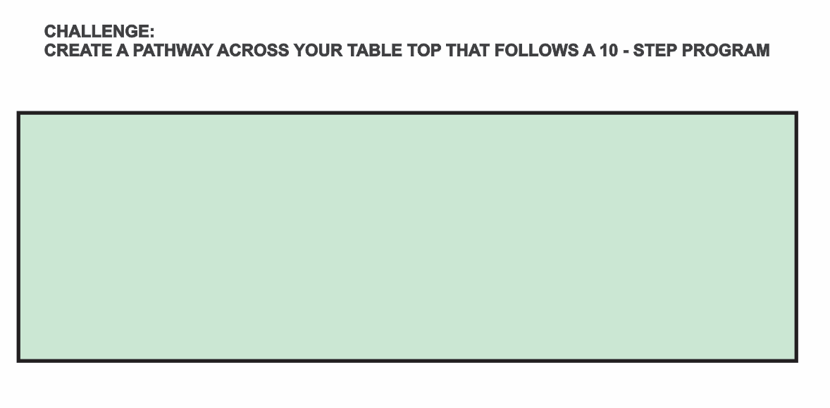
Create your own algorithmic design (step-by-step directions)

Slide 14

A more ill-structed use of the Hex Bugs ……….
Challenge: How can you engineer a Hex Bug Nano-Bot Ultimate Maze for a robotic bug to complete without your assistance (aside from turning it on) with the goal of including the most elements and completing the maze in the shortest time possible?
Limitations
Maze should include the following elements:
Path of 'bug" at least 12 inches long
Travel from start to finish without escaping or being touched
Make at least 2 right angle turns (90 degrees)
Make a sound it does not naturally make
Elevation change (up, down, over, at least height of Hex Bug)
Travel through a tunnel (at least length of Hex Bug)
Materials
Aluminum Foil (1 sheet or 6" X 6")
Copy Paper (1 sheet)
Construction Paper (1 sheet)
Sticky Notes (5 notes)
Craft Sticks (1 jumbo)
Pipe Cleaners (1 regular)
Empty Toilet Paper Rolls (2)
Empty Paper Towel Roll (1)
1 Yard of Masking Tape
Tools (Not allowed in solution): Scissors, Ruler, Timer
To test the design, make sure that your maze solution meets most of the following criteria. If you don't have all the boxes checked, please think about how to try to redesign your model to include what is missing.
Test Checklist:
Path of 'bug" at least 12 inches long
Travel from start to finish without escaping or being touched
Make at least 2 right angle turns (90 degrees)
Make a sound it does not naturally make
Elevation change (up, down, over, at least height of Hex Bug)
Travel through a tunnel (at least length of Hex Bug)

Slide 15



Additional Ideas for Introducing Computational Thinking
https://pencilcode.net/
https://scratch.mit.edu/
https://code.org/en-US/hour-of-code

