Slide 1
Science
4-PS3-2 Make observations to provide evidence that energy can be transferred from place to place by sound, light, heat, and electric currents.
Standard for Technological and Engineering Literacy
Standard 8: Applying, Maintaining, and Assessing Technological Products and Systems
  Follow directions to complete a technological task.
  Use appropriate symbols, numbers, and words to communicate key ideas about technological products and systems.
  Identify why a product or system is not working properly.
Additional Standard
Additionally, you will identify and integrate another appropriate Mathematics and/or Social Studies or English Language Arts standard/s.
* Big Idea – Energy can be transferred through an electrical circuit
*Big Idea – It is important to be able to
follow directions to complete a project
*Big Idea – Troubleshooting is an important skill to
understand why a device or system is not working properly
*Big Idea – After selecting an additional standard for integration you will also include a big idea related to the standard and real-world application.

Slide 2
Essential Electricity Vocabulary
Electrical Circuit - A complete pathway for electrons to flow, transferring energy from a source like a battery to a load or components like an LED or motor.
Conductor - Material (graphite, wire, conductive tape) that allows easy flow of electrical current due to movable electrons.
Insulator - Material (paper, class, non-conductive tape, etc.) that resists electrical flow, preventing short circuits.
Electrons - Negatively charged particles that move to create current.
Anode/Cathode - Positive/negative terminals of the battery; electrons flow from cathode to anode externally.
Electromotive Force (e.m.f.) / Volts - The "push" from the battery that drives electrons, measured in volts.
Closed Circuit - Complete pathway/loop where current flows and the device (LED) works.
Open Circuit - Broken path where no current flows.
Short Circuit - Direct low-resistance path bypassing components, potentially dangerous.
Resistance - Opposition to current flow; higher in longer or thinner graphite paths.
LED - Light Emitting Diode; lights up when current passes in the correct direction.

Slide 3
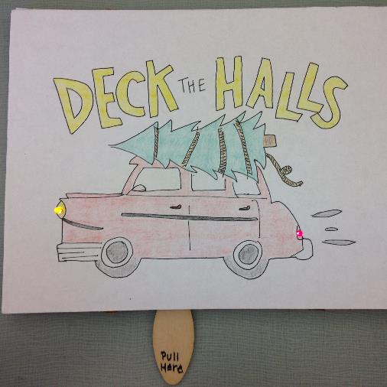
Key Vocabulary for the Technical/Procedural Directions
*Your project should focus on these concepts -
Transfer of Energy - Electrical Pathway – Electron Flow - Circuit
DC Power Source – Coin Battery (3V) – Energy
  Anode (+)
  Cathode (-)
Conductors
Insulators
LED – Light Emitting Diode - Illuminate
Switch – Control - Open Circuit/Closed Circuit

Slide 4
Essential Electricity Vocabulary
Electrical Circuit - A complete pathway for electrons to flow, transferring energy from a source like a battery to a load or components like an LED or motor.
Conductor - Material (graphite, wire, conductive tape) that allows easy flow of electrical current due to movable electrons.
Insulator - Material (paper, class, non-conductive tape, etc.) that resists electrical flow, preventing short circuits.
Electrons - Negatively charged particles that move to create current.
Anode/Cathode - Positive/negative terminals of the battery; electrons flow from cathode to anode externally.
Electromotive Force (e.m.f.) / Volts - The "push" from the battery that drives electrons, measured in volts.
Closed Circuit - Complete pathway/loop where current flows and the device (LED) works.
Open Circuit - Broken path where no current flows.
Short Circuit - Direct low-resistance path bypassing components, potentially dangerous.
Resistance - Opposition to current flow; higher in longer or thinner graphite paths.
LED - Light Emitting Diode; lights up when current passes in the correct direction.

Slide 5
Common Feedback from Past Projects
I would suggest that you include specific vocabulary in your directions that discusses how the materials that students are using are conductive and how these materials allow for the transfer of energy. You could also specifically talk about the switch (you do use the term – but explain what is happening – it completes the pathway for the energy to be transferred to illuminate the LED), insulators, etc.
It is important that students understand the transfer of energy through electrical circuits and the importance of following directions to assemble a product and safely use tools.
I would also suggest substituting the craft knife for more appropriate tools such as a Chomp Saw, Canary Cutter and Shears specially made for cutting cardboard.

Slide 6
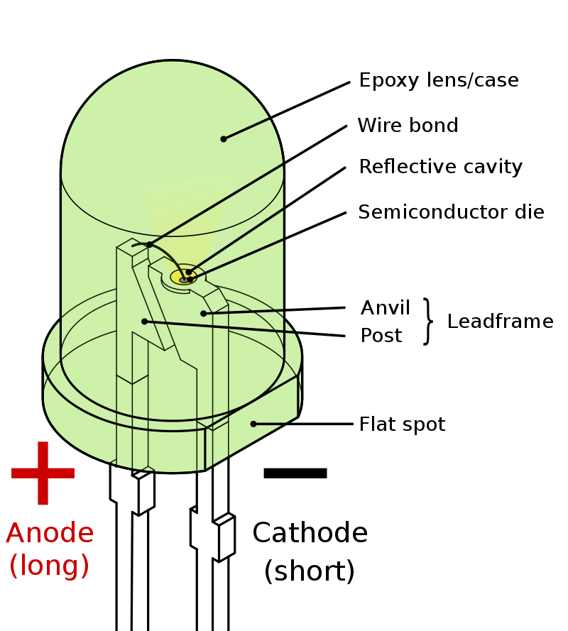
LED – Light Emitting Diode – Illuminate
A light-emitting diode (LED) is a semiconductor device that emits light when current flows through it. Electrons in the semiconductor recombine with electron holes, releasing energy in the form of photons.

Slide 7
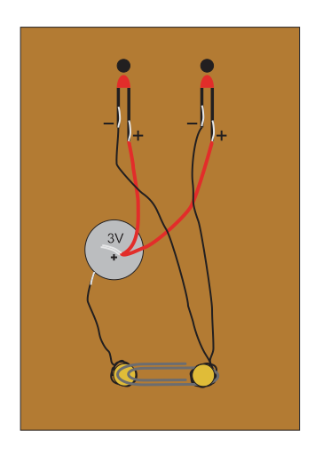
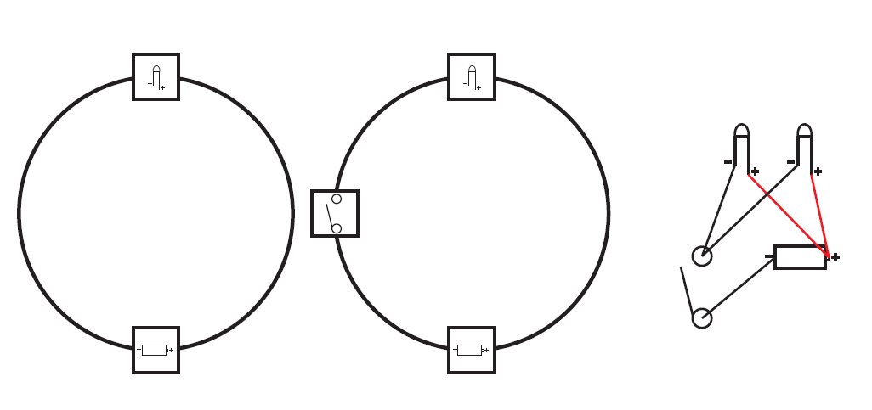

Slide 8
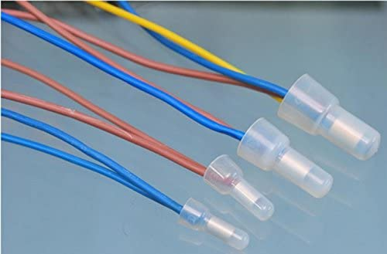
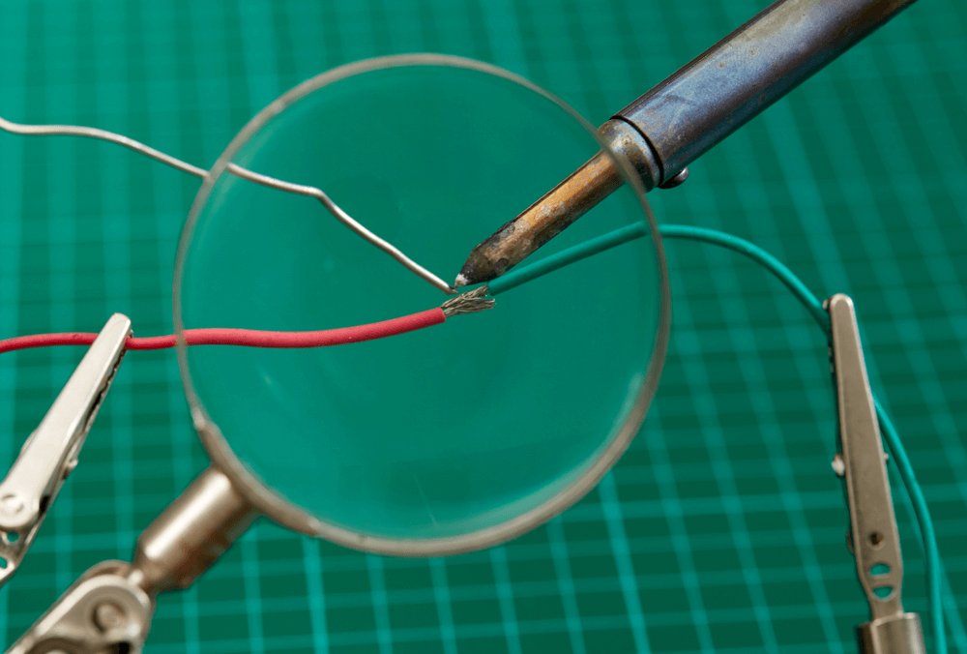
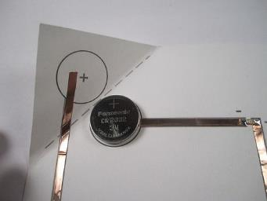
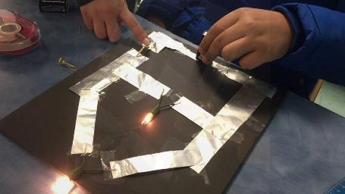
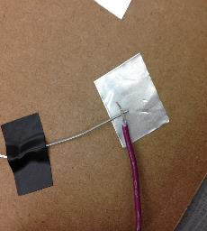
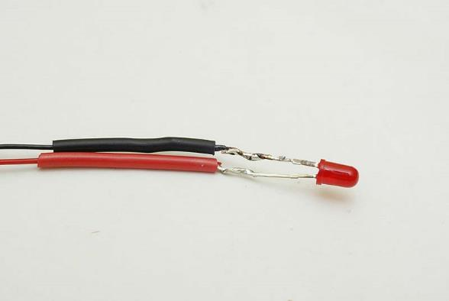
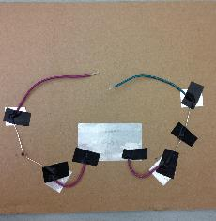
It is Very Important to Make Good Connections
Crimp Connections
Soldering
Using Duct/Copper Tape

Slide 9
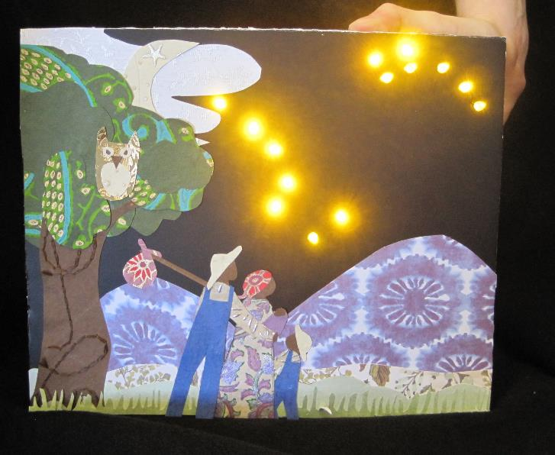
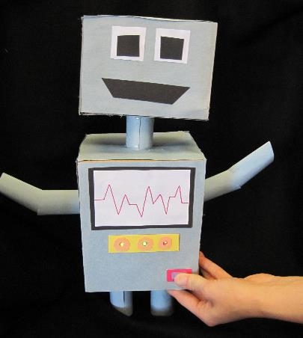
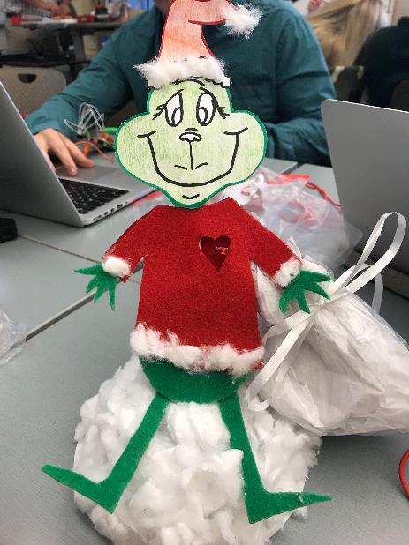
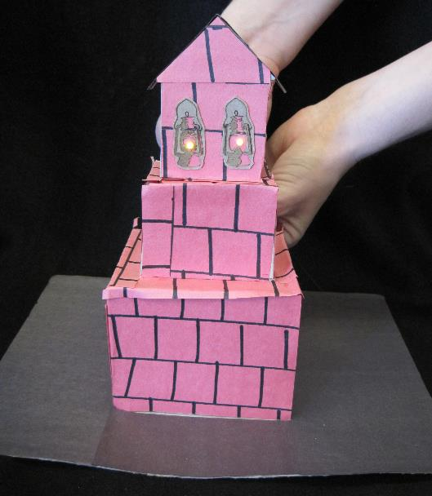
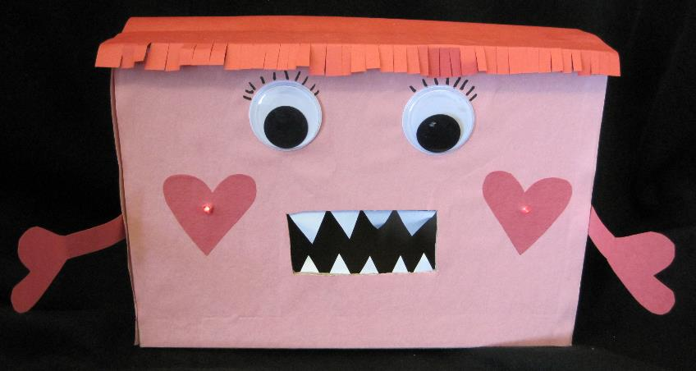

Slide 10
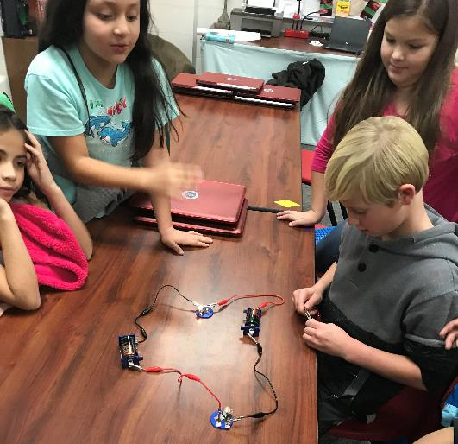
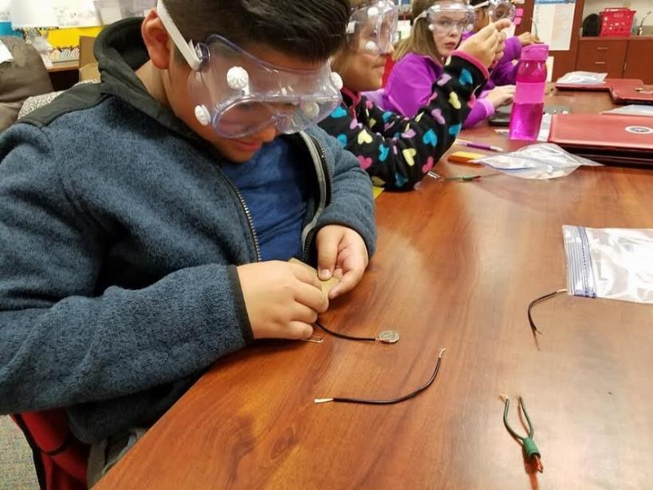
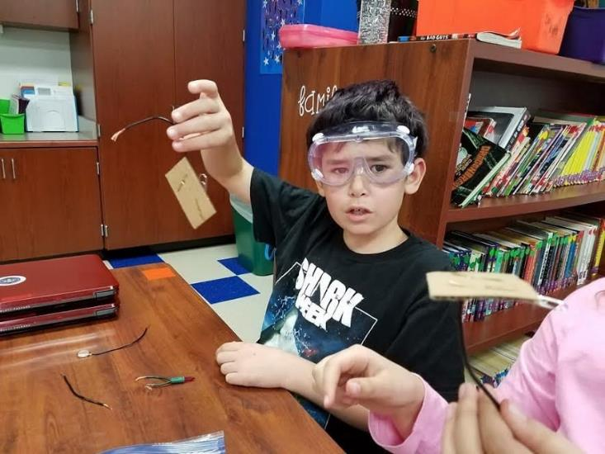
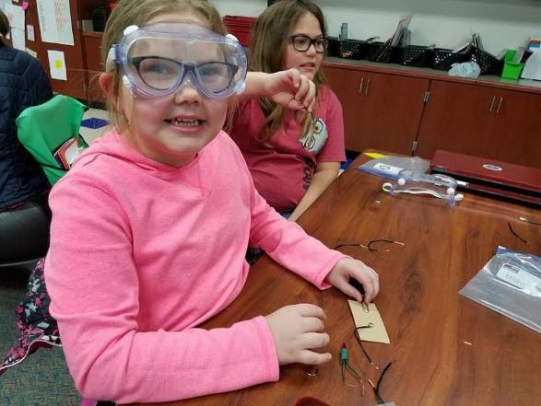

Slide 11
