Slide 1
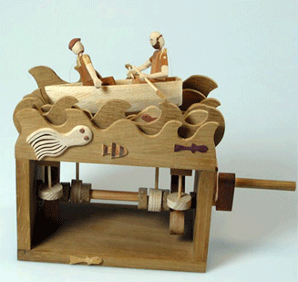
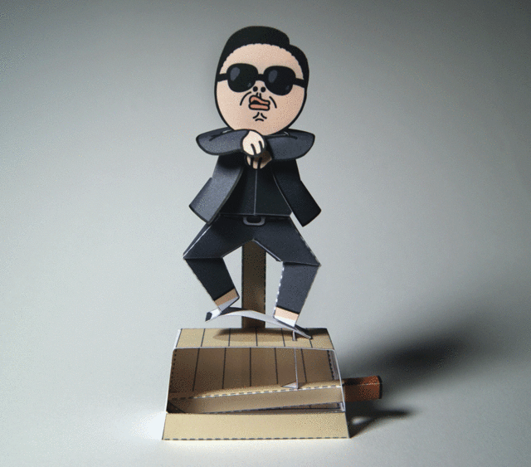
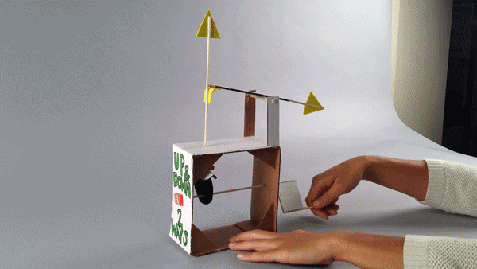
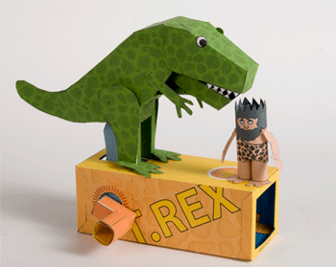
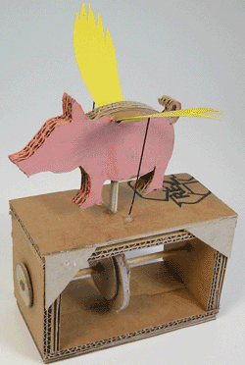
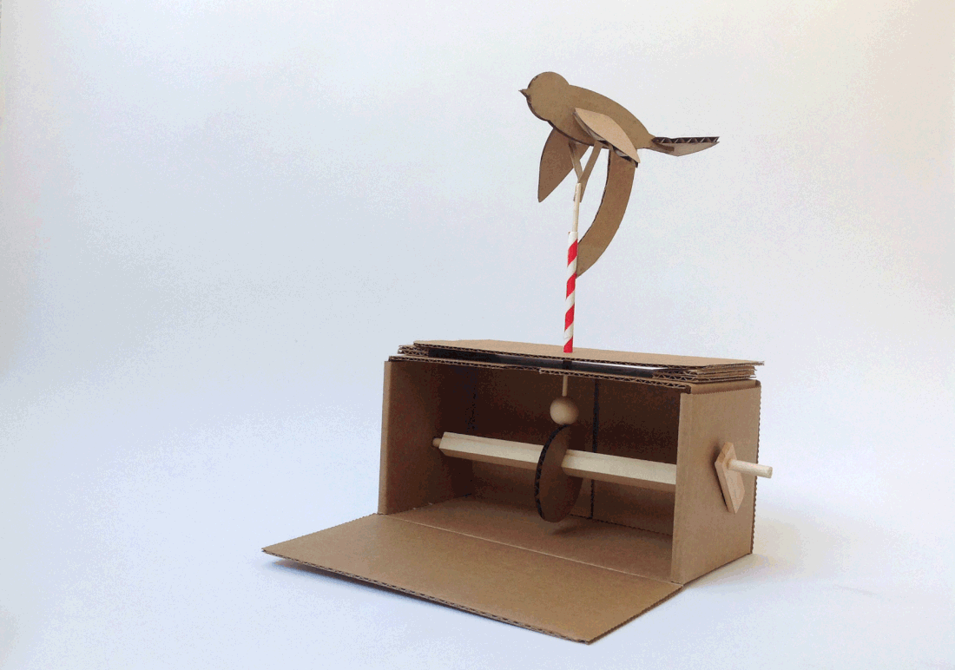
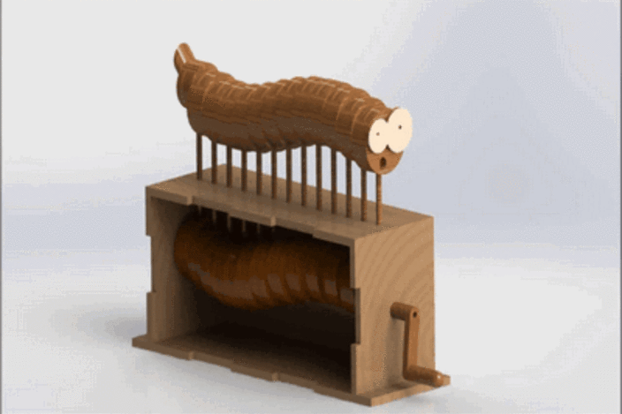
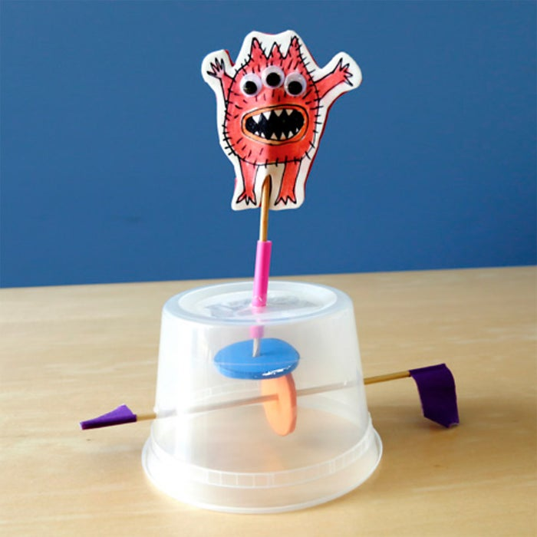
The Final Project

Slide 2
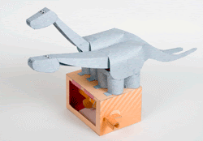
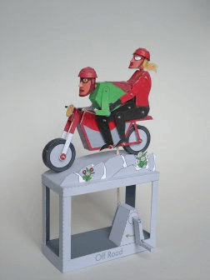
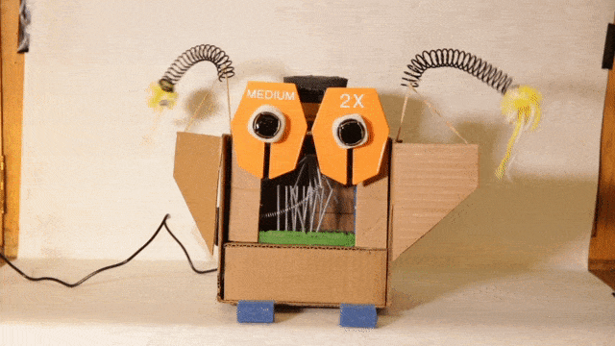
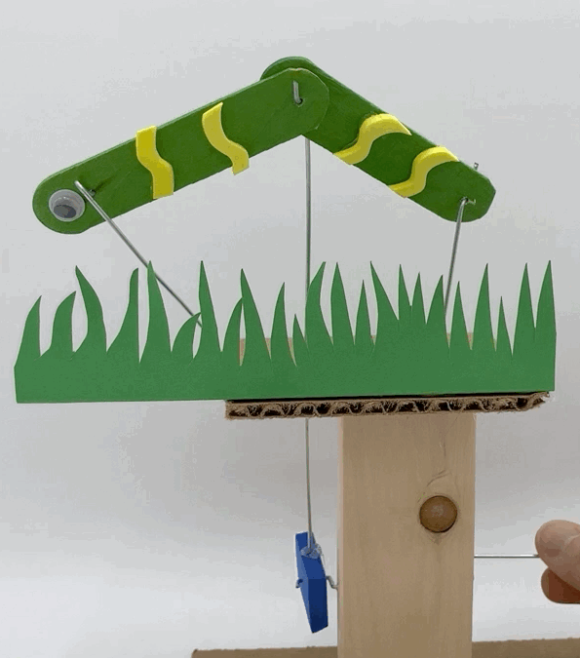
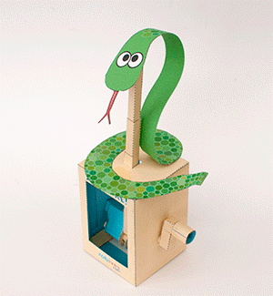
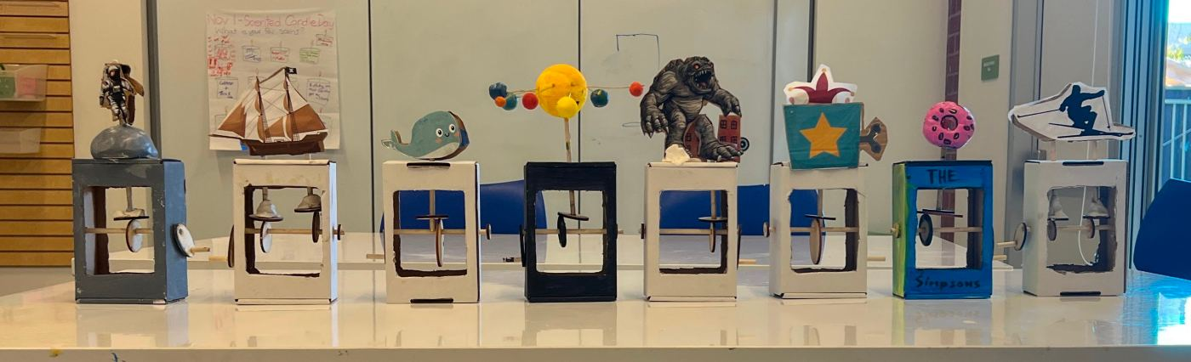

Slide 3
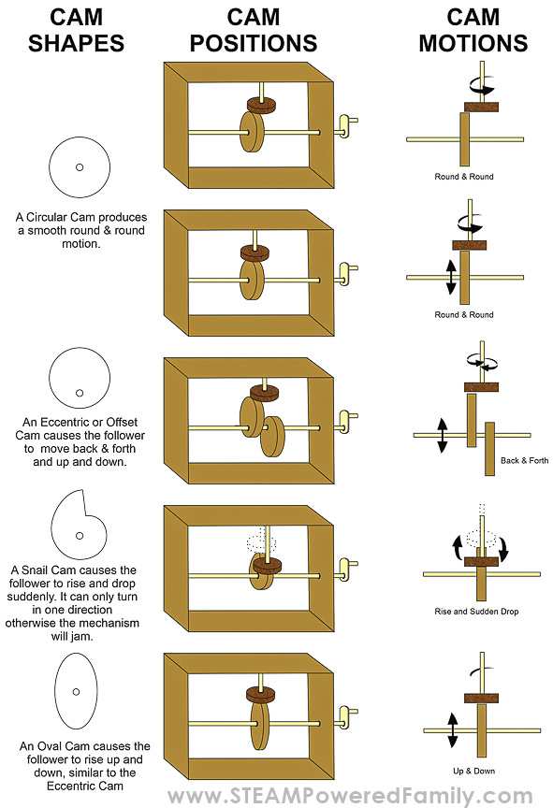
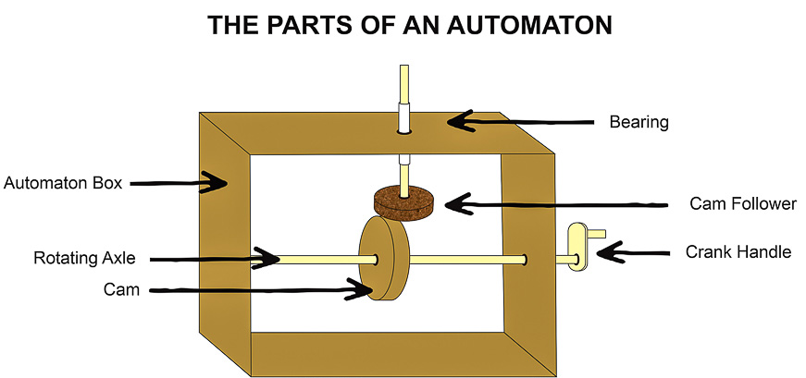
Check out the video at the Houston Children’s Museum:
https://www.cmhouston.org/classroom-curriculum/cardboard-automata

Slide 4
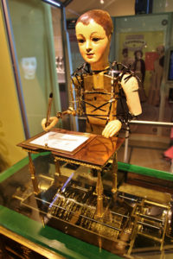
History of the Automata
An automata is a moving mechanical device. It can be complicated, like a robot, or simple, like a flag raising and lowering
Almost anyone can make a simple automata using dowels, cardboard boxes, foam board, hot glue guns and plastic straws (and feathers, googly eyes, colored paper and other items for decorating).
Automata use simple machine elements such as cams, levers, and linkages to create cardboard or paper mechanical sculptures.
Automata have been designed for thousands of years. One of the earliest was a wooden version of a pigeon, built by Archytas of Tarentum in about 400 bc. He was a friend of the philosopher Plato.

Slide 5
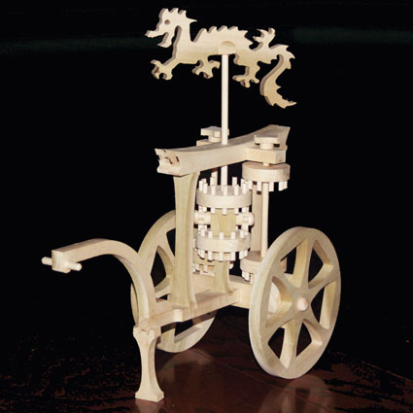
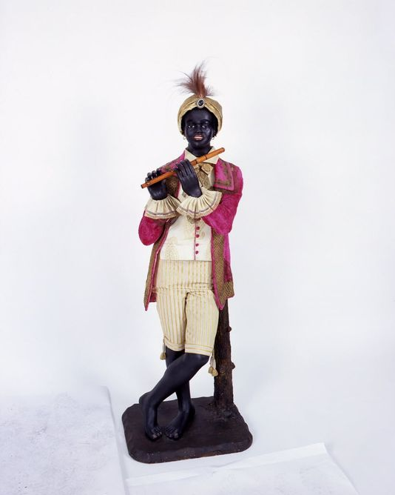
History of the Automata
The Han Dynasty in China created automata that included a mechanical orchestra constructed for the Emperor. During the Sui Dynasty, automata had become very common. From the T'ang period there are accounts of flying birds and characters that performed, ranging from girls singing to a monk begging
One of the most famous designer of automata was Jacques de Vaucanson (1709–82). He designed robotic devices that used modern industrial techniques. In 1738 he constructed an automaton, ‘The Flute Player’, followed by ‘The Tambourine Player.’

Slide 6
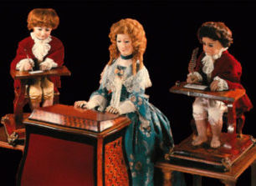
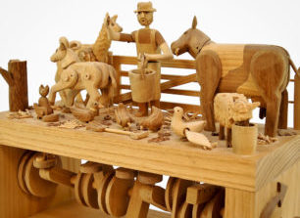
History of the Automata
During the European Renaissance, sophisticated fountains involving sensational and secret effects became fashionable among the nobility. For example, the mid-sixteenth-century waterworks and fountains erected in the gardens of the Villa d'Este at Tivoli, near Rome.

Slide 7
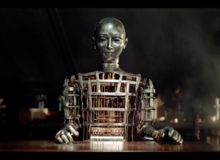
History of the Automata
The term robot was derived from the Czech word rabit (work) and came into popular use after 1923 to describe automata that was mechanical or so ingenious as to be almost human.

Slide 8
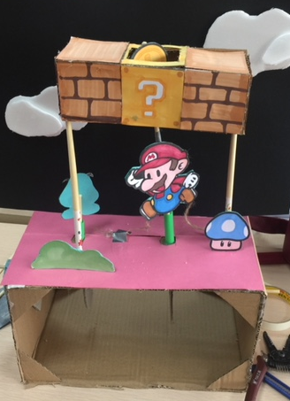
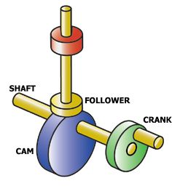
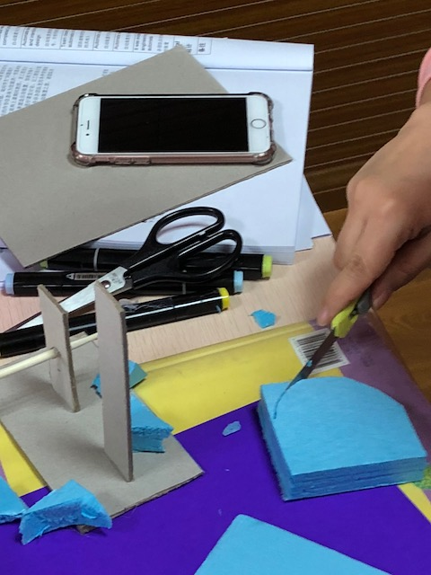
Using axles, cams, and cam followers to turn rotary motion into reciprocating motion
Making the cam from dense foam

Slide 9
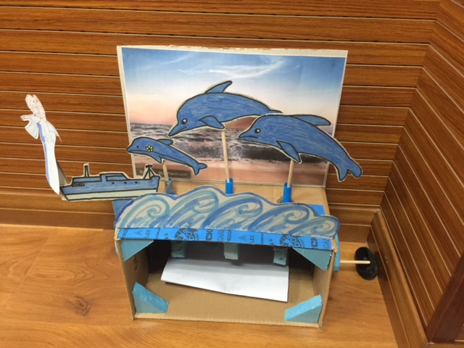
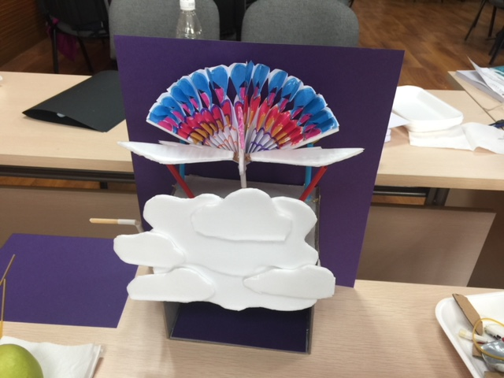
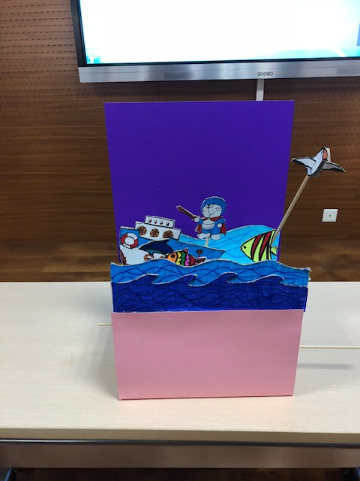
Solutions to the STEM Problem
Using multiple cams and cam followers to create the illusion of life

Slide 10
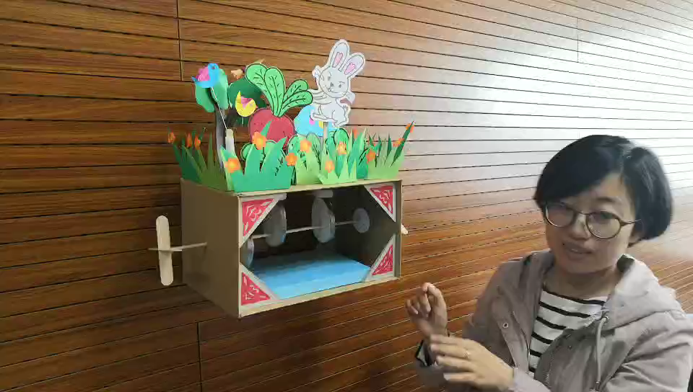
One Solution to the STEM Challenge

Slide 11
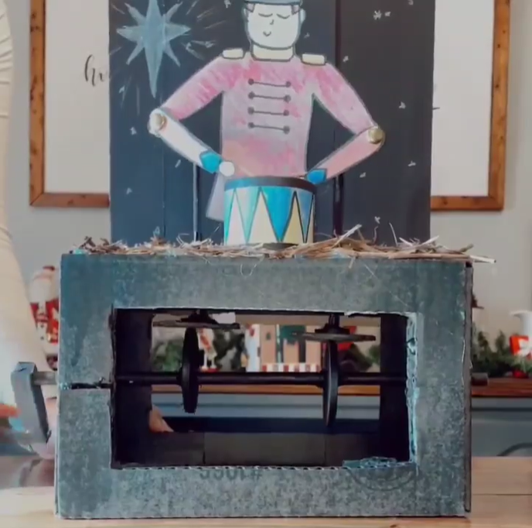
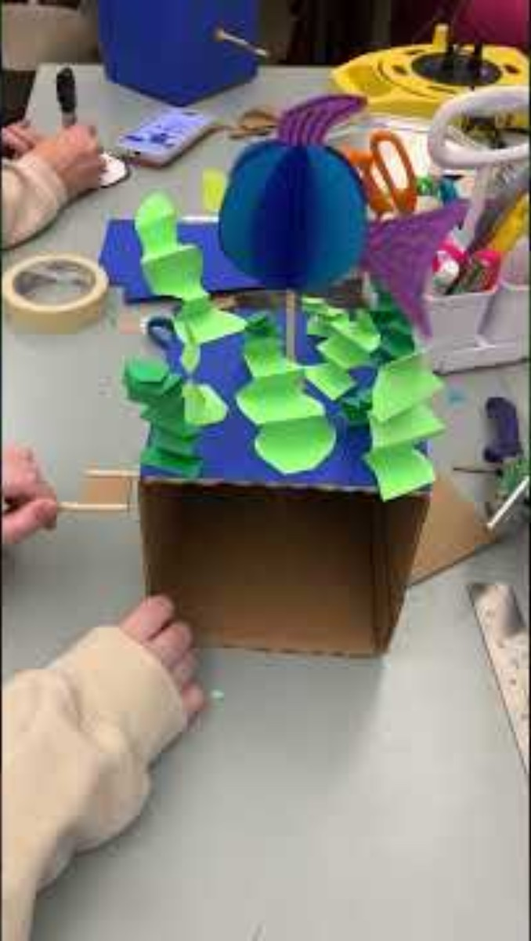
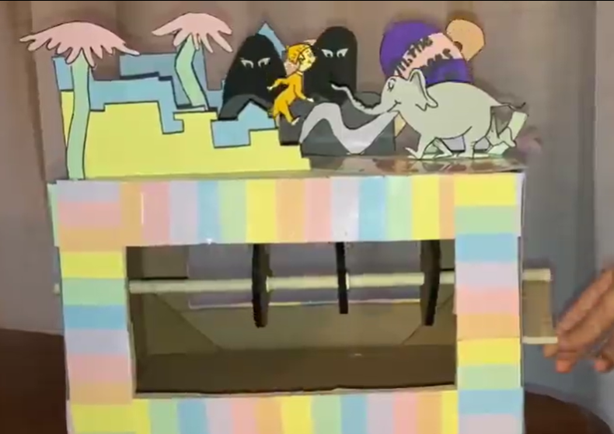
https://www.instagram.com/p/CY2dJEhgZUn/
https://www.instagram.com/p/CY2caEQgqcn/

