Slide 1
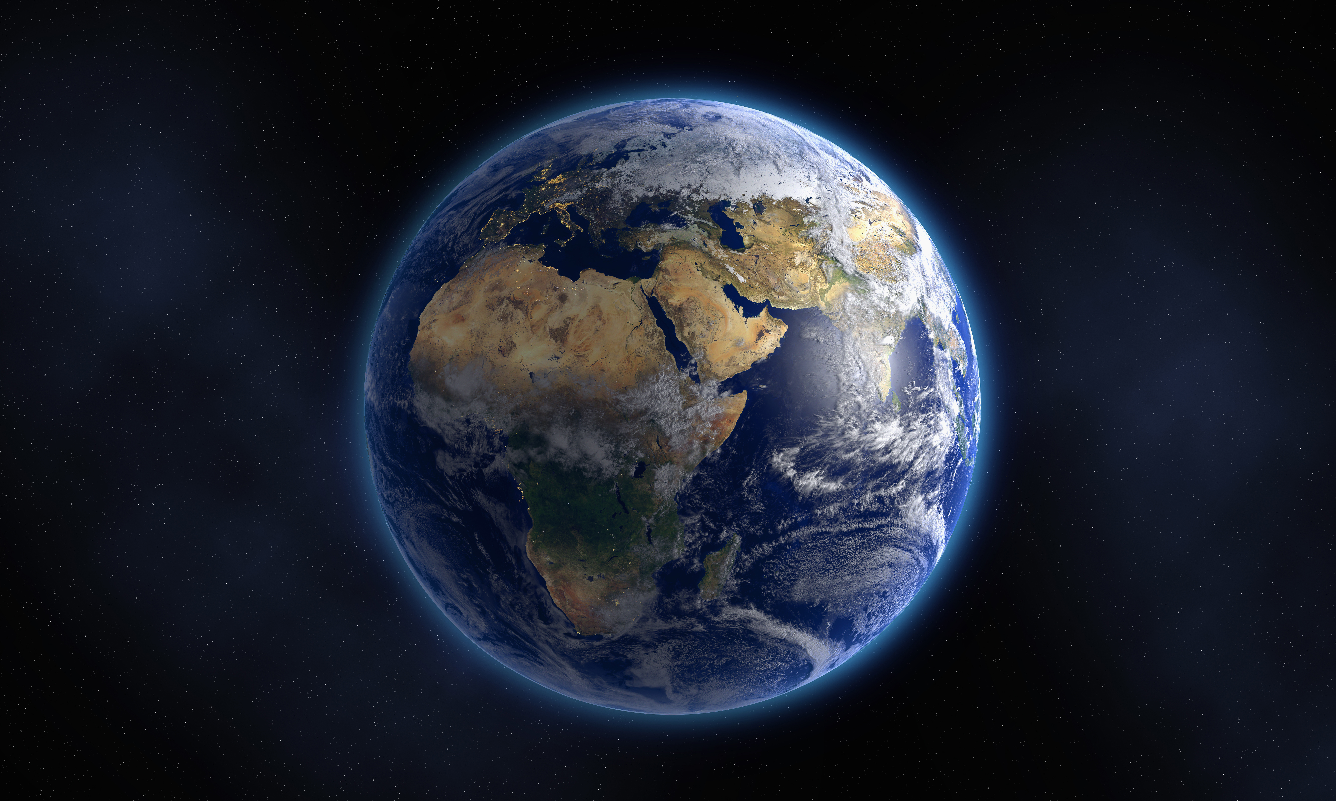

The Earth ball challenge
Educator Guide

Slide 2
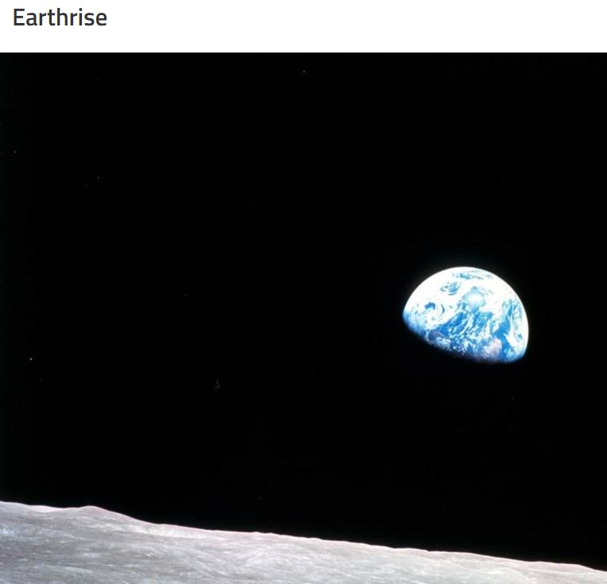
Astronaut Edgar Mitchell, observing the Earth from the moon in 1971
"Suddenly from behind the rim of the moon … there emerges a sparkling blue and white jewel, a light, delicate blue sphere laced with slowly swirling veils of white, rising like a small pearl in a thick sea of black mystery. It takes more than a moment to fully realize this is Earth … home."

Slide 3
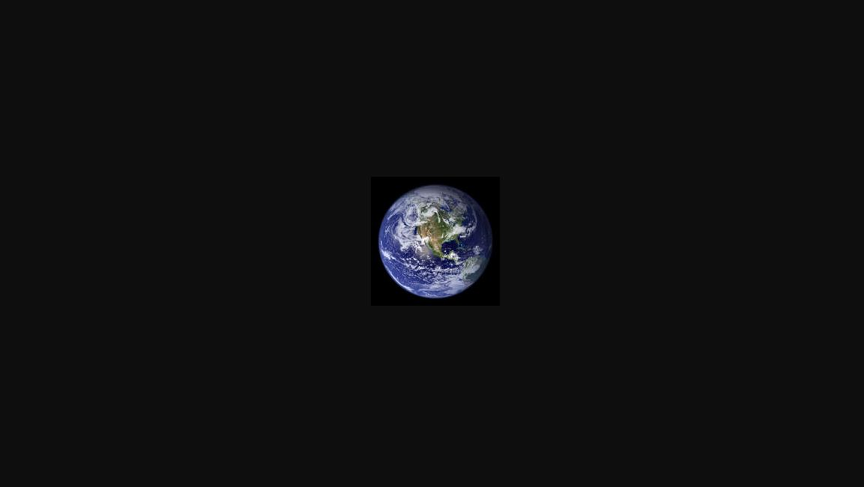

Slide 4
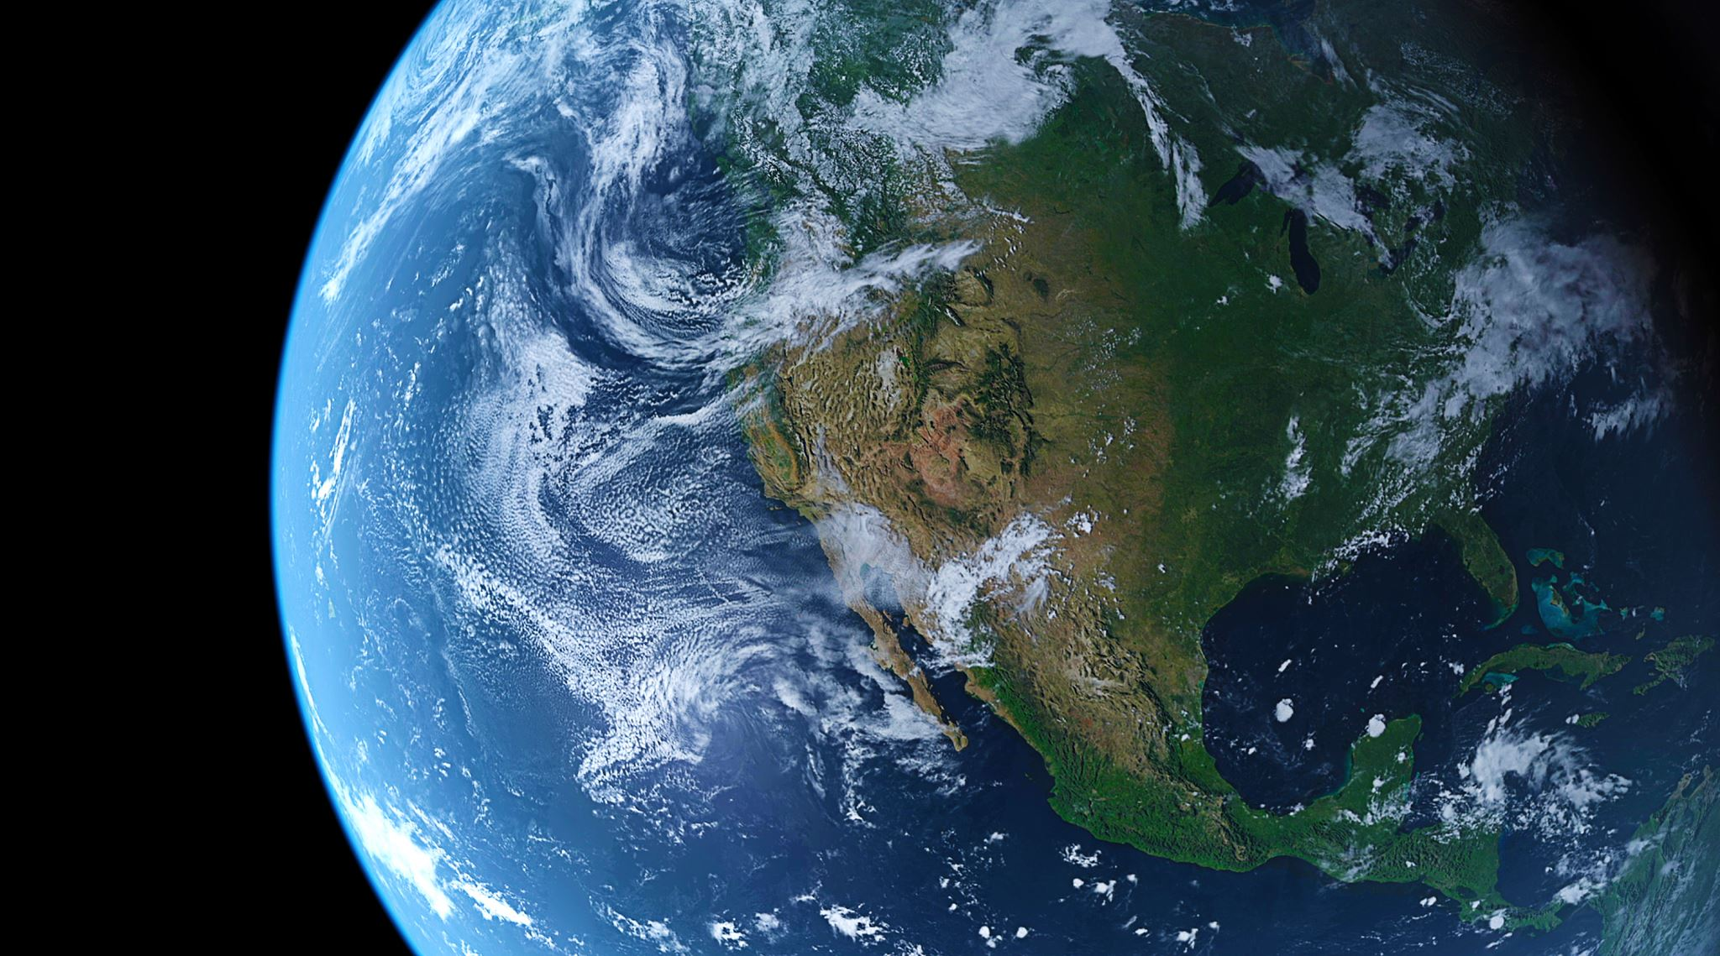
How much of the Earth is Land and How much of the Earth is Water?

Slide 5
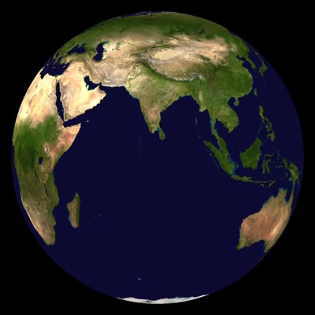
What would the Earth look like without Clouds and Shadow?

Slide 6
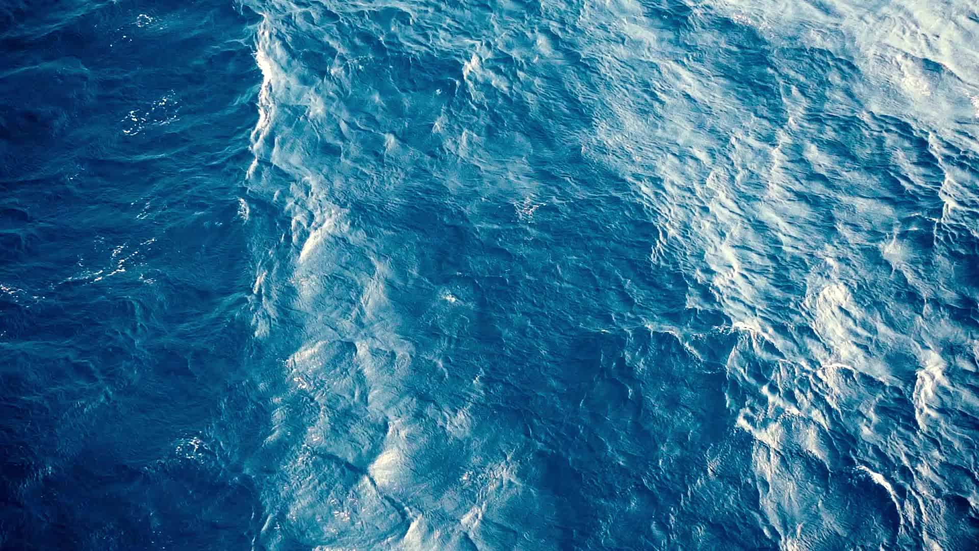
Speaking of oceans…
How many oceans are on Earth and what are their names?

Slide 7
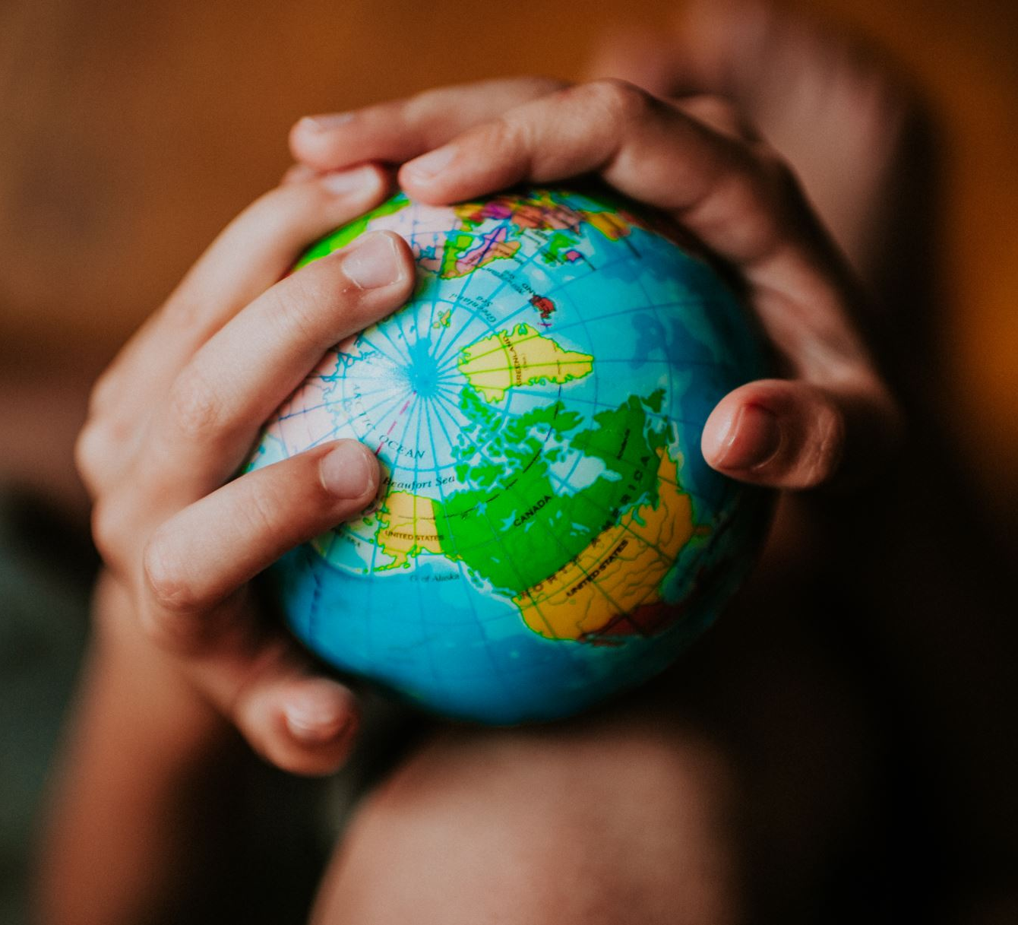
What about the continents?
How many?
Can you name and locate them?

Slide 8
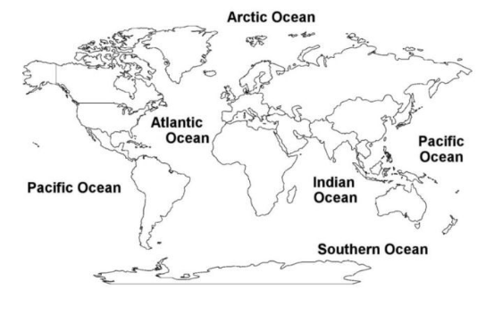
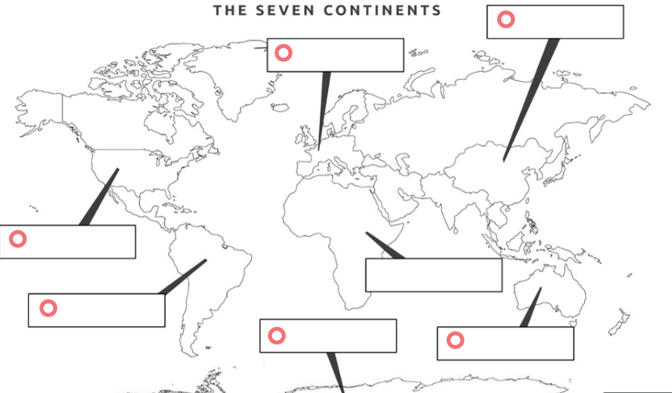
Remember these?

Slide 9
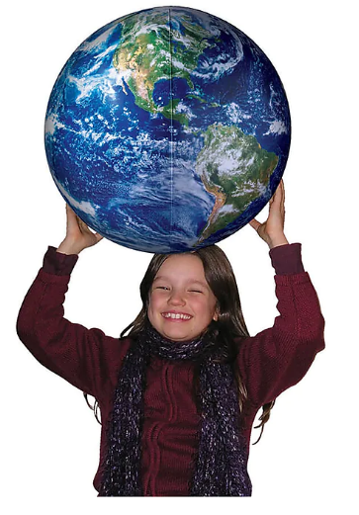

Earth ball challenge
Let’s do the integrated STEM way!

Slide 10
How much of the Earth is Land and How much of the Earth is Water?

Slide 11
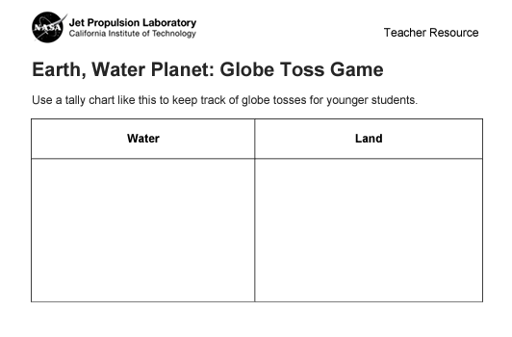
Why use a worksheet?

Slide 12
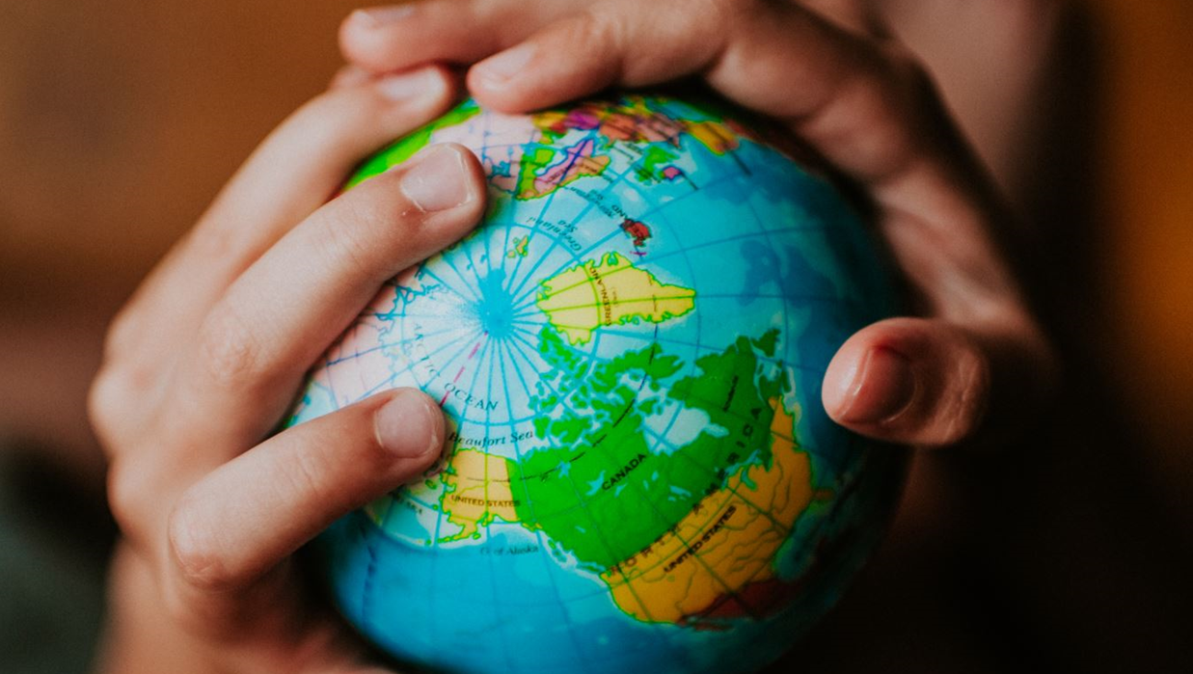
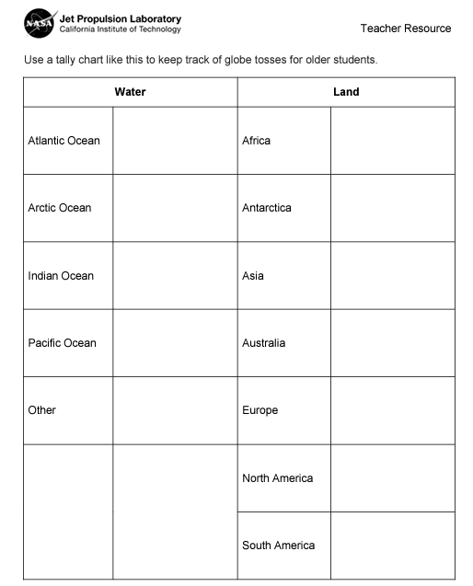
Do we need a worksheet?
How many oceans are on Earth and what are their names?
How many continents?
Can you name and locate them?

Slide 13
And something else…

Slide 14
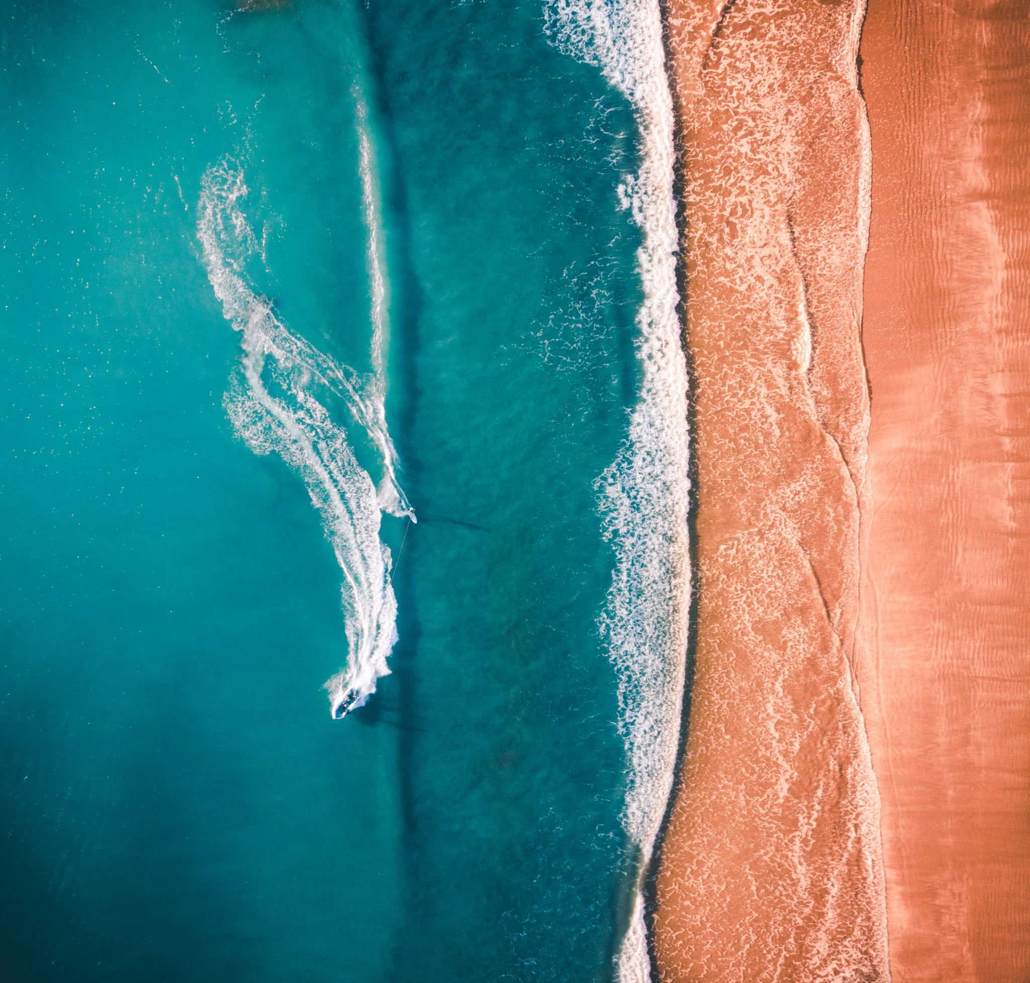
What would happen if we drained the oceans?
What would we see?

