Slide 1
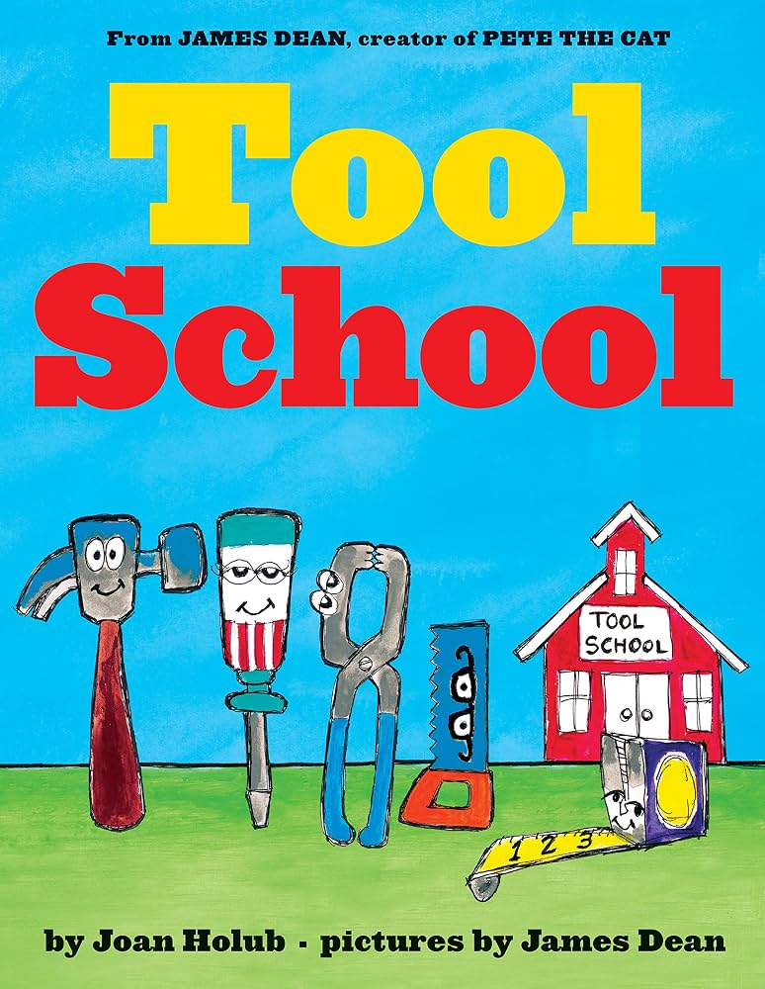
Each tool has a different capability. Early in the story, they learn and play together, but when they are given a building task, each decides to work independently. The problem is that no single tool can complete the job alone.
A successful project requires different tools working together.
Big Ideas:
Tools have specific purposes. Different tools are designed to perform different jobs.
Choose the right tool for the task. Understanding what a tool can and cannot do is part of solving a problem.
Complex problems often require multiple tools and skills. No one tool can do everything.
Collaboration makes us more capable.
Integrated STEM/Engineering Design Challenges require that students go through a similar process seen in the book when they create, design or build something:
tool selection → planning → building → collaborating → evaluating

Slide 2

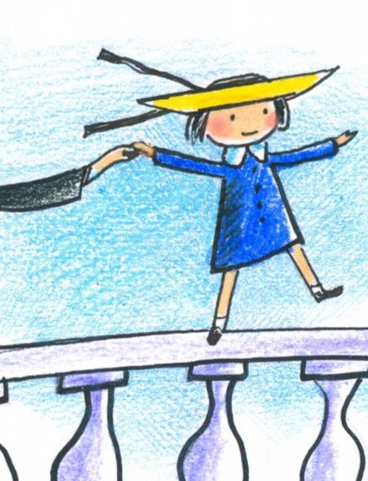
Madeline’s Treehouse Engineering Design Challenge
Scenario
In Madeline by Ludwig Bemelmans, Madeline is a brave little girl who lives in Paris with eleven other girls and Miss Clavel. One night, Madeline becomes very sick and must go to the hospital to have her appendix removed. Her friends miss her while she is away and are excited for her to come home.
Madeline’s friends want to do something special for her. They have decided to build a treehouse where Madeline and her friends can play, read, imagine, and spend time together.
Today, you are an ENGINEER who will help Madeline’s friends begin building their treehouse.

Slide 3
What do we know about Madeline that should matter to us as designers?
What would you want Madeline to feel when she sees the treehouse her friends built for her?

Slide 4
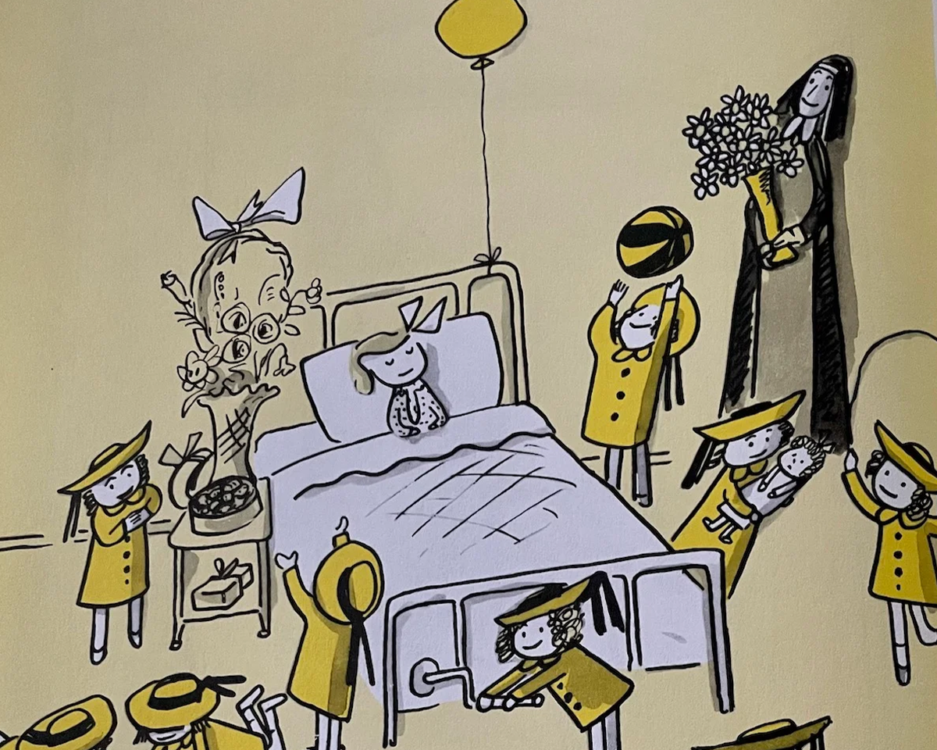
Challenge
Let’s help Madeline and her friends!
Working individually, design and build a 6" × 6" frame (Your space frame) that could be used as part of Madeline’s treehouse.
Your frame must be carefully measured, cut, and assembled so that it is square, sturdy, and ready to become part of a larger structure.
As you work, remember who you are designing for: How can careful engineering help Madeline’s friends create a safe and welcoming place for her?

Slide 5
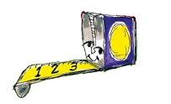

Processes
Measuring
Cutting
Drilling
Gluing
Sanding
Clamping

Slide 6
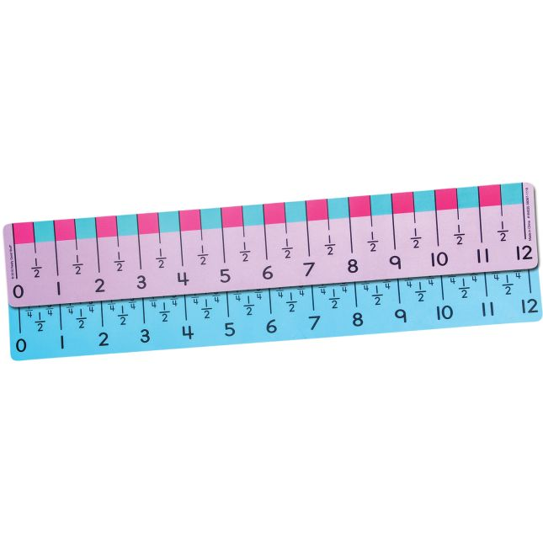
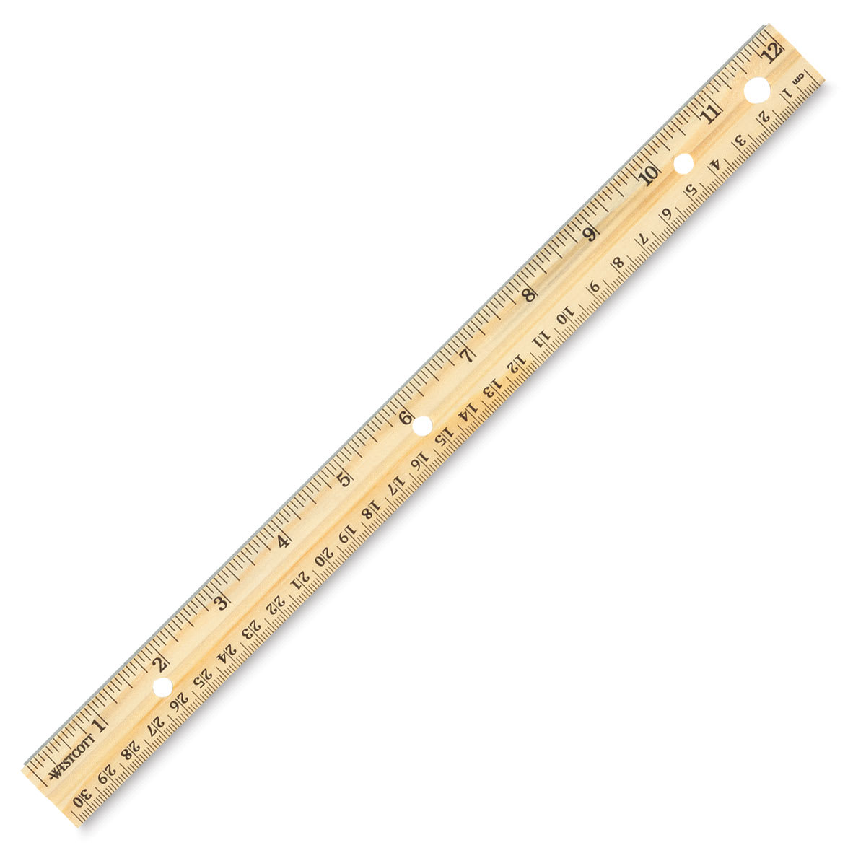
Design, creating, or building often
begins with MEASUREMENT.

Slide 7
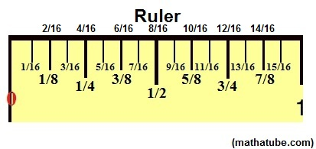
Measure Twice, Cut Once

Slide 8
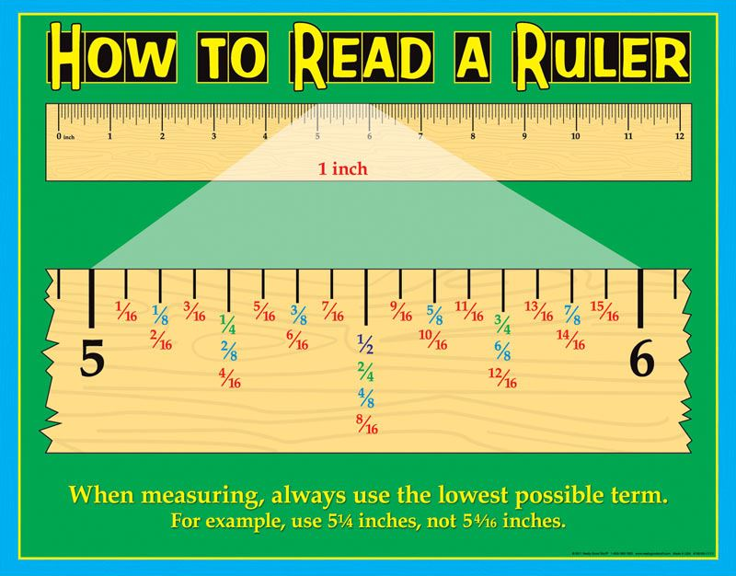

Slide 9
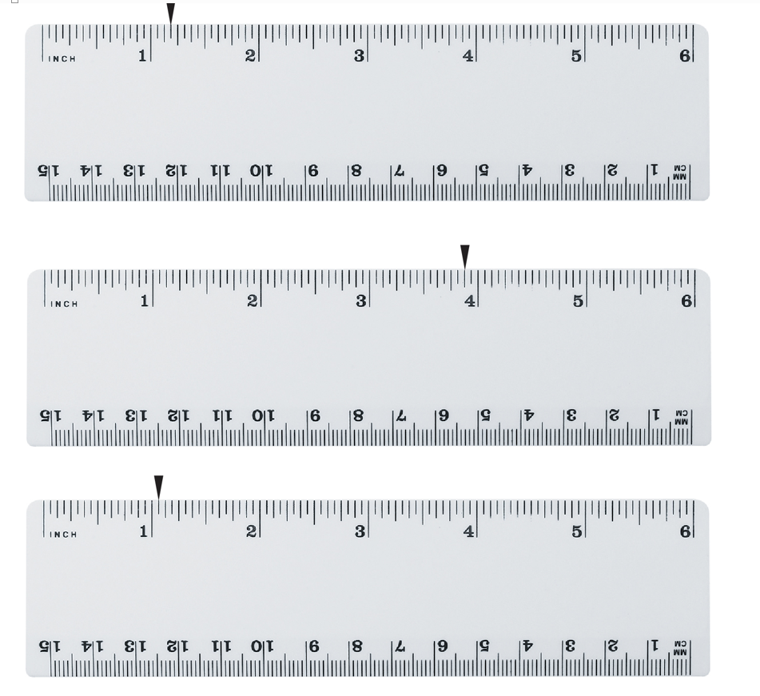

Slide 10
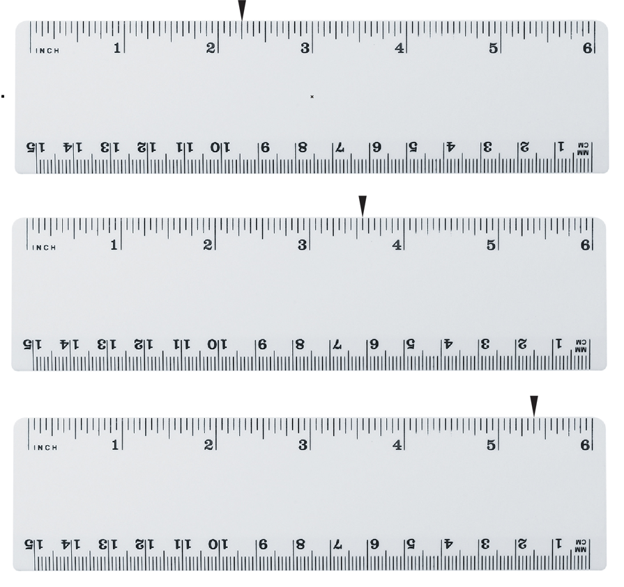

Slide 11
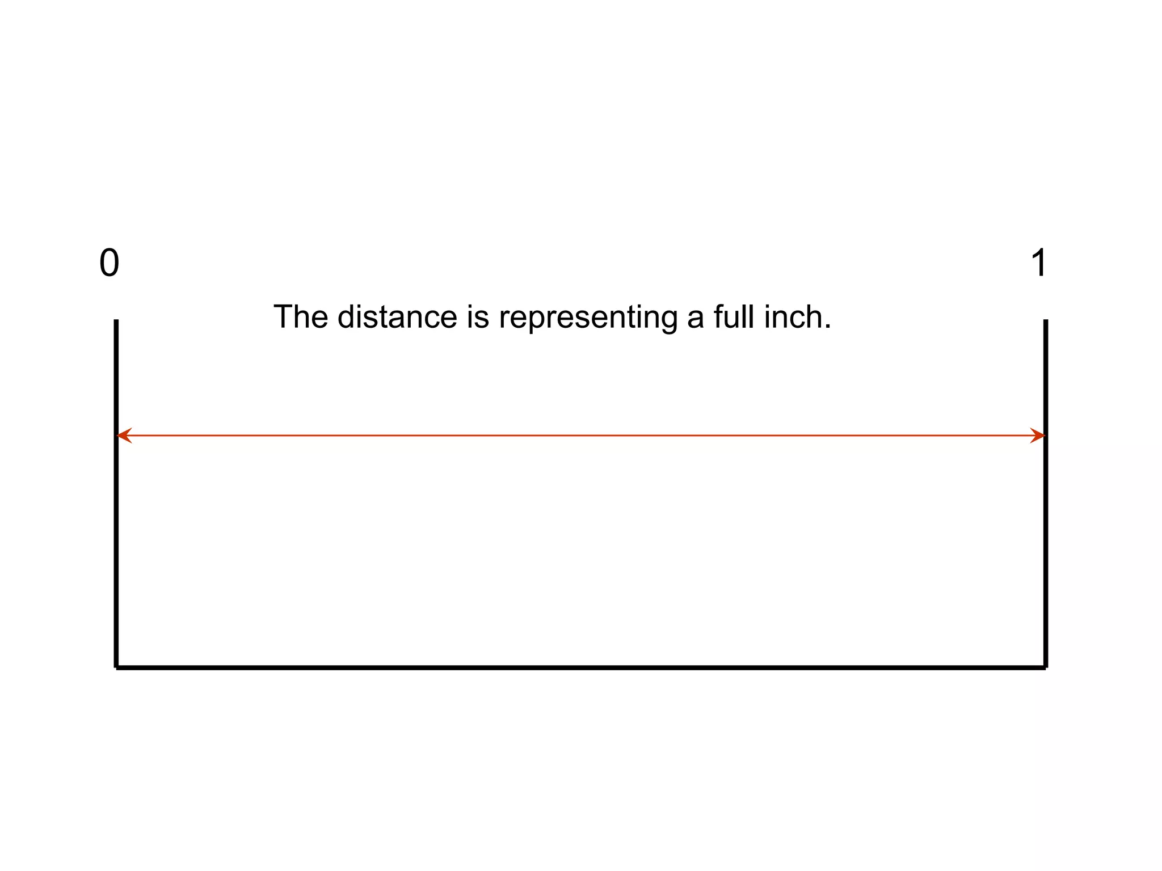

Slide 12
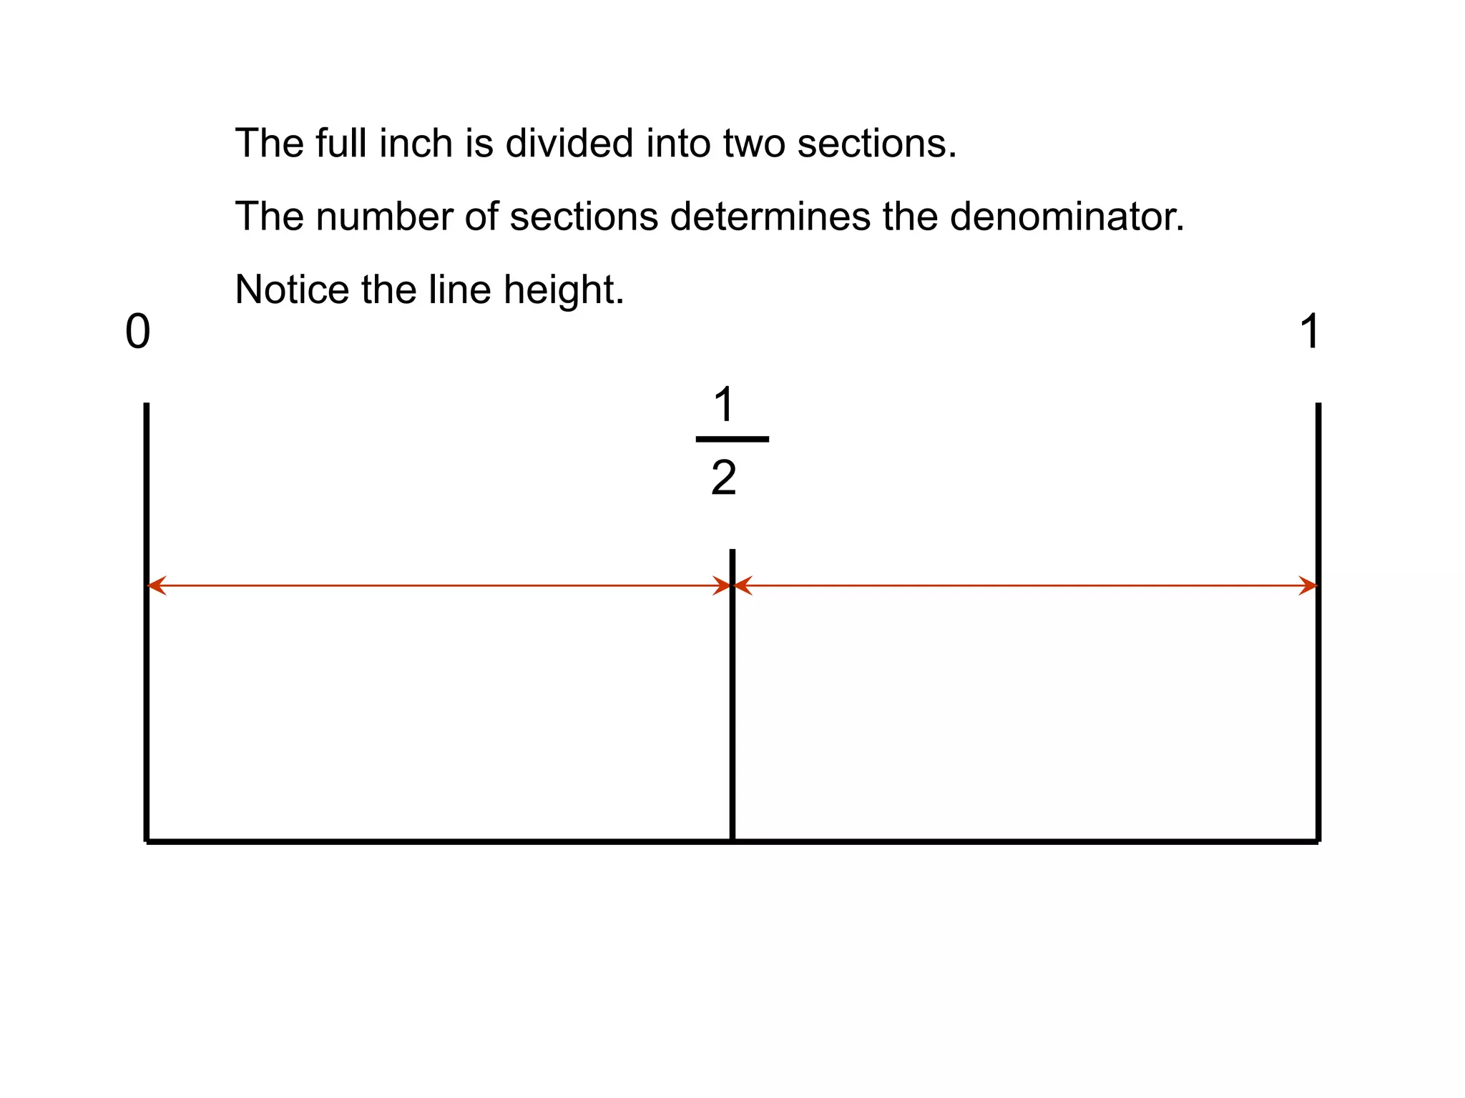

Slide 13
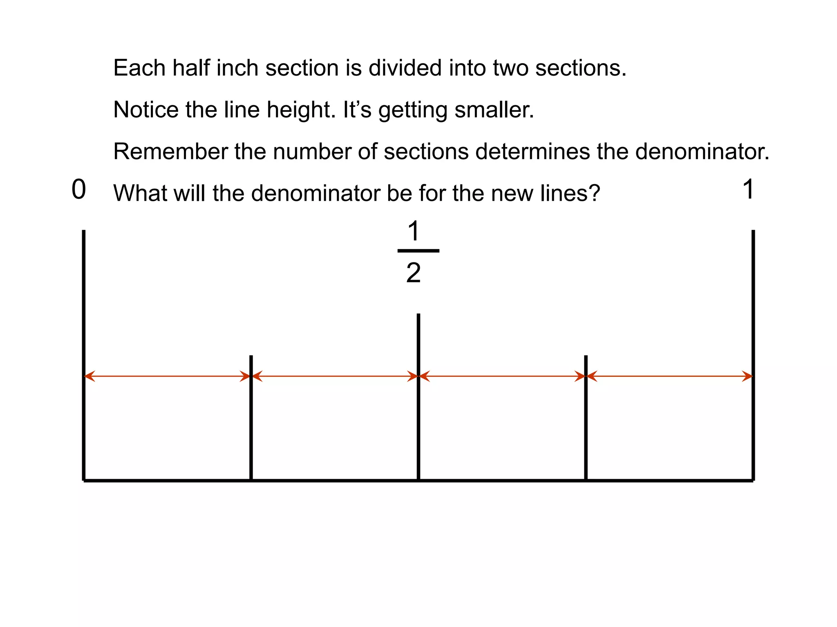

Slide 14
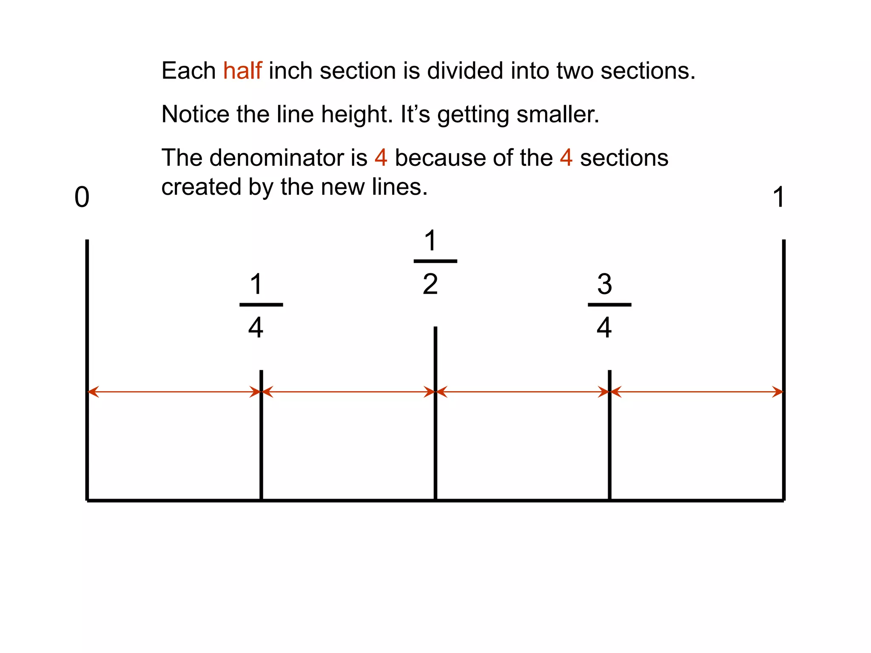

Slide 15
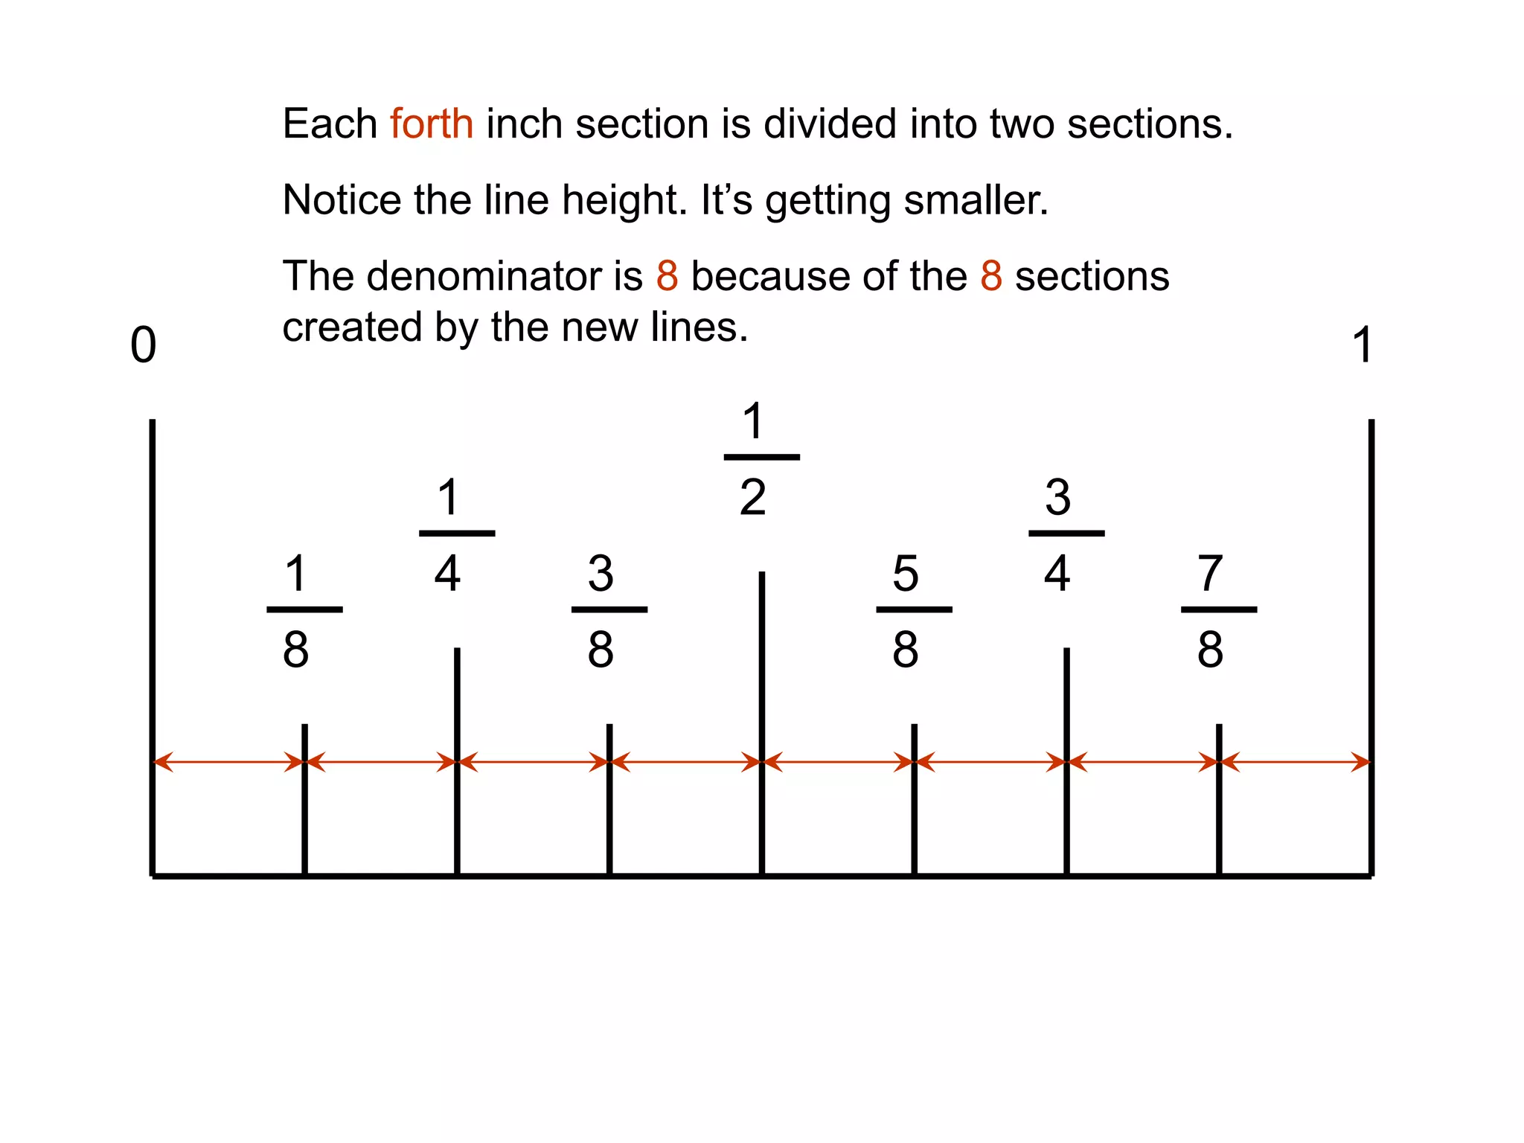

Slide 16
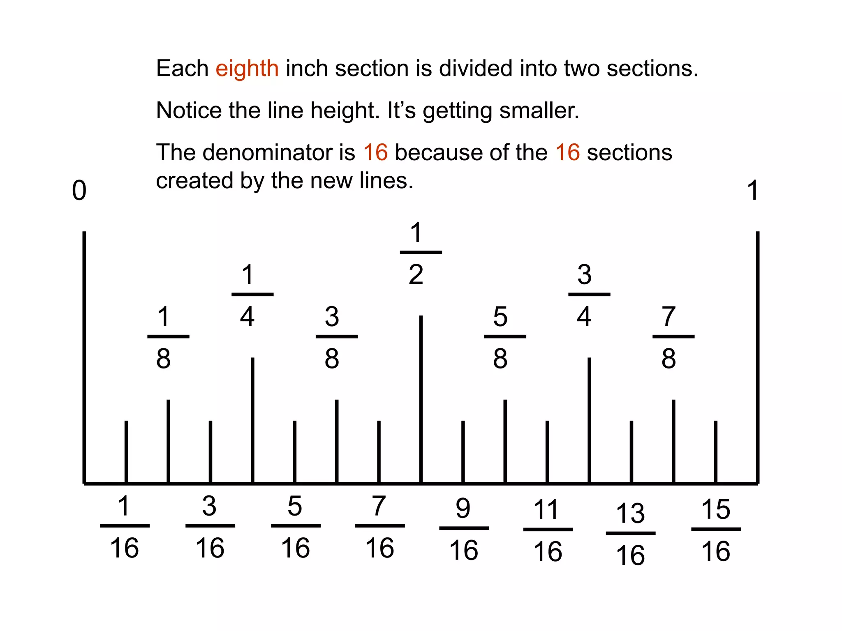

Slide 17
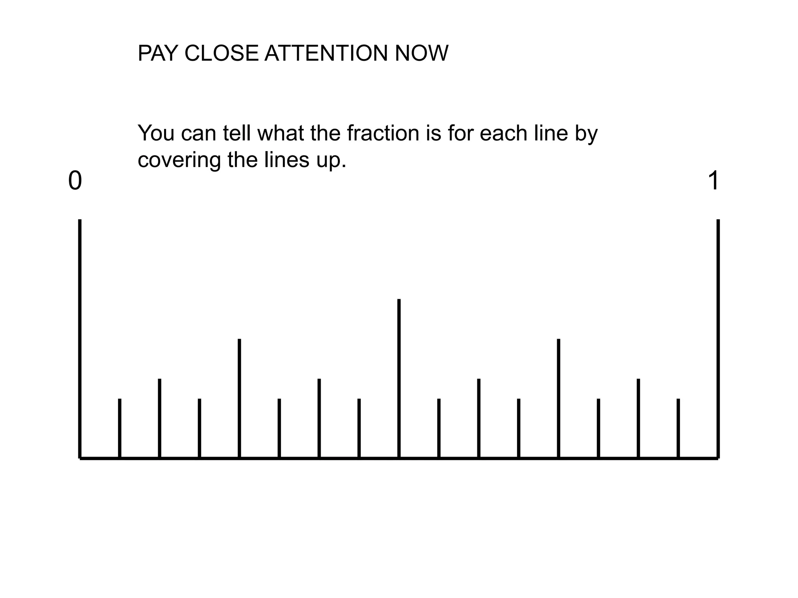

Slide 18
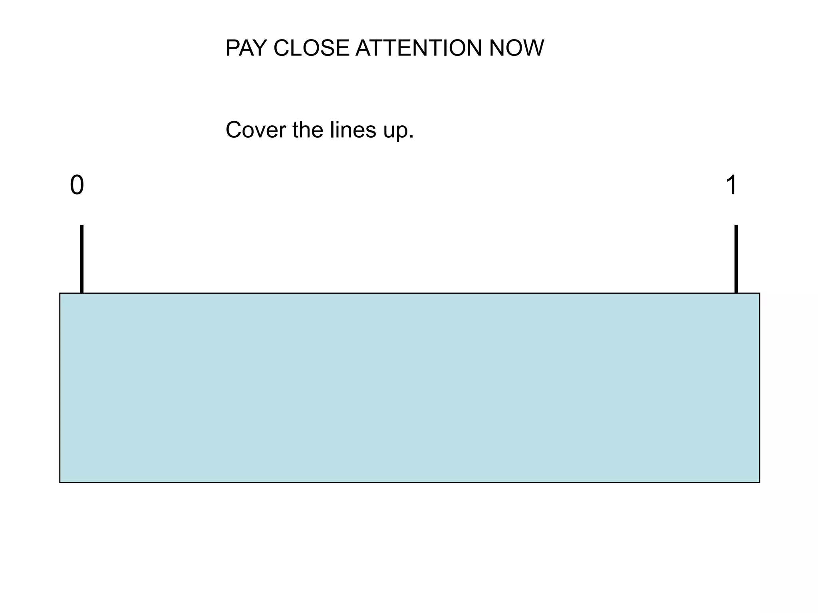

Slide 19
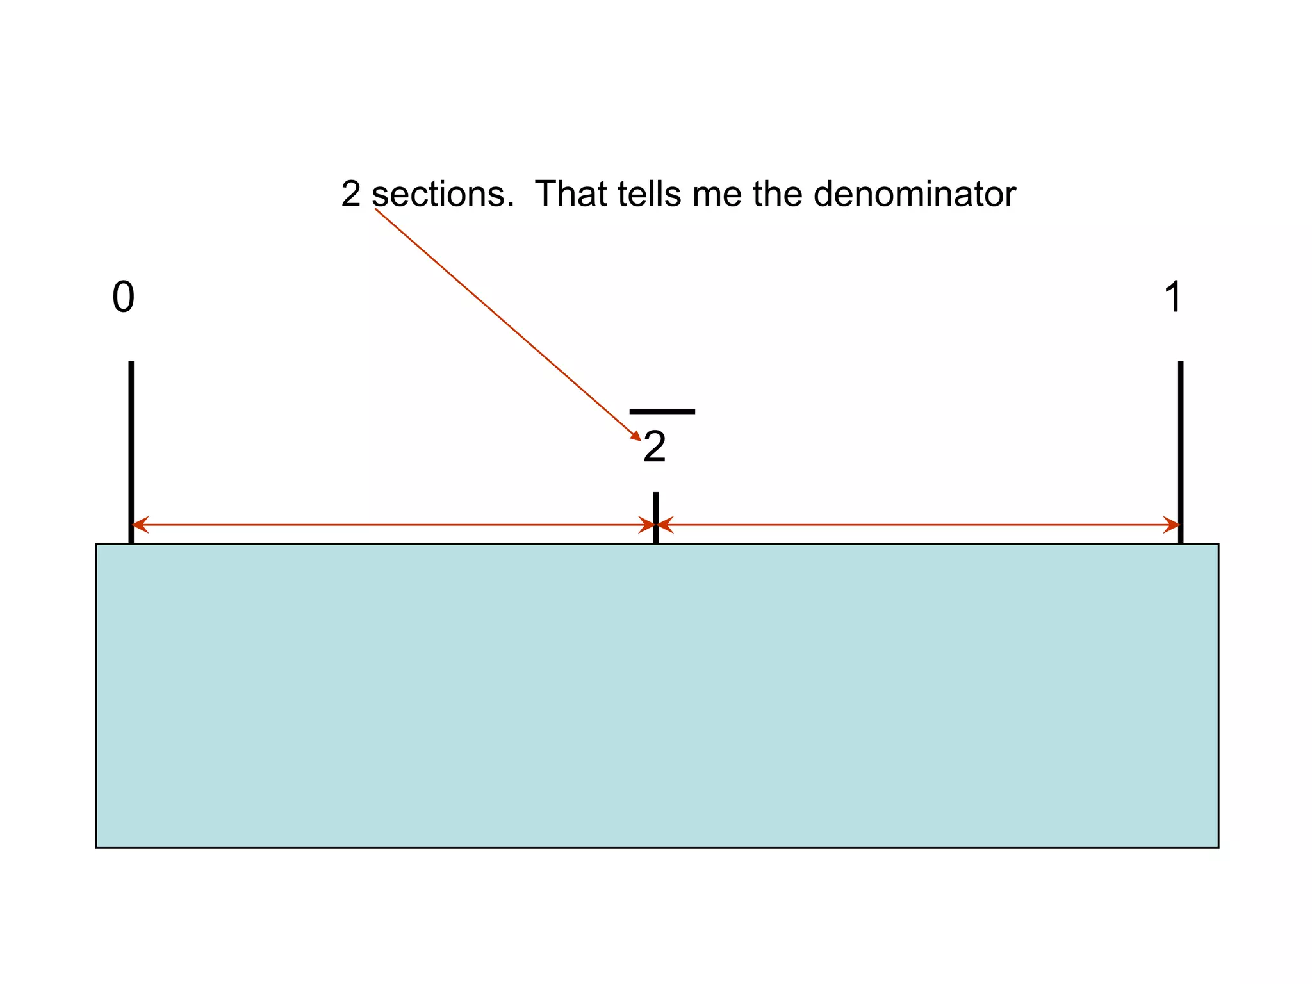

Slide 20
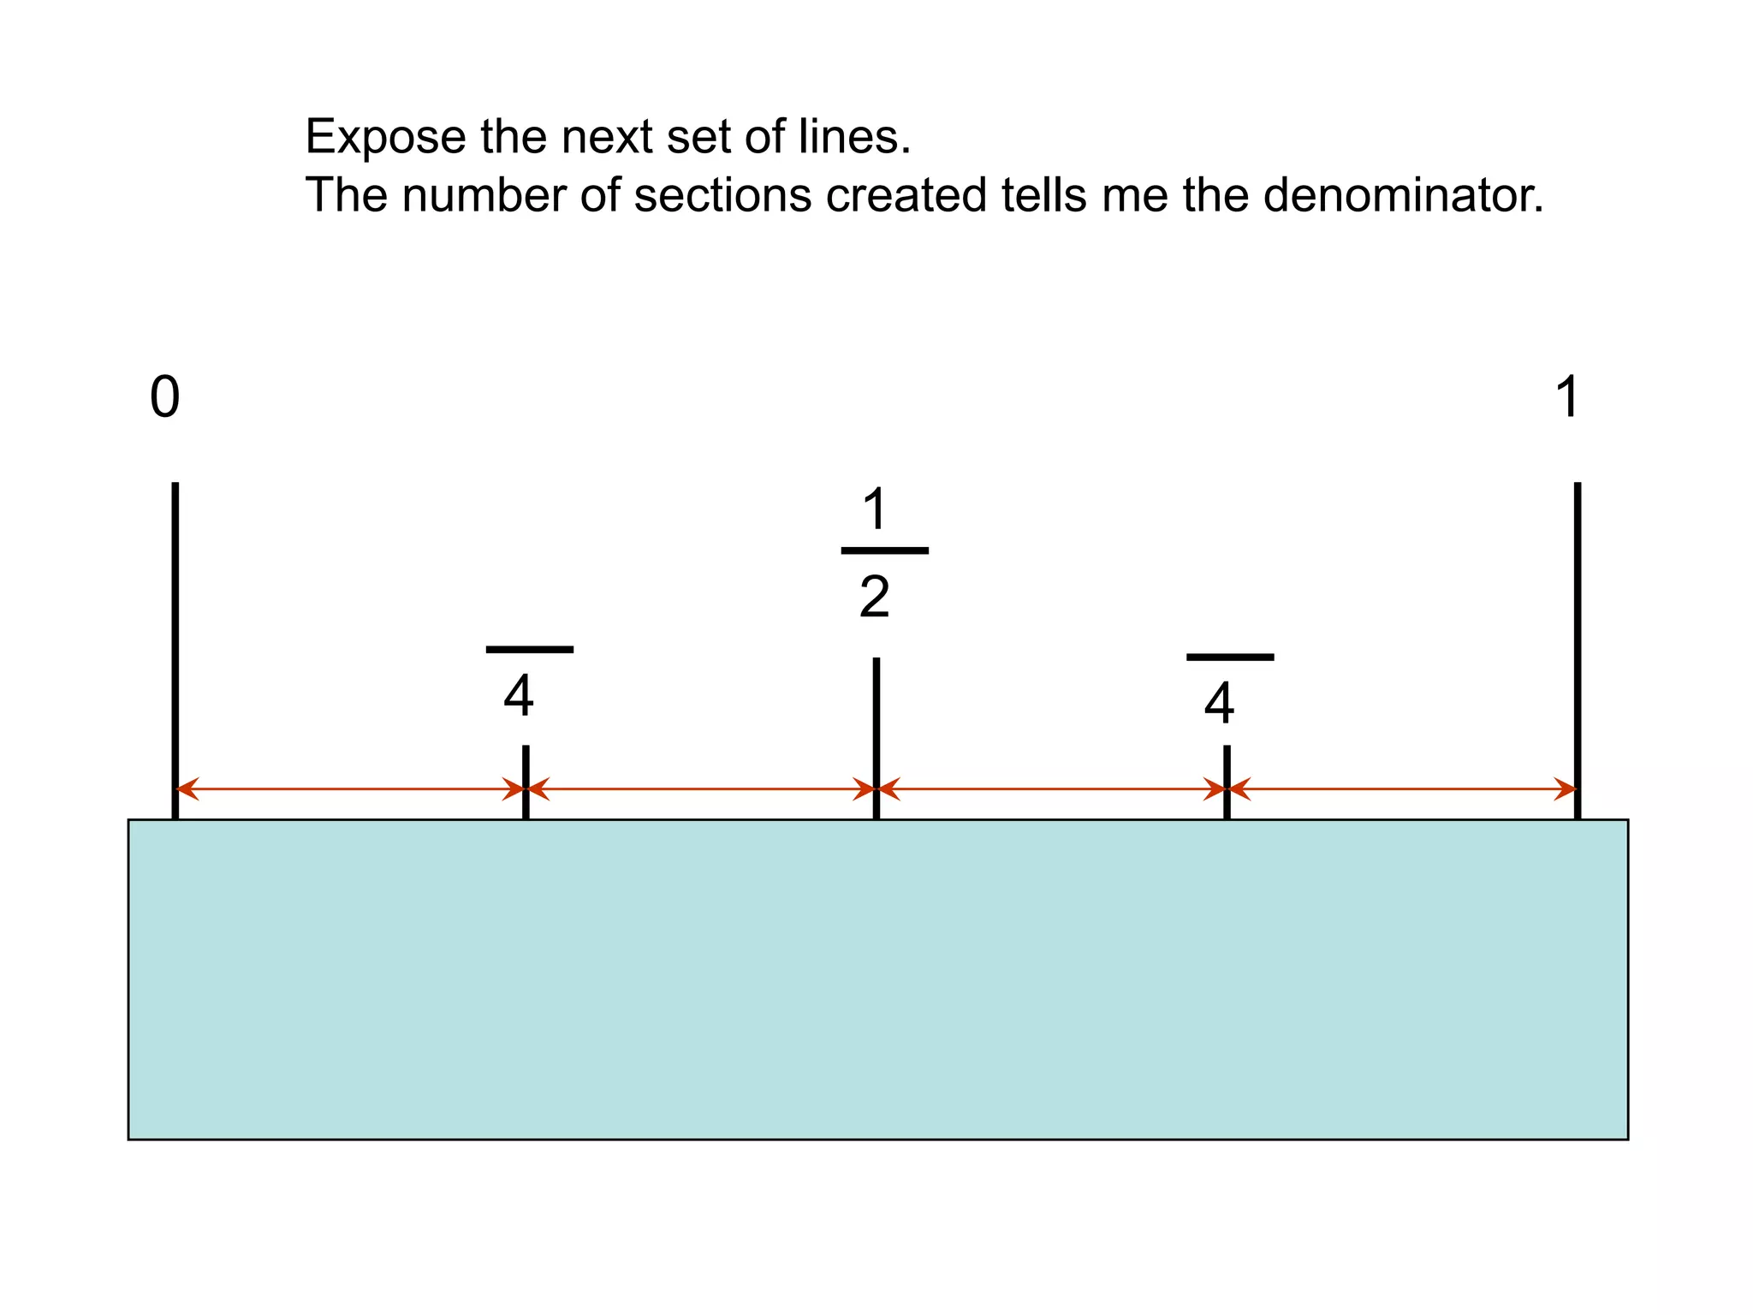

Slide 21
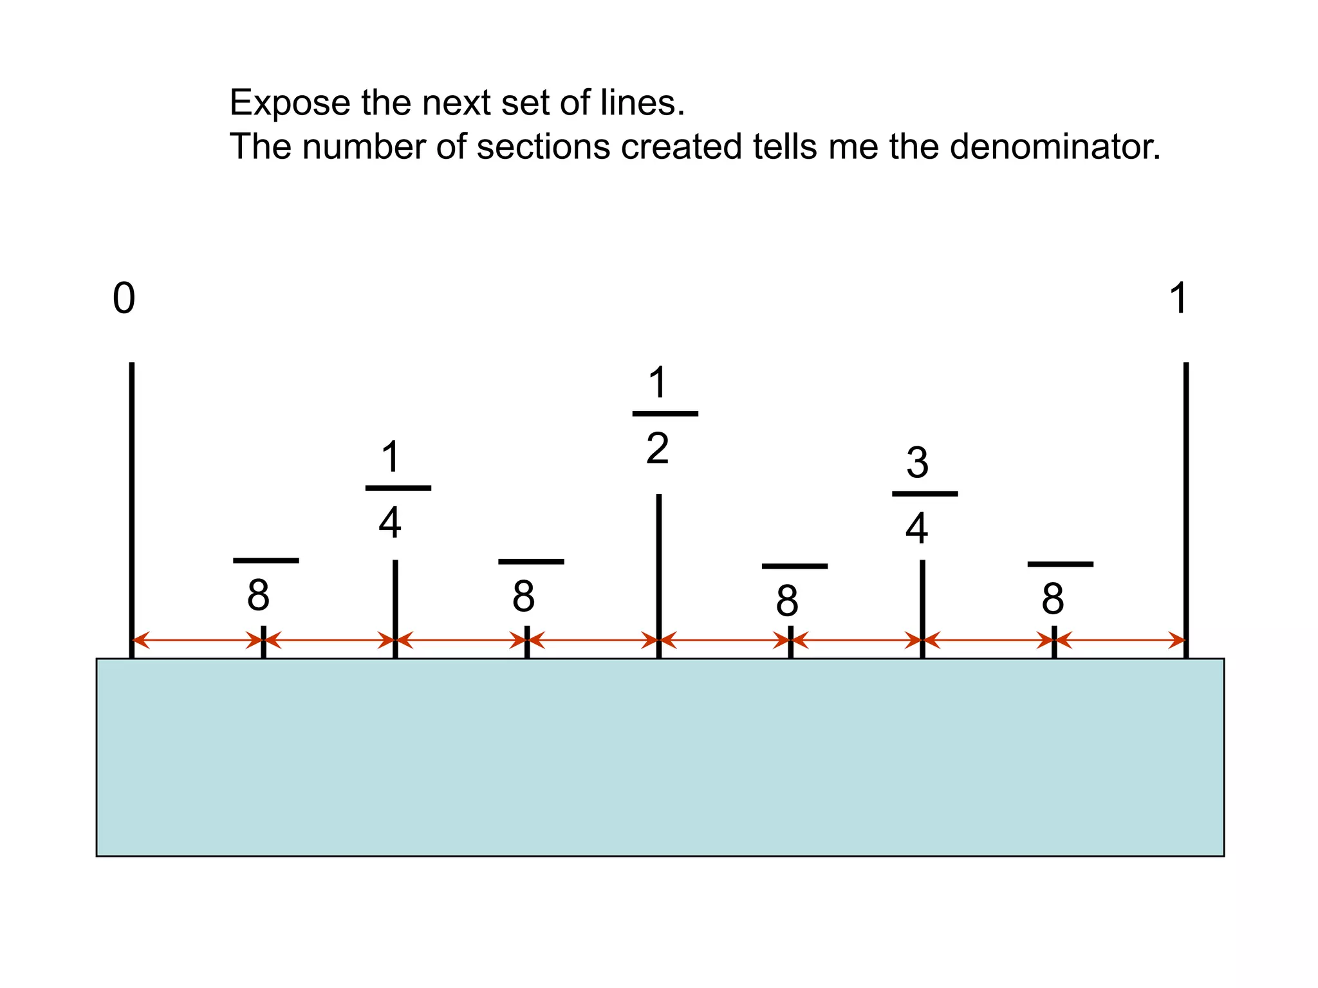

Slide 22
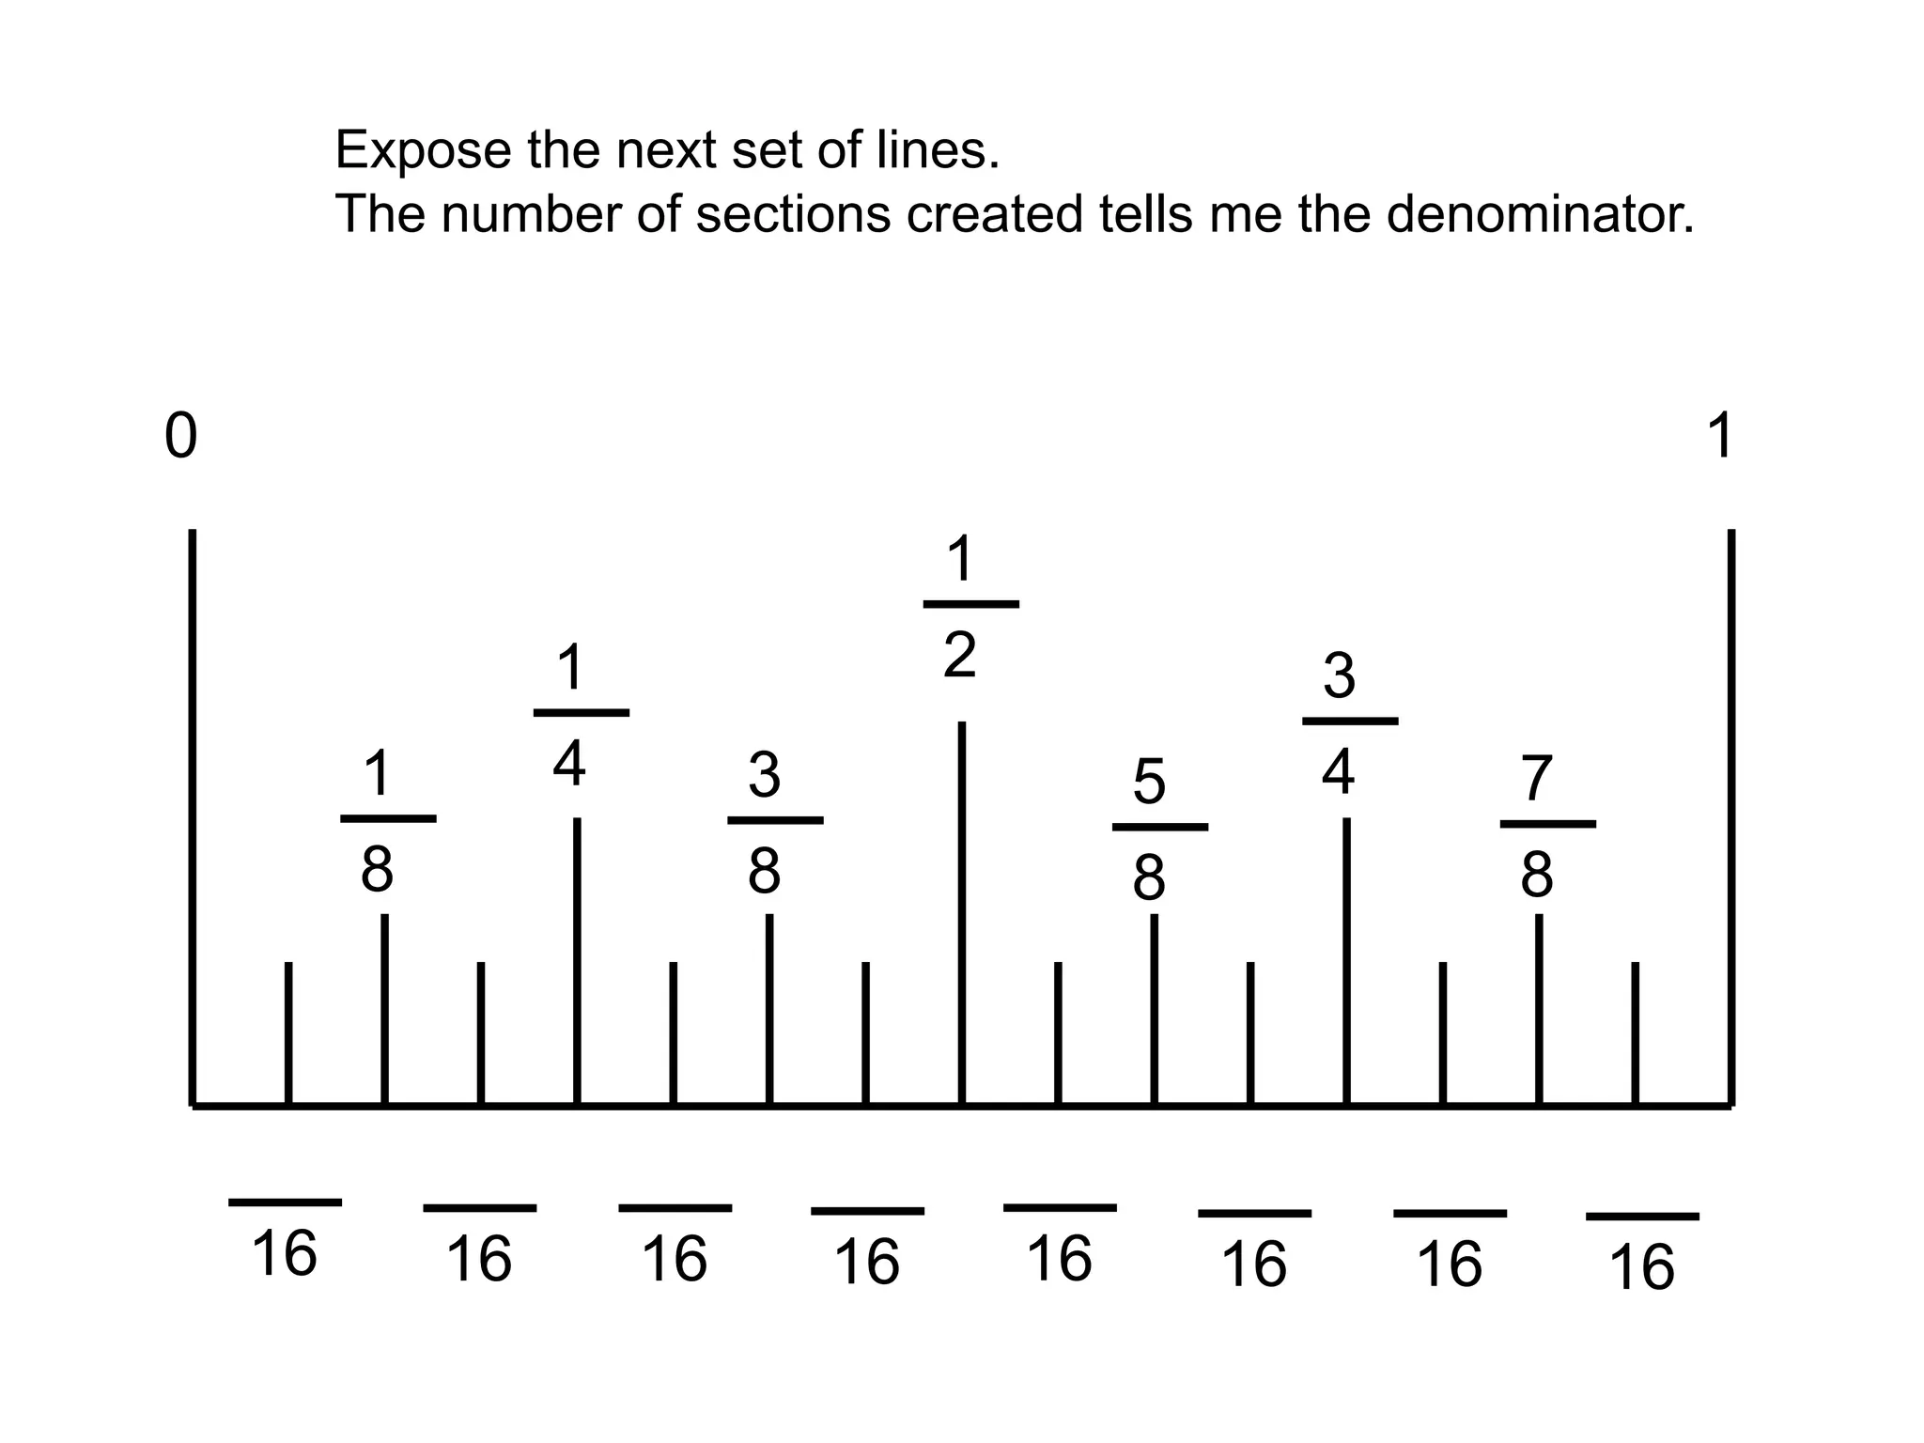

Slide 23
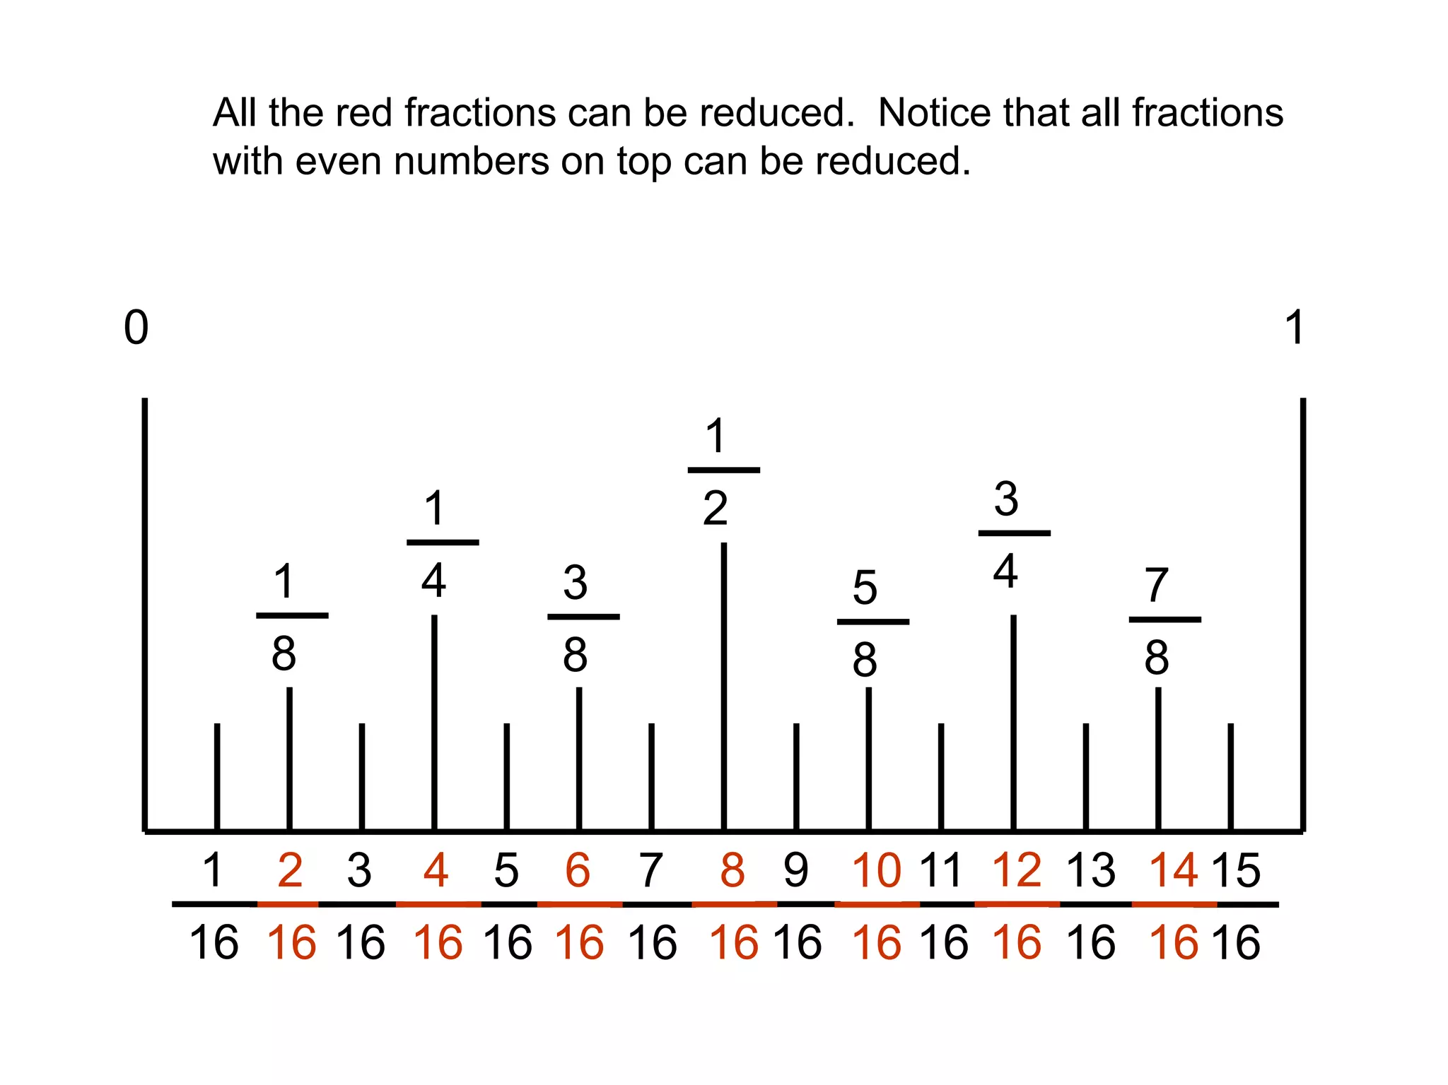

Slide 24
Three Simple Steps to Add Fractions
Step 1: Make sure the bottom numbers (the denominators) are the same.
Step 2: Add the top numbers (the numerators), put that answer over the denominator.
Step 3: Simplify the fraction (if needed)

Slide 25
Processes
Measuring
Cutting
Drilling
Gluing
Sanding
Clamping

Slide 26
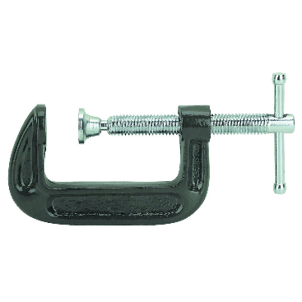
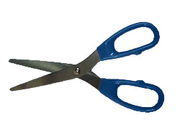
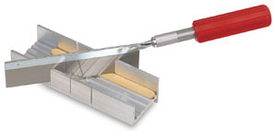
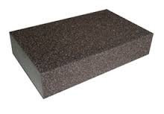
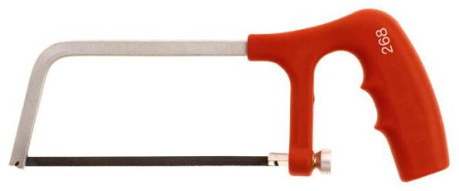
Tools
Scissors
C-clamp
Razor Saw
Miter Box
Sanding Sponge
Hack Saw

Slide 27
Why should we provide opportunities for children to use tools?
Teaching children to use tools helps develop critical cognitive, physical, and social-emotional skills, including fine and gross motor coordination, problem-solving, patience, self-control, and independence.
Tool use also fosters a sense of agency, boosts confidence, encourages creativity, and provides practical life skills, while safely introducing them to risk assessment and real-world applications.

Slide 28
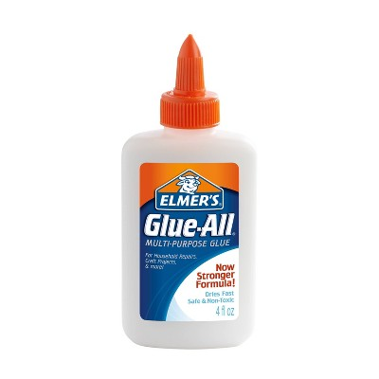
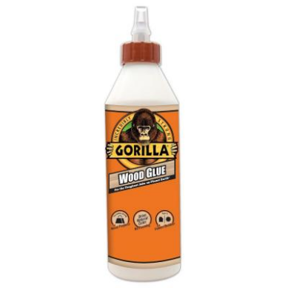
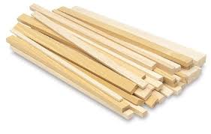
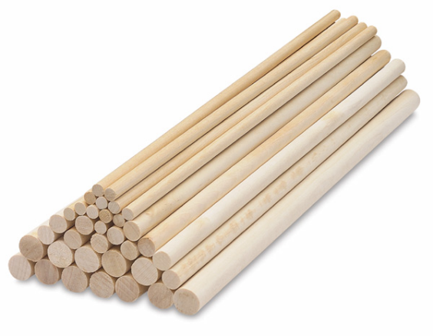

Materials
Wood Glue
Wood (Dimensional Lumber)
Notecard/Cardstock
Dowel Rods

Slide 30
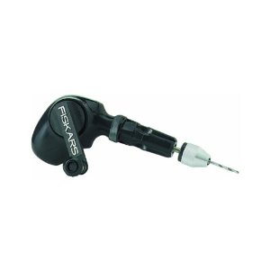
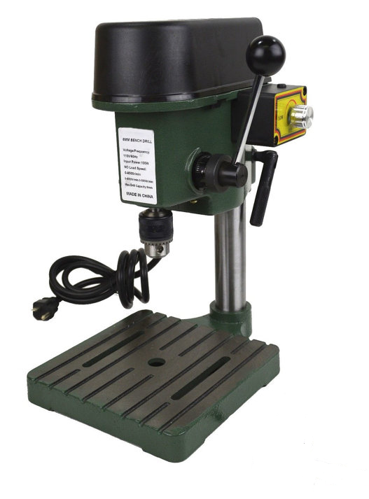
More Tools
Hand Drill
Drill Press

Slide 31
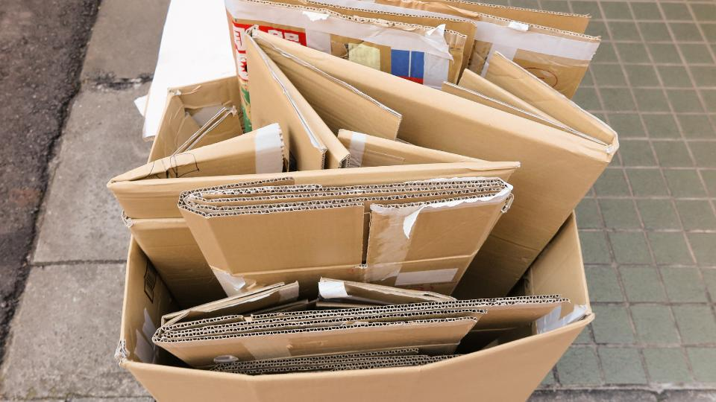
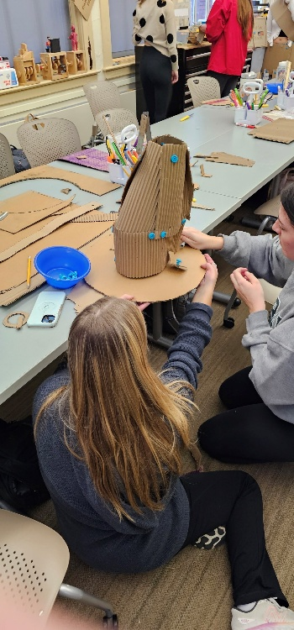
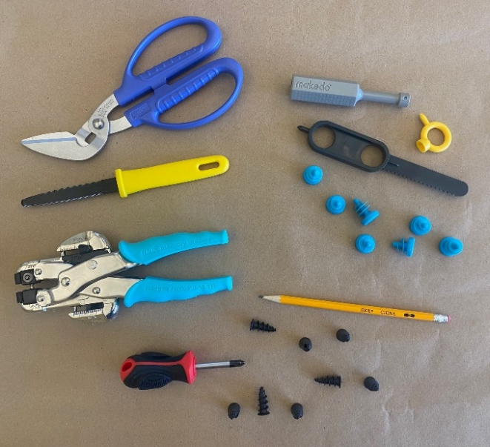
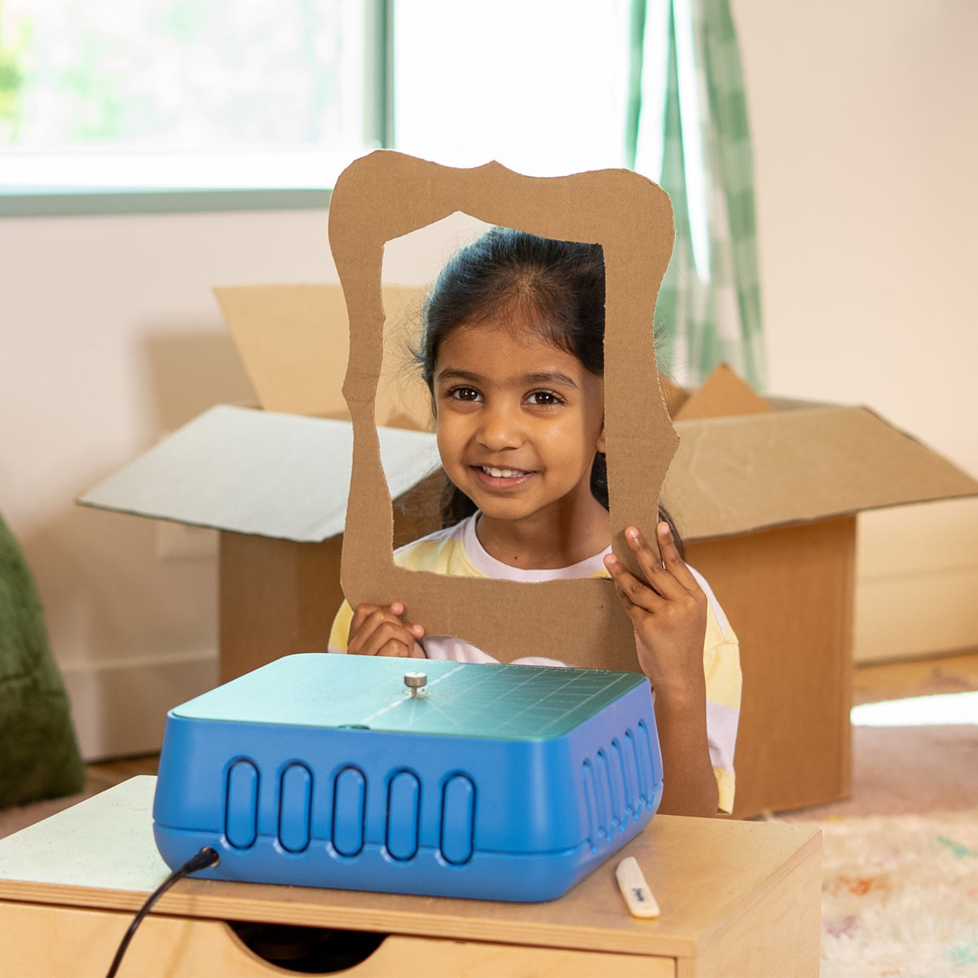
Tools for Cardboard
Canary Cutters and Shears
MakeDo
ChompSaw
Drywall Fasteners
Crop-a-Dile

