Slide 1
Integrating Literacy and Engineering Instruction

Slide 2


Slide 3
Technological and engineering literacy is defined by the ITEEA STEL as the ability to understand, use, assess, and manage technology and engineering, alongside knowing how they shape society and the natural world.

Slide 4
STEL - 1 - Nature and Characteristics of Technology and Engineering
  Understanding the scope, core concepts, and relationships between technology, engineering, and other disciplines.
STEL - 2 Core Concepts of Technology and Engineering
  Exploring systems, processes, and resources integral to technology and engineering.
STEL - 3 - Integration of Knowledge, Technologies, and Practices
  Applying interdisciplinary knowledge and processes to solve problems and innovate.
STEL – 4 - Impacts of Technology
  Analyzing the positive and negative effects of technology on individuals, society, and the environment.

Slide 5
STEL - 5 - Influence of Society on Technological Development
  Examining how societal needs, values, and demands shape technological advancements.
STEL – 6 - History of Technology
  Understanding the historical development and evolution of technology and engineering.
STEL – 7 - Design in Technology and Engineering Education
  Engaging in design processes to develop solutions to problems using critical thinking and creativity.
STEL – 8 - Applying, Maintaining, and Assessing Technological Products and Systems
  Using, managing, and evaluating technological products and systems effectively and safely.

Slide 6
Standard 6: History of Technology
Grades PreK-2
  A. Discuss how the way people live and work has changed throughout history because of technology.
Grades 3-5
  B. Create representations of the tools people made, how they cultivated food, made clothing, and built shelters to protect themselves.
Grades 6-8
  C. Compare various technologies and how they have contributed to human progress.
  D. Engage in a research and development process to simulate how inventions and innovations have evolved through systematic tests and reﬁnements.
  E. Verify how specialization of function has been at the heart of many technological improvements.

Slide 7
You will individually develop an integrated STEM education design challenge that is directly connected to a piece of children’s literature used in the elementary or middle grades (2 grade or above).
Step one - select a grade level (2 grade or above) and a minimum of one science (life, earth/space, or physical), one mathematics, and one STEL (standard and benchmark).
Step two - consider a children's book (picture book or chapter book) that could be used to guide an engineering design challenge.
Before getting started, confirm that your book selection and design challenge is an original idea. Please do not develop an activity that is commonly found in schools such as a foil/penny boat challenge, egg drop, 3 Little Pigs – blowing a structure with a hairdryer, 3 Billie Goats Gruff - bridge, or other common design challenge. If you can do a web search for the name of your book and design challenge (STEM challenge, engineering design challenge, etc.) and the idea can be found, it is not original. If your first choice doesn't work, find another book.
Step three – Read Developing Big Ideas and Essential Questions
Step four - Complete the Lit-based Curr. Rough Draft – Part 1 - no more than one two pages

Slide 8
Connecting Compassion: Empathy’s Role in STEM and Literacy Integration
Begin with your standards and a picture book from your classroom library.
To draw out empathetic connections, focus on the story grammar, particularly the setting, characters, and plot.
Consider the problem that the character(s) are facing in the story that could be solved using the engineering design process.
Link the natural empathetic connections evoked through the story grammar with the authentic compassion of your students.
Connect other standards.* - science, math, STEL
Propel the story grammar and uncover empathetic connections as students develop a solution to an engineering design challenge.

Slide 9
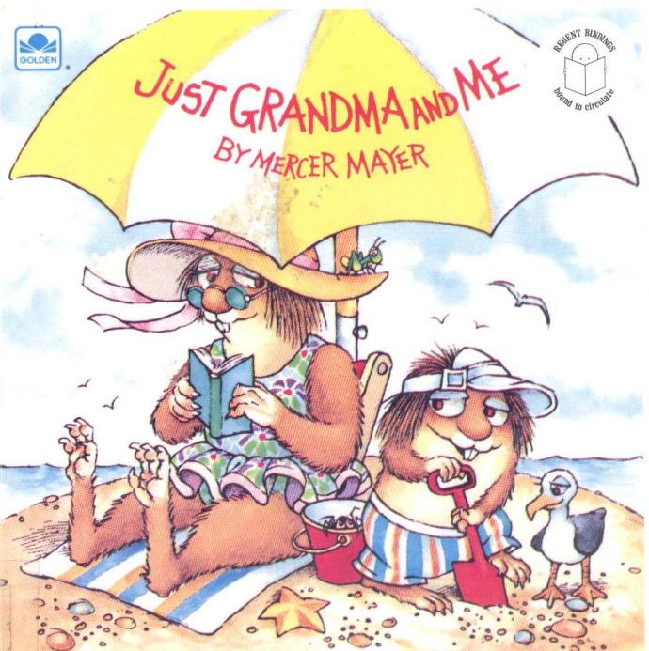

Slide 10
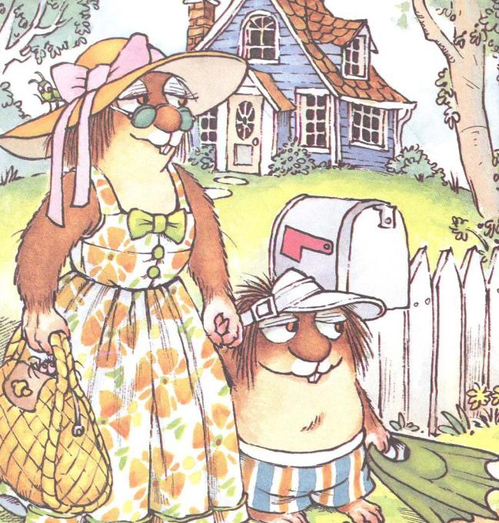

Slide 11
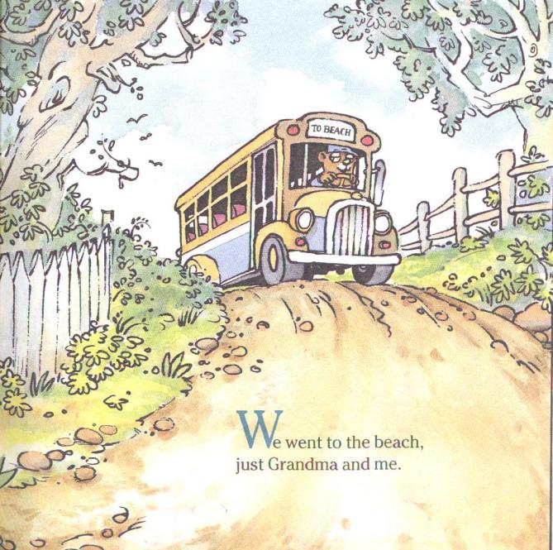

Slide 12


Slide 13


Slide 14
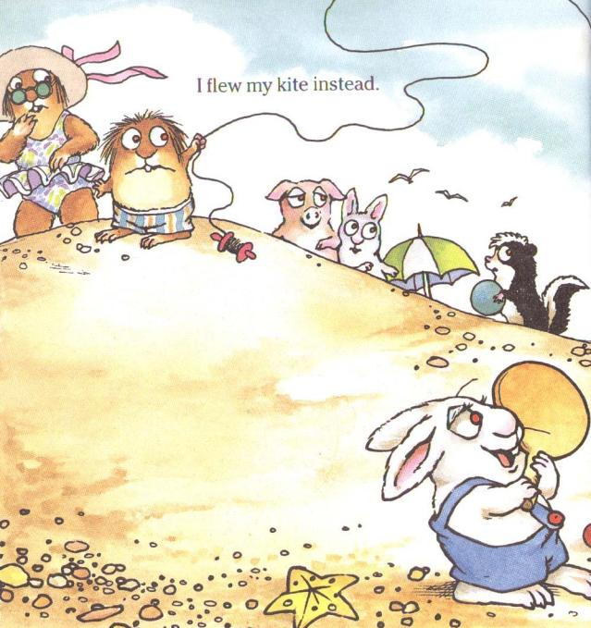

Slide 15
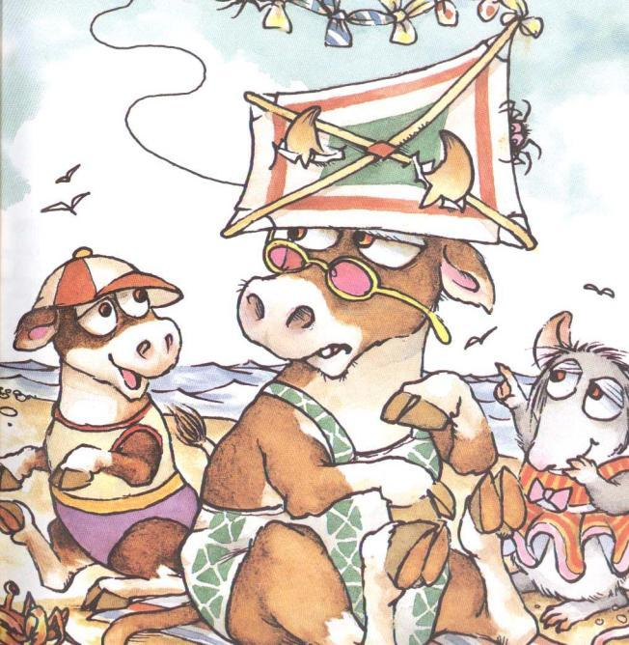

Slide 16
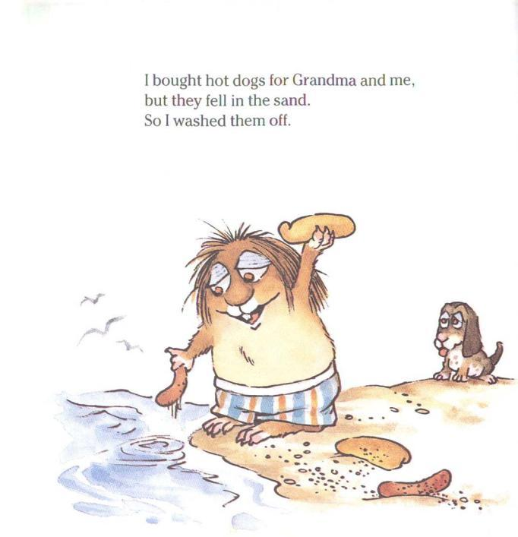

Slide 17
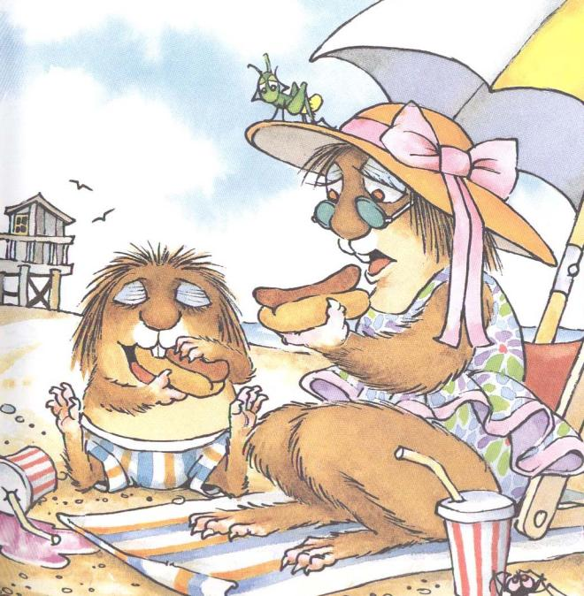

Slide 18
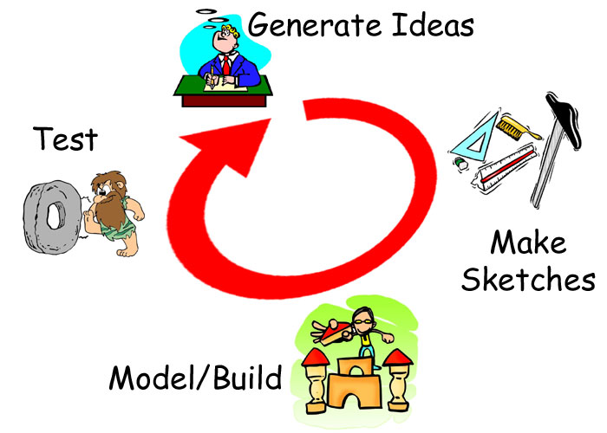
What is the problem here?

Slide 19

Curriculum Standards
Science – Structure and Properties of Matter
2-PS1-1 Plan and conduct an investigation to describe and classify different kinds of materials by their observable properties (color, texture, hardness, and flexibility)
2-PS1-2 Analyze data obtained from testing different materials to determine which materials have the properties that are best suited for an intended purpose
Another possibility -
2-PS1-4 Construct an argument with evidence that some changes caused by heating or cooling can be reversed and some cannot.

Slide 20
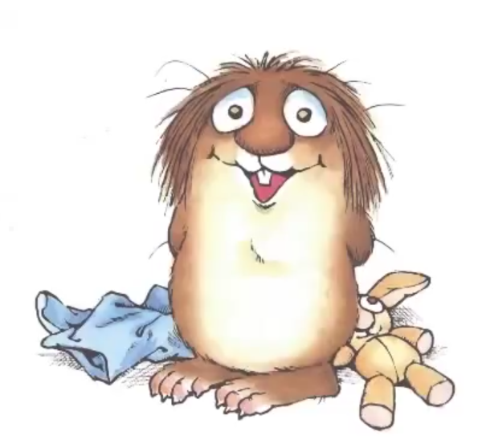
Curriculum Standards (cont.):
Technology and Engineering Education
Standard 2: Core Concepts of Technology and Engineering
  b. Safely use tools to complete tasks.
  c. Explain that materials are selected for use because they
  possess desirable properties and characteristics.
  d. Develop a plan in order to complete a task.
  e. Collaborate effectively as a member of a team.
Social Studies - Economics
E.1 Students will understand the impact of economic decision-making.
  E.1.2.6 Explain the role of money in making exchange easier.

Slide 21
Curriculum Standards (cont.):
Math
Measurement and Data
AR.Math.Content.2.MD.A.1 - Measure the length of an object by selecting and using appropriate tools such as rulers, yardsticks, meter sticks, and measuring tapes
Working with time and money
AR.Math.Content.2.MD.C.7 - Tell and write time from analog and digital clocks to the nearest five minutes, using a.m. and p.m.
AR. Math.Content.2.MD.C.8 - Solve word problems involving dollar bills, quarters, dimes, nickels, and pennies, using $ and ¢ symbols appropriately

Slide 22

Curriculum Standards (cont.):
English Language Arts
Oral Language
2.CC.1.OL: Participate in collaborative conversations following class
created discussion guidelines to expand upon conversations.
2.CC.2.OL: Ask and answer questions about what a speaker says to
gather additional information and clarify understanding.
Presentation
2.CC.5.P: Speak audibly in collaborative communication and presentations.
Writing
2.W.4.P: Produce clear and coherent writing, using precise language, relevant details and descriptions, and grade-appropriate conventions.

Slide 23

Main Ideas from the Standards
Materials – structure and properties
    Describing – understanding intended purpose - strength, flexibility, hardness, texture, and absorbency
    *heating and cooling (maybe?)
Measuring
Counting
  Creating a simple budget
  Using credits or money
Working as a team
Designing and making your thinking visible to others
What experiences could I create for students to ‘master’ or practice these ideas from the standards?

Slide 24


The Hot Dog Carrier
2nd Grade
Scenario
Little Critter and his grandma are spending the day at the beach. They are having lots of fun, but soon they get hungry!
Little Critter goes to get hot dogs and buns for lunch. On his way back to Grandma, he accidentally drops the food in the sand. Oh no! Their lunch is covered in sand!
How can Little Critter carry the hot dogs and buns across the beach without dropping them in the sand?

Slide 25
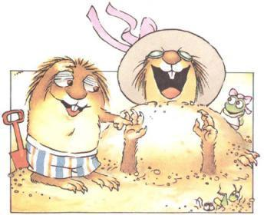
Challenge
Little Critter and Grandma don’t want to eat hot dogs covered in sand!
Your challenge is to design and build a hot dog carrier for Little Critter.
Your carrier should
Keep the hot dogs and buns warm.
Keep sand off the food.
Be small and light so Little Critter can carry it.
Cost no more than $2.00 to build.
How can you design a carrier that will safely get lunch to Grandma’s beach blanket?

Slide 26
Big Ideas
Materials have distinct properties
The properties of materials influence how we use them in everyday life.
A budget helps us keep track of how much money we can spend.
Essential Questions
How do the properties of a material help determine what we use it for?
What tools and methods can we use to observe and describe materials accurately?
Why is it important to keep a budget?

Slide 27

Evaluation:
Test your hot dog carrier and refine your design.
Evaluate and record your solution in your Design Journal.
    -understanding of properties of materials
    -measuring/counting
    -working as a team
Present and demonstrate your solution to the class.

Slide 28

What I’m Learning | 3 – I Got It! | 2 – I’m Getting It | 1 – I Need More Practice
Explore Materials | I can describe and compare materials using properties like color, texture, hardness, and flexibility. | I can describe some properties of the materials. | I need help describing and comparing materials.
Choose the Best Materials | I use results from our tests to choose materials that will work well for my carrier, and I can explain why I chose them. | I choose materials that might work and give a reason for my choices. | I need help choosing materials that fit the job.
Make a Plan | I draw and label a clear plan before building and show the materials I will use. | I make a plan, but some parts are missing or unclear. | I need help making a plan before I build.
Measure My Design | I choose and use the correct measuring tool to accurately measure my design. | I measure my design with some help. | I need help choosing or using a measuring tool.
Stay on Budget | I correctly find the cost of my materials and keep my design at $2.00 or less. | I find most of my costs correctly or need some help staying within the $2.00 budget. | I need help finding the cost of my materials and using my $2.00 budget.
Use Tools Safely | I use tools correctly and safely while building. | I usually use tools safely but sometimes need reminders. | I need help or reminders to use tools safely.
Work as a Team | I share ideas, listen to others, and help my team complete the challenge. | I work with my team but sometimes need reminders to share, listen, or help. | I need help working with my team.
Share My Design | I speak clearly and loudly enough for others to hear as I explain my design and material choices. | I explain my design but sometimes need reminders to speak clearly or loudly. | I need help explaining my design so others can hear and understand me.

Slide 29

Design Requirements (Sometimes called constraints or limitatations)
What your hot dog carrier must do -
Work with your partner or team to plan, build, test, and improve a hot dog carrier for Little Critter.
Your hot dog carrier must:
Keep the hot dogs and buns warm.
Keep the hot dogs and buns clean and sand-free.
Keep the hot dogs and buns from falling out.
Be no larger than 12" × 12" × 12".
Weigh less than 1 pound.
Cost no more than $2.00 to build.
Use materials that your team selects based on their properties and how well they work for the job.

Slide 30
Design Requirements - (What your hot dog carrier must do)
Your team must also:
Develop a plan before you begin building.
Use tools safely as you build.
Work together and share ideas.
Complete a Design Journal to record your ideas, material tests, plan, measurements, costs, testing, and improvements.
Test your finished carrier to see how well it meets the design requirements.
Present your design to the class and explain the choices your team made.

Slide 31

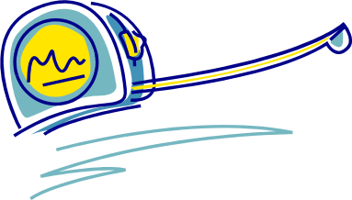
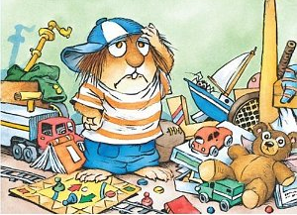
Materials/Tools/Resources:
Styrofoam trays – 50¢
Egg cartons - 50¢
Carboard box - $1.00
Cardboard tubes - 25¢
12” yarn - 10¢
12” string - 10¢
Yogurt/sour creamtubs – $1.00
1 pipe cleaners - 10¢
12” X 12” cardboard - 50¢
Paper fasteners - 25¢
Plastic knives/spoons - 50¢
12” X 12” aluminum foil - 25¢
Tape/glue – as needed
Tools
Rulers
Scissors
Chomp-saw
Hole punch

Slide 32
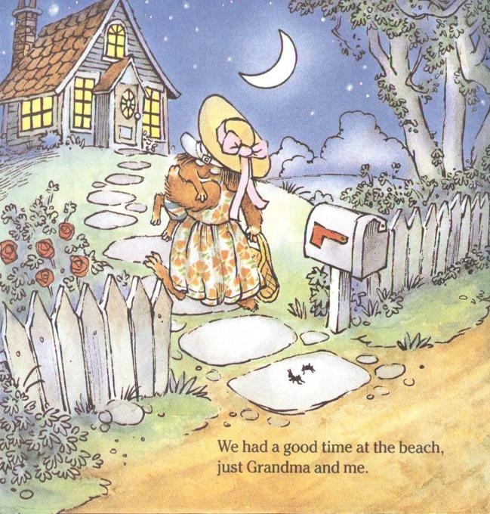

Slide 33
How could you create reflective questions in your engineering design journal?
For example: Looking at the data collected during our Materials Investigation, what items will float?

Slide 34
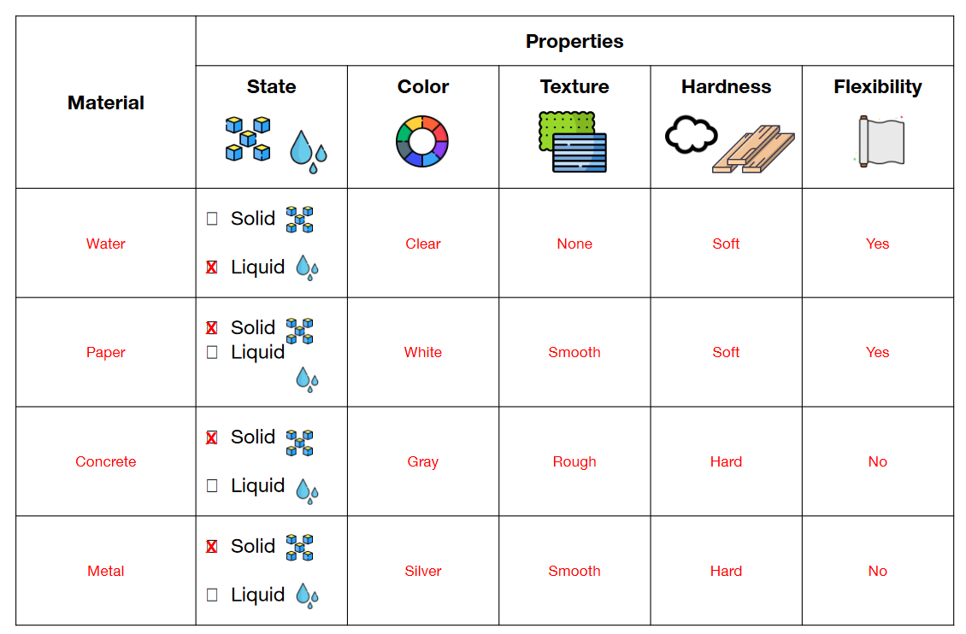
2-PS1-1 Plan and conduct an investigation to describe and classify different kinds of materials by their observable properties (color, texture, hardness, and flexibility)
2-PS1-2 Analyze data obtained from testing different materials to determine which materials have the properties that are best suited for an intended purpose
The Traditional Worksheet

Slide 35
Materials Investigation as Part of the Engineering Design Journal -
Material | Color | Texture | Hardness | Flexibility | Buoyancy (will this material float?) | What other observable properties did you find?
Styrofoam Tray
Egg Cartons
Cardboard Tube
Yarn
Masonry Line
Plastic Tub
Fuzzy Stick (pipe cleaner)
Paper Fastener (brad)
Aluminum Foil
Masking Tape

Slide 36
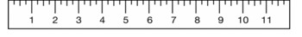
AR.Math.Content.2.MD.A.1 - Measure the length of an object by selecting and using appropriate tools such as rulers, yardsticks, meter sticks, and measuring tapes
Material | Length | Inches | CM | What other measurement data could you collect from your material (width, height, etc.)? | Cost per item
Styrofoam Tray
Egg Cartons
Cardboard Tube
Yarn
Masonry Line
Plastic Tub
Fuzzy Stick (pipe cleaner)
Paper Fastener (brad)
Aluminum Foil
Masking Tape

Slide 37
How can you document evidence that ensures that the students get intentional practice with the content/vocabulary of your target standards?
What else? How do you know that your students truly understand the intent of the standards?

Slide 38
Before getting started, confirm that your book selection and design challenge is an original idea. Please do not develop an activity that is commonly found in schools such as a foil/penny boat challenge, egg drop, 3 Little Pigs – blowing a structure with a hairdryer, or other common design challenge. If you can do a web search for the name of your book and design challenge (STEM challenge, engineering design challenge, etc.) and the idea can be found, it is not original.

Slide 39
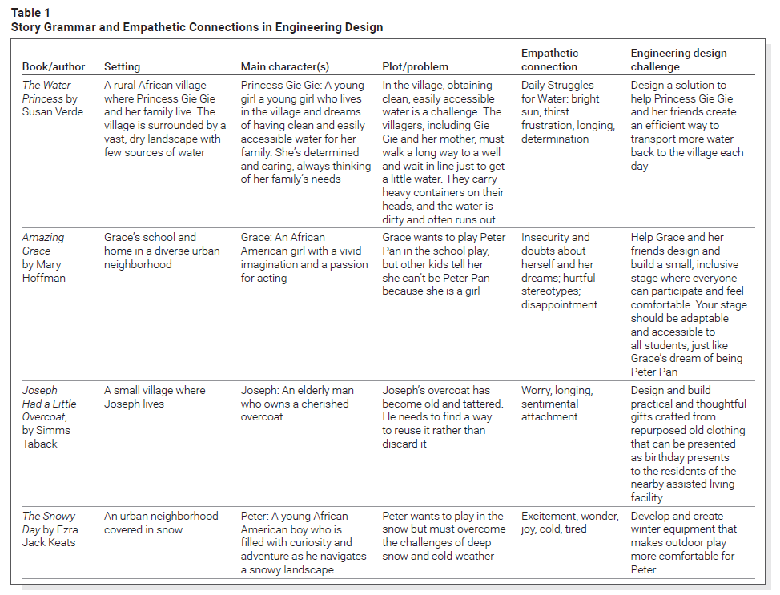
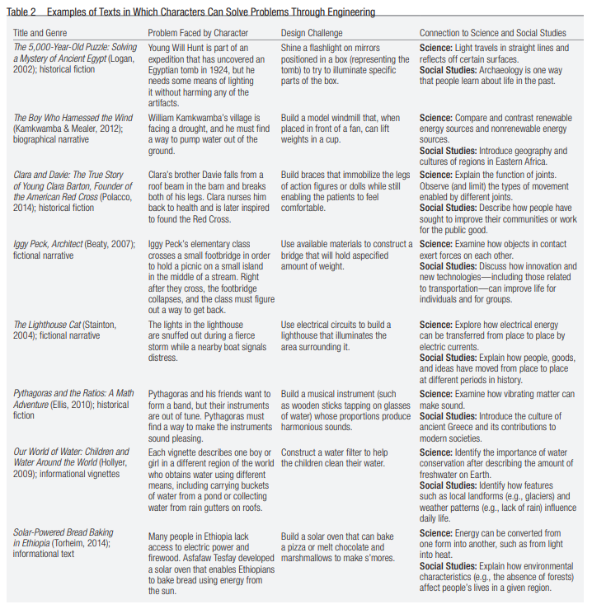
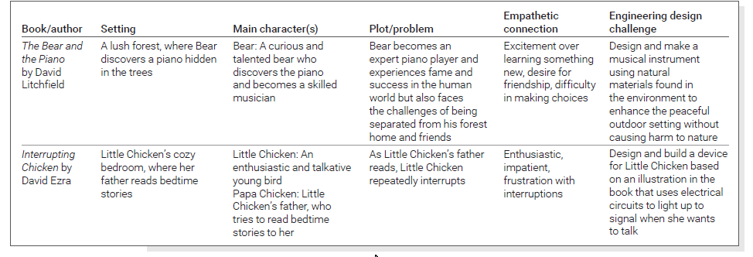
Obviously, we want to void the books mentioned in our readings this semester

