Slide 1
Play is the work of the child.
-Maria Montessori
Play is often talked about as if it were a relief from serious learning. But for children, play is serious learning... Play is really the work of childhood.
-Fred Rogers

Slide 2
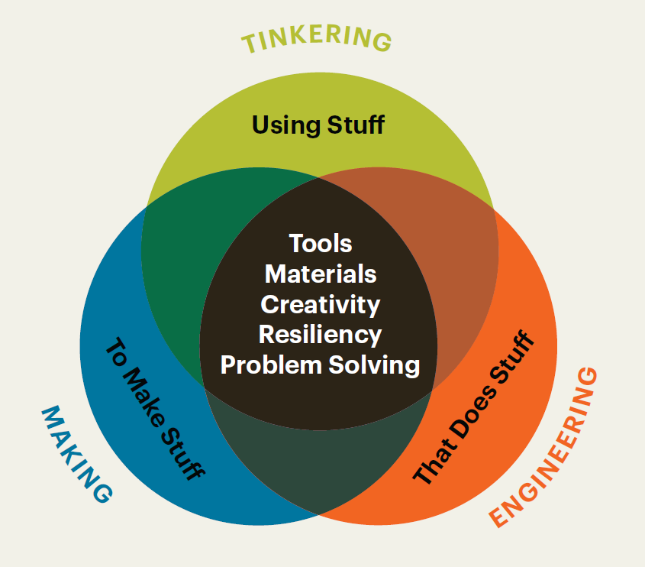
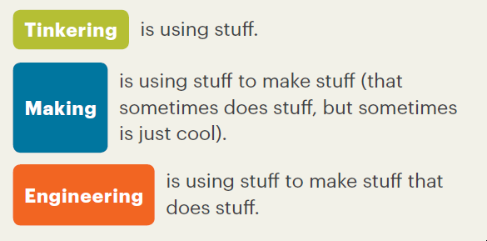
What You Need to Know About Tinkering, Making, and Engineering, NAEYC, Adapted from the Boston Children’s Museum, Tinker Kit: Educators’ Guide (2016)

Slide 3
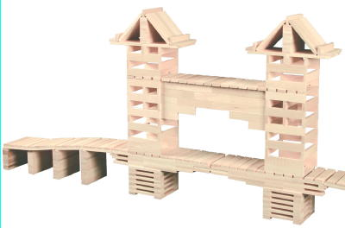
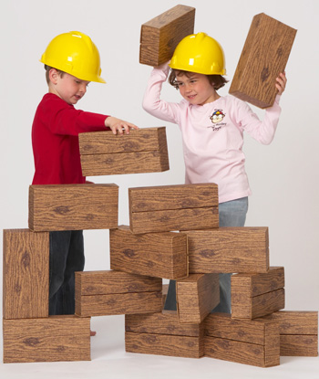
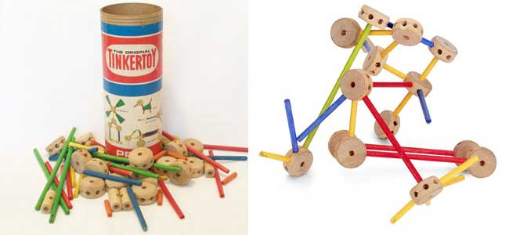
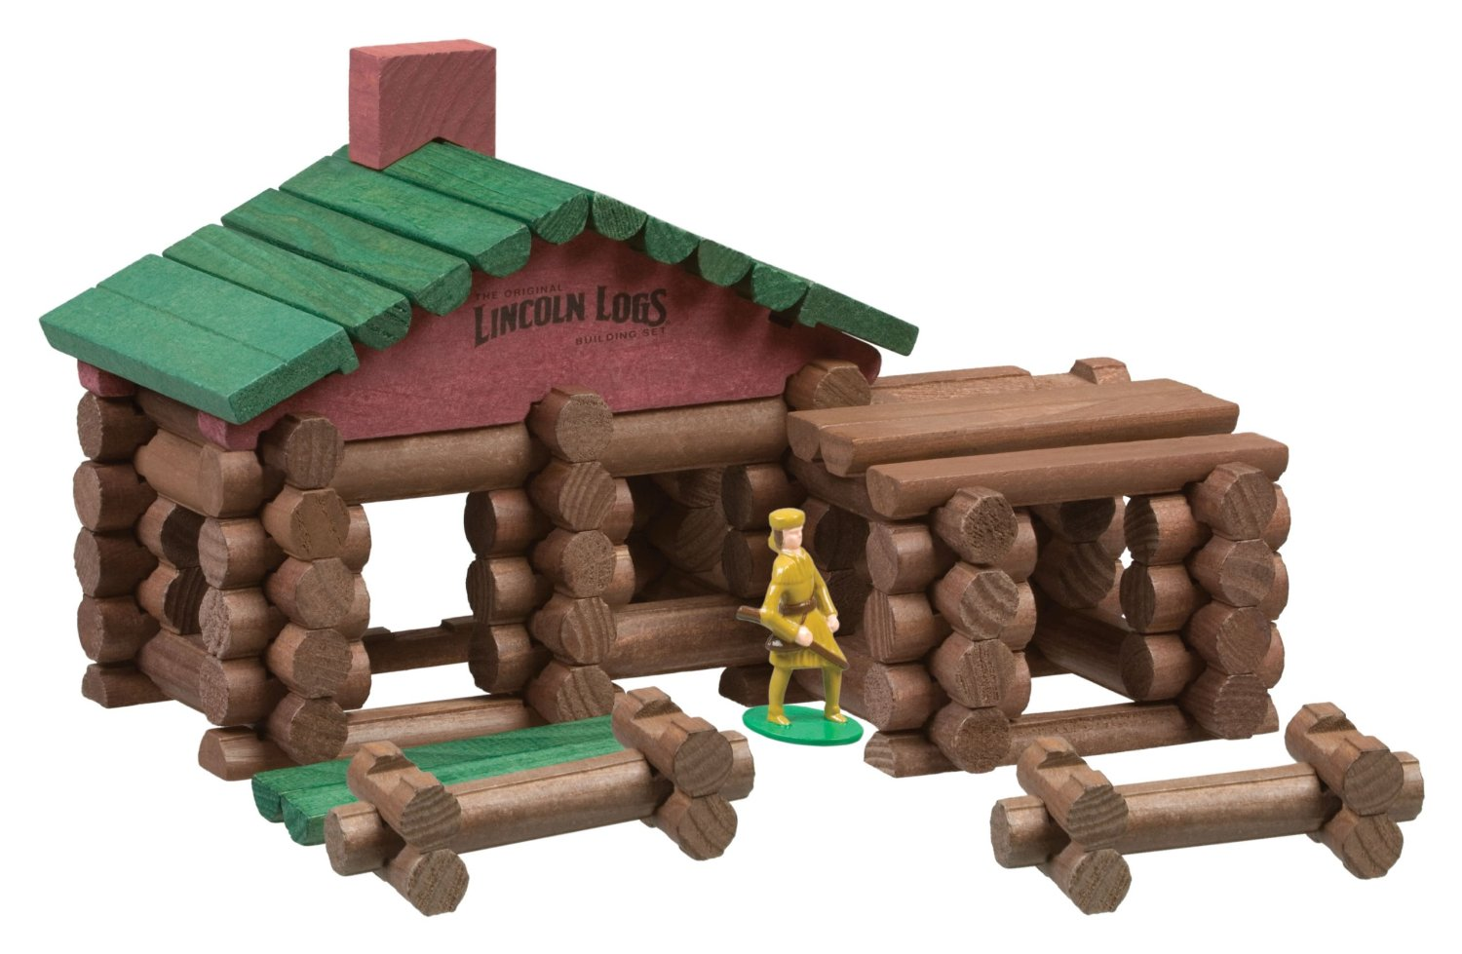
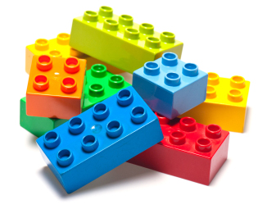
Using Blocks and Construction Toys for Teaching STEM Content

Slide 4
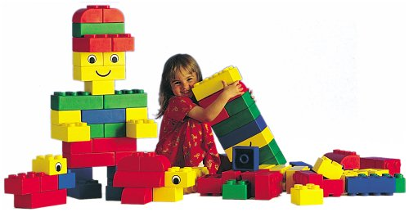
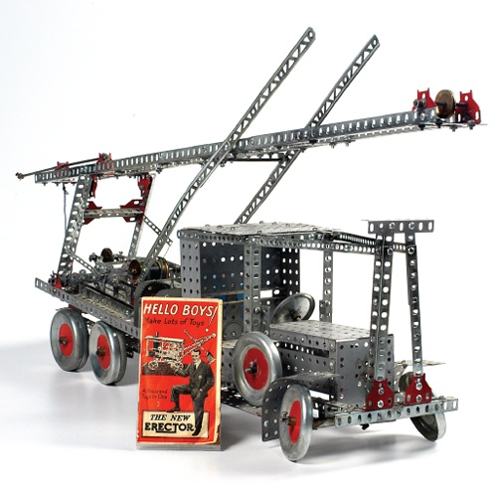
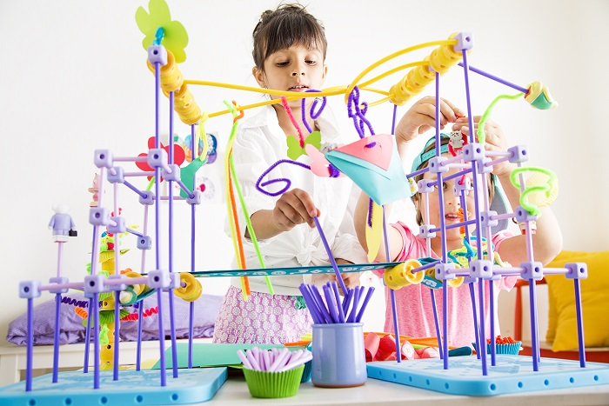
What are We Talking About?
Legos and/or Mega Bloks
K’nex
Lincoln Logs
Keva Planks
Goldie Blocks
Tinker Toys
Unit Blocks
Erector Sets
Others

Slide 5
Ten Things Children Learn From Block Play
(National Association for the Education of Young Children (NAEYC), 2015)
Problem solving. Sometimes it is intentional: “I want to build X. How do I do that?” Other times it is in-themoment: “To go higher and add to one side, what can I use?”—Peter Pizzolongo
Imagination. Children can follow their own plan, or they can share a friend’s vision and work together to create something they never dreamed of.—Karen Cairone
Self-expression. Blocks offer many ways for young dual language learners to explore, express themselves, and demonstrate what they are learning across languages.— Karen Nemeth
Mathematics. Important concepts and skills are practiced and strengthened through block play, including length, measurement, comparison, number, estimation, symmetry, balance.—Kristen Kemple
Continuity and permanence. Block play engages spatial sense and motor abilities; it can be a solo or a group effort; block creations can stand for an indefinite period of time.—Lawrence Balter

Slide 6
Ten Things Children Learn From Block Play (cont.)
(National Association for the Education of Young Children (NAEYC), 2015)
Creativity. Blocks and other loose parts can be moved freely by children, to be combined and recombined in countless ways.—Angela Eckhoff
Science. Blocks offer opportunities to test hypotheses and build scientific reasoning.—Gayle Mindes
Self-esteem. Children discover that they have ideas and that they can bring their ideas to life by creating, transforming, demolishing, and re-creating something unique.—Holly Bohart
Social and emotional growth. Blocks help children learn to take turns and share materials, develop new friendships, become self-reliant, increase attention span, cooperate with others, and develop self-esteem.— Kathleen Harris
Development in all areas. Block play requires fine and gross motor skills. Blocks enhance children’s problem-solving abilities, mathematics skills, and language and literacy abilities. And constructing “creations” builds selfesteem and feelings of success. —Linda Taylor

Slide 7
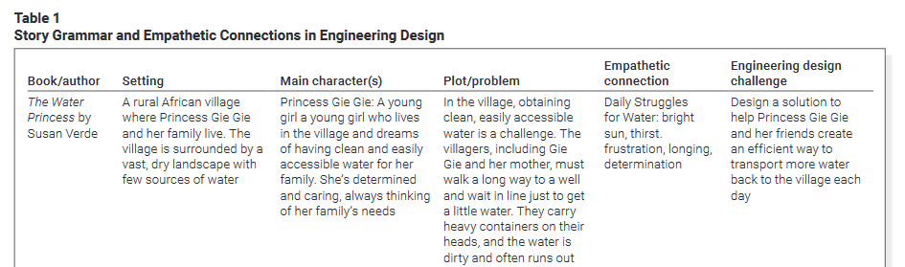
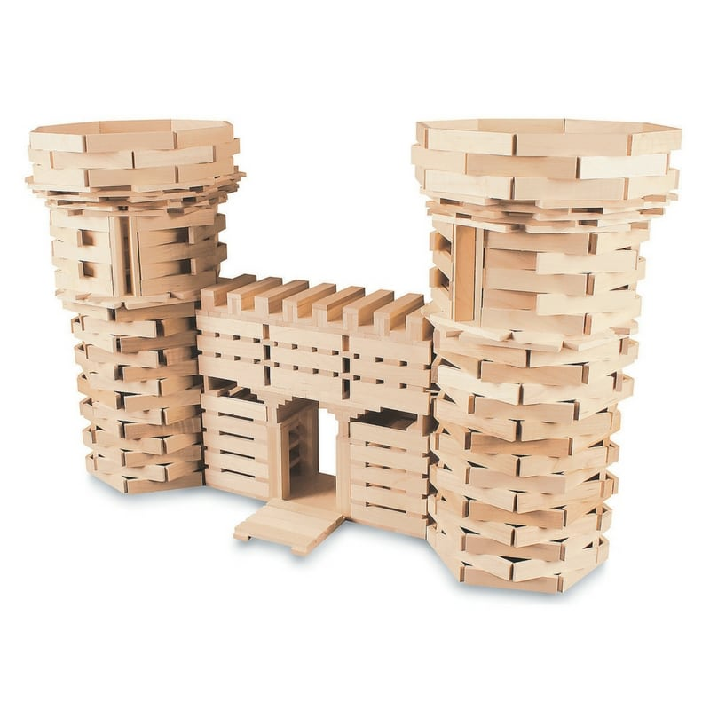
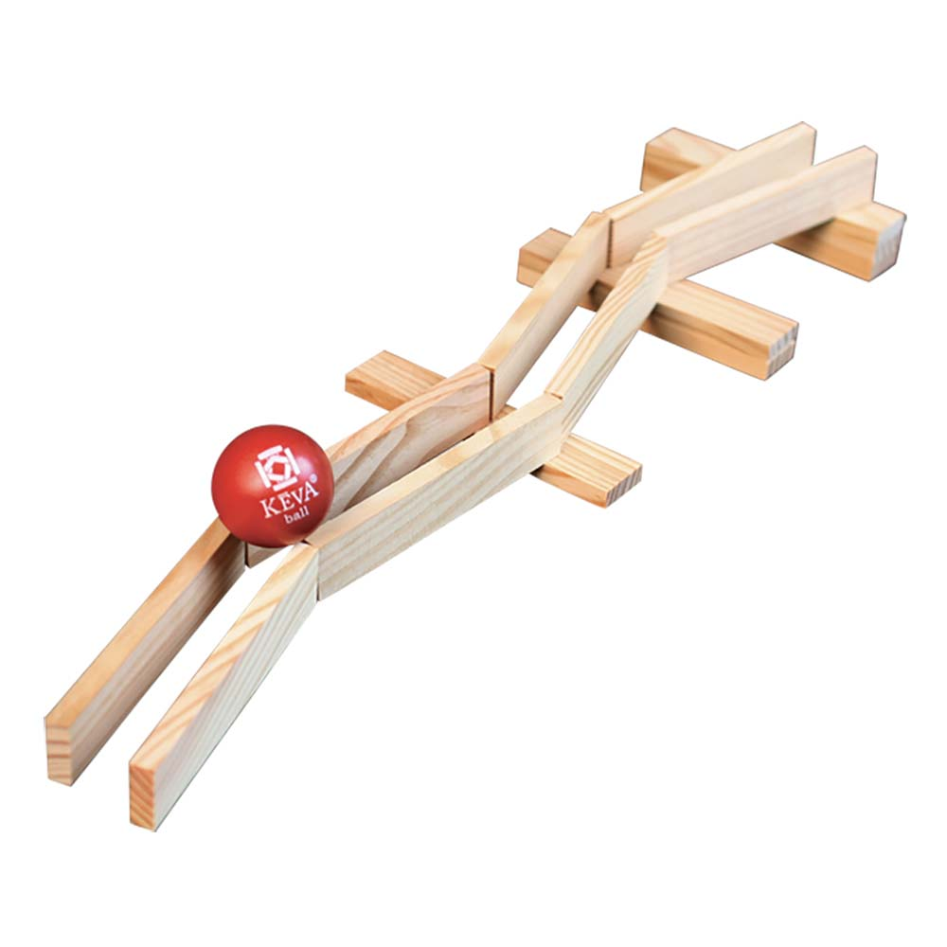
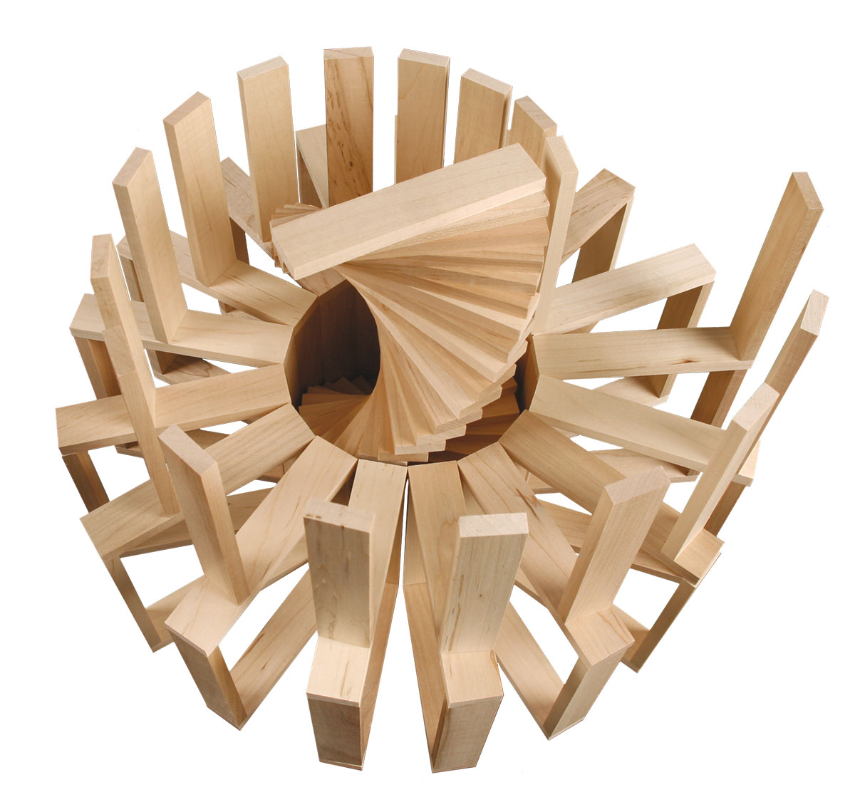
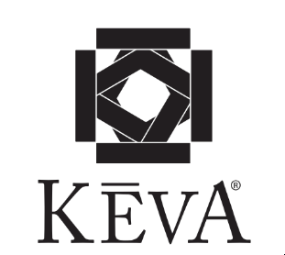

Slide 8
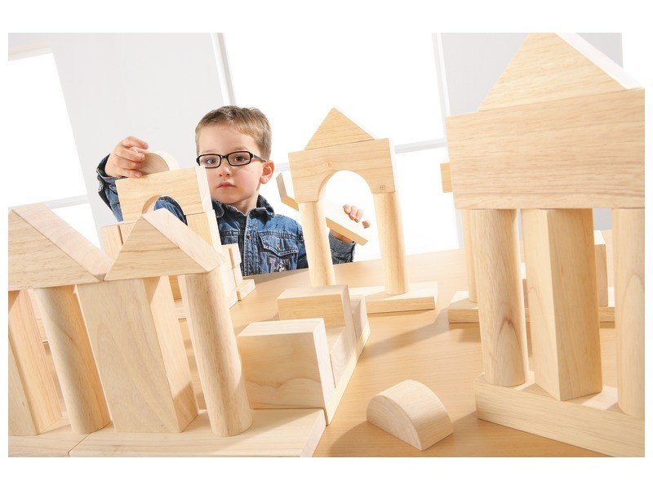
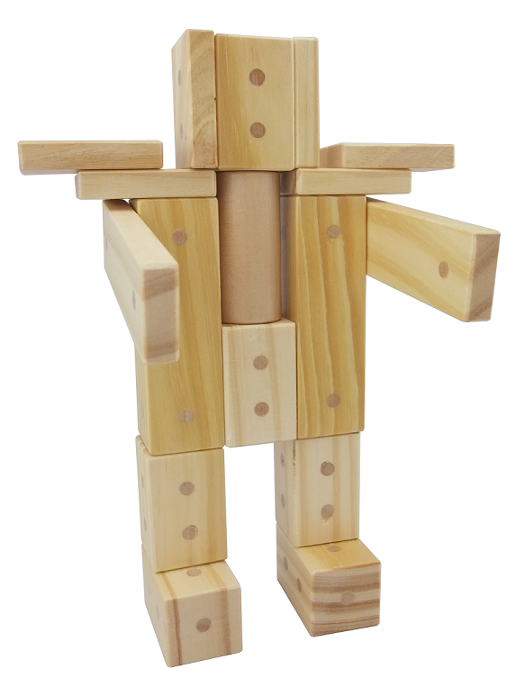
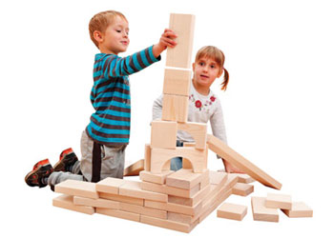
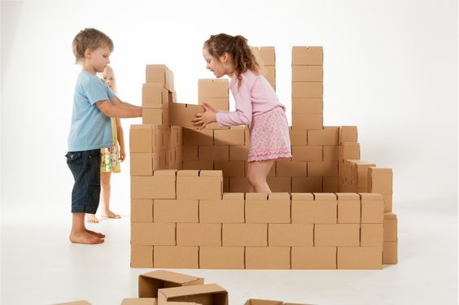
Construction Blocks are not as Flashy as Robots
But, they encourage and augment vastly higher levels of problem solving and creativity
Construction blocks:
  Build motor skills
  Build hand-eye coordination
  Build spacial skills
  Develop capacity for creative/divergent thinking
  Build social skills
  Build language skills
  And, they’re cheap!

Slide 9
Mimicking Professional Challenges
Children building structures face the same physics challenges that architects, engineers, scientists face!
Large numbers of engineers attribute their interest in CB’s as a first motivation to enter the field
Recent study of high achieving STEM graduates (from college) noted that this group was far more likely than the average American to have extensive backgrounds with hands-on crafts and hobbies, including: woodworking, crafting, sewing, etc.

Slide 10
Construction blocks have probably been in schools for more than 100 years, but there is still rich potential for using building blocks as a learning tool. The idea that something so simple can be used to teach complex STEM ideas is only beginning to be understood.

Slide 12
Introductions – Getting to Know You
Big Idea – People have different perspectives
Spell your name with KEVA
Conduct a gallery walk around the classroom to look at the different ideas

Slide 13
Introductions – Getting to Know You
Create a model with KEVA
that demonstrates to the class your favorite activity or hobby

Slide 14
Symmetry Challenge – with a partner
Big Ideas – Symmetry is an important part of the designed world. It is important to be able to work with others.
Create a line of symmetry (3 or 4 blocks)
  -Take turns building off of the line of symmetry (3 or 4 blocks).
  -The second team member follows the lead of the first.

Slide 15
Symmetry Challenge – with a partner
Big Ideas – Symmetry is an important part of the designed world. It is important to be able to work as a team.
Create a line of symmetry (3 or 4 blocks)
  -Take turns building off of the line of symmetry (3 or 4 blocks).
  -The second team member follows the lead of the first.
*Discuss divergent and convergent thinking

Slide 16
Creating Patterns
Big Idea – Patterns are repeatable. It is important to be able to work as a team.
  -Individually create a pattern that is repeatable.
    -Each person at the table will vote (1-2-3-point) at the pattern that they believe will be the most repeatable.
  -Work as a team to repeat the selected pattern across your team’s table.

Slide 17
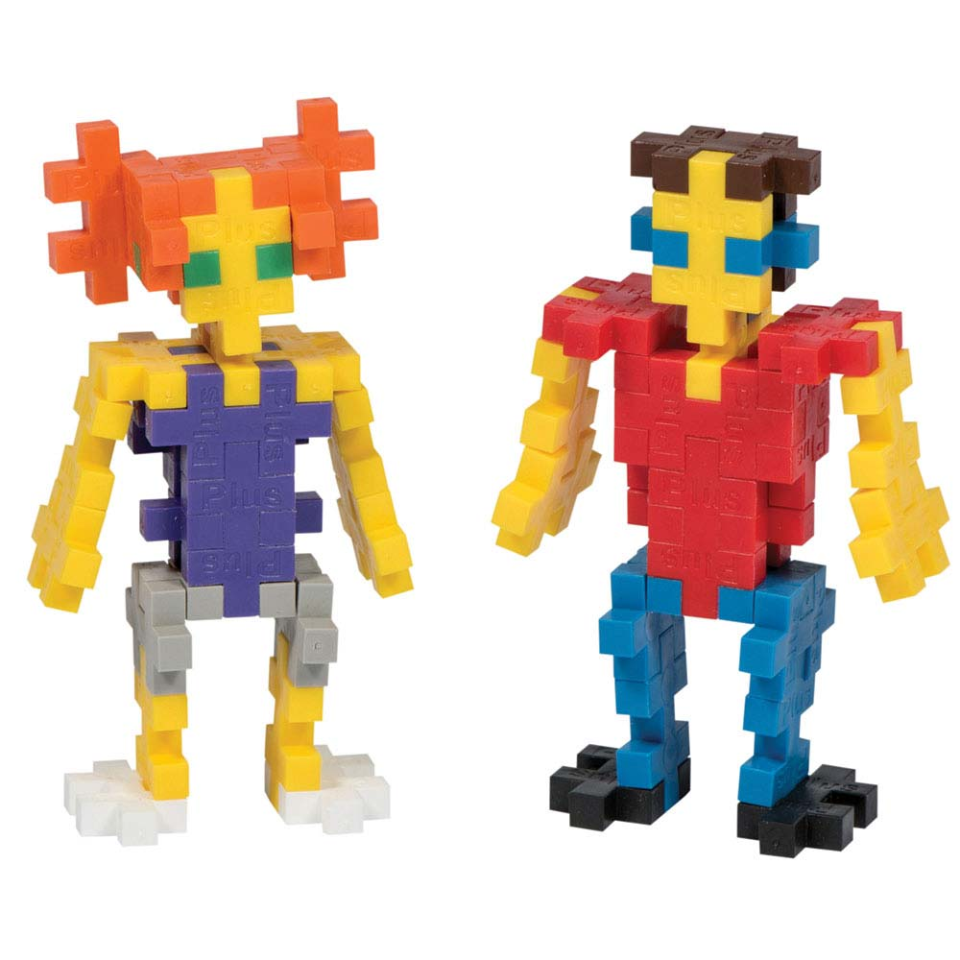
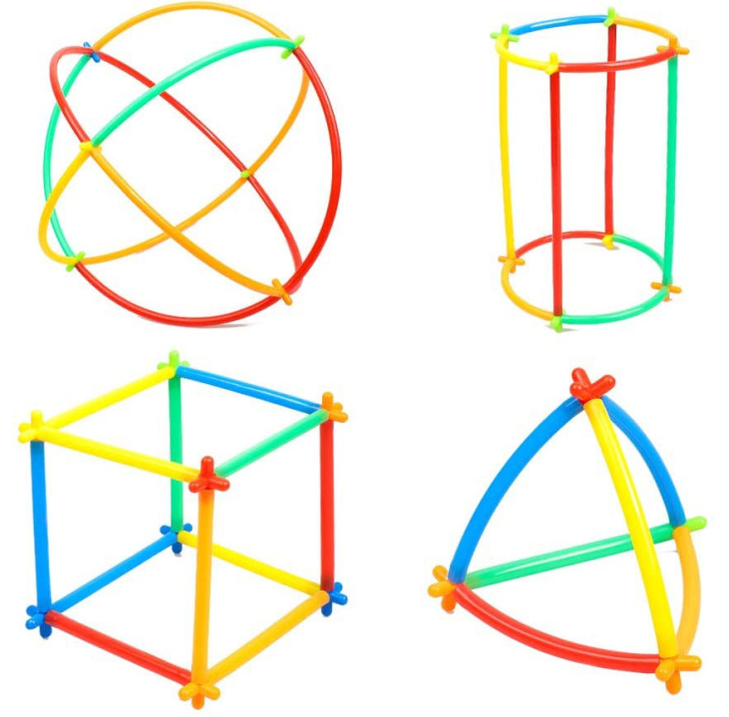
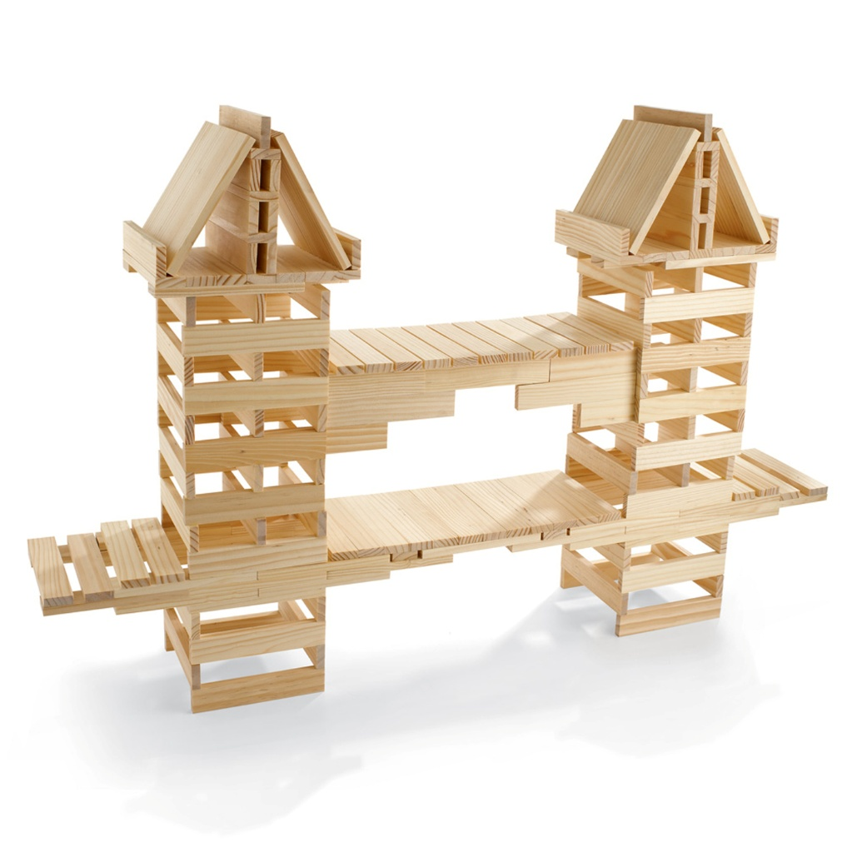
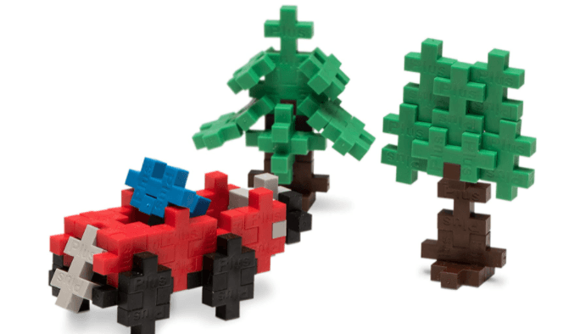

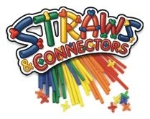

Construction Blocks

Slide 18
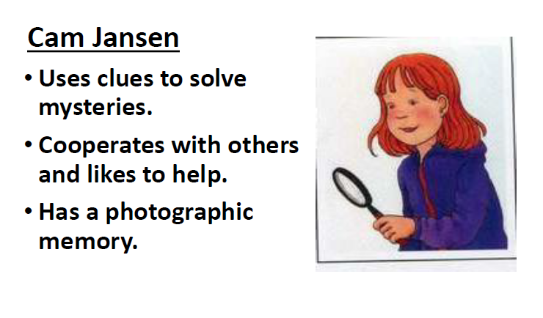
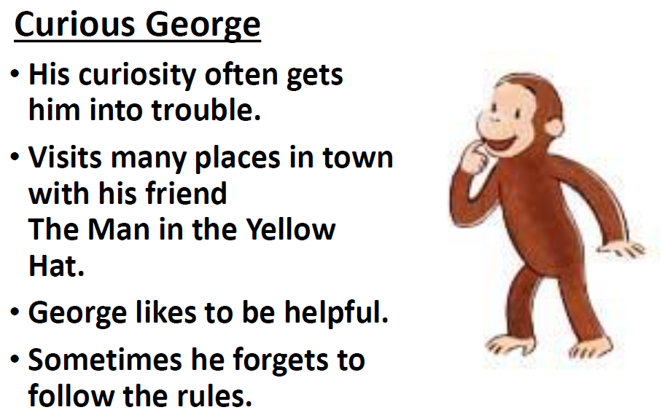
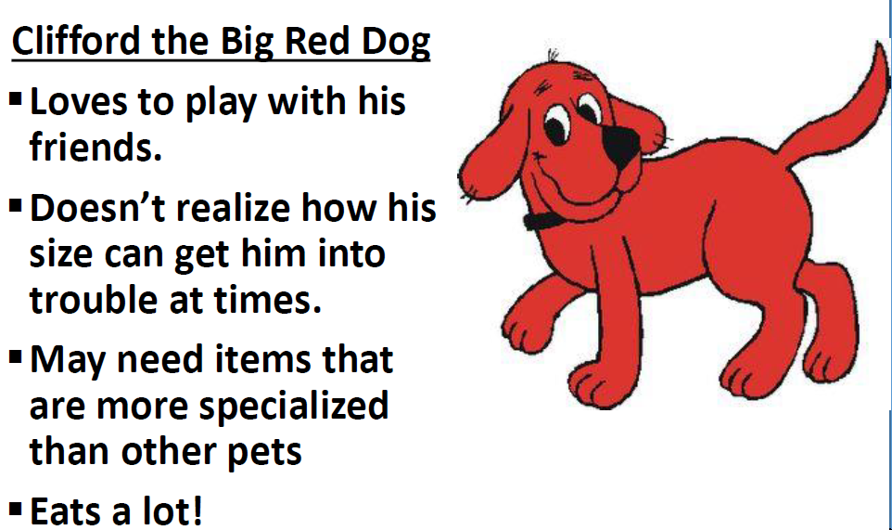
Character Cards

Slide 19
Character Cards can also be a great way to blend engineering design quick challenges (making/tinkering) and story grammar -
Story Grammar includes ……
The various integral components or elements of a story and the relationships among these parts. Typically, they include the character, setting, problem/conflict, plot, and resolution. Story grammar elements support the essential text structure for most narratives.
The grammar of the story is how the story is told and includes such things as plot, suspense, climax, and characters.
A framework including the basic elements of a story and the rules that explain the relationship between these elements.

Slide 20
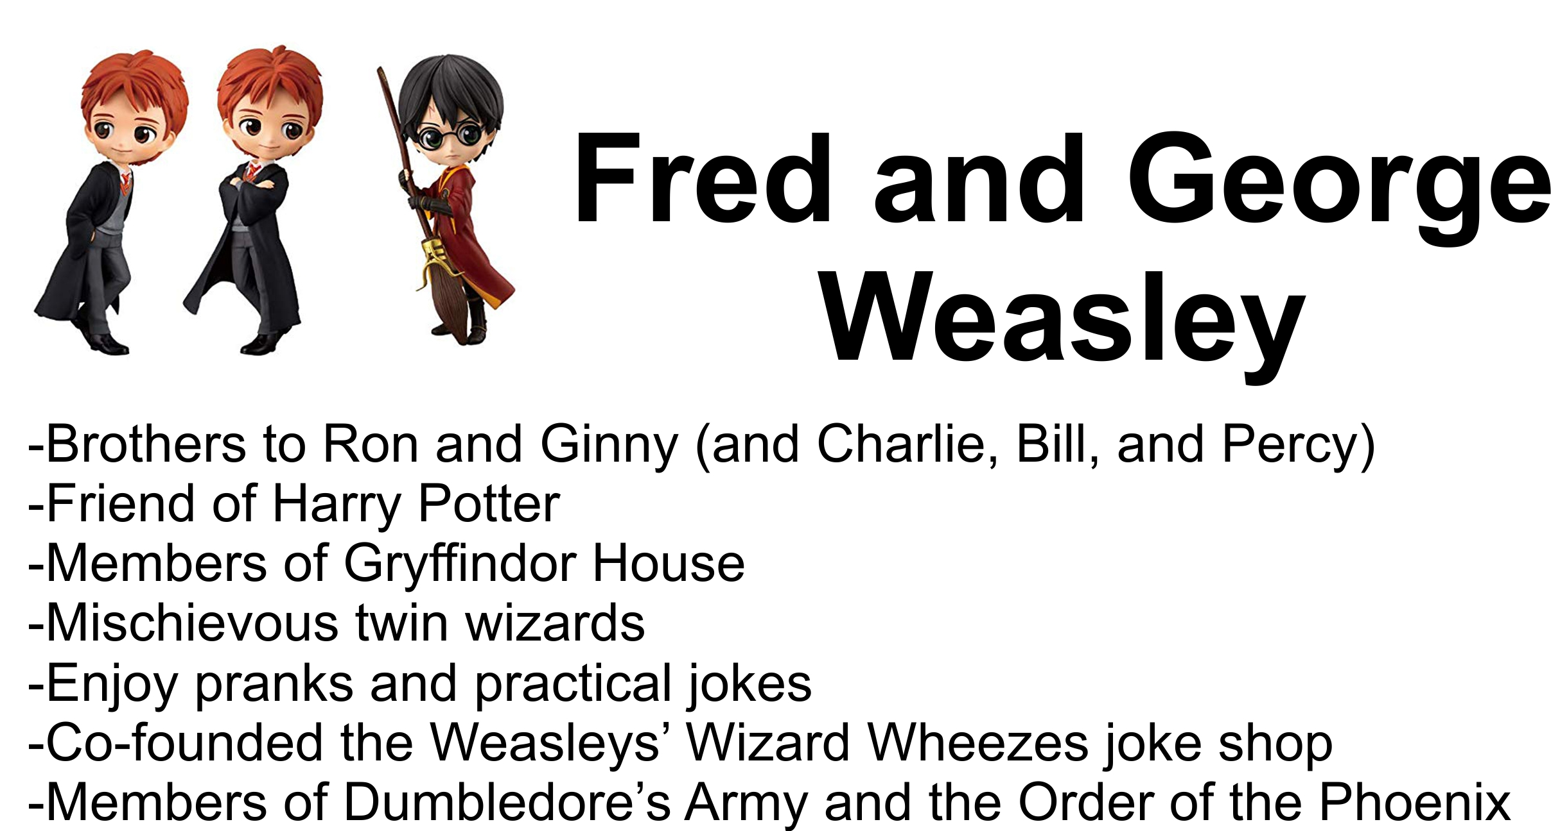

Slide 21
Character Card Quick Challenges
Home
Design a home, hideout, or space to relax for the character.
Recreation
Design an item or place that the character could play, exercise and have fun.
Accessories
Design an accessory that might enhance the look or comfort of your character.
Transportation
Design a mode of transportation that would work for your character.
Tools
Design a tool or gadget that would help your character solve a problem.
Free Choice
Design any of the above items.

Slide 22

The younger of two daughters in the Quimby family.
She is eight years old and in the third grade at Cedarhurst Elementary School in Portland, Oregon.
  She is eager to please her teacher
She is proud of her age (being 8yrs old) but tries to act like a "grown-up" whenever possible.
  She resents being treated like a child at times, particularly when she is expected to play with or entertain younger children.
Ramona is a bright and creative girl.
  She is good at drawing and enjoys reading.
  Ramona is an observant person, noticing small details
She has an unlucky tendency to be involved in minor accidents that draw attention to her, and for which she feels she is often blamed.
  She tries to avoid these situations, but her efforts are sometimes frustrated by her bad luck.

Slide 23
Vacation Resort – using a character card
Big Idea – empathy, teamwork, modeling with Keva
Each table will be given a character card. As a team develop a vacation resort for that character.
Conduct a gallery walk around the classroom to look at the different ideas

Slide 25
Team Challenge
Big Ideas – repeating a pattern, teamwork, empathy, senses
Collaborate with a partner to create a pattern with 20 total blocks (partner one – 2 blocks, partner two – 3 blocks)
Race to see who finishes the pattern first.
Try with your non-dominate hand
Try it with one eye closed
Try it without certain senses (earmuffs, no talking)

Slide 27
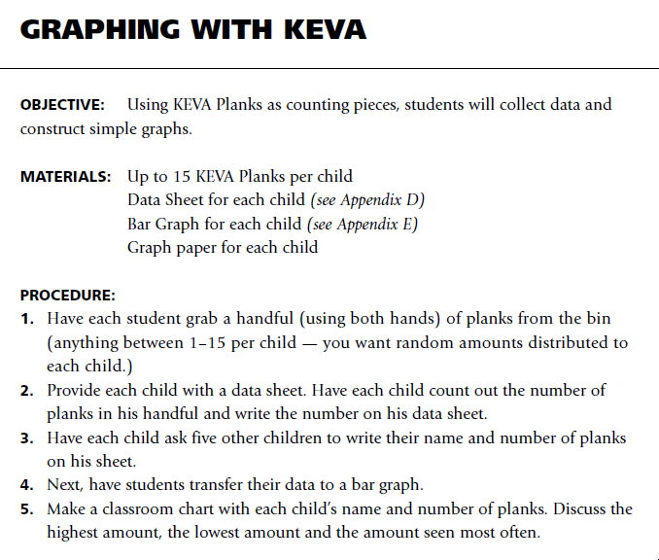

Slide 28
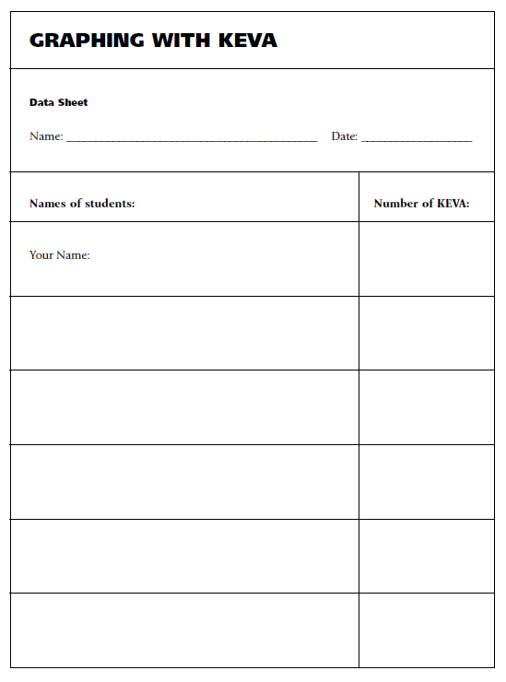
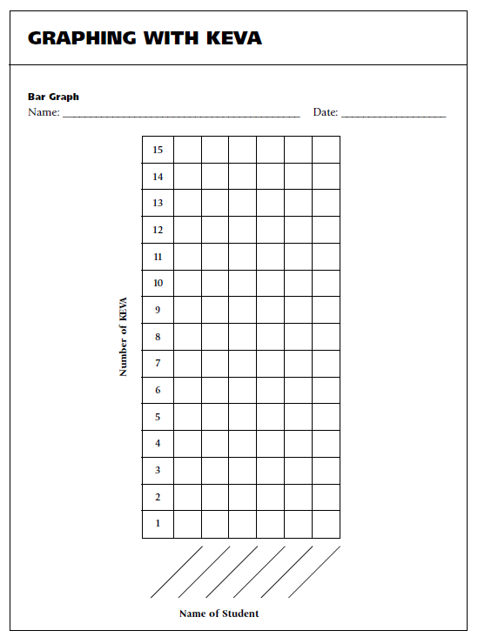

Slide 29
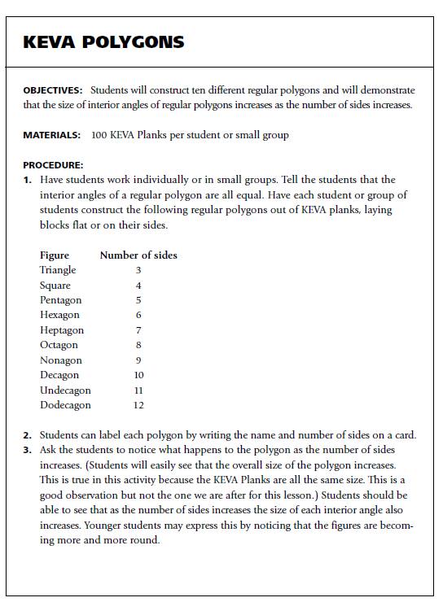

Slide 30
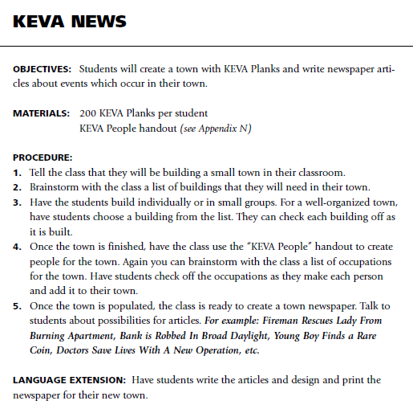
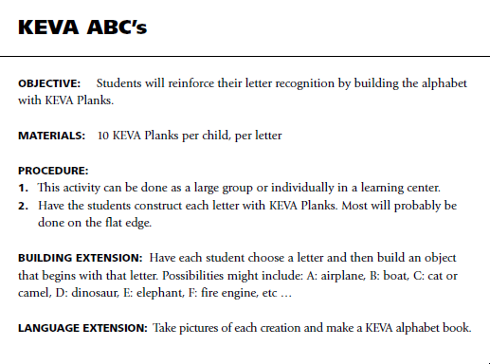

Slide 31
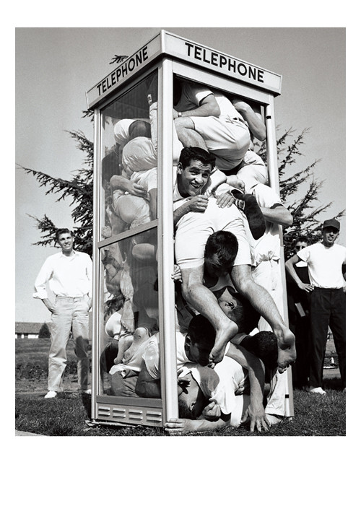
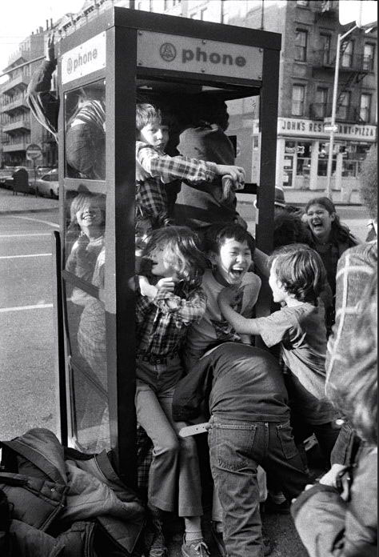
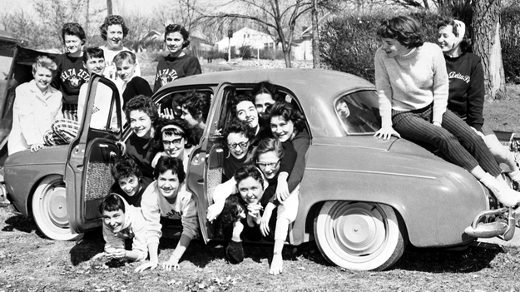
Colleges and universities have long been recognized as institutions that launch crazy fads. I the 1950’s and 1960’s, stuffing as many people as possible into a phone booth was very popular on college campuses. While it was an absurd trend, it did require a great deal of creativity, collaboration, and problem-solving ability.

Slide 32
As a team calculate the –
Perimeter of your fort ______________________
Area of your fort ____________________
Volume of your fort ___________________

Slide 33
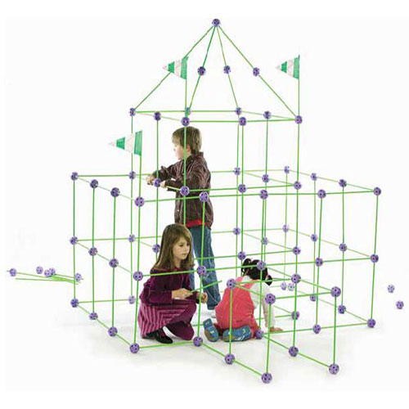
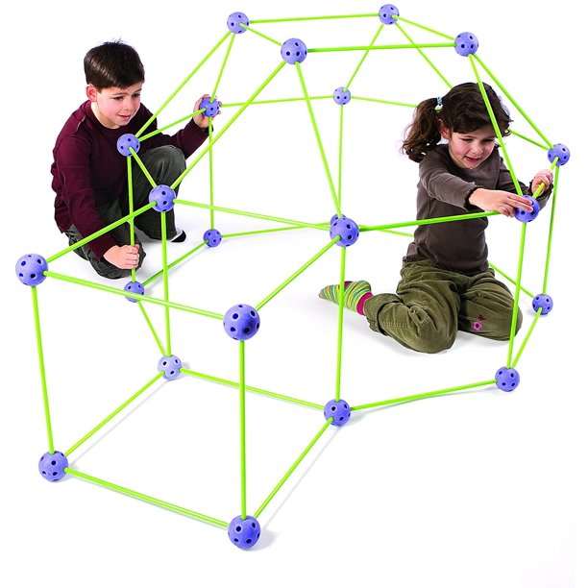
Scenario:
In the spirit of phone booth stuffing—and, to test your levels of creativity, cooperative spirit, understanding of area, and problem-solving ability, use the Crazy Fort® building materials to build a fort that will enclose your entire team.
Challenge:
Work as a member of a design team to build a rectangular fort (with a flat roof) that will enclose your entire team. Then calculate the perimeter, area, and cubic volume of the fort.
Essential Question: How can we determine the area of a space enclosed in a scale model structure?
Limitations:
The completed fort must have walls and a roof.
The connector ball arrows must always point upwards
Materials must not be cut or bend
Twist the green sticks to insert and remove from the connector balls
The structure must enclose your entire problem-solving team
If you can fit more than your team, and you have volunteers; build the biggest fort in class!
Big Ideas:
The area of a space can be determined by the length and width of a model.
Area models can represent the inner size of a space

Slide 34
History of Construction Blocks in Education
The natural world has provided abundant building materials (Stones, Sticky burdock, Twigs) which have been connected to learning.
  Evidence of this has been dated back to Plato (429-347 B.C.)
U.S. and European manufacturers began making wooden blocks as a sideline to their main woodworking or printing business.
The first centers on the building unit focused on letters, words, or narratives. The second addressed the act of building and constructing. The third focused on cultural heritage and modeling specific architecture.
The advancement of blocks can be seen in electronics as well. Lego Mindstorms uses programmable bricks to control simple robotics.
It is important to remember that we cannot understand until we take apart, examine, and rebuild. Children need an environment with open-ended materials and teachers who understand, encourage, build on, and even participate in this basic and complex mode of learning.

