Slide 1
How would you….
-define technology?
-explain why you chose this definition?

Slide 3
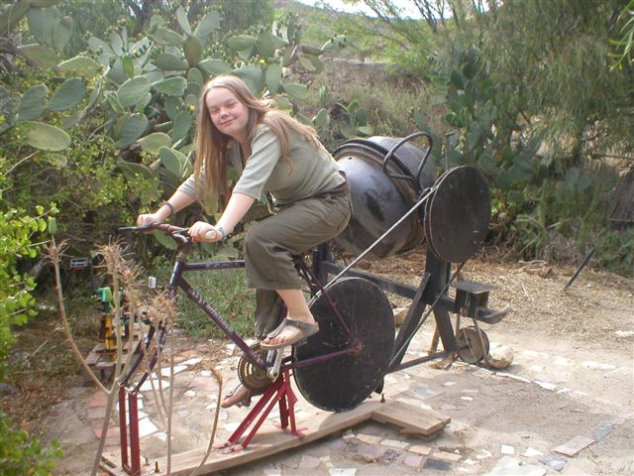
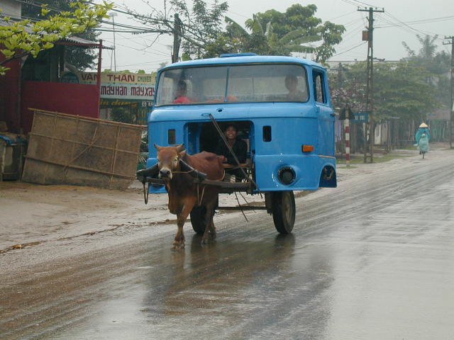
The Social & Cultural Side of Engineering Design

Slide 4
Role of Technology in Society
We live in a human-made world
Technology is the modification of the natural world
Technology is the act of creating
Technology is complex
Technology has been a powerful force in shaping cultures

Slide 5
Myths About Technology
Technology = Computers
The “Aha” moment
Invention
  The light bulb - social influences

Slide 6
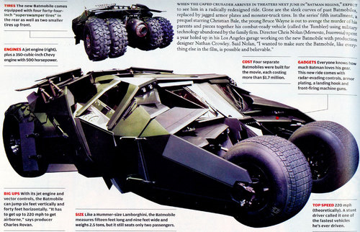
Technology & Progress
Most people define progress through technological innovation
  Travel: Buggy to a Space Shuttle
  Weaponry: Musket to a nuclear weapon
  Communications: Quill Pen to computer
  Is new always better?
    When is it not?
  Is more better?
    When is it not?
  Is less better?
    When is it not?

Slide 7
Technology Defines Society
History is recorded through technology
  Iron Age, Bronze Age, Industrial Age
Technology shapes the human environment
Our values are reflected in the technologies we use
  Skyscrapers, Interstate roadways
Nature becomes a smaller part of human existence
  Most people live in homes/apartments
  Work/shop in large buildings
  Drink from public water systems
  Rely on newspapers, radios, television, Internet

Slide 8

Society Determines the Role of Technology
Human wants and needs
The steam engine
  Forests gone
  Need for coal
  Too much water in mines
The gasoline automobile
The typewriter
Nuclear power

Slide 9

Many Believe that
Technology is Desirable
Advances in medicine
Clean water/available electricity
Good transportation systems
Good communications systems
Automated manufacturing brings products
we desire

Slide 10

Other Effects of Technology are Less Than Desirable
Traditional ways displaced (Sunday Dinner)
Inequalities magnified (Dinner in Dallas)
Harmful side-effects
  Asbestos, x-rays, chemicals
Unknown side-effects
  The cotton gin, Eli Whitney’s musket
Cultural trade-offs
  Trading TV for caribou hunting

Slide 11
The Effects of Technology
Technology can be helpful or harmful
  Can have unintended consequences
  Is neither good, nor bad
Technology poses ethical questions
Technology causes change (political, environmental, cultural, ethical, etc.)
Technology can cause natural disasters or prevent them
Different cultures place different value on technological devices/systems (a good knife)

Slide 12
The Effects of Technology
The implementation of technology introduces conflicting arguments (spotted owl)
Societies may limit or expand the powers of technology (nuclear power)
Throughout history, new technologies have resulted from the demands of people
Cultural priorities are reflected in the technologies that they use
Decisions regarding the implementation of technology involve the weighing of trade-offs and optimization

Slide 13
A Give and Take Relationship
Technology is the engine of history
Changes in technology are followed by cultural changes
Technology is created to fill cultural needs and wants
Some consequences of technological development are not intentional

Slide 14
A Give and Take
Relationship (Continued)
We tend to relinquish control to technology
Technology begets technology
The rate of technological development is dependent upon previous development
We live in a technologically sophisticated world, but we are not sophisticated!
Technology prevents and causes isolation

Slide 15
OBSERVATIONS
We are extremely dependent on technology
Most people have an unquestioning faith in technology to solve our problems
The use of technology changes society
  Self-sufficient, self-centered, isolated
  Loss of traditions and rituals
  Effects are often delayed, unintentional, unrelated to expectations

Slide 16

Evaluating New Technology
If developed, will it help us maintain or destroy traditions?
  Will it isolate people further or bring them together?
  Can it be abused or misused?
  Who stands to gain the most?
  Who stands to lose the most?

Slide 17
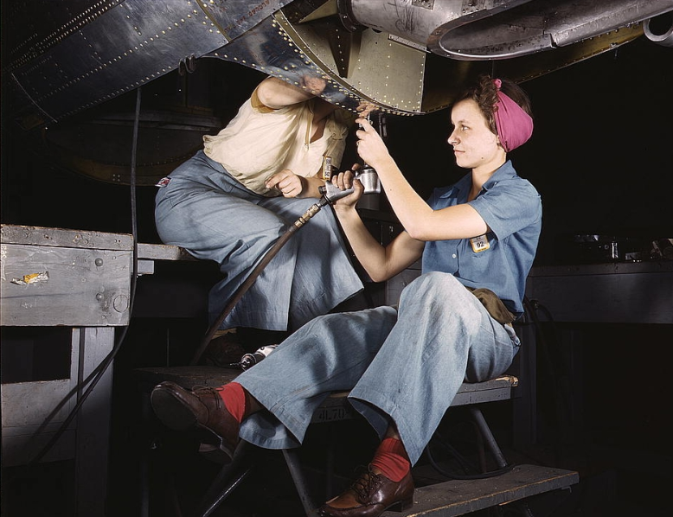
An Example
In the 19th century, gender roles were clearly defined: men conducted business, had a job, did government, did the outside chores; women stayed at home, nurtured children, cooked, washed and ironed clothes, cleaned the house. Maids were common.
In the 20th century, roles have not changed much, but now 60% of women work outside the home

Slide 18
More Examples:
Technology & Change
100 Years ago:
  47 was the average life expectancy
  14% of homes in America had a bathtub
  8% of homes in America had a telephone
    A 3-minute call from Denver to NYC cost $11
  The U.S. had 144 miles of paved roads and 8,000 cars
  The maximum speed limit in most cities was 10 mph
  The average wage in the U.S. was 22 cents per hour and the average worker made $200 per year
  95% of all births took place at home

Slide 19
Technology & Change
(Continued)
100 Years ago:
  90% of all physicians had no college education
  Most women washed their hair once each month and used egg yokes for shampoo
  The American flag had 45 stars
  Drive-by shootings were a major problem in many western cities (teenagers galloping through town shooting from horseback)
  The population of Las Vegas Nevada was 30
  10% of all Americans could not read or write
  Plutonium, insulin, antibiotics, Scotch tape, crossword puzzles, canned beer, iced tea, and a million other products had not been invented

Slide 20
Let’s Face it!
Technology Rules
We buy things that we do not need
  And, pay for things that we do not want
As a society, we are not very savvy when it comes to purchasing and using technology
  We buy on impulse
  We discard on impulse
  We allow technology to control our lives
    In ways that we would never allow another human to control our lives!

Slide 21
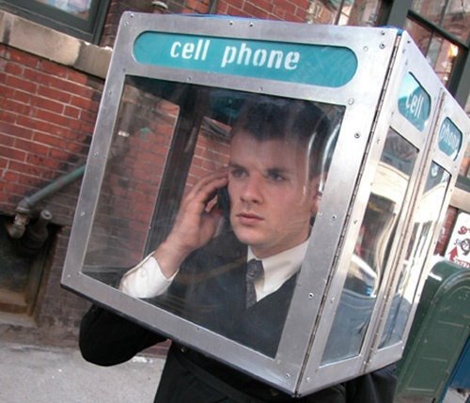
Technology is Pervasive
Technology is becoming:
  Faster
  Smaller
  More Invasive
  More in Control of our lives
  More Dangerous
  More Indispensable
  A Larger Threat

Slide 22
Does Technology = Progress?
We have largely relinquished control of our lives to technology
In the Western World, success is largely based on Gross National Product
  GNP: A measure of all economic activity--positive or negative. (the sale of technology)
  For example: If a plane crashes and the airline is forced to purchase a new one, we all profit through an increased GNP
  Obviously, increased GNP should not always be used as a measure of our “quality of life.”

Slide 23
"If you think you are too small to make a difference, try sleeping with a mosquito.“
-- the Dalai Lama

Slide 24
A Final Thought on the Subject
A Perfect Example:
  When NASA first started sending up astronauts, they quickly discovered that ballpoint pens would not work in 0 gravity. To combat this problem, NASA scientists spent a decade and $12 billion developing a pen that writes in zero gravity, upside down, underwater, on almost any surface including glass and at any temperature ranging from below freezing to over 300 C.
        The Russians used a pencil.

Slide 25
Homework
Read the “Systems Technology” article
Complete Philosophy of Technology assignment
  Find a philosophical quote about technology
  Credible source– Use APA format
  Know about the person you quote
  Be able to explain the quote

