Slide 1
Curriculum Design
Understanding By Design
Developing Standards-based Curriculum

Slide 2
The Problem
“Even good students don’t always display a deep understanding of what is taught even when conventional tests certify success.”
(Wiggins & McTighe)

Slide 3
Try this….. Draw this…..

Slide 4

A Curriculum Fable
One time the animals had a school. The curriculum consisted of running, climbing, flying and swimming, and all the animals took all the subjects. The duck was good in swimming; better in fact than his instructor, and he made passing grades in flying, but he was practically hopeless in running. Because he was low in this subject, he was made to stay after school and drop his swimming class in order to practice running. He kept this up until he was only average in swimming. But average is acceptable, so nobody worried about that except the duck. The eagle was considered a problem pupil and disciplined severely. He beat all the others to the top of the tree in the climbing class, but he used his own way of getting there. The rabbit started out at the top of the class in running, but he had a nervous breakdown and had to drop out of school on account of so much make-up work in swimming. The squirrel led the climbing class, but his flying teacher made him start flying lessons from the ground instead of the top of the tree down, and he developed "charley horses" from over-exertion at the take-off and began getting C's in climbing and D's in running. The practical prairie dogs apprenticed their offspring to a badger when the school authorities refused to add digging to the curriculum. At the end of the year, an abnormal eel that could swim well, run, climb, and fly a little, was made valedictorian.

Slide 5
Curriculum That Makes a Difference
Focus on a topic that matters
Use instructional methods that engage
Cause deep and enduring learning related to an important standard
Is it important enough to remember when the student is 50 years old?

Slide 6
What is Backward Design
BD Begins with the end in mind
Starting with a clear understanding of the destination
Making sure that you are taking steps in the right direction (Stephen Covey)
Is justifiable and reliable

Slide 7
Unfortunately, Many Teachers
Begin with a favored lesson, time-honored activities (or the next page in the text)
Backward design starts with the end (the desired results).
What would I accept as evidence that students have attained the desired understandings and/or abilities?

Slide 8
Backwards Design
We begin BD with the following question:
What would I accept as evidence that students have attained the desired understandings/abilities?

Slide 9
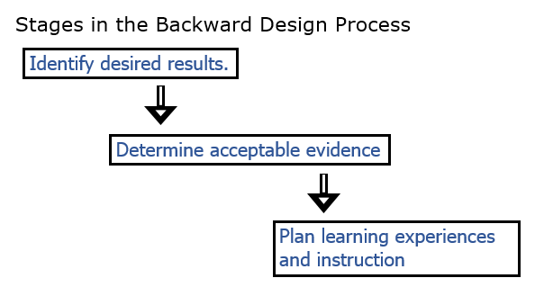
Backwards Design Process

Slide 10
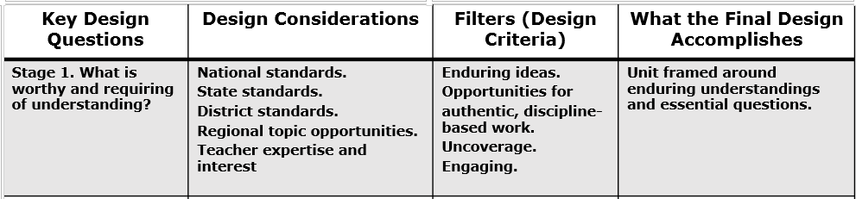
Stage One: Backward Design

Slide 11
How do teachers decide what content should be taught? -standards/frameworks

Slide 12
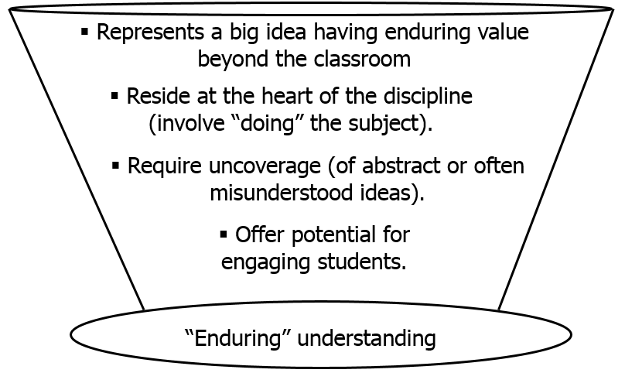
Should a Lesson be Taught
4 filters to determine worthiness

Slide 13
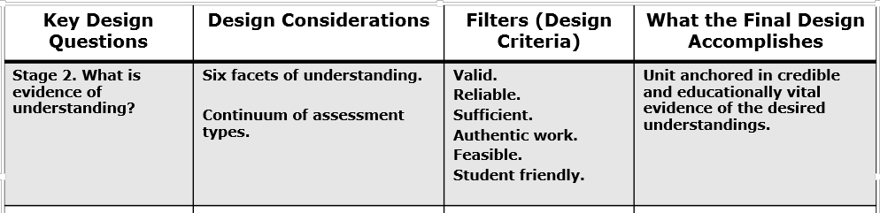
Stage 2: Backwards Design

Slide 14
Six Facets of Understanding
Facet 1:
A student who really understands, can explain.
Can provide complex, insightful and credible reasons.
Can make distinctions, argue for and justify central ideas
Can avoid common misunderstandings
Can personalize the information
Facet 2:
A student who really understands, can interpret.
Can make powerful, meaningful interpretations and translations
Can read between the lines
Can use historical and biographical information to make ideas more relevant

Slide 15
Six Facets of Understanding
Facet 3:
A student who really understands, can apply.
Can extend what he/she knows to realistic, hands-on situations
Can make adjustments along the way
Can apply knowledge in a variety of settings
Facet 4:
A student who really understands, sees in perspective.
Can critique and justify a position
Understanding the history of an idea
Know the limits as well as the power of an idea
Can see through biased arguments

Slide 16
Six Facets of Understanding
Facet 5:
A student who really understands, demonstrates empathy.
Can appreciates another’s situation
Can see when even flawed ideas are plausible
Can describe how an idea could be misunderstood by others
Can listen and hear what others often do not
Facet 6:
A student who really understands, reveals self-knowledge.
Can recognize own prejudices and style
Can think about thinking
Can question his/her own convictions
Can self-assess
Can accept feedback/criticism without defensiveness

Slide 17
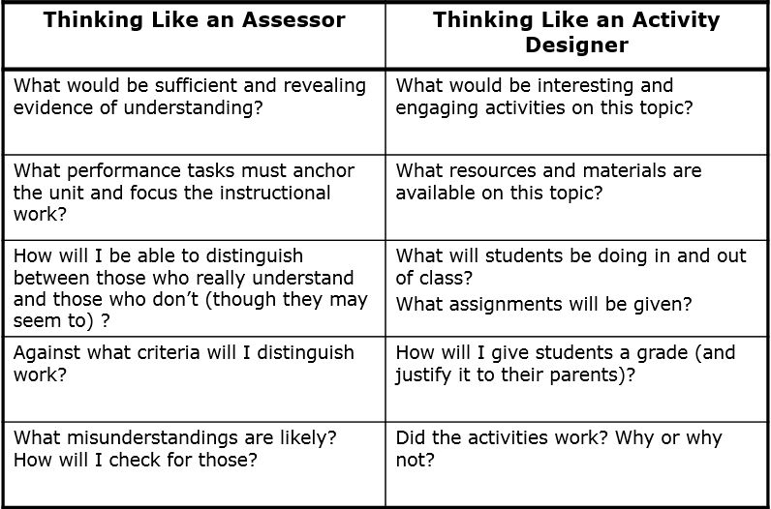
Two Different Approaches

Slide 18
Thinking Like the Assessor
Does not come naturally to most teachers
We unconsciously jump to the activity once we have a target
Backwards design demands that we short-circuit the natural instinct that leads most of us to develop the activity first

Slide 19
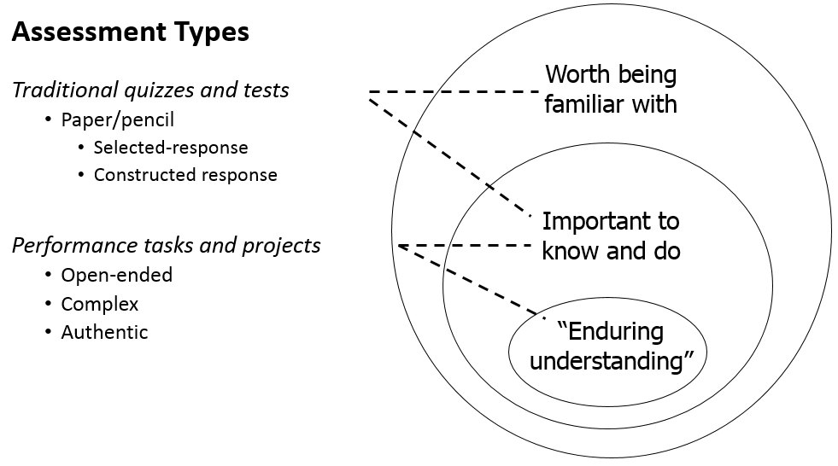
Types of Assessments

Slide 20
You’re planning to deliver a lesson that uncovers the following standard –
NGSS Earth Science - ESS3.C Human impacts on Earth systems
Societal activities have had major effects on the land, ocean, atmosphere, and even outer space. Societal activities can also help protect Earth’s resources and environments
So far you have decided that the students will design a composting system for the school cafeteria during the exploration of this standard.
What evidence will you accept to verify all 6 Facets of Understanding?
Explain, Interpret, Apply, Perspective, Empathy, & Self-Knowledge
Whiteboard/Marker Discussion

Slide 21
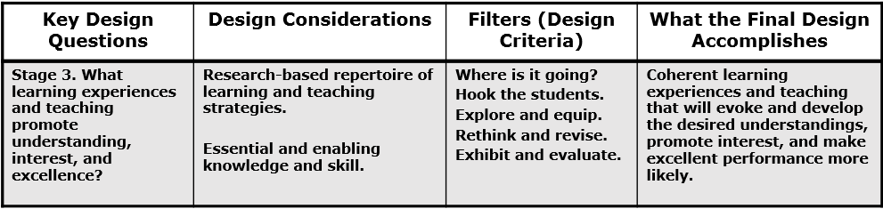
Stage 3: Backwards Design

Slide 22
Key Questions for Instructional Design
What facts, concepts, principles and skills will students need to achieve in lessons?
What activities will equip students with needed knowledge/skills?
What materials/resources are available?

Slide 23
How Will You?
Bring abstract ideas and far-away facts to life?
Students must see knowledge and skill as building blocks—not just isolated lessons

Slide 24
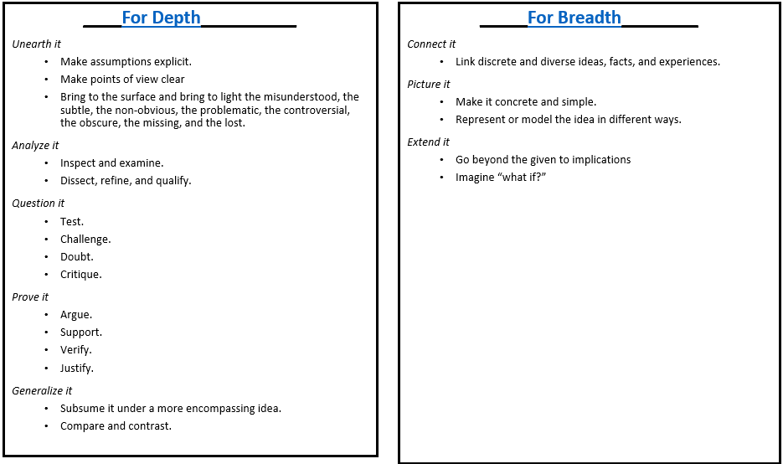
Blending Breadth and Depth

Slide 25
You’re planning to deliver a lesson that uncovers the following standard –
STL 20. Students will develop an understanding of and be able to select and use construction technologies.
K-2 – A. People live, work, and go to school in buildings, which are of different types: houses, apartments, office buildings, and schools.
This lesson will be assessed through the following ways:
Product, use of the design process, design journal, teamwork, and students ability to differentiate between four different types of man-made structures and their use and purpose in society.
In general, you are thinking that the students will build different types of structures and testing them.
What would be an acceptable hook and design activity for this lesson?
Whiteboard/Marker Discussion

Slide 26
Teaching in a UBD Environment
More learning through less teaching
Suspends instructional planning
Specific lessons are not developed until the last phase. This runs counter to the habits of many
BD demands that we set goals and establish assessments first

Slide 27
Wisdom Can’t be Told
Understanding is more stimulated than learned
It grows from questioning oneself and being questioned by others
Students must figure things out, not simply wait to be told!
This requires the teacher to alter their curriculum and teaching style

Slide 28
Teaching for Understanding Requires:
Routinely using teaching methods from all three general types
Didactic: Direct instruction (used to dispense factual information)
Coaching: Teachers providing feedback and guidance to students as they work
Constructivist: Allowing the student to “construct their own learning” by solving their own problems.

Slide 29
Direct and Indirect Teaching Approaches
It is not an either-or proposition
As a teacher:
When should we present the facts that we know?
When should we force to students to discover the information on their own?
When should we allow practice while we coach?
These are the key questions for teachers of understanding

Slide 30
We Should. . .
Use direct instruction and focused coaching for discrete, unproblematic, and enabling knowledge and skill
Use indirect teaching for those ideas that are subtle, easily misunderstood, and those ideas that need some personal inquiry, testing and verification

Slide 31
Guidelines for Student Autonomous Learning
Engage students in inquiry and inventive work as soon as possible
Use the text as a reference—not a syllabus
Ask more questions/answer fewer
Make it clear that there are no stupid questions

Slide 32
Guidelines for Student Autonomous Learning
Ask naïve questions and let the students correct you
Raise questions with many possible answers and push students to answer in multiple ways
Demand final performances (speech, presentation, project demonstration)
Continually assess for understanding

Slide 33
Performance Based Assessment

Slide 34
What is Performance Based Assessment?
PBA is a form of assessment that requires students to perform a task rather than an answer questions from a ready made list.
Also known as:
Authentic Assessment
Alternative Assessment
Active Learning
Performance Assessment

Slide 35
Introduction
Performance-based assessments require students to apply knowledge and skills.
PBA’s can be used as formative or summative assessments.
Can be labor- and time-intensive.
Can also be quite diverse.

Slide 36
Characteristics of PBA
PBA’s present students with hands-on tasks or other performance-based activities that students must complete individually or in small groups;
Work is evaluated using pre-established criteria:
A performance task (actual prompt or activity)
A scoring rubric (scoring guide consisting of pre-established performance criteria)
Direct observation of student skills and capabilities (very different from pencil-and-paper tests)

Slide 37
Characteristics of PBA
Performance assessments are:
Based in the “real world” = authentic assessment
Must be linked to instructional objectives/standards
Less abstract than more traditional forms of assessment
Assessments, by themselves, are meaningful learning activities
Concept of performance assessments is not new
Specific behaviors/capabilities should be observed
Measure complex capabilities/skills that can’t be measured with pencil-and-paper tests
Must focus on teachable processes
Can judge appropriateness of behavior/understanding

Slide 38
Characteristics of PBA
Performance assessments are (continued):
Can be used to judge appropriateness of behavior or understanding
require products of behaviors that are valuable in their own right
tasks should encourage student reflection
Can specifically targets procedures used by students to solve problems
Results in tangible outcome or product

Slide 39
Pros and Cons of PBA
Pros
More than one correct answer
Creative solutions
Engaging
Part of learning process
Can assess students ability to apply knowledge
Real life/world tasks
Can assess thinking skills
Cons
Address fewer learning objectives – time intensive
Found intimidating to students used to memorization
Less reliable
Lower ability students sometimes frustrated

Slide 40
Developing PBA Tasks
Six essential features to keep in mind. PBA’s should:
Have a clear purpose that specifies the decision that will be made resulting from the assessment.
Focus be on process, product, or both
No simple right or wrong answers; they must be assessed along some sort of continuum.
Focus on degrees (e.g., quality, proficiency, understanding, etc.).
Try to reduce potential subjectivity in scoring.
Share scoring information with students early—as a guide

Slide 41
Research Findings on PBA
Students actively construct meaning of their own understanding.
Students become more actively engaged when they have to organize, structure and apply their knowledge.

Slide 42
What Does PBA Look Like in the Classroom?
No pencil and paper, not multiple choice
Rubrics given prior to start
Open ended response exercises/Hands on
Portfolios – compilation of required tasks and best works
Use of higher order thinking skills
Synthesis of classroom instruction
Student reflection
Practical/Real life experiences
Extended tasks

