Slide 1
Curriculum Design
Understanding By Design
Developing Standards-based Curriculum

Slide 2
The Problem
“Even good students don’t always display a deep understanding of what is taught even when conventional tests certify success.”
(Wiggins & McTighe)

Slide 3

A Curriculum Fable
One time the animals had a school. The curriculum consisted of running, climbing, flying and swimming, and all the animals took all the subjects. The duck was good in swimming; better in fact than his instructor, and he made passing grades in flying, but he was practically hopeless in running. Because he was low in this subject, he was made to stay after school and drop his swimming class in order to practice running. He kept this up until he was only average in swimming. But average is acceptable, so nobody worried about that except the duck. The eagle was considered a problem pupil and disciplined severely. He beat all the others to the top of the tree in the climbing class, but he used his own way of getting there. The rabbit started out at the top of the class in running, but he had a nervous breakdown and had to drop out of school on account of so much make-up work in swimming. The squirrel led the climbing class, but his flying teacher made him start flying lessons from the ground instead of the top of the tree down, and he developed "charley horses" from over-exertion at the take-off and began getting C's in climbing and D's in running. The practical prairie dogs apprenticed their offspring to a badger when the school authorities refused to add digging to the curriculum. At the end of the year, an abnormal eel that could swim well, run, climb, and fly a little, was made valedictorian.

Slide 4
Stating a Concept vs. Developing a Concept

Slide 5
Seatwork Time Spent in 3 Kinds of Tasks

Slide 6
The Question
How will your courses and lessons contribute to the academic achievement of your students?
Answer: Develop curricula that makes a difference

Slide 7
Curriculum That Makes a Difference
Focus on a topic that matters
Use instructional methods that engage
Cause deep and enduring learning related to an important standard
Is it important enough to remember when the student is 30 years old?

Slide 8
What is Backward Design
BD Begins with the end in mind
Starting with a clear understanding of the destination
Making sure that you are taking steps in the right direction (Stephen Covey)
Is justifiable and reliable

Slide 9
Unfortunately, Many Teachers
Begin with a favored lesson, time-honored activities (or the next page in the text)
Backward design starts with the end (the desired results).
What would I accept as evidence that students have attained the desired understandings and/or abilities?

Slide 10
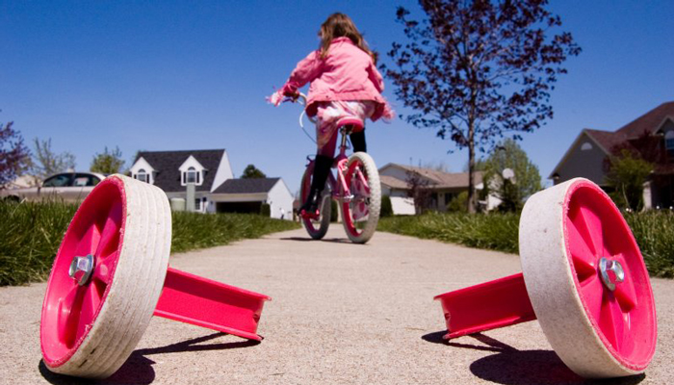
Backwards Design
We begin BD with the following question:
What would I accept as evidence that students have attained the desired understandings/abilities?

Slide 11
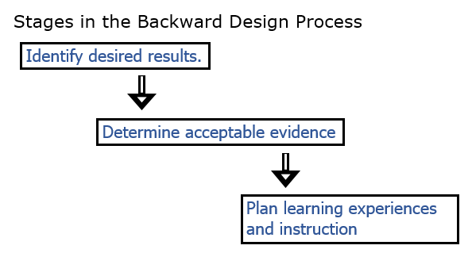
Backwards Design Process

Slide 12
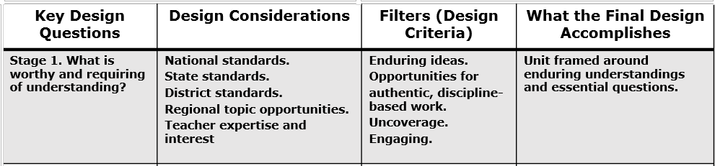
Stage One: Backward Design

Slide 13
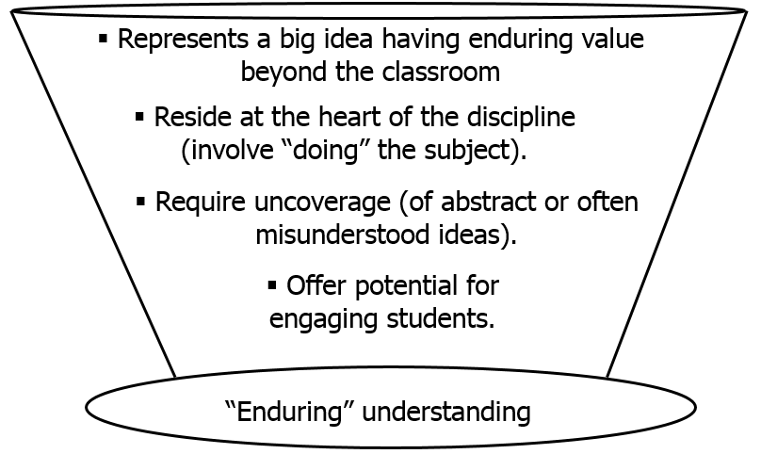
Should a Lesson be Taught
4 filters to determine worthiness

Slide 14
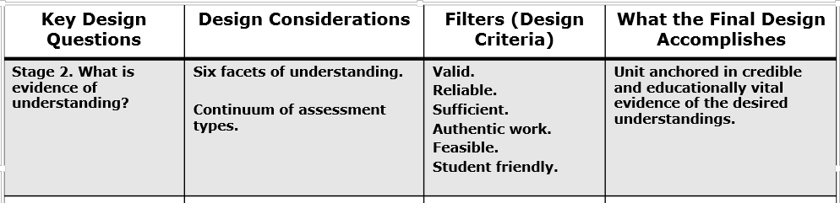
Stage 2: Backwards Design

Slide 15
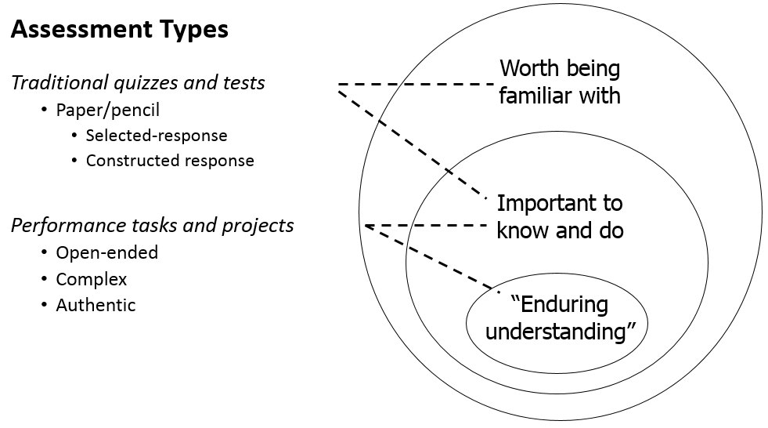
Types of Assessments

Slide 16
Thinking Like the Assessor
Does not come naturally to most teachers
We unconsciously jump to the activity once we have a target
Backwards design demands that we short-circuit the natural instinct that leads most of us to develop the activity first

Slide 17
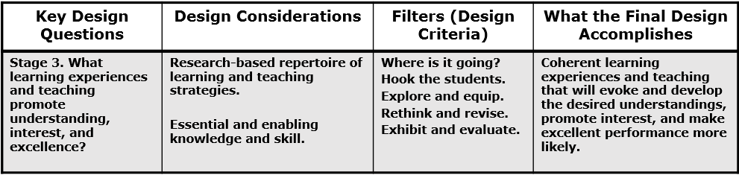
Stage 3: Backwards Design

Slide 18
Key Questions for Instructional Design
What facts, concepts, principles and skills will students need to achieve in lessons?
What activities will equip students with needed knowledge/skills?
What materials/resources are available?

Slide 19
How Will You?
Bring abstract ideas and far-away facts to life?
Students must see knowledge and skill as building blocks—not just isolated lessons

Slide 20
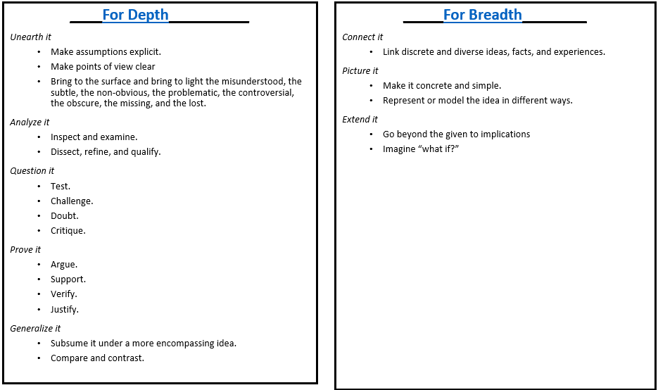
Blending Breadth and Depth

Slide 21
Teaching in a UBD Environment
More learning through less teaching
Suspends instructional planning
Specific lessons are not developed until the last phase. This runs counter to the habits of many
BD demands that we set goals and establish assessments first

Slide 22
Wisdom Can’t be Told
Understanding is more stimulated than learned
It grows from questioning oneself and being questioned by others
Students must figure things out, not simply wait to be told!
This requires the teacher to alter their curriculum and teaching style

Slide 23
Teaching for Understanding Requires:
Routinely using teaching methods from all three general types
Didactic: Direct instruction (used to dispense factual information)
Coaching: Teachers providing feedback and guidance to students as they work
Constructivist: Allowing the student to “construct their own learning” by solving their own problems.

Slide 24
Direct and Indirect Teaching Approaches
It is not an either-or proposition
As a teacher:
When should we present the facts we that know?
When should we force to students to discover the information on their own?
When should we allow practice while we coach?
These are the key questions for teachers of understanding

Slide 25
We Should. . .
Use direct instruction and focused coaching for discrete, unproblematic, and enabling knowledge and skill
Use indirect teaching for those ideas that are subtle, easily misunderstood, and those ideas that need some personal inquiry, testing and verification

Slide 26
Guidelines for Student Autonomous Learning
Engage students in inquiry and inventive work as soon as possible
Use the text as a reference—not a syllabus
Ask more questions/answer fewer
Make it clear that there are no stupid questions

Slide 27
Guidelines for Student Autonomous Learning
Ask naïve questions and let the students correct you
Raise questions with many possible answers and push students to answer in multiple ways
Demand final performances (speech, presentation, project demonstration)
Continually assess for understanding

