Slide 1
Integrated STEM Education
Introduce, Practice, Apply
Introduction to STEM Education Fall 2014

Slide 2


Michael Daugherty
STEM 4033

Slide 3
Overview
Understand the role and purpose of integrated STEM education
Understand how content standards can be delivered using STEM
Understand how heuristics are used as a conceptual tool in delivering project/problem-based learning.
Understand how integrated STEM lessons are developed and delivered in the classroom.
Exhibit increased understanding and confidence in teaching STEM content.

Slide 4
The Plan
Introduce Integrated STEM Education
Review the Call for Increased STEM
Review the Design Loop
Practice using the Design Loop
Investigate strategies for Using Problem-based Learning

Slide 5
The Problem
Just as the nation’s economic engines and national security measures have come to rest squarely on the shoulders of science, technology, engineering, and mathematics (STEM), American students are recoiling from these disciplines in record numbers.

Slide 6
Need for STEM
Why is there a need for STEM?
U.S. Department of Education says competencies and skills needed in classrooms are the same skills that are critical for workforce
21st century economy will be increasingly driven by contributions that come from discoveries and innovations in STEM
STEM career opportunities are expected to grow by 17% between 2008 and 2018
By 2018, 8 million jobs in the U.S. economy will require a college degree in STEM
Number of students pursuing STEM degrees falls short of the demands for projected STEM careers
Political pressure to improve students overall performance in mathematics and science

Slide 7
What We Need in Schools
Improve the quality of STEM education and experiences;
Promote engaged learning in STEM fields;
Prepare teachers to deliver comprehensive STEM education;
Change the status quo concerning learning and teaching STEM;
Move individuals from underrepresented groups into the STEM disciplines; and,
Increase the number of students in STEM programs and fields.

Slide 8
STEM in School
Call for Action
Educational and political efforts are being made to improve students’ overall performance, attitudes, and aspirations to learn in STEM subjects
School districts across the nation are implementing STEM programs in their schools
  STEM programs are primarily targeted at middle and high school grades
Why STEM in Early Grades
Students have already decided by this point whether STEM subjects will be of interest and regardless of program and are not likely to change their minds
  In 2008 315 STEM programs were being implemented but only 3-4% included elementary grades
It is important that special attention and efforts be given to students who are in critical grade levels (Elementary) for developing dispositional attitudes toward learning in STEM subjects
Up to 50% of elementary students turn away from STEM disciplines by 3rd or 4th grade
29% of elementary teachers report teaching science two or fewer days per week.

Slide 9
Ingenuity Gap

Slide 10
Top 10 STEM Challenges
China and India are challenging American dominance
Brand promiscuity: People aren’t loyal consumers
Global battle for smart talent
Globalization of manufacturing and production
Engineering and technology talent is often imported
Technological problems exceed capabilities of national workforce
Educational infrastructure not sufficient to produce creative people/solutions
Attractive and lucrative offers in other countries draw away best and brightest

Slide 11
Currently, Schools Tend to:
Emphasize solving problems correctly
Minimize creativity
Focus on tests, grades, college admissions
Reward factual competence
Reward logical thinkers
Reward following directions

Slide 12
What Needs to be Emphasized
Critical thinking
Problem solving abilities
Leadership and teamwork
Ethics and responsibility
Invention, imagination, and ingenuity
Communications

Slide 13
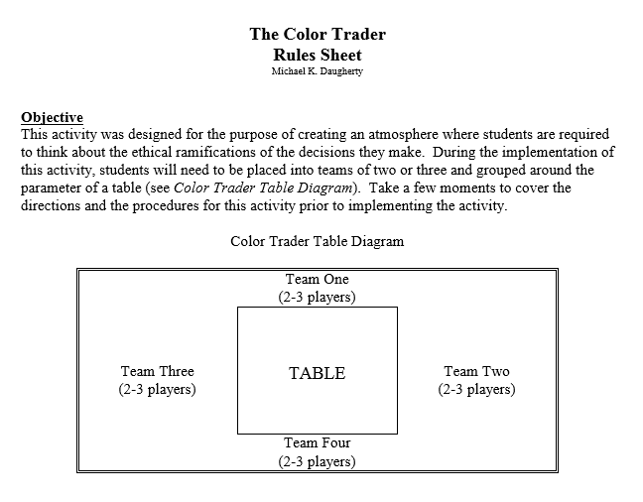
Quick challenge - The Color Trader
Cooperative Learning

Slide 14
Attributes of STEM
How does STEM work?
Technological literacy
Creativity, problem solving and real world application
Creating real and relatable experiences for the student
  Shows the importance of the information being taught
Relevant to the students’ world and perspectives
Thinking tools (heuristics)
The ability to synthesize information
Creating a body of content knowledge

Slide 15
Strategies for STEM Problem Solving
How do students approach a problem where the answer is unknown?
What steps do you take to solve a problem?
Are students aware of heuristics used to solve complex problems?

Slide 16
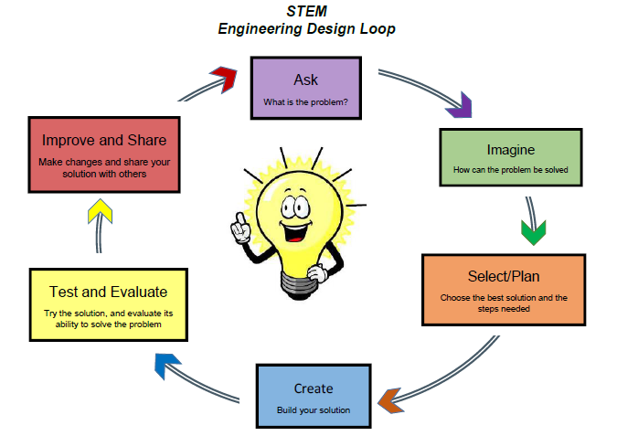
Engineering Design Loop
What is the Design Loop?
The Design Loop is a tool that helps make design problem solving a more effective learning tool for students
A structure for thinking and doing- the essence of design problem solving
Designing is not a linear process

Slide 17
Engineering Design Loop
STEP 1: Identifying problems and opportunities
Identify the problem in need of a solution
STEP 2: Clarifying the design problem
Here the student designer attempts to clarify, understand the specifications, and detail what exactly they intend to do
At this point, the student begins to ask a number of questions
  What are my limits?
  How much time do I have?
  What materials do I have access to?
STEP 3: Investigating and Conducting Research
In order to solve problems, all pertinent information must be gathered and documented for possible future reference
  The importance of investigation and research and cannot be overemphasized
  Few solutions are new. Most new inventions involve many previously known principles and concepts.
STEP 4: Generation of Alternative Solutions
Generating a number of alternative solutions is one of the most important steps and often the most difficult to do. Although it seems to be human nature to latch on to your first idea and try and make it work, more ideas = better solutions.
Techniques: Brainstorming, sketching, doodling, attribute listing, and forced connection.
STEP 5: Choosing a Solution
Choosing the best among a number of ideas is less straightforward than it may appear.
Two strategies:
  1) Listing the attributes (good and bad points) of the ideas and comparing them,
  2) Developing a decision matrix that compares attributes to design criteria.
The evaluation process may indicate a way to combine features of several solutions into an optimum solution.

Slide 18
Engineering Design Loop
STEP 6: Developmental Work
The student designer begins working on the myriad of sub-problems that need solutions.
Involves
Modeling
Experimentation with different materials
Fastening techniques, shapes, and other things that need to be done before actual construction of the final design is undertaken.
STEP 7: Modeling and Prototyping
Construction
At this point the student designer begins to develop models and prototypes that represent their idea.
Two-dimensional and Three-dimensional models, computer models, and mathematical models are commonly used.
STEP 8: Testing and Evaluating
This may be as simple as applying the specifications to the end product to see if it does all the things that it is supposed to do
More often it is performance testing, as in the case of a practical device.
STEP 9: Re-designing and Improving
After evaluating the design, student designers begin implementing what they have learned from the evaluation
An effort to improve the product.
STEP 10: Presenting and Producing
All design problems should end with a culminating event. This could be a formal presentation of the production of the product or system.

Slide 19
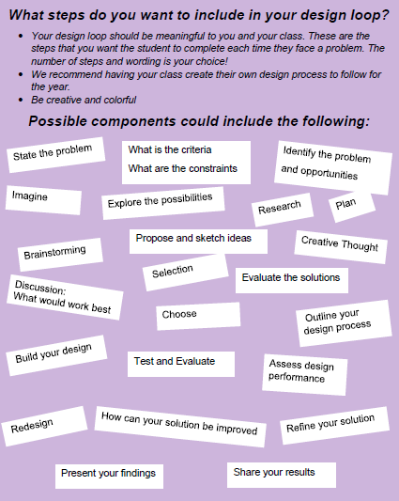
What Will Your Design Loop Include?

Slide 20
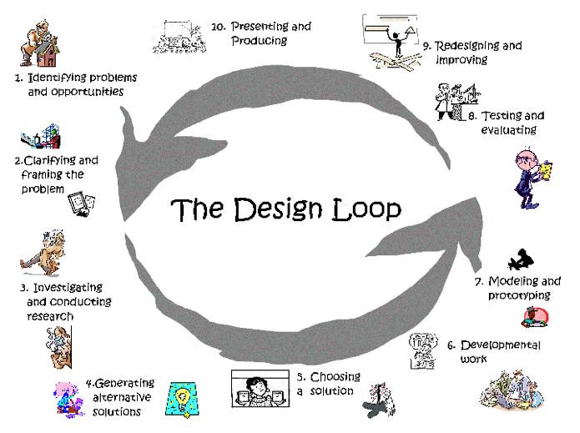
Example Design Loops

Slide 21
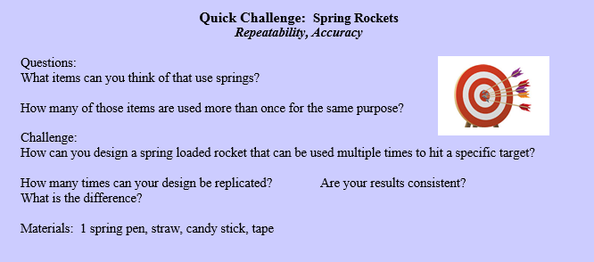
Quick challenge: Spring Rockets
Repeatability and Accuracy

Slide 22
DISCUSSION STOP

Slide 23
Problem-based learning
Problem vs. Project based learning
Problem-based learning: Students develop a solution to a problem/issue
Project-based learning: Students develop a tangible artifact
Project/problem-based instruction has become popular because of its impact on student learning
It is focused on experimental learning organized around the investigation and resolution of messy, holistic, and real world problems
Creates a learning environment that facilitates deeper understanding

Slide 24
Problem-based learning
How does PBL work?
  Using ill-structured problems to increase personal responsibility for learning
  Engaging students in math, science, technology and engineering at an early age.
  Causing students to gather information, assess its validity, and provide evidence to support decisions.
  Teaching and encouraging learning transfer
  Treating teamwork as an important outcome
Students don’t need the whole subject laid out to master a challenge
  A step- by- step series of lessons explaining each piece of the automobile and its function prior to ever touching the car is not the best way to understand how it works or how to fix it!
  Much important teaching occurs after, not before, students attempt to perform – when students are ready to hear and grasp its value

Slide 25
Problem-based learning
Through PBL, students learn:
Problem solving skills
Self-directed learning skills
Ability to find and use resources
Critical thinking
Measurable knowledge base
Performance ability
Social and ethical skills
To become self-sufficient and self-motivated
Facility with computer
Leadership skills
Ability to work on a team
Communication skills
Proactive thinking
Congruence with workplace skills

Slide 26
Assessment
Common concerns
Need to be able to access:
Grading
  Group projects
Content Expert
Meeting the Standards
  Standardized testing
Parental Questions/Concerns
Problem-solving
Quality of work
Creativity
  Creative use of materials
Efficiency
Collaboration
Learning

Slide 27
Assessing Student Performance
Team performance rubrics
Journals and logs
  Engineering journals
    Digital or paper
  Analytical writing
Checklist
Models / Prototypes
Cooperative learning
Presentations

Slide 28
Assessing Student Performance
Performance-based Assessments
  Concept of performance assessments is not new
  Based in the “real world” = authentic assessment
  Must be linked to instructional objectives/standards
  Assessments, by themselves, are meaningful learning activities
  Specific behaviors/capabilities should be observed
  Measure complex capabilities/skills that can’t be measured with pencil-and-paper tests
  Must focus on teachable processes
  Can specifically target procedures used by students to solve problems
  Results in tangible outcome or product

Slide 29
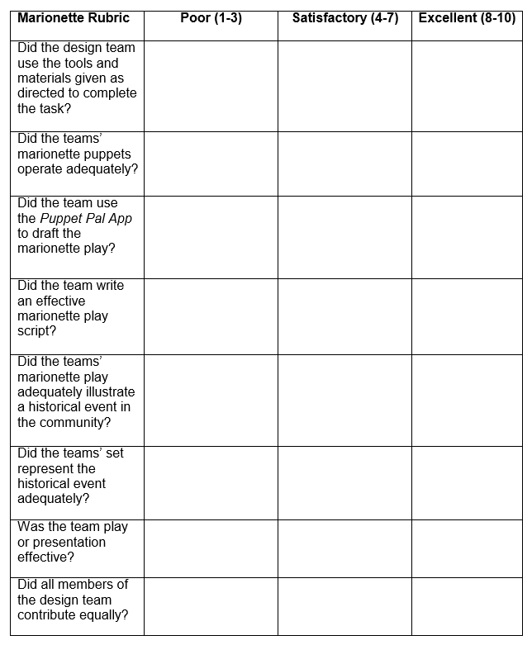
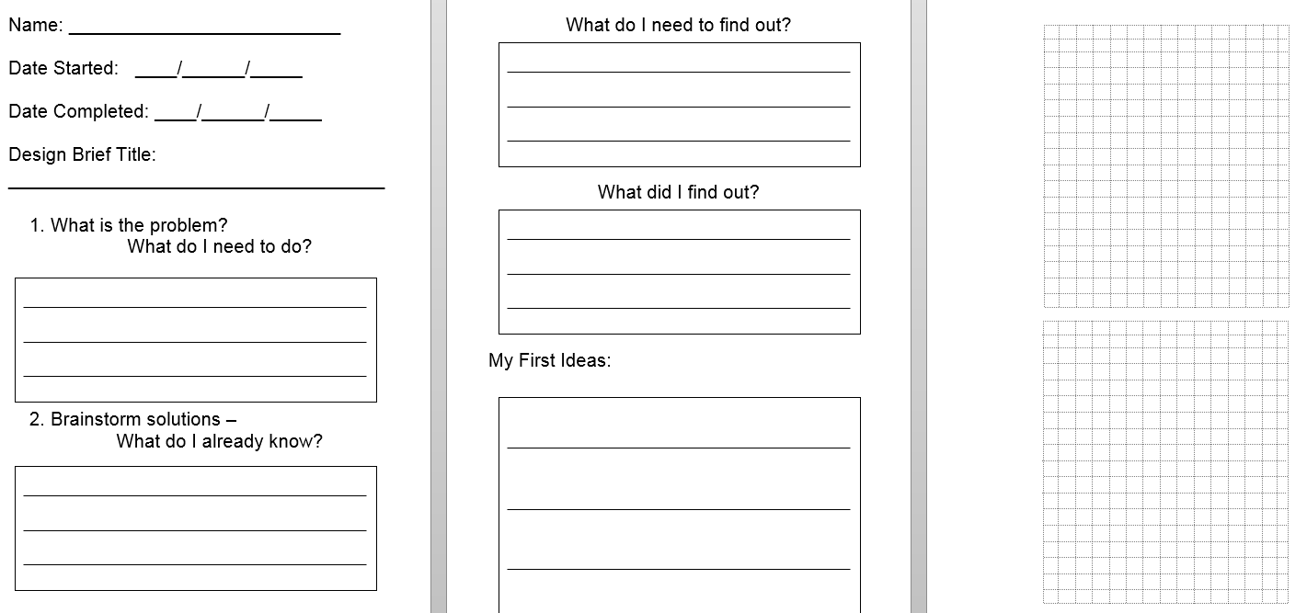
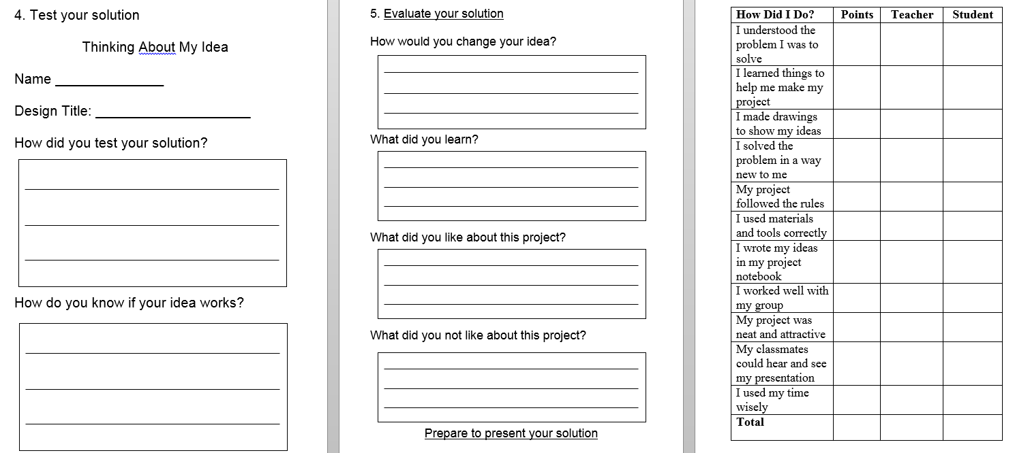
Example Assessments
Rubric
Engineering Journal

Slide 30
Introducing STEM – Narrative
What is Narrative Curriculum?
Consider curriculum as a story
Stories rarely lay out all the facts and ideas in a step- by- step fashion
Although sometimes illogical and incomplete, stories are likely to engage the reader
Storytellers are great teachers
Instead of presenting a straightforward sequence of events, the storyteller deliberately raises questions and delays answering them
We do not easily remember what other people have said if they do not tell it in the form of a story
PBL thrusts students into problem situations immediately, much like a reader is thrust into the middle of a story

Slide 31
Narrative Curriculum
3 Questions answered in all Narrative Curricula
  What do we know?
  What do we need to know?
  How can we find out?
Key Features of Narrative Curriculum
The presence of a mystery, dilemma, or oddity is essential
  The most basic feature of all compelling stories (or problems)
  We are placed into an environment that has to be figured out or understood
Think of a course designed to provide drama, to offer surprises, twists, and turns
  What drives a story? What makes it worth telling?
    TROUBLE
    Some misfit between the characters, their actions, the goals of the story, the setting, and the means
A good story centers on what is essential
  A big idea

Slide 32
Narrative Curriculum
5 Essential Elements of a Narrative Curriculum
Identifying importance
    What is most important about this topic?
    Why should it matter to students?
    What is engaging about it?
Finding binary opposites
    What opposites best capture the importance of the topic?
Organizing content into story form
    What content most dramatically embodies the opposites
Conclusion
    What is the best way of resolving the conflicts between the opposites/solve the conflict
Evaluation
    How will we determine whether they have learned?

Slide 33
Informational Text
The Common Core State Standards ask teachers and students to:
  Build knowledge through content-rich nonfiction and informational texts, in addition to literature
  Produce reading and writing grounded in evidence from the text, both literary and informational
  Regularly practice with complex text and its academic vocabulary
Informational Text Characteristics
  Colorful
  Fun
  Engaging
  Rich content
Learning standards
Not boring
Ample opportunities for learning
Foundation for future learning

Slide 34
Benefits of Informational Text
When should informational text be used?
Exposure within early grades leads to:
  Kindergarten and ELL students have better grasp on language when read informational text
  Increased writing and comprehension
  Positive attitudes toward reading
What learning standards can be addressed?
  Expository Text: includes definitions/explanations, compare/contrast, graphics
  Persuasive Text: states position supported by evidence, strong language to incite action
  Procedural Text: includes material list, shows steps for directions, measures of specificity, has an end result
  Nonfiction Narrative: chronological order, presents problem and solution, uses artifacts

Slide 35

Narrative Curriculum Design Challenge

Slide 36

Narrative/Informational Text Design Challenge

Slide 37
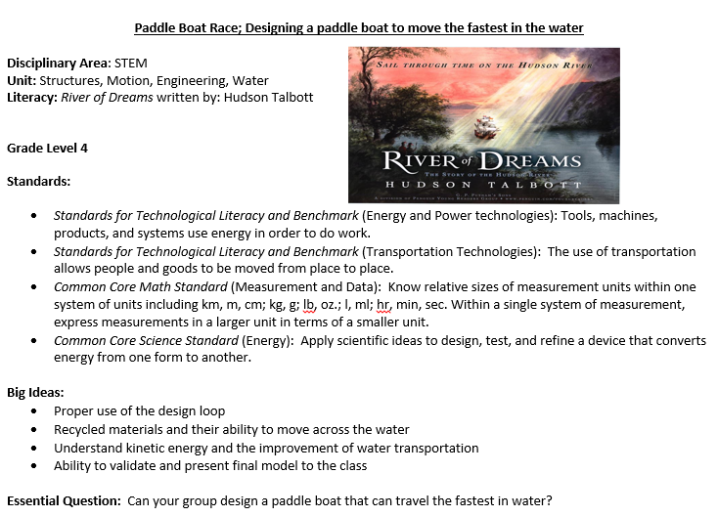
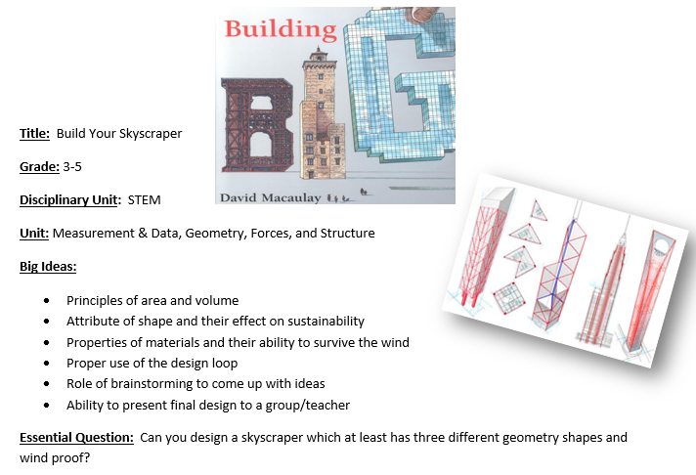
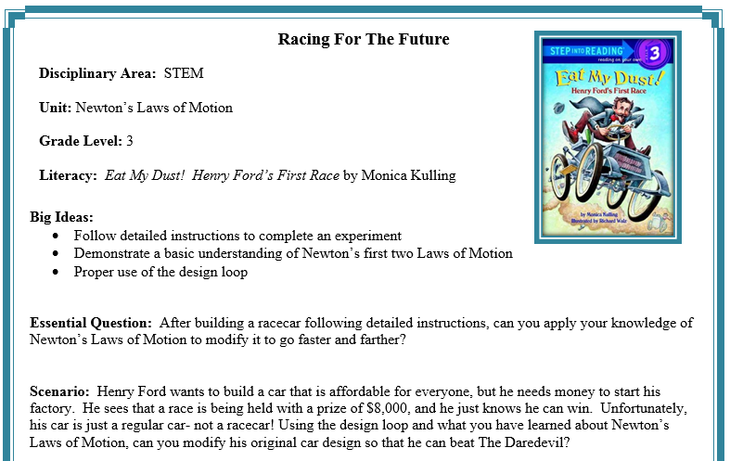





Examples of Informational Text Design Challenges

Slide 38
Creating STEM Lessons
7 Elements of a Good STEM Lesson/Project
Purpose and Relevance: Is it personally relevant to the students? Does it provide a certain level of intrigue? Does it cause the student to want to invest time and effort?
Time: Projects can last one class period or an entire term, but time must be provided to research, plan, build, test, debug, retest, and communicate.
Complexity: The best STEM projects include content from all disciplines in STEM and the connections between these content areas.
Intensity: Tap into that natural intensity that children exhibit when mastering a video game, reading a new book from a series, etc.
Connection: Great projects or prompts force students to connect with other students, people, and ideas (think Internet) with whom they might not naturally connect.
Communication: The big idea of PBL is the concept that the final solution must be shared and defended. This provides a great deal of motivation and a sense of satisfaction.
Novelty: Perhaps the most important consideration in STEM. Few project ideas are so profound that they can be used year after year with the same level of success with students (think egg drop activity). If the teacher is bored with the idea, students will be bored with the idea.

Slide 39
Creating STEM Lessons - PBL
Six essential features for Problem-based task:
  Have a clear purpose that specifies the decision that will be made resulting from the assessment.
  Focus be on process, product, or both
  No simple right or wrong answers; they must be assessed along some sort of continuum.
  Focus on degrees (e.g., quality, proficiency, understanding, etc.).
  Try to reduce potential subjectivity in scoring.
  Share scoring information with students early—as a guide

Slide 40
Creating STEM Lessons
Backwards Design
Stages in the Backward Design Process
Identify desired results
Determine acceptable evidence
Plan learning experiences and instruction

Slide 41
Creating STEM Lessons
Writing a Design Brief
Make sure it delivers something important
(standards, big ideas, extension of a lesson or unit)
  But remember, it’s not something fun to do after the lesson—it is the lesson
2. Make sure it captures a big idea and answers an essential question (think assessment)
Big idea filters
  Is it important enough to remember when the child is 30?
  Does it have the potential to engage to child?
  Is it central to understanding the STEM content?

Slide 42
Creating STEM Lessons
3. Develop a problem scenario
  Craft an engaging scenario that both captures the attention of the child and engages them in solving an authentic problem
4. Develop content information.
  Using the standards and big ideas for the problem, develop content information that promotes learning in science, technology, engineering, and mathematics.
5. Develop boundaries for the problem (materials/resources, parameters, deliverables)
6. Develop an authentic, performance-based assessment
7. Force students to use the Design Loop

Slide 43
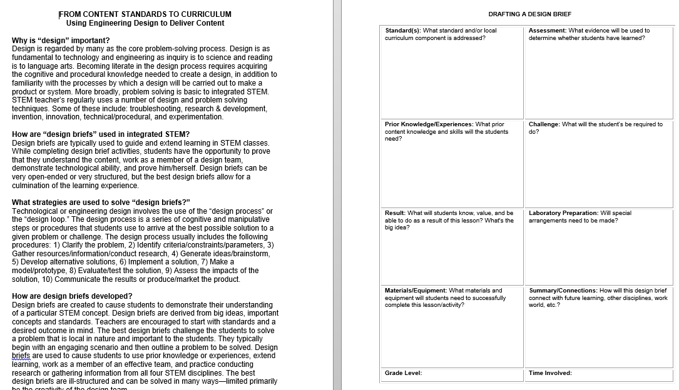
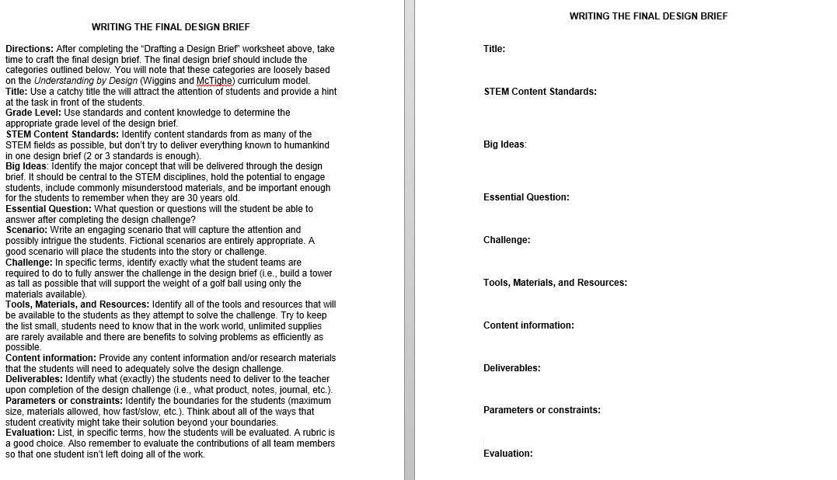
From Content Standards to Curriculum
Using Engineering Design to Deliver Lessons

Slide 44
Action Plan Presentation

