Slide 1
Teaching Design and Problem Solving
Design
Trouble-Shooting
Invention and Innovation
Research and Development
Experimentation
Technical/Procedural
One of the simplest problem solving models (design loops) includes these steps.
Identify the problem
Select a solution
Apply the solution
Test and revise the solution

Slide 2
Technical/Procedural Problem Solving
Technical/procedural problems differ from engineering design problems in that they are more structured and the solutions to such problems require background knowledge as well as the ability to follow technical directions.
  Show the students "how to" complete a task or process.
  Procedures are action oriented.
  They outline steps to take, and the order in which they need to be taken.
  They're often instructional, and they may be used in applying newly learned content, but they should never be used exclusively in the

Slide 3


Slide 4

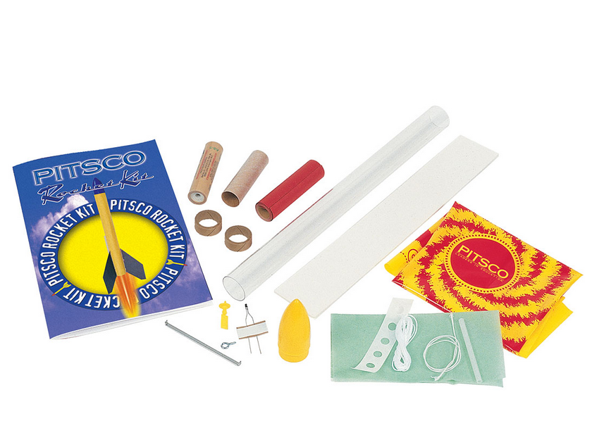
Planning a Lesson or Unit on Rocketry

Slide 5
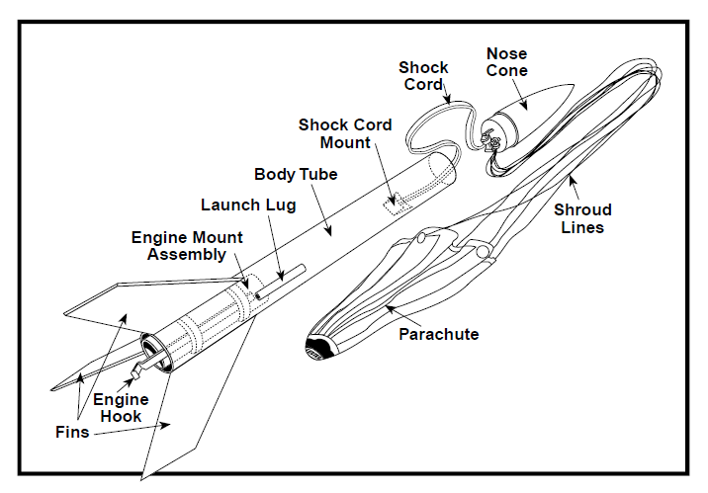
Key Elements to Building a Model Rocket
Non-Flammable
Tissue Paper Wadding

Slide 6
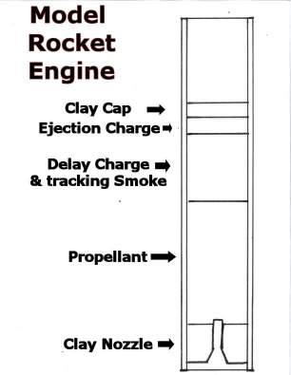
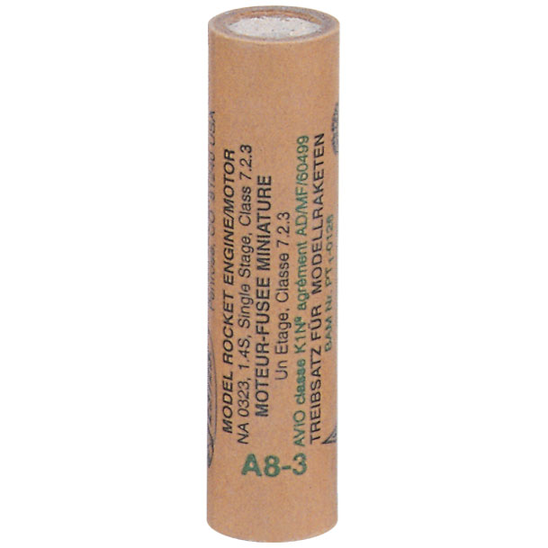
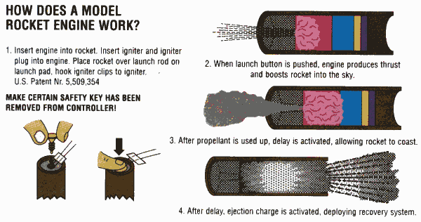
A8-3 Solid Fuel Rocket Engine

