Slide 1
Define the term ‘Maker’

Slide 2
Maker Culture
The maker culture is a contemporary culture or subculture representing a technology-based extension of DIY culture. Typical interests enjoyed by the maker culture include engineering-oriented pursuits such as electronics, robotics, 3-D printing, and the use of CNC tools, as well as more traditional activities such as metalworking, woodworking, and traditional arts and crafts. The subculture stresses new and unique applications of technologies, and encourages invention and prototyping. There is a strong focus on using and learning practical skills and applying them creatively.

Slide 3
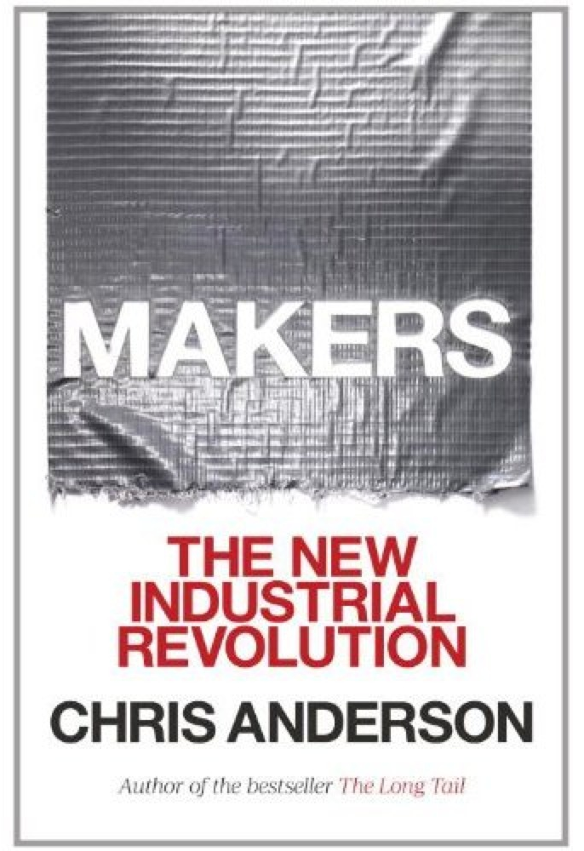
Chapter One - The Invention Revolution
Group 1 - Define technological literacy. How does technological literacy fit into the concept of the ‘invention revolution’?
Group 2 - Explain the concepts of bits and atoms.
Group 3 - How has the Web democratized the tools of the inventor and producer?

Slide 4
Points to Ponder
At what point in your life have you had a fascination with making?
Are you an inventor or entrepreneur?

