Slide 1
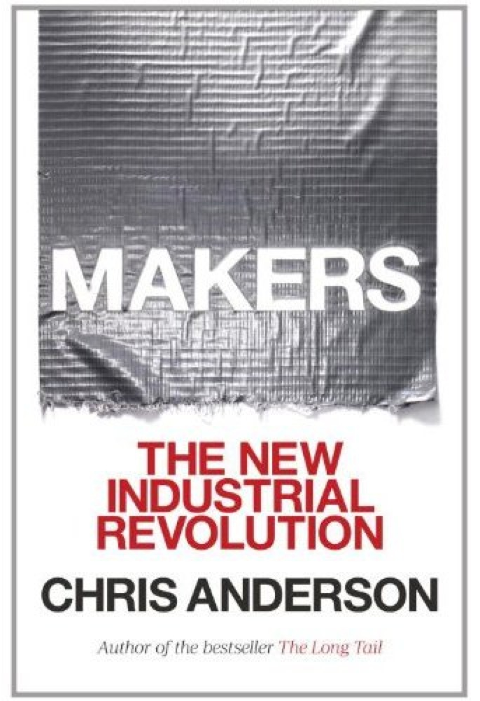
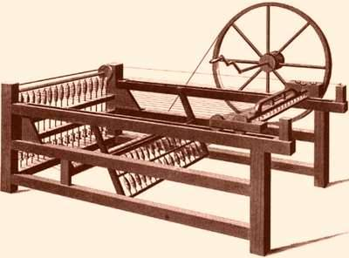
Chapter Three
“The History of the Future”

Slide 2
How did the Spinning Jenny launch the industrial revolution?
widespread availability of cotton
designed to distribute power from a central point (human, water, steam, etc.)
right place at the right time (Britain in the 1700’s was going through an intellectual renaissance – patent laws and policies)

Slide 3
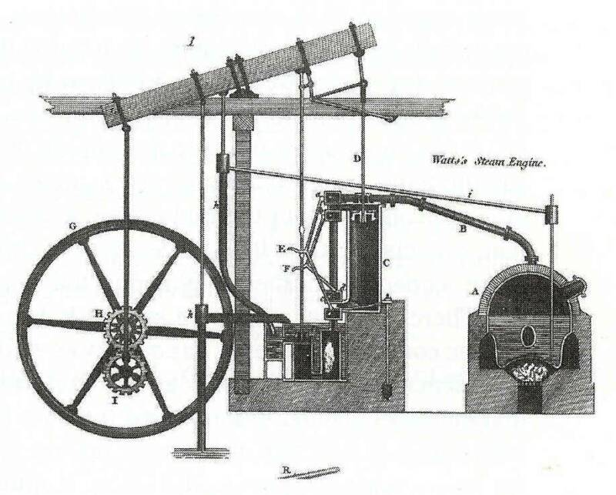
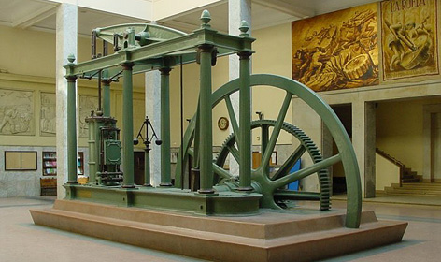
James Watt – The Steam Engine – 1776
-what was the connection to the colonies Declaration of Independence

Slide 4
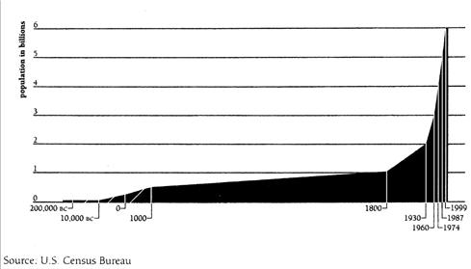
Industrial Revolution = Social Revolution (the population of GB tripled between 100-1850)

Slide 5
Why?
the smallpox vaccine
improved farming methods
better hygiene = clothing and soap
cotton was easier to wash than wool
migration to cities = more access to medical care and other positive effects such as clothing and transportation
The modern expectation of continual growth and improving quality of life is just a few hundred years old.

Slide 6
The Second Industrial Revolution – 1850-the end of WW I
  the assembly line
  interchangeable parts
  The Colonization of Time? – Defining ‘Westernization’
The Third Industrial Revolution
computing and communications
rather than amplifying human power, they amplify brain power
digital and personal manufacturing

