Slide 1
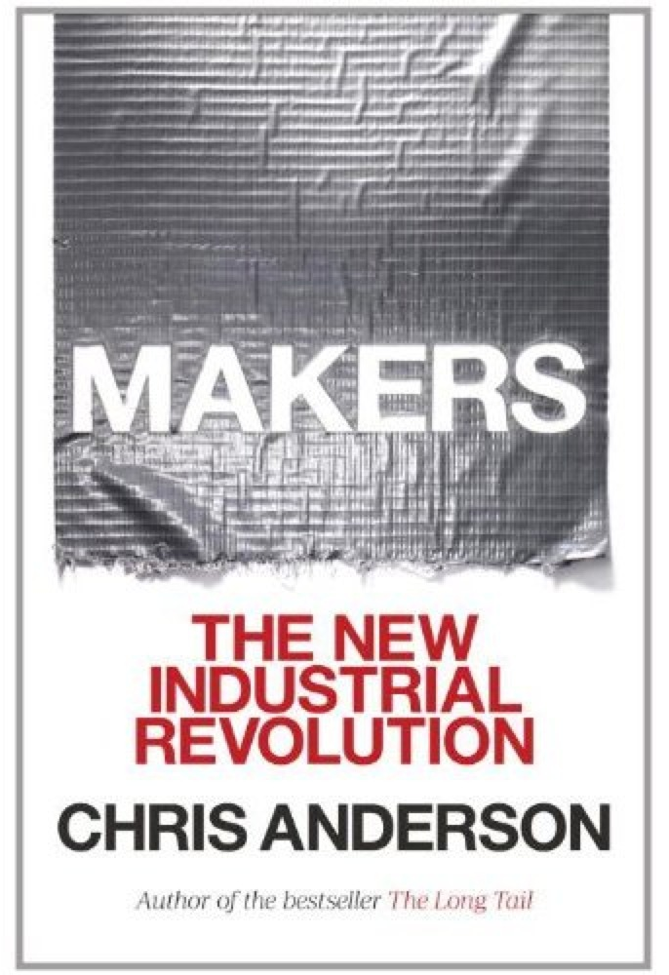
Chapter Two “The quest for reality ends in making real things”

Slide 2
What is ‘open source’?
Network Effects = connecting people and ideas
Kickstarter
Donors Choose
Make Magazine
Instructables

Slide 3
Characteristics of the Maker Movement
People using digital desktop tools to create design for new products and prototype them (“digital DIY”).
A cultural norm to share those designs and collaborate with others in online communities.
The use of common design file standards that allow anyone, if they desire, to send their designs to commercial manufacturing services to be produced in any number, just as easily as they can fabricate them on their desktop. This radically foreshortens the path from idea to entrepreneurship, just as the Web did in software, information, and content.

Slide 4
The Toolkit for Transformation (it can apply to practically any product):
How would these products be improved if they were connected to the Internet?
How would they be improved if the designs were open, so anyone could modify or improve them?
How much cheaper would they be if their manufacturers didn’t charge for their intellectual property?

