Slide 1
Philosophy of Technology

Slide 2
Early Philosophy of Tech
Democritus
Technology imitates nature
Aristotle
Nature is not connected to technology
Technology cannot reproduce itself, as natural objects
Nature “inner driving” instead of “external” benefits
Biomimicry
What are some examples?

Slide 3
Questions of Philosophy?
Epistemology
The nature of technical knowledge; the nature of technical explanation
Metaphysics
Difference between being “natural” and “artificial”; How technology transforms human nature.
Moral Philosophy
Ethics and Technology; is technology “value neutral” or “value laden”; Appropriate limits to technology?
Political Philosophy
Technology impact on rights and liberties; How decisions are made; Distribution of benefits and burdens of technology.
Environmental Philosophy
Superior – Nature/Technology? ; impact of technology; biotech.

Slide 4
Four Classic Theories of Technology
Neutrality
Tool can be used for good or bad purposes
Determinism
The driving force of history
Autonomy
Frankenstein’s monster that is increasingly beyond our control
Social Construction
Man made things that shape society, which in turn, shape technological development. Humans, Tech and context fit together like a puzzle. (Kaplan, 2009 p. XIV)

Slide 5
Question Concerning Technology…..
….the essence of technology is by no means anything technological. Thus we shall never experience our relationship to the essence of technology so long as we merely conceive and push forward the technological, put up with it, or evade it. Everywhere we remain unfree and chained to technology, whether we passionately affirm or deny it. But we are delivered over to it in the worst possible way when we regard it as something neutral; for this conception of it, to which today we particularly like to do homage, makes us utterly blind to the essence of technology. (p. 35)
Martin Heidegger

Slide 6
Cause and Effect
Patterns
Regular
Repeat
Ripple effect
What are some “technology ripples”?

Slide 7
Technology Systems
System
Aggregate of two ore more physical components and a set of disciplines or procedures by means of which they interact.
“Stuff working together”
Understanding Systems
Subsystems
Reductionism
Only as far as needed
What are some technology systems?

Slide 8
Systems Model
Process
Output
Feedback
Input

Slide 9
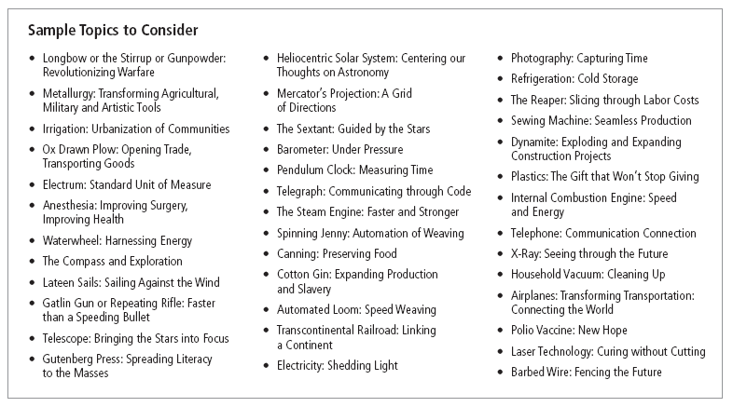
Assignment
Inventor Card

Slide 10
