Slide 1
Philosophy of Technology

Slide 2
Early Philosophy of Tech
Democritus
  Technology imitates nature
Aristotle
  Nature is not connected to technology
    Technology cannot reproduce itself, as natural objects
    Nature “inner driving” instead of “external” benefits
Biomimicry
  What are some examples?

Slide 3
Questions of Philosophy?
Epistemology
  The nature of technical knowledge; the nature of technical explanation
Metaphysics
  Difference between being “natural” and “artificial”; How technology transforms human nature.
Moral Philosophy
  Ethics and Technology; is technology “value neutral” or “value laden”; Appropriate limits to technology?
Political Philosophy
  Technology impact on rights and liberties; How decisions are made; Distribution of benefits and burdens of technology.
Environmental Philosophy
  Superior – Nature/Technology? ; impact of technology; biotech.

Slide 4
Four Classic Theories of Technology
Neutrality
  Tool can be used for good or bad purposes
Determinism
  The driving force of history
Autonomy
  Frankenstein’s monster that is increasingly beyond our control
Social Construction
  Man made things that shape society, which in turn, shape technological development. Humans, Tech and context fit together like a puzzle. (Kaplan, 2009 p. XIV)

Slide 5
Question Concerning Technology…..
….the essence of technology is by no means anything technological. Thus we shall never experience our relationship to the essence of technology so long as we merely conceive and push forward the technological, put up with it, or evade it. Everywhere we remain unfree and chained to technology, whether we passionately affirm or deny it. But we are delivered over to it in the worst possible way when we regard it as something neutral; for this conception of it, to which today we particularly like to do homage, makes us utterly blind to the essence of technology. (p. 35)
Martin Heidegger

Slide 7
Cause and Effect
Patterns
  Regular
  Repeat
Ripple effect
  What are some “technology ripples”?

Slide 8
Technology Systems
System
  Aggregate of two ore more physical components and a set of disciplines or procedures by means of which they interact.
    “Stuff working together”
Understanding Systems
  Subsystems
  Reductionism
    Only as far as needed
What are some technology systems?

Slide 9
Systems Model
Process
Output
Feedback
Input

Slide 10
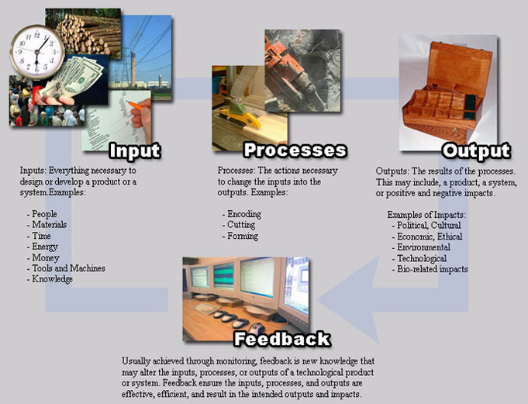

Slide 11
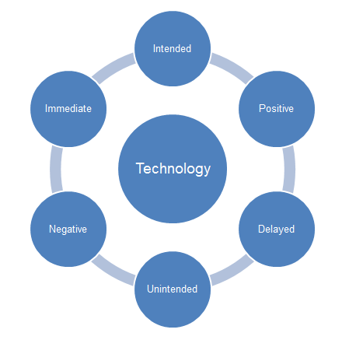

Slide 12
Assignment for Thursday – Read pgs. 65-72 in the STLs

Slide 13
The Plastic Grocery Bag

Slide 14
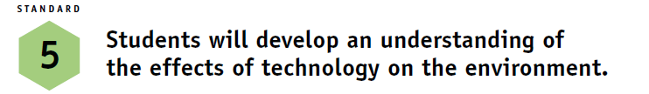


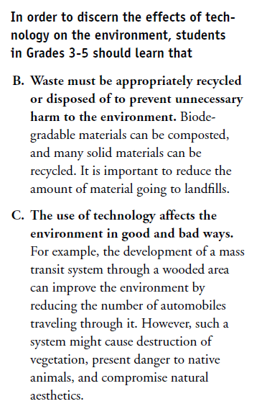
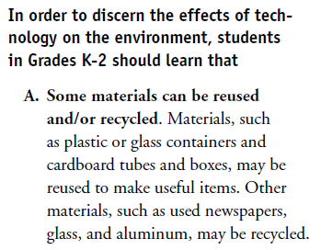

Slide 15

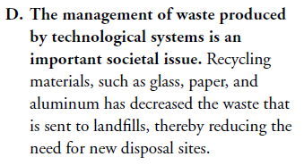
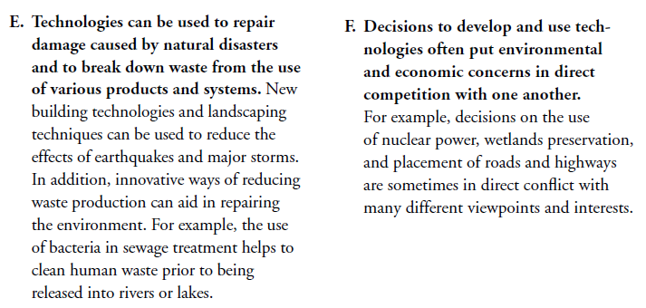

Slide 16

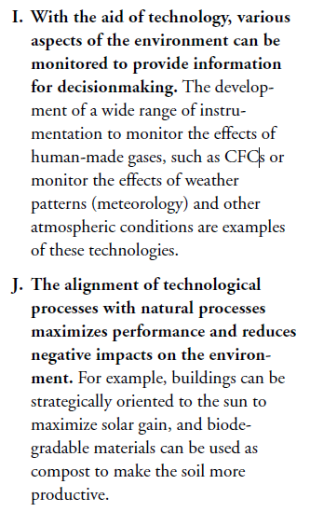
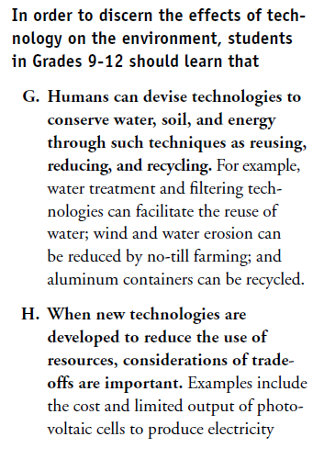


Slide 17
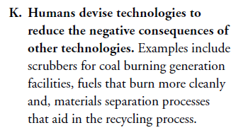
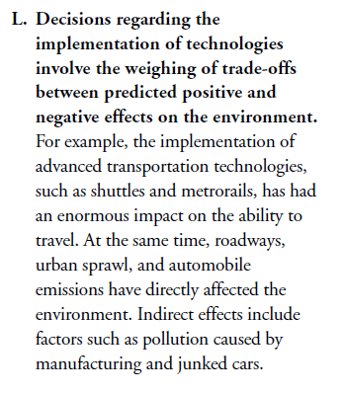

Slide 18
Assignment for TUEsday – Read pgs. 73-78 in the STLs

