Slide 1

Standards within Curriculum

Slide 2
STEM Standards
Science:
Next Generation Science Standards
Technology and Engineering:
Standards for Technological Literacy (STL’s)
Math:
Common Core
Each STEM lesson should have at least one standard from each discipline. This makes it an integrated lesson.
Your lessons may have more standards such as English Language Arts (Common Core), Economics, Art, etc.

Slide 3
Science Standards
Need for Science standards
Reduction of the United States' competitive economic edge
Shrinking share of patents: Foreign competitors filed over half of U.S. technology patent applications in 2010.
Diminishing share of high-tech exports: Our share of high-tech exports in on the decline, while China has become the single largest exporting country for high-tech products. Correspondingly, the United States' high-tech trade deficit continues to grow.
Lagging achievement of U.S. students
United States is 23rd in Science, 30th in Math, and 20th in Reading Literacy out of 65 international education systems.
In 2011, the United States ranked 23rd in high school graduation rate
Over a third of eighth-graders scored below basic on the 2011 NAEP Science assessment.
In 2012, 54% of high school graduates did not meet the ACT's college readiness benchmark levels in math, and 69% of graduates failed to meet the readiness benchmark levels in science.

Slide 4
Science Standards
Need for Science standards
Essential preparation for all careers in the modern workforce
Preparation of 21st century skills for all jobs not just those in STEM fields
Fastest growing occupations are those that emphasize science and math
Scientific and technological literacy for an educated society
Preparation for the quickly changing society and dilemmas that occur
Energy sources, sustainability, communication, nuclear impacts

Slide 5
Next Generation Science Standards
Creation and Purpose
Created by 18 individuals who are nationally and internationally known as experts within science fields and education
Developed to incorporate the most current research on science and science learning
Provide all students an internationally-benchmarked science education
Aimed to prepare students for college and careers
Arrangement
Practices, Crosscutting Concepts, Disciplinary Core Ideas
Listed by

Slide 6
Math Standards
Need for Math Standards
Students are preparing to enter a career world that is more demanding
Alignment with college and work expectations, to ensure students success after high school graduation
Reinforcement of 21st century skills
Development of Math core standards
Developed from quality math standards used by states across the country
Incorporate skills found successful in current research
Input was gathered from State departments, scholars, assessments, educators, parents, students, organizations, and public

Slide 7
Common Core Math Standards
Intended to set forward thinking goals
Should be essential, rigorous, clear and specific, coherent, and internationally benchmarked
Crucial to solving real-world problems
Provide a way for teachers to measure student progress throughout the year
Helps to identify struggles and ensure a set pathway to success throughout the years
Provide a clear set of skills and knowledge for students regarding mathematics
Adopted by 43 states including Arkansas

Slide 8
Technology and Engineering
Need for Technology and Engineering standards
Escalating rate of change
Global competition
High-stakes testing
Graduating technologically illiterate students
What is Technology and Technological literacy?

Slide 9
Technology and Engineering
Technology is the modification of the natural environment in order to satisfy perceived human needs and wants.
Technological literacy is the ability to use, manage, assess, and understand technology.
Is Technological Literacy Possible?

Slide 10
Skills of a Technologically Literate Person
Evaluate technological information
Form opinions about technology
Assess technological value (or the lack of value)
Exhibit a level of comfort with technology
Neither afraid, nor infatuated
Understand how technology is created
Understand how technology shapes society and is shaped by society

Slide 11
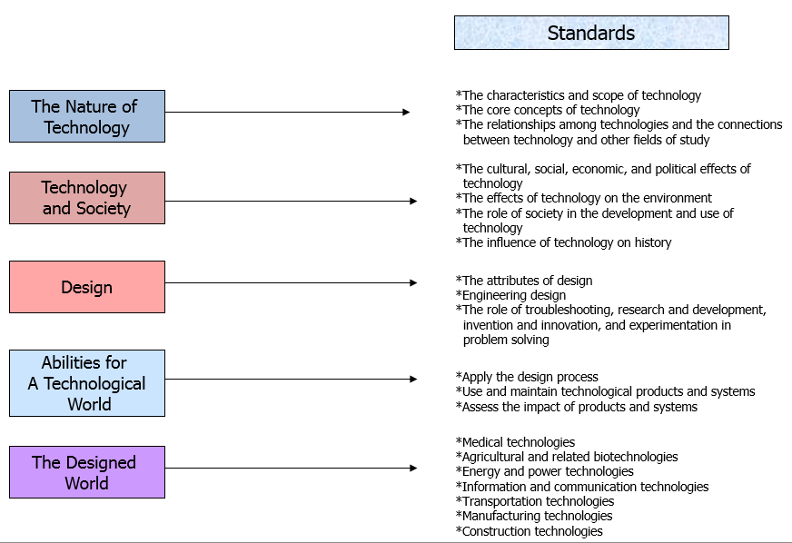
STL’s

Slide 12
Primary Concepts of Engineering Design Engineering design is delivered using technological problem solving
Optimization
Quality Control
Iterative Processes
Environmental Concerns
Ethical Considerations
Market Analysis
Design Principles
The Design Loop
The Attributes of Design
Criteria/Constraints
Risk/Benefit Analysis

Slide 13
Engineering Design Attributes
Working as a Team
Defining the problem
Brainstorming
Conducting Researching
Generating Ideas
Identifying Criteria
Specifying constraints
Exploring possibilities
Developing Proposals
Making a Model/prototype
Evaluating a design using specifications
Assessing a Solution
Refining a design
Creating or making products
Communicating results
Selecting Approaches

Slide 14
Embedding the standards within your STEM lessons
Have a general idea about the topic to be taught
Review standards to determine what needs to be delivered
Assessment: Determine how you will measure achievement
Determine what students must know & be able to do
Plan the lesson
Assess the students/determine if additional instruction is needed

Slide 15
Standards-based Doesn’t Require Abandoning Current Projects/Lessons
But, must be aligned with standards
Brushing past vs. delivering standards
Emphasis on knowing that content is learned
Takes time, practice, professional judgment

Slide 16
Scenario: Have an idea for topic to be taught, what to do . . . Select and analyze standard to be met
Essential for all lessons
Supportive
Has real-life application
Fundamental step in a larger process
Based in the present
Helps student function
Vital concept
Linked to a curriculum objective
Promotes independent study
Can be more fully developed in another subject area
Provokes student interest
Provides opportunities for student to expand knowledge

Slide 17
Use the Standards to Develop Assessments & Drive Lesson Development
How will we know that they have achieved the knowledge and abilities specified in the standards?
What essential questions would prove attainment?
What learning experiences would deliver the goods?

