Slide 1
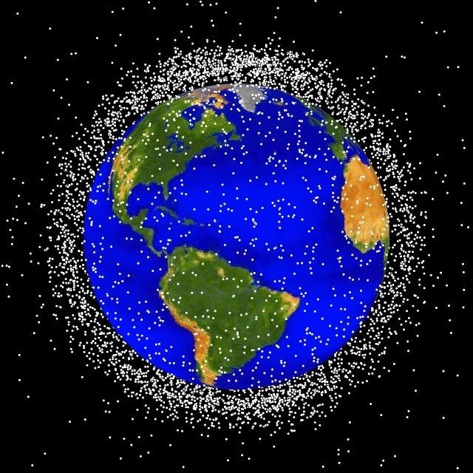
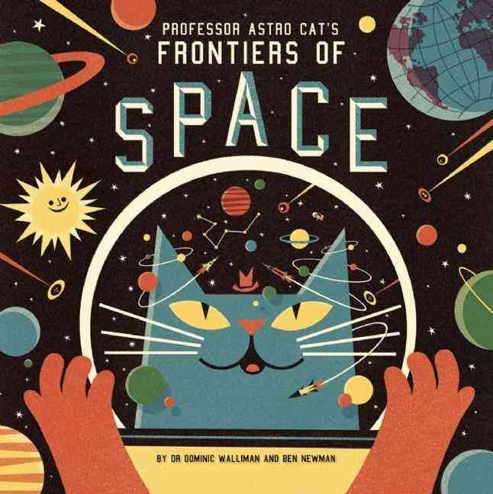
Using Scientific Inquiry to Drive Engineering Design

Slide 2

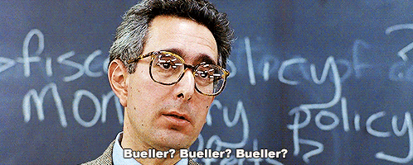
Scientific Inquiry in STEM Education
Engineering design is a cornerstone of integrated STEM education and is closely related to scientific inquiry.
Unfortunately, an inquiry-approach to teaching is not the norm in most schools—even in science classes it is often omitted for more traditional content delivery methods.

Slide 3
A good starting point -
The 5 Features of Scientific Inquiry
Learner Engages in Scientifically Oriented Questions
Learner Gives Priority to Evidence in Responding to Questions
Learner Formulates Explanations from Evidence
Learner Connects Explanations to Scientific Knowledge
Learner Communicates and Justifies Explanations
(National Research Council, 2000)

Slide 4
Scientific inquiry provides evidence to create explanations or answers -
Helping students use evidence to create explanations or answers for natural phenomena is central to science inquiry.
Inquiry means that students are handling science; they are manipulating it, working it into new shapes and formats, integrating it into every corner of their world, and playing with it in unknown ways.
Inquiry implies that students are in control of an important part of their own learning where they can manipulate ideas to increase understanding.
As students learn to think through the designs and developments of their own inquiry, they also develop a sense of self-responsibility that transcends all subject areas.

Slide 5
Personalizing the Learning Experience
Many science textbooks portray science as a collection of facts or a body of knowledge for students to learn. Unfortunately, this sometimes results in students doing nothing more than memorizing facts and mastering theories.
On the contrary, there is much room in science for intuitive, hypothetical, playful, and imaginative forms of learning. In other words, there is room for inquiry.
"Scientific inquiry refers to the diverse ways in which scientists study the natural world and propose explanations based on the evidence derived from their work. Inquiry also refers to the activities of students in which they develop knowledge and understanding of scientific ideas, as well as an understanding of how scientists study the natural world."

Slide 6
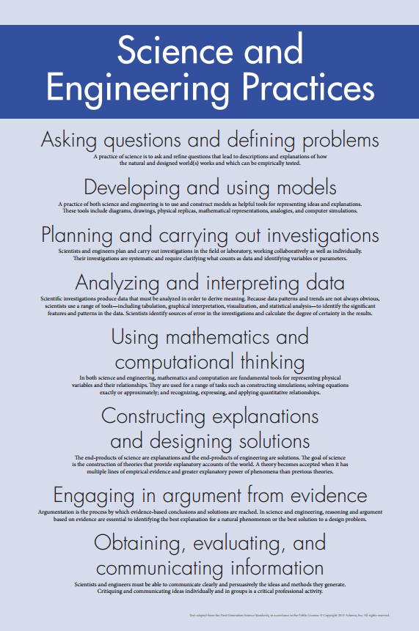
Personalizing the Learning Experience
Describe objects and events.
Ask questions.
Construct explanations.
Test explanations against current scientific knowledge.
Communicate their ideas to others.
Identify their assumptions.
Use critical and logical thinking.
Consider alternative explanations.

Slide 7
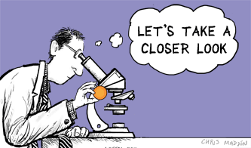
Approaches to Inquiry
Inquiry is "the creation of a classroom where student are engaged in essentially open-ended, student-centered, hands-on activities." The inquiry-based classroom encompasses several approaches to inquiry-based instruction including:
Structured Inquiry
The teacher establishes parameters and procedures for inquiry. Students are provided with a hands-on problem to investigate as well as the procedures and materials necessary to complete the investigation. Students discover relationships between variables or generalize from data collected, which in essence leads to the discovery of expected outcomes.
Guided Inquiry
The teacher provides the problem for investigation as well as the necessary materials. Students are expected to devise their own procedure to solve the problem.
Open Inquiry
Open Inquiry has been defined as student-driven. Similar to Guided Inquiry, students formulate their own problem to solve as well as the procedure. Open Inquiry is analogous to doing science. Science fair projects are often examples of Open Inquiry.
Learning Cycle
Students are involved in an activity that introduces a new concept. Afterwards, the teacher informs the students of the formal name of the concept. Students transfer knowledge of the concept through application in a different context.
(Colburn, 2000)

Slide 8
Inquiry-based STEM Learning
As teachers we should:
Develop STEM activities that are more inquiry-based so students can develop practical skills and an understanding of the ambiguity and complexity associated with empirical work in science.
Provide opportunities for students to read, write, and engage in critical discussions as they work.
Encourage students to construct or critique arguments (i.e., an explanation supported by one or more reasons) and to embed diagnostic, formative, or educative assessment into the instruction sequence."
Look for ways to reinforce the creation and critiquing of arguments in the classroom. "How do you know?" should be one of the most frequently asked questions in your classroom.
Expect that student answers (verbal or written) should include evidence.
Look for opportunities for students to critique the use of evidence in science news, reports and other media.

Slide 9
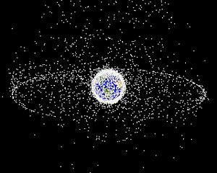
It’s a Minefield up Here
During a routine mining mission to an asteroid in the year 2052, your team of astronauts encounters a pesky piece of space junk. Your team will be making several trips through this sector and you’d like to remove this dangerous obstacle by capturing it and then thrusting it toward a nearby planet to burn up in that planet’s atmosphere. You only have one problem: You don’t know the exact mass, size or shape of the space debris.
Build a space debris capture device that can be used to capture most any space junk so that it can be removed safely from your path.

Slide 10
It’s a Minefield up Here
Big Ideas:
Understanding types of energy and energy transfers
Understanding Newton’s 1st law of physics
Understanding how weight affects velocity
Use scientific inquiry to adapt potential solutions for differing circumstances
Use engineering design to solve technological problems
Essential Question: How can you build a space debris capture device that can be adapted to easily grasp space debris and then launch that debris on a trajectory to burn up in some planet’s atmosphere?

