Slide 1
STEM education
integrated
IN THE ELEMENTARY CLASSROOM
Michael Daugherty& Vinson Carter
University of Arkansas

Slide 2
What is STEM?
INTEGRATED SCIENCE, TECHNOLOGY, ENGINEERING, & MATHEMATICS

Slide 3
Integrated STEM education
Authentic, engaging, hands-on learning
Teaching students how to think critically and deeply
Using curiosity/imagination to engage students in the disciplines
Building agility, adaptability, and entrepreneurialism spirit
Building a mental warehouse
  learning transfer: Basic skills—application—synthesis
Augmenting collaborative team skill development

Slide 4

Five Course STEM Graduate Certificate
  Introduction to STEM Education
  Creativity & Innovation in the Early Grades (Technology & Engineering)
  Math Methods in STEM Education
  Science Methods in STEM Education
  Curriculum Development in STEM Education

Slide 5
First Course: Introduction to STEM Education
Clearly defining Science, Technology, Engineering, and Mathematics
Rationale/purpose for integrated STEM education
STEM content and pedagogy
The nature & pedagogies of the STEM disciplines
Modeling the methods of STEM
Research focused and driven
STEM standards & assessments are central

Slide 6
  Second Course: Creativity & Innovation in the Early Grades
Facilitating creativity and innovation
Focus on using Technology & Engineering to support Science and Mathematics
Apply technical tools and resources toward solving human and environmental problems
NXT Robotics
Research focused and driven
STEM standards & assessments are central

Slide 7
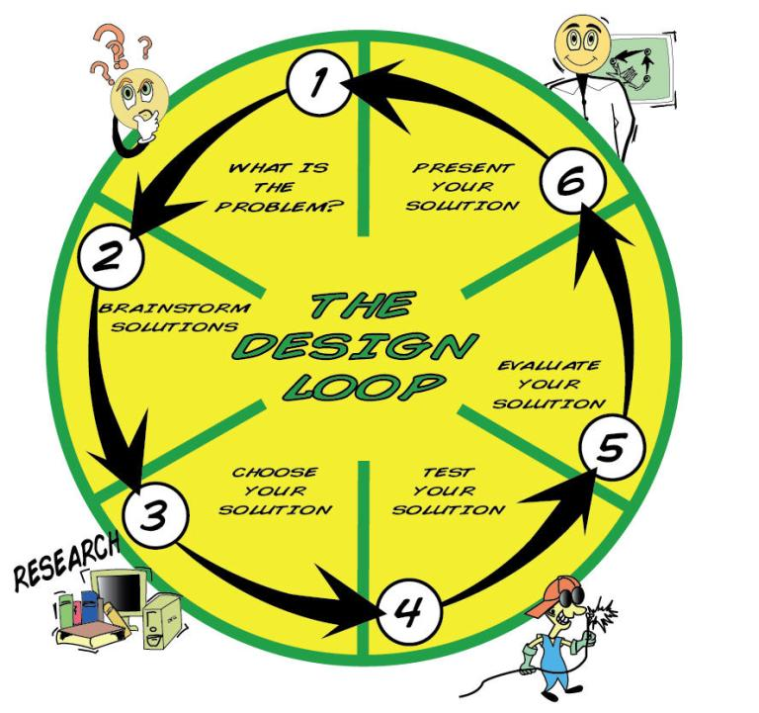
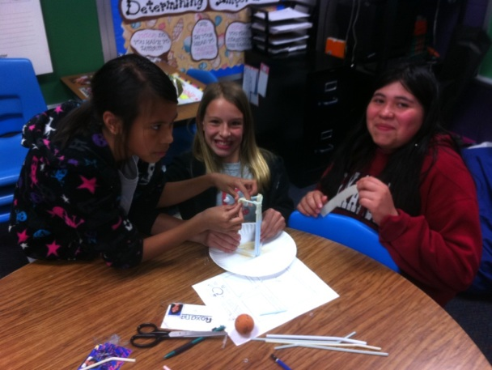
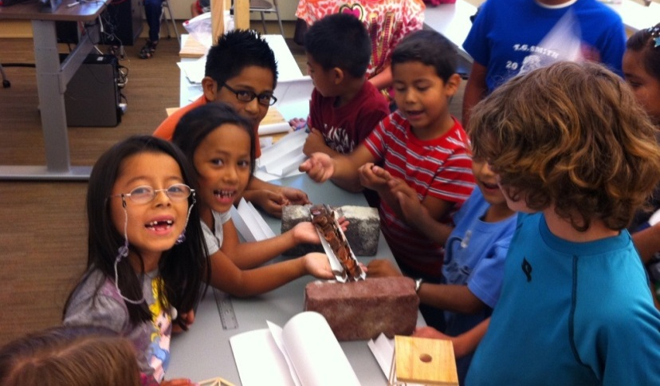
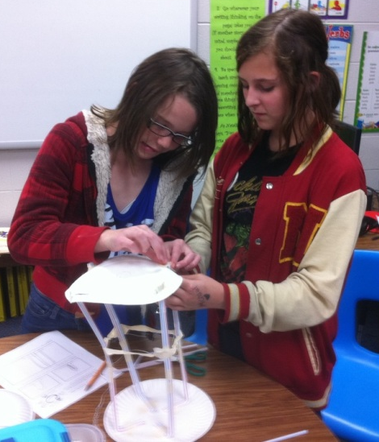
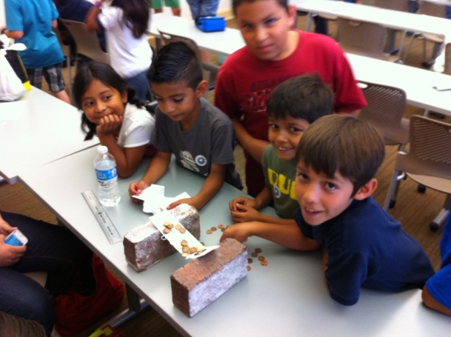
Cognitive Tools:
Scientific inquiry &
the engineering design process

Slide 8
Curriculum Models & Standards
Understanding by Design - Curriculum filters
Problem/project based learning
Discipline based heuristics & engineering design
Standards and frameworks
Collaborative learning format
Lesson & unit plan model
Performance-based assessment

Slide 9
What is PROJECT-BASED LEARNING (PBL)?
Investigation and resolution of messy,
real-world problems.
Learning in relevant and connected ways.
Increasing exposure to higher order thinking.
Facilitating deeper application and understandings.

Slide 10
What is PROJECT-BASED LEARNING (PBL)?
Using ill-structured problems to increase personal responsibility for learning
Engaging students in math, science, engineering at an early age.
Causing students to gather information, assess its validity, provide evidence to support decisions.
Encouraging learning transfer
Treating teamwork as an important outcome
Teaching students how to learn and transfer knowledge

Slide 11
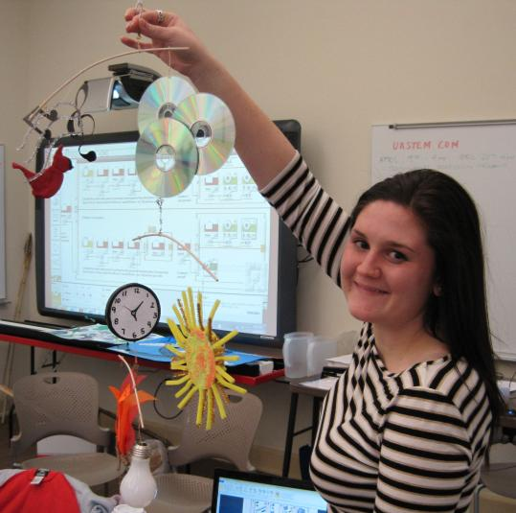
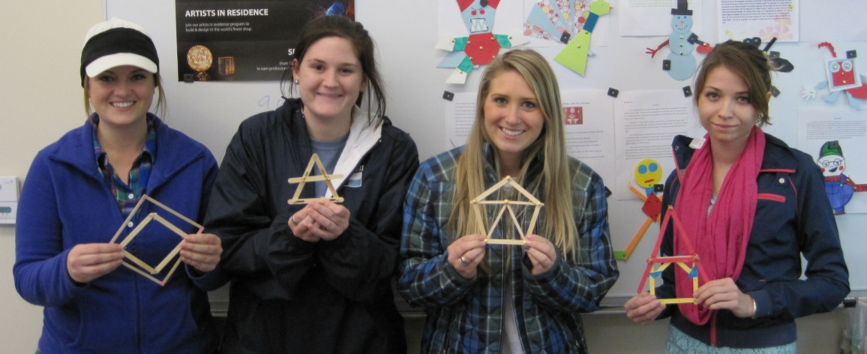
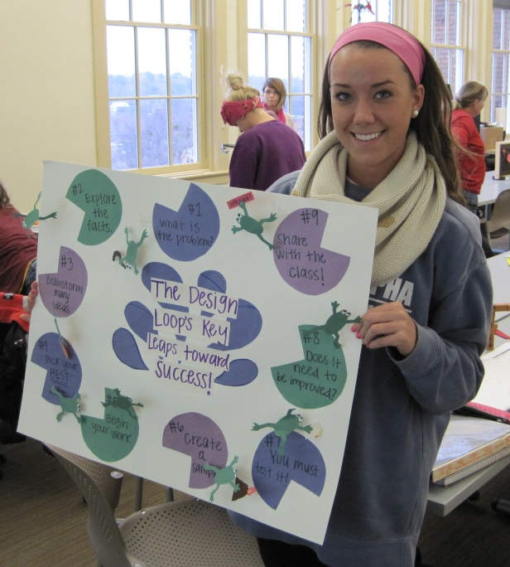
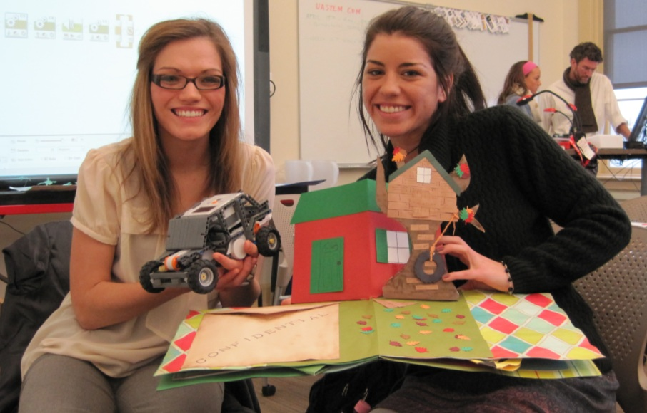
Example Projects
STEM assessment
Flash cards
Mobile design
Engineering portfolio
Resource procurement
Electronics project
Pop-up book activity
Narrative curriculum

Slide 12
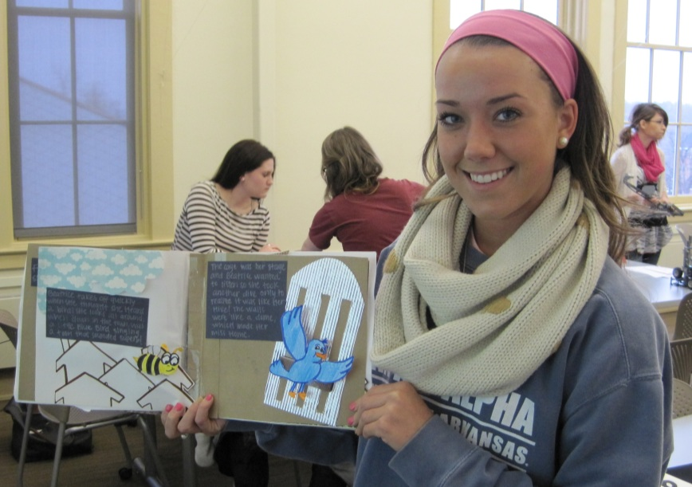
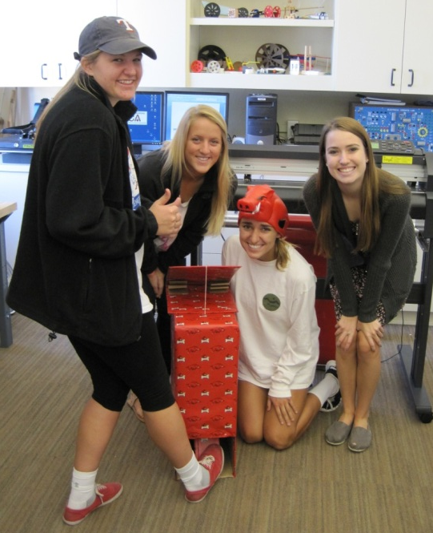
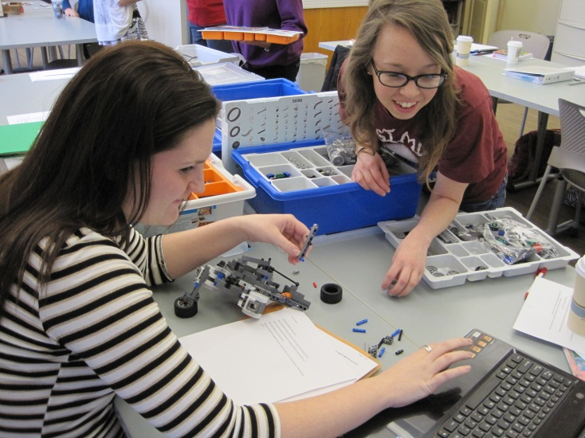
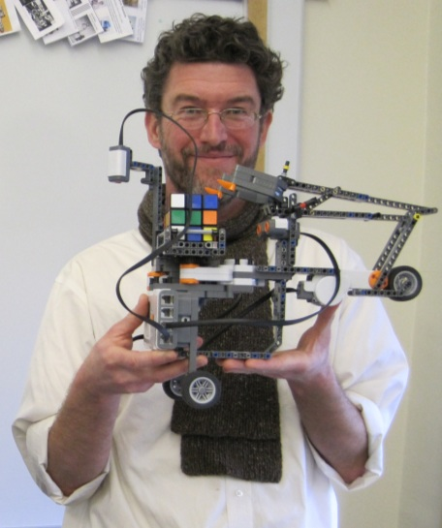
Example Projects
Programmable control project
NXT Robotics projects
KEVA planks
Creating/solving long-term
design challenges:
  Human-power challenge
  Earthquake proof shelter
  Wind-powered vehicle

Slide 13
Kinds of problems
Exploring a question, Investigating a historical event, Problem solving situation, Examining controversial issue, Designing an artifact, Create a piece of writing, art, or multimedia
Where to state?
Standards/frameworks, Your community (recycling, community history, pets), Items relevant to students (cars, toys, etc.), What people do outside school (farmers, construction workers, engineers, dentists), Colleagues, and On-line resources
THE DESIGN CHALLENGE

Slide 14
Use children’s literature to promote STEM
Expand upon a book commonly shared in schools
Move from comfortable to uncomfortable/known to unknown
Story-centric problem solving activities
Compelling virtual worlds
Believable characters
Thought provoking themes
THE NARRATIVE CURRICULUM
Narrative-Centered Learning Environments

Slide 15

Dog Bone Slinger
Design Challenge
Situation:
The city of Mousopolis is in trouble once again
now that Dogzilla’s puppies are free! The Big Cheese and all the other mice must find a new way to keep the puppies away from their precious city and of course the Second Annual Barbeque Cook-Off! They decide to create the incredible Dog Bone Slinger to run the pups far, far away from the city. The only problem is that the mice don’t know how to build it!

Slide 16
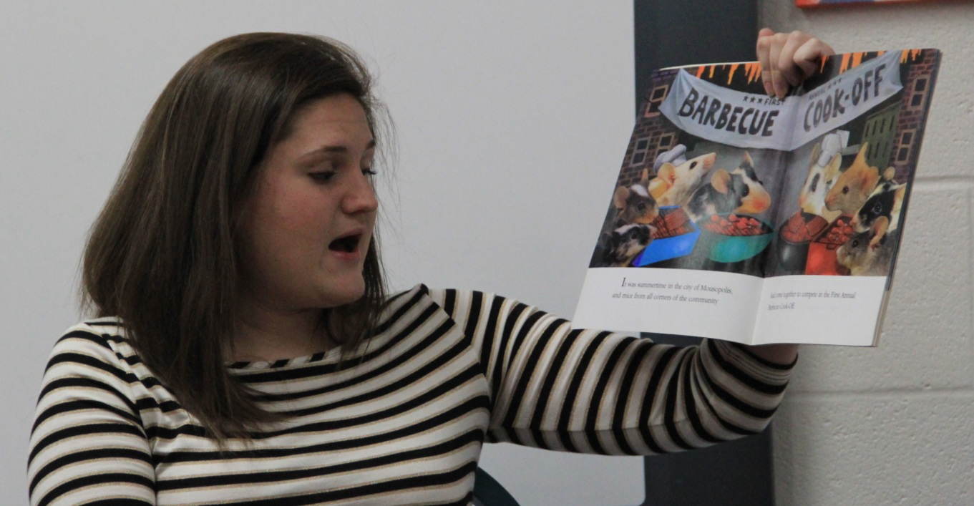

Pre-service teachers use a narrative curriculum (Lauritzen & Jaeger, 1996) approach to set-up the background organization, motivation, and structure for creating meaningful engineering design challenges.
Using children’s literature to expand upon and promote STEM learning by engaging students with a problem that may arise in both fiction and informational text.

Slide 17
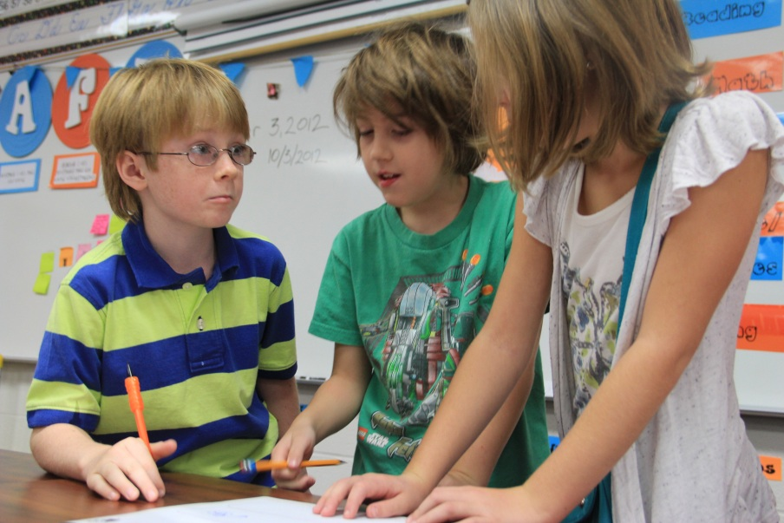
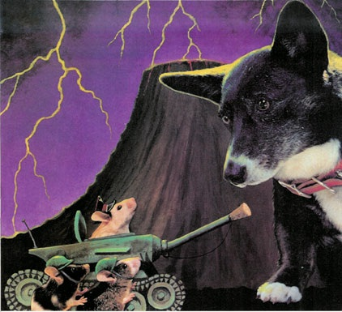
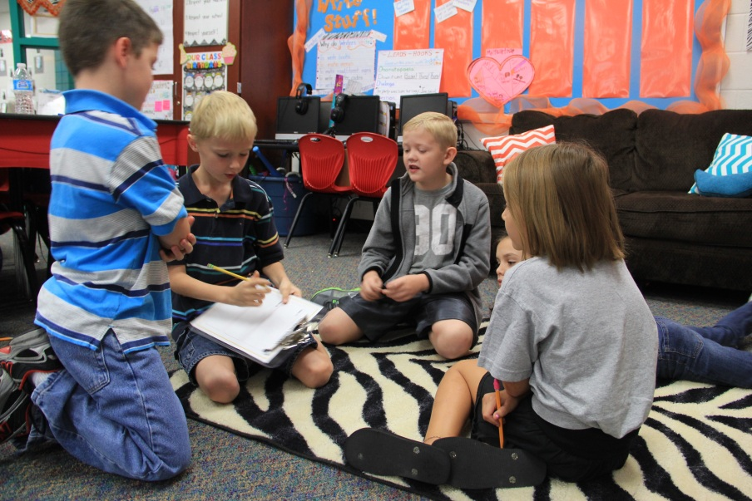
Challenge:
In your assigned groups, you will help the mice design the most incredible Dog Bone Slinger. Using the design loop and the materials below, create a machine that is easy to operate and will fling dog bones as far away as possible from the city.

Slide 18
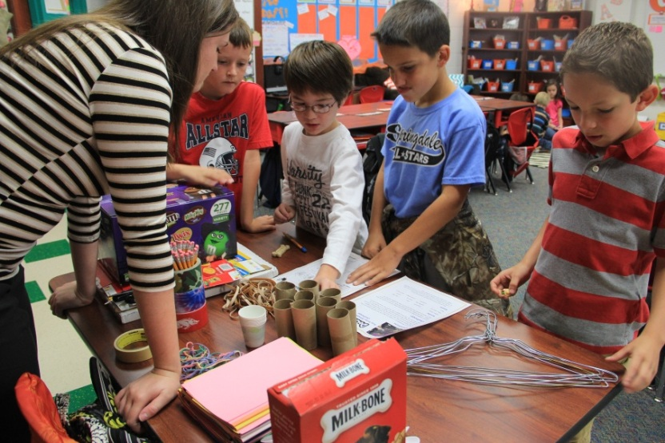
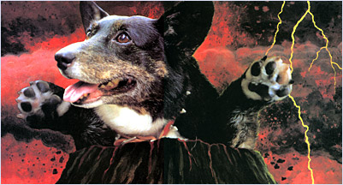
Parameters:
The completed machine must:
be capable of shooting a dog bone as far as possible from the machine
be easy to operate
be designed with the engineering design process in mind
be turned in to instructor along with brain blast activity sheets, showing that the ideas were purposeful, thoughtful, and creative
demonstrate the knowledge of force and motion through design
Tools and Materials:
rubber bands
pencils
pencil spring
bottle cap
clothes hanger
plastic spoon
toilet paper roll
masking tape
recycled paper & cardboard
ruler
hot glue gun
scissors

Slide 19
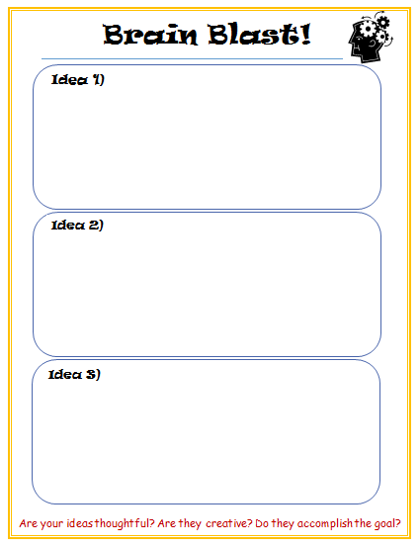
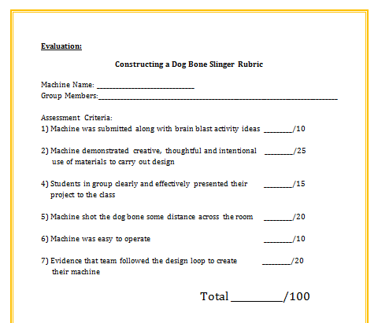

Slide 20
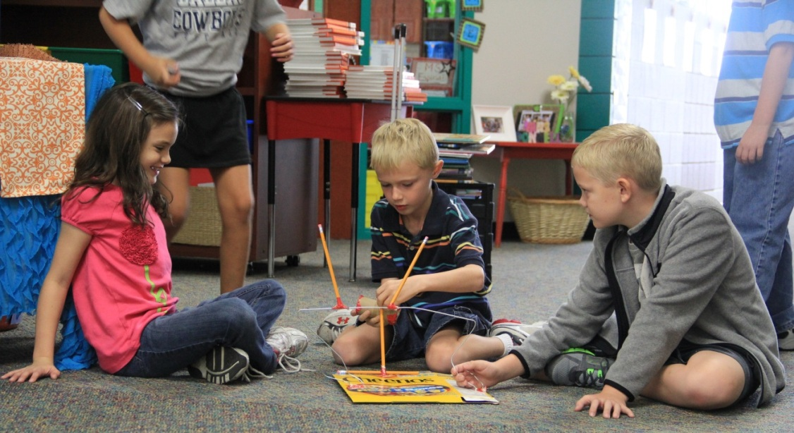
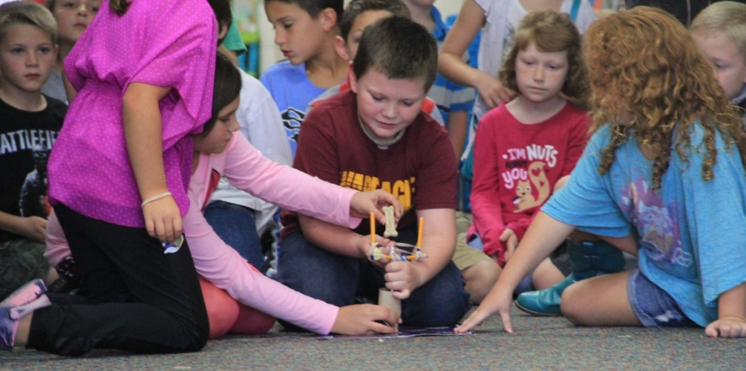
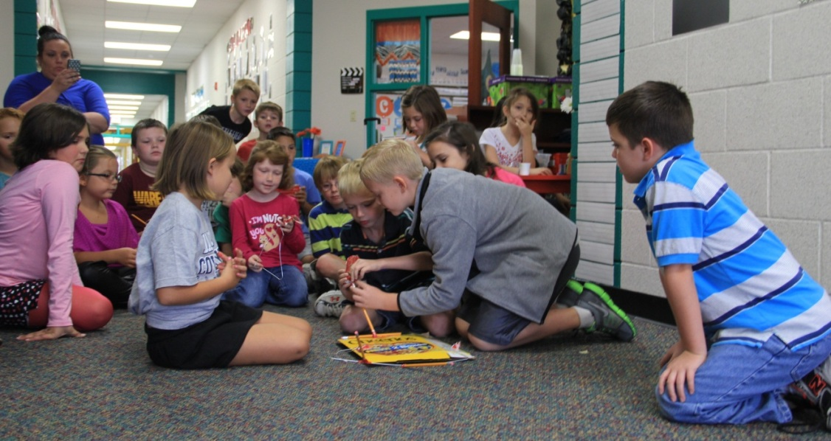
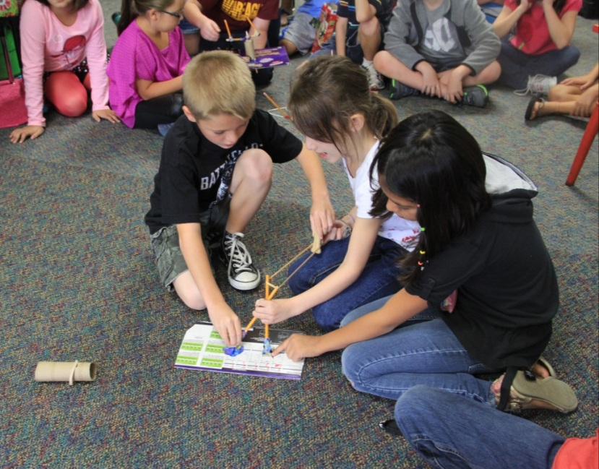
Solve the Problem
Using the design loop!

Slide 21

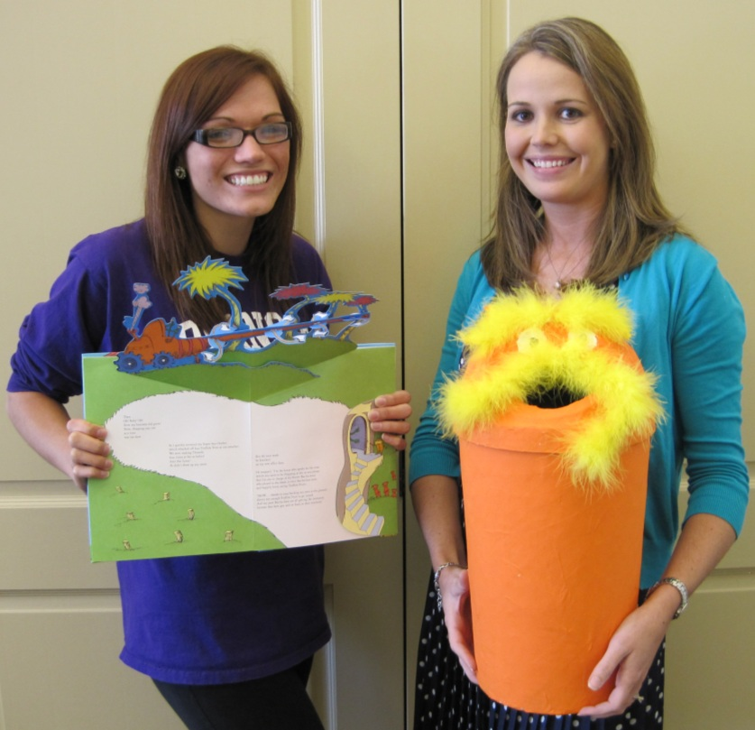
Big Ideas
Recycling is important and everyone should be doing it.
Measuring and geometry are applicable for building and designing objects.
Essential Question
Can we build a recycling device that resembles a character from the Lorax that will be appealing to students and motivate them to recycle?
I SPEAK FOR THE TREES
DESIGN CHALLENGE

Slide 22
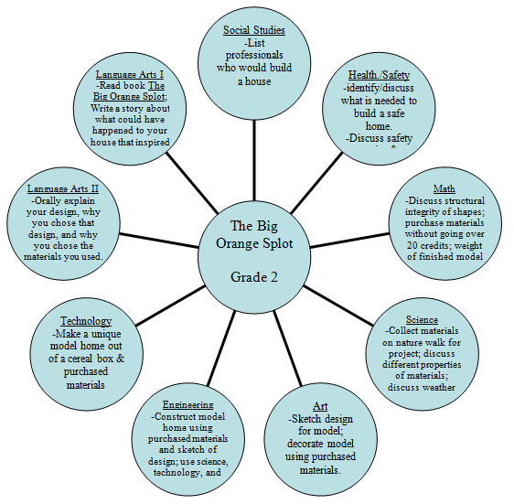
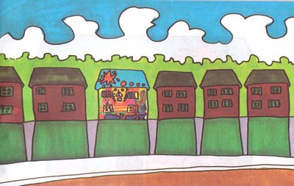
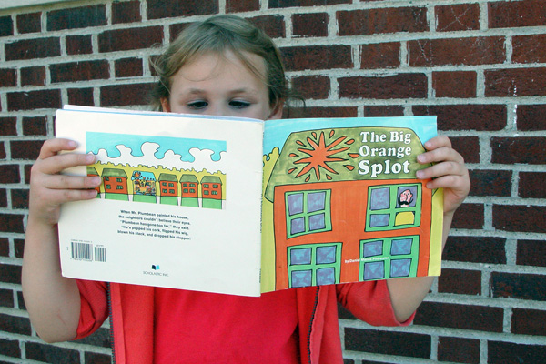
The Big Orange Splot
DESIGN CHALLENGE
Essential Question
If you could build a house that was completely unique, what would it look like, what would you use to build it, and how does your design reflect your personality?
Evaluation
Test stability and weight, refine your design.
Evaluate and record your solution.
Present and demonstrate your solution to the class.

Slide 23

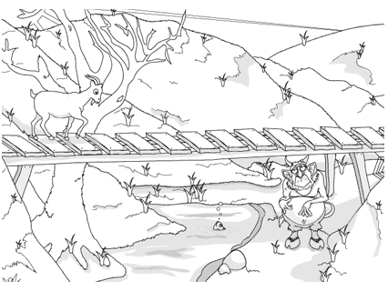
Big Ideas
Science is a process for producing knowledge
Engineering is the application of science and technology
Tools and Techniques
The role of creativity and problem solving
Engineering design
Design under constraint
Fundamental concepts of science and technology
Surviving the Troll
DESIGN CHALLENGE
Essential Question
Can you design a structure to get the 3 Billy goats from one side of the creek to the other?

Slide 24
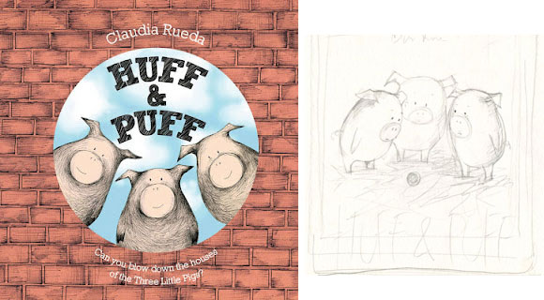
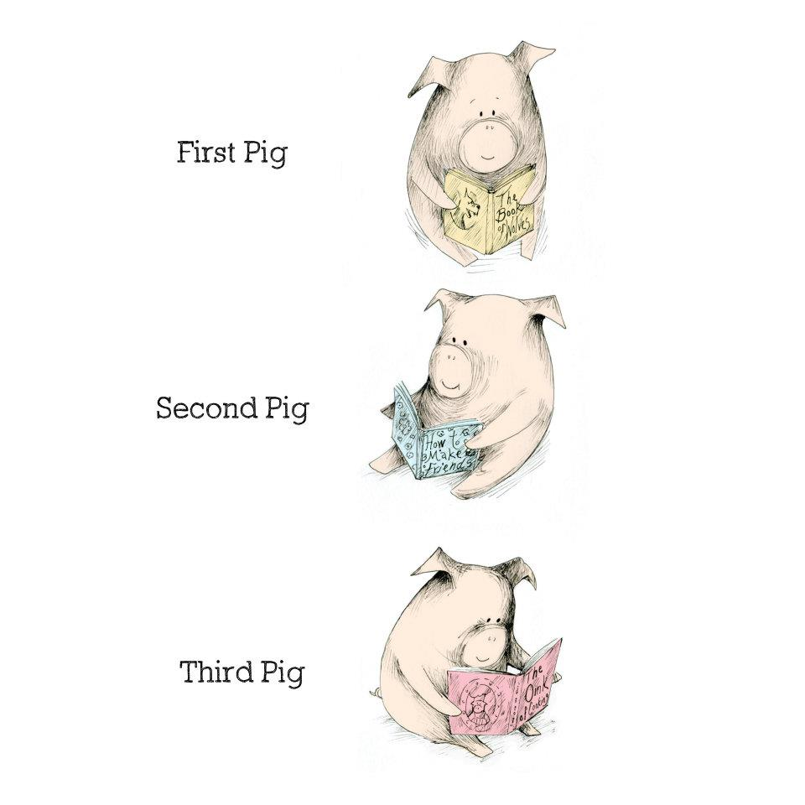
Huff & Puff
DESIGN CHALLENGE
Essential Question
Can a model shelter be designed to withstand a tornado?
Big Ideas
Attributes of shapes used in structures
Properties of materials
Use of the engineering design loop
Ability to clearly demonstrate and present final project

Slide 25

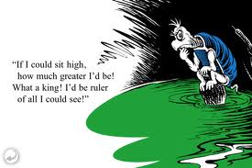
Building a Castle
DESIGN CHALLENGE
Essential Question
Can students help the other turtles (townspeople) build a castle for the king to see for “miles”?
Big Ideas
Attributes of Structural Design
Tools and Techniques
Teamwork

Slide 26
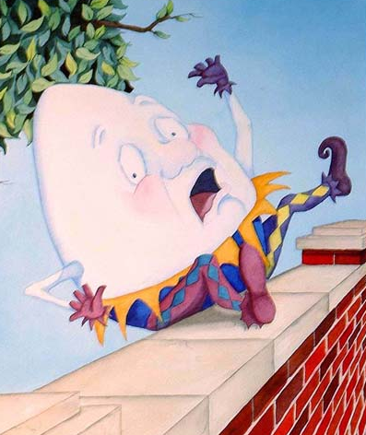
Will Humpty Go Splat or
Will He Last?
DESIGN CHALLENGE
Essential Question
How might you design a structure that would help Old Humpty survive his fall off of the wall?
Big Ideas
Attributes of scientific principles - gravity, force, impact, and motion.
Develop the skills necessary to describe methods, predictions, explanations, and generalizations experienced trial and error.

Slide 27
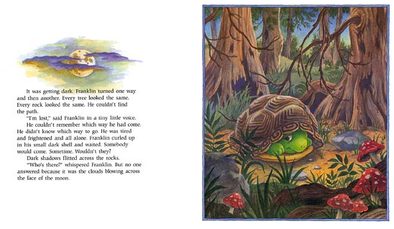
Franklin is Lost: Map Making
DESIGN CHALLENGE
Essential Question
How would you design a
3-dimensional map?
Big Ideas
Cardinal Directions
Understanding Maps
Geological & Industrial Landmarks

Slide 28
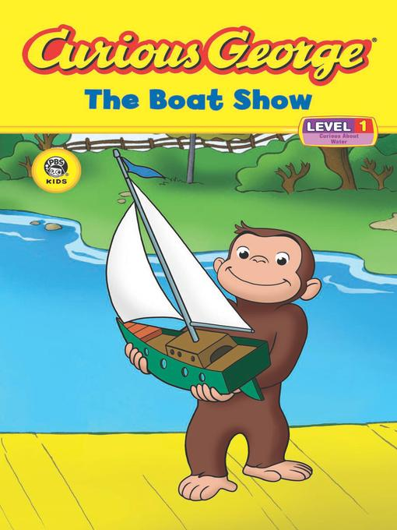
Staying Afloat
DESIGN CHALLENGE
Essential Question
Can you help Curious George design a boat that will float?
Big Ideas
The role of creativity and problem solving
Design under constrain
Turning something known into something understood

Slide 29

The New Game
DESIGN CHALLENGE
Essential Question
Can you design a game that is fun and appropriate for the whole family to play?
Big Ideas
The role of creativity and design
Design under constraint
Fundamental concepts of geometry
Game design

Slide 30
What Makes a Good STEM Design Problem?
First, make sure it delivers something important (standards, big ideas, extension of a lesson or unit)
  But remember, it’s not something fun to do after the lesson—it is the lesson
Second, make sure it captures a big idea and answers an essential question (think assessment)
  Big idea filters
  Is it important enough to remember when the child is 30?
  Does it have the potential to engage to child?
  Is it central to understanding the STEM content?

Slide 31
What Makes a Good STEM Design Problem?
Three, Develop a problem scenario: Craft an engaging scenario that both captures the attention of the child and engages them in solving an authentic problem
Four, Develop content information.
  Using the standards and big ideas for the problem, develop content information that promotes learning in science, technology, engineering and mathematics.
Five, develop boundaries for the problem (materials/resources, parameters, deliverables)
Six, develop an authentic, performance-based assessment
Seven, force students to use the design loop to solve the problem!

Slide 32
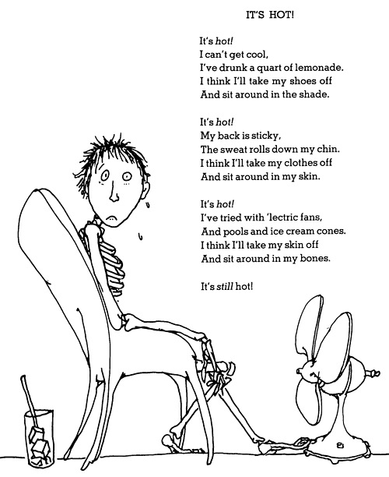
Human-Powered Fan
Design Challenge
Essential Question:
Can an human-powered fan be designed to cool students in areas where electricity is not available?

Slide 33
Common Core State Standards
Mathematically Proficient Students
  Make sense of problems and persevere in solving them.
    They explain to themselves the meaning of a problem and look for entry points to its solution.
    They analyze givens, constraints, relationships, and goals.
  Reason abstractly and quantitatively.
    They make sense of quantities and their relationships in problem situations.

Slide 34
National Council of Teachers of Mathematics (NCTM)
Process Standards
  Problem Solving
    Solve problems that arise in mathematics and in other contexts
  Connections
    Recognize and apply mathematics in contexts outside of mathematics

Slide 35
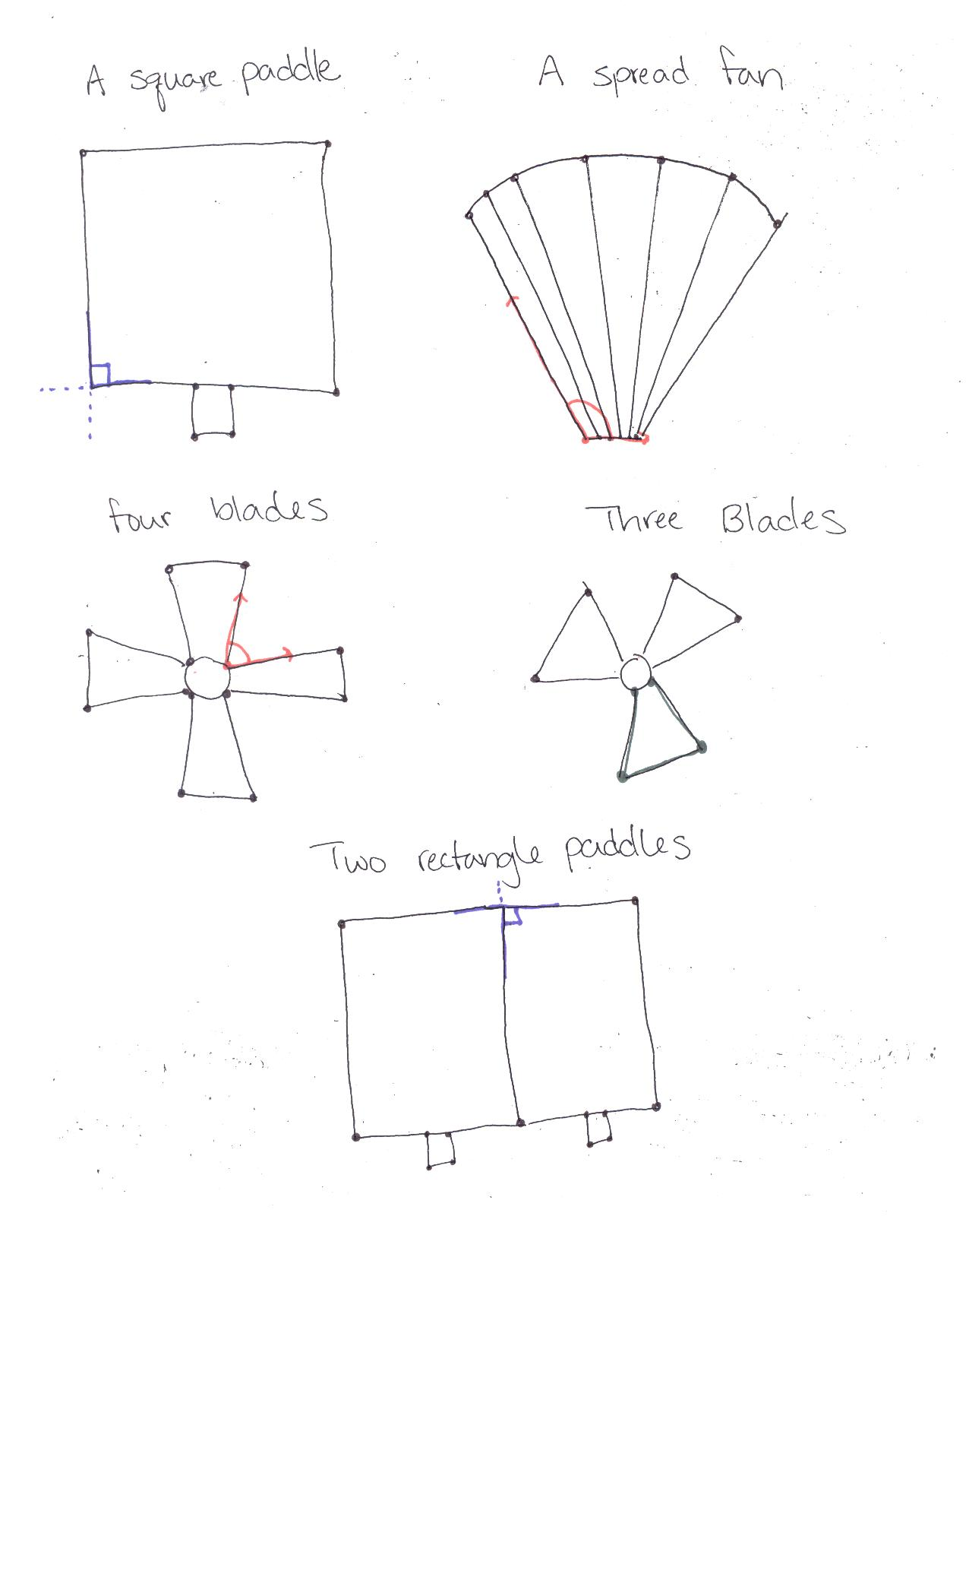
Draw Fan Designs
Draw and identify lines and angles, and classify shapes by properties of their lines and angles.
4.G.1 Draw points, lines, line segments, rays, angles (right, acute, obtuse), and perpendicular and parallel lines. Identify these in two-dimensional figures.

Slide 36
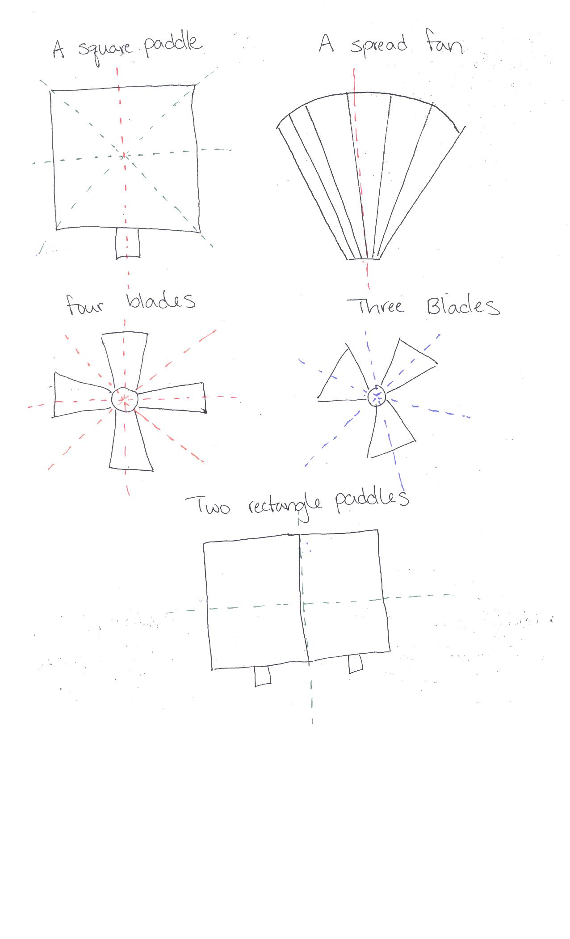
Analyze Fan Designs
After students have been working on a fan design explore lines of symmetry in their designs.
4.G.3 Recognize a line of symmetry for a two-dimensional figure as a line across the figure such that the figure can be folded along the line into matching parts. Identify line-symmetric figures and draw lines of symmetry.

Slide 37
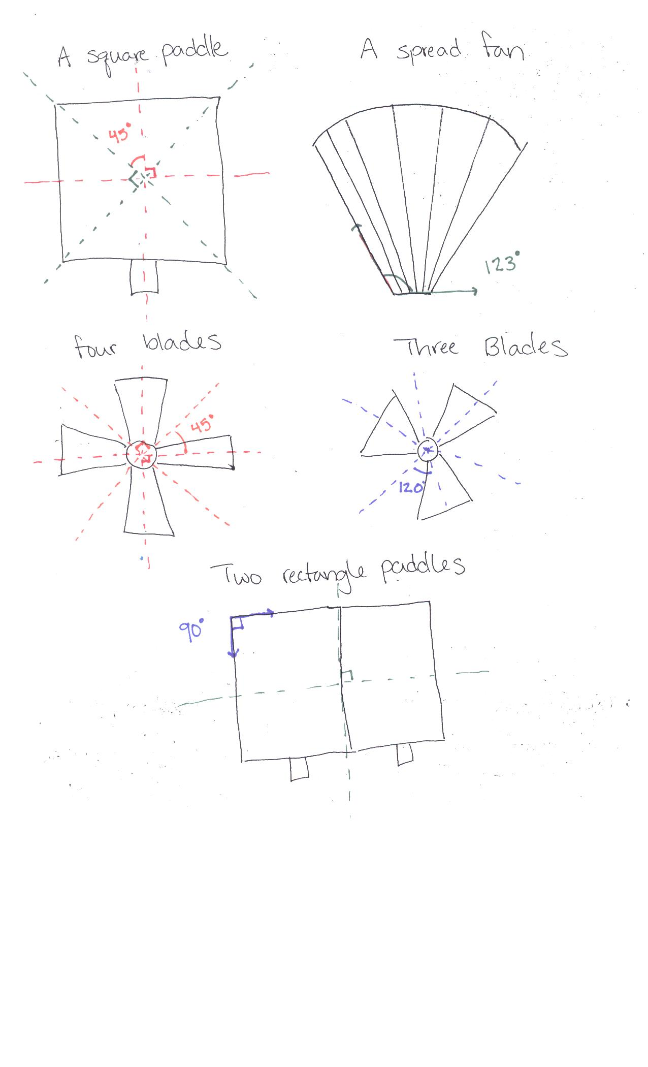
Measure Angles in Fan Designs
Have students measure angles in their designs. Have students measure the angles between the lines of symmetry in their designs.
4.MD.6 Measure angles in whole-number degrees using a protractor. Sketch angles of specified measure.

Slide 38
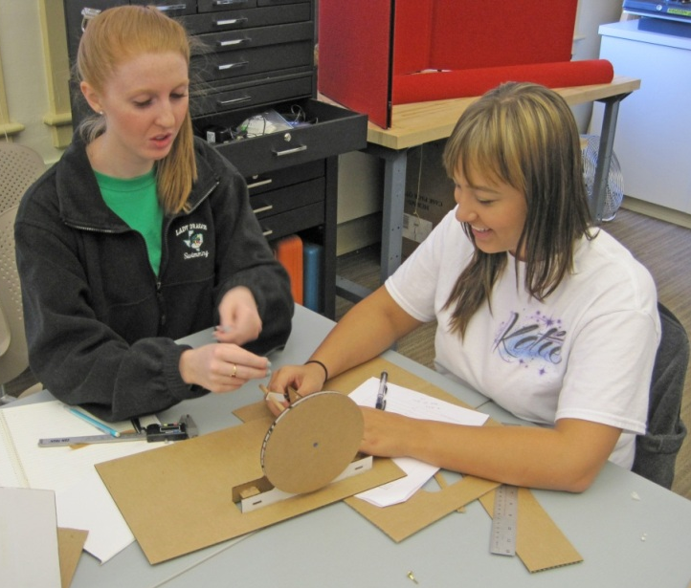
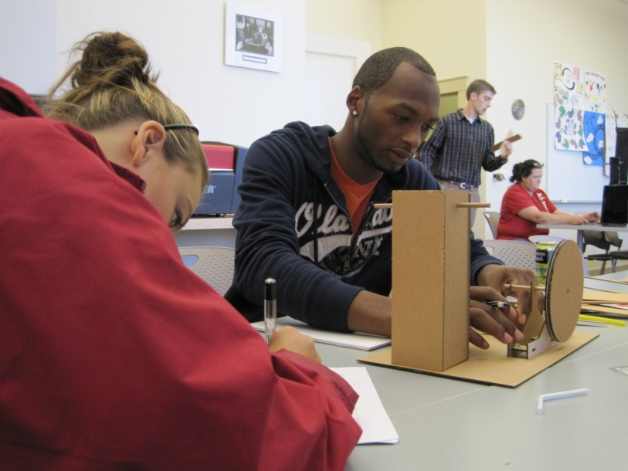
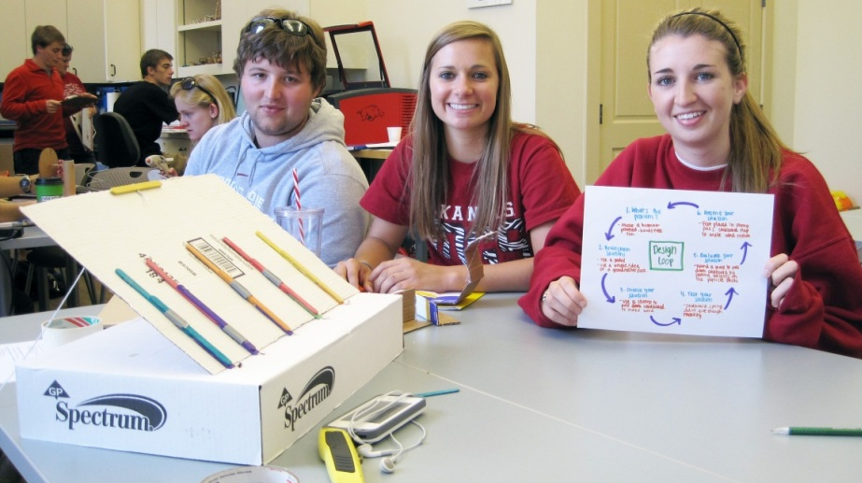

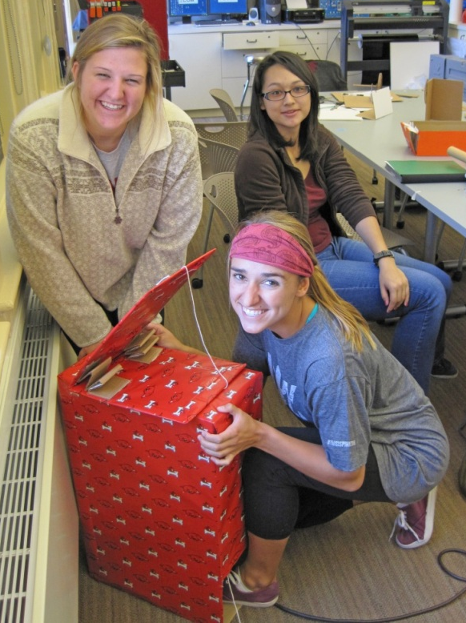
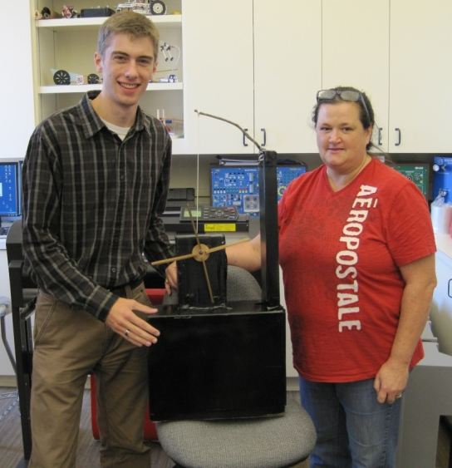
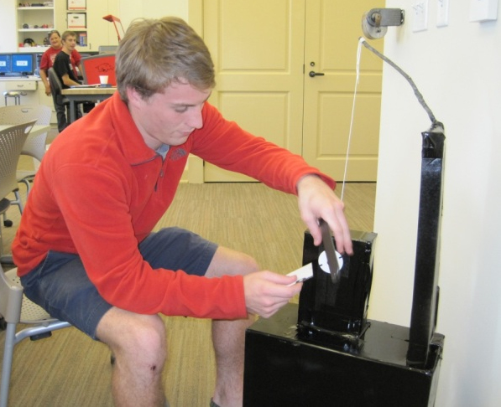
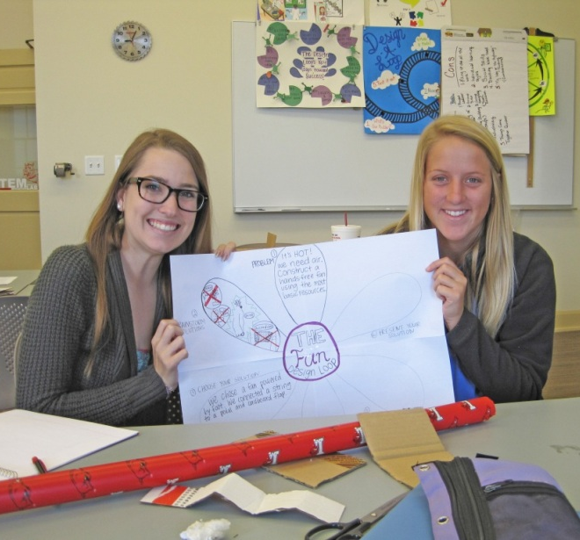

Slide 39
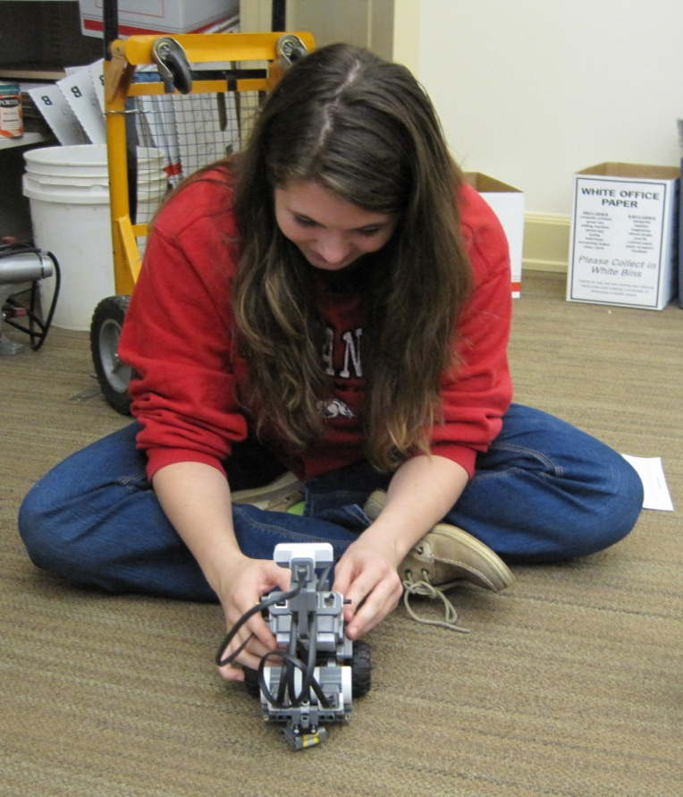
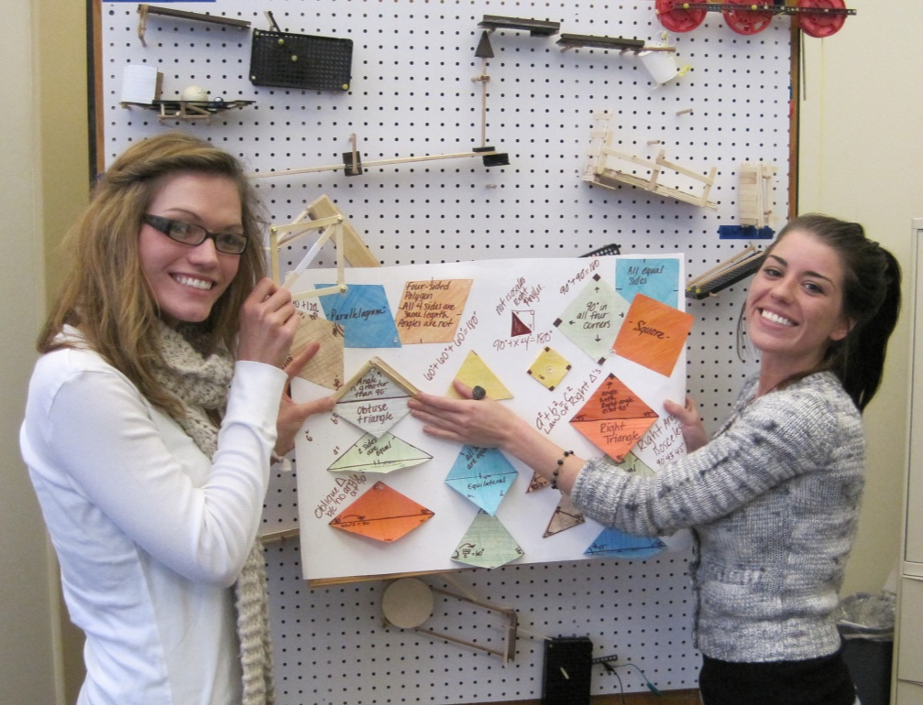
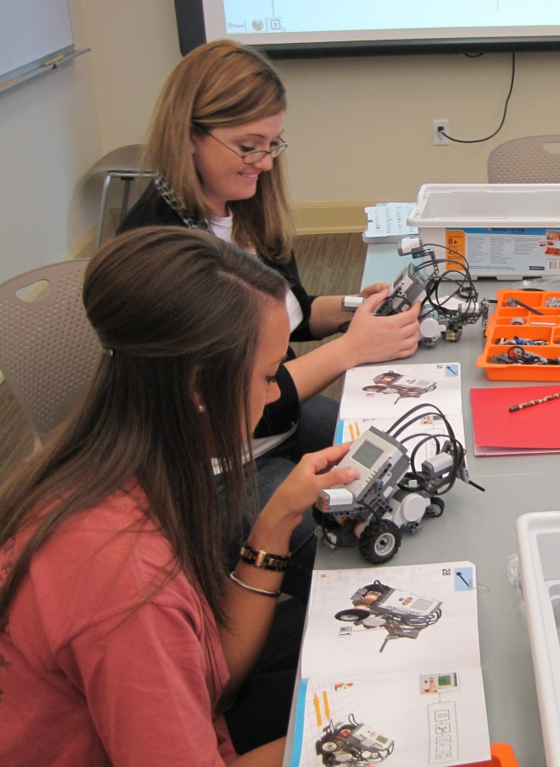



Slide 40







