Slide 1
Preparing Teachers to Teach Integrated STEM Education
Michael Daugherty, Vinson Carter,
& Pre-service Teacher Education Candidates, University of Arkansas

Slide 2
INTEGRATED SCIENCE, TECHNOLOGY, ENGINEERING, & MATHEMATICS EDUCATION
STEM
EDUCATION

Slide 3

INTEGRATED STEM
Authentic, engaging, hands-on learning
Developing thinking skills: How to think vs. what to think
Project-based learning
Curiosity, imagination, technological literacy
Exploiting technology to foster creativity
Treating effective teamwork as an outcome
Learning transfer: Basic skills—application—synthesis
Building a STEM mental warehouse!

Slide 4

Five Courses (STEM Grad Certificate)
Introduction to STEM Education
Creativity & Innovation in the Early Grades (Technology & Engineering)
Math Methods in STEM Education
Science Methods in STEM Education
Curriculum Development

Slide 5
First Course: Introduction to STEM Education
Clearly defining Science, Technology, Engineering, and Mathematics
Mobile activity
Rationale/purpose for integrated STEM education
STEM content and pedagogy
The nature & pedagogies of the STEM disciplines
Modeling the methods of STEM
Research focused and driven
STEM standards & assessments are central

Slide 6
www.uastem.com http://stem-education.wikispaces.com
STEM Resources

Slide 7
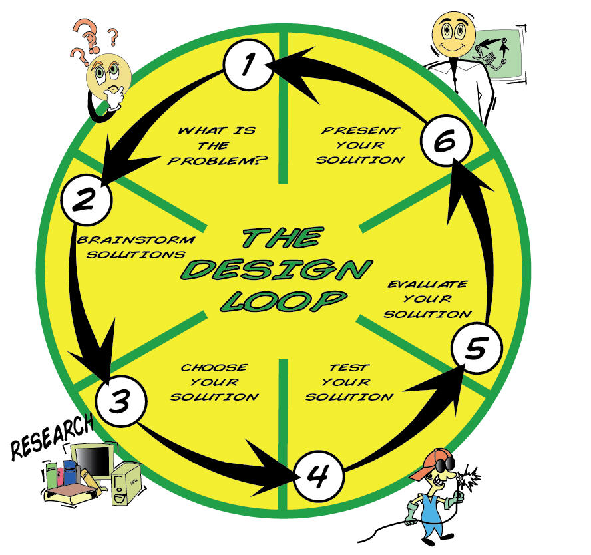
Cognitive Tools (scientific inquiry & the engineering design process)

Slide 8
Curriculum Models & Standards
Understanding by Design
Curriculum filters
Problem/project based learning
Discipline based heuristics & engineering design
Standards and frameworks
Collaborative learning format
Lesson & unit plan model
Performance-based assessment

Slide 9
Example Projects
STEM assessment
Flash cards
Mobile design
Engineering portfolio
Resource procurement
Electronics project
Pop-up book activity
Narrative curriculum
Programmable control project
KEVA planks
Creating/solving long-term design challenges:
Human-power challenge
Earthquake proof shelter
Wind-powered vehicle

Slide 10

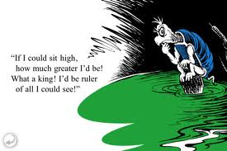
Building a Castle
DESIGN CHALLENGE
Essential Question
Can students help the other turtles (townspeople) build a castle for the king to see for “miles”?
Big Ideas
Attributes of Structural Design
Tools and Techniques
Teamwork

Slide 11
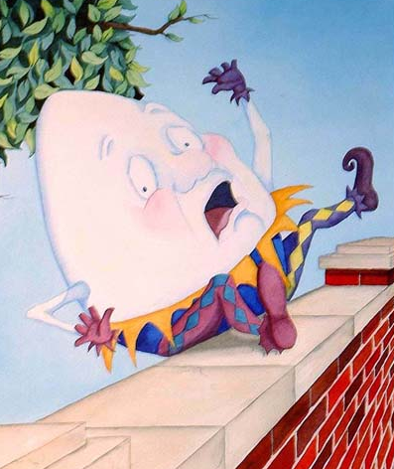
Will Humpty Go Splat
or Will He Last?
DESIGN CHALLENGE
Essential Question
How might you design a structure that would help Old Humpty survive his fall off of the wall?
Big Ideas
Attributes of scientific principles - gravity, force, impact, and motion.
Develop the skills necessary to describe methods, predictions, explanations, and generalizations experienced trial and error.

Slide 12

Franklin is Lost:
Map Making
DESIGN CHALLENGE
Essential Question
How would you design a
3-dimensional map?
Big Ideas
Cardinal Directions
Understanding Maps
Geological & Industrial Landmarks

Slide 13

The New Game
DESIGN CHALLENGE
Essential Question
Can you design a game that is fun and appropriate for the whole family to play?
Big Ideas
The role of creativity and design
Design under constraint
Fundamental concepts of geometry
Game design

Slide 14

Staying Afloat
DESIGN CHALLENGE
Essential Question
Can you help Curious George design a boat that will float?
Big Ideas
The role of creativity and problem solving
Design under constrain
Turning something known into something understood

Slide 15
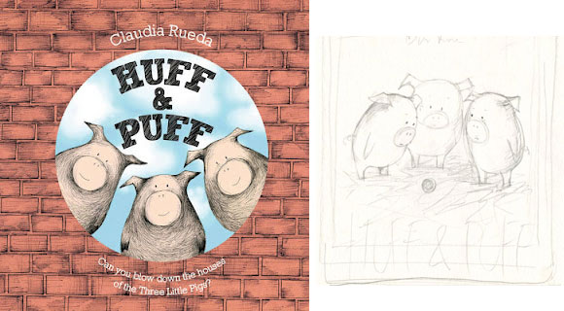
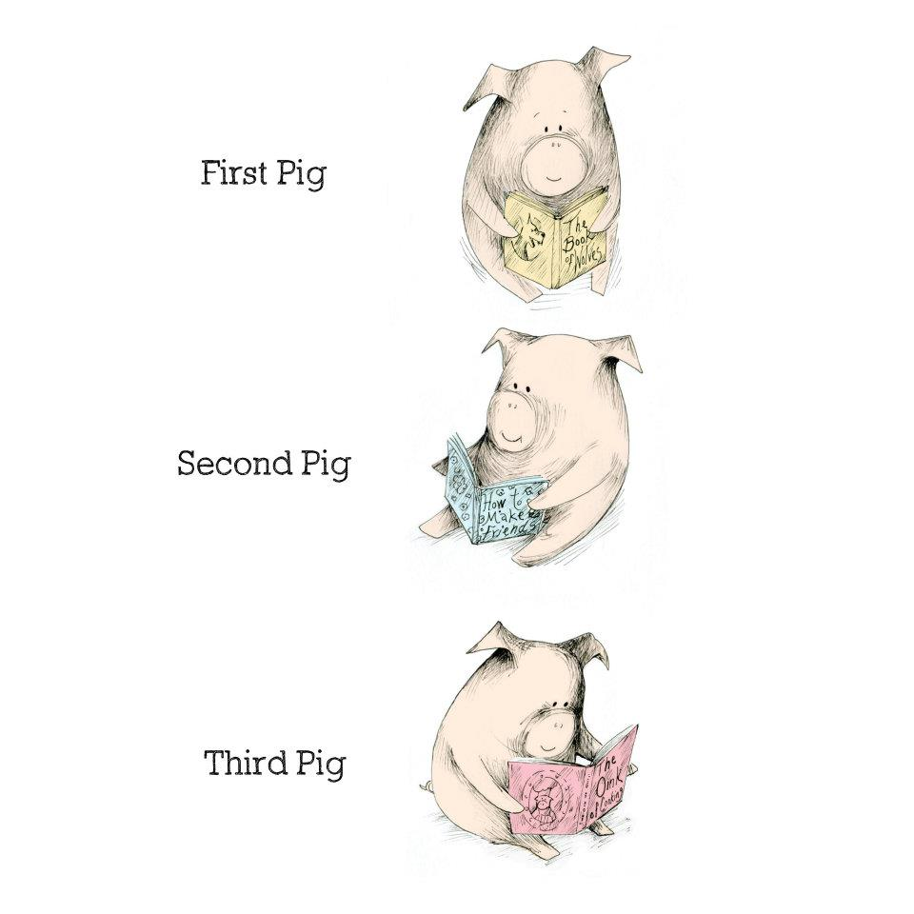
Huff & Puff
DESIGN CHALLENGE
Essential Question
Can a model shelter be designed to withstand a tornado?
Big Ideas
Attributes of shapes used in structures
Properties of materials
Use of the engineering design loop
Ability to clearly demonstrate and present final project

Slide 16
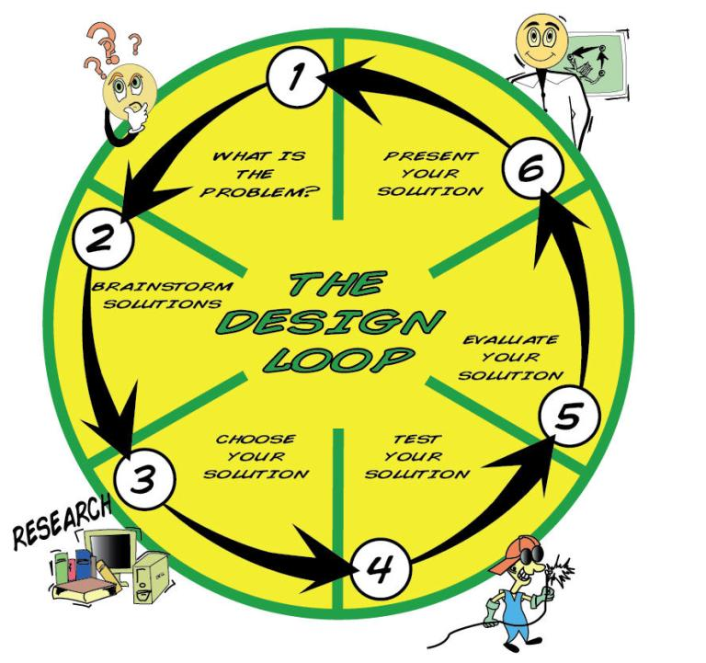
Solve the Problem Using the design loop!

Slide 17
How is disciplinary content delivered in STEM?

Slide 18
Common Core State Standards
Mathematically Proficient Students
Make sense of problems and persevere in solving them.
They explain to themselves the meaning of a problem and look for entry points to its solution.
They analyze givens, constraints, relationships, and goals.
Reason abstractly and quantitatively.
They make sense of quantities and
their relationships in problem situations.

Slide 19
National Council of Teachers of Mathematics (NCTM)
Process Standards
Problem Solving
Solve problems that arise in mathematics and in other contexts
Connections
Recognize and apply mathematics in contexts outside of mathematics

Slide 20
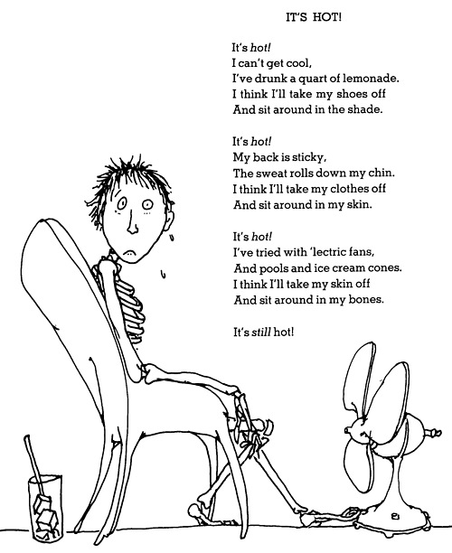
Human-Powered Fan Design Challenge
Essential Question:
Can an human-powered fan be designed to cool students in areas where electricity is not available?

Slide 21
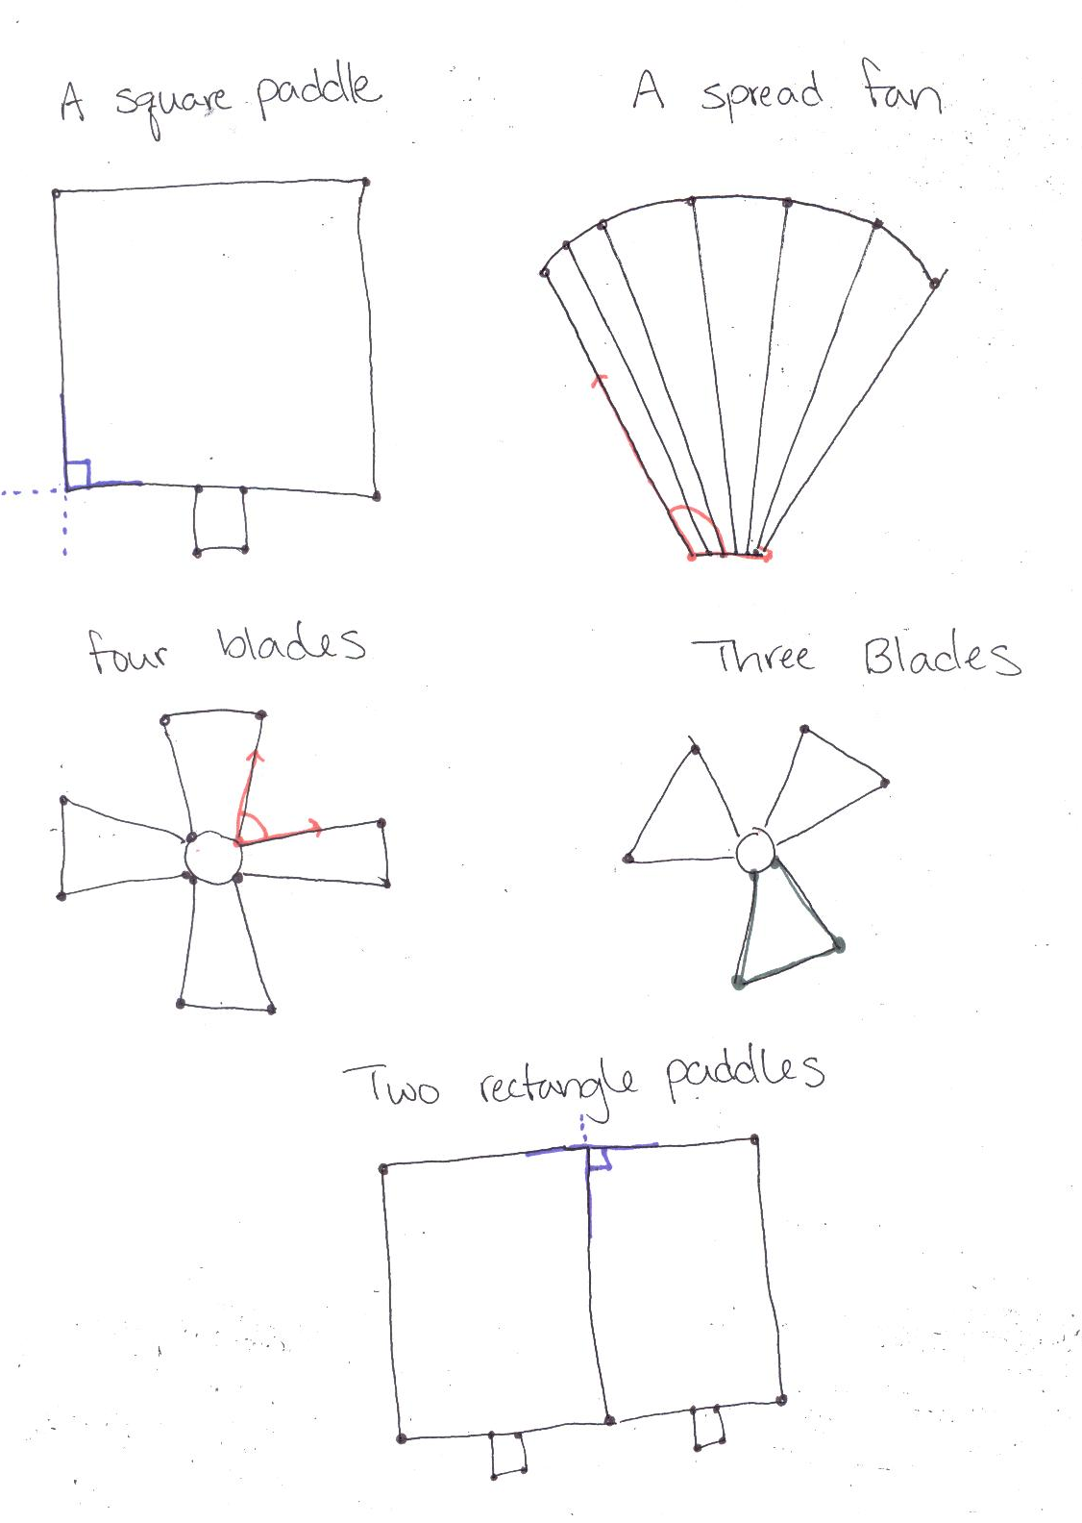
Draw Fan Designs
Draw and identify lines and angles, and classify shapes by properties of their lines and angles.
4.G.1 Draw points, lines, line segments, rays, angles (right, acute, obtuse), and perpendicular and parallel lines. Identify these in two-dimensional figures.

Slide 22
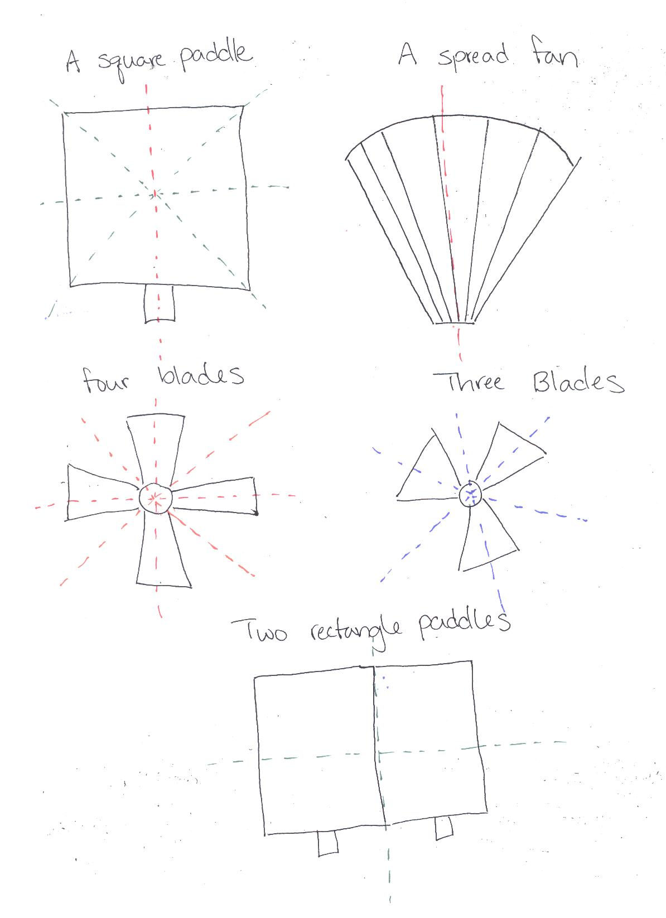
Analyze Fan Designs
After students have been working on a fan design explore lines of symmetry in their designs.
4.G.3 Recognize a line of symmetry for a two-dimensional figure as a line across the figure such that the figure can be folded along the line into matching parts. Identify line-symmetric figures and draw lines of symmetry.

Slide 23
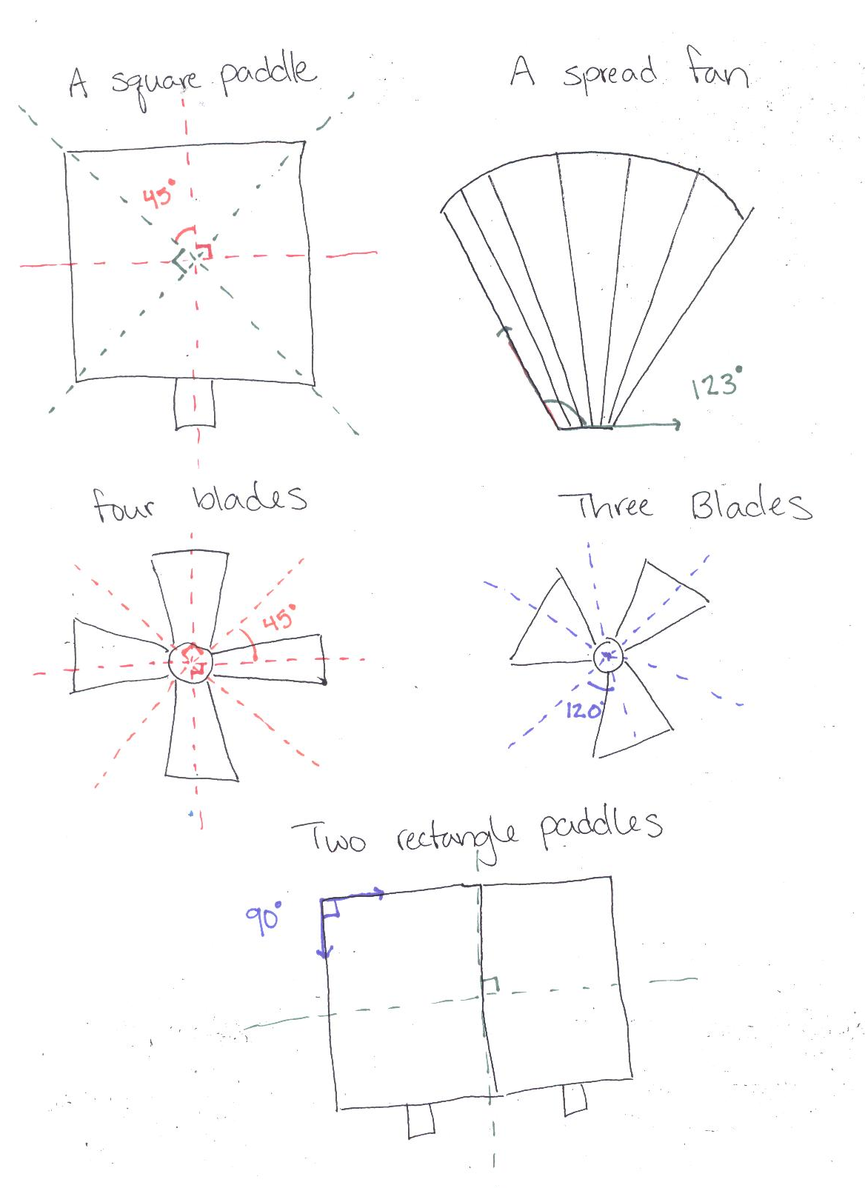
Measure Angles in Fan Designs
Have students measure angles in their designs. Have students measure the angles between the lines of symmetry in their designs.
4.MD.6 Measure angles in whole-number degrees using a protractor. Sketch angles of specified measure.

Slide 24
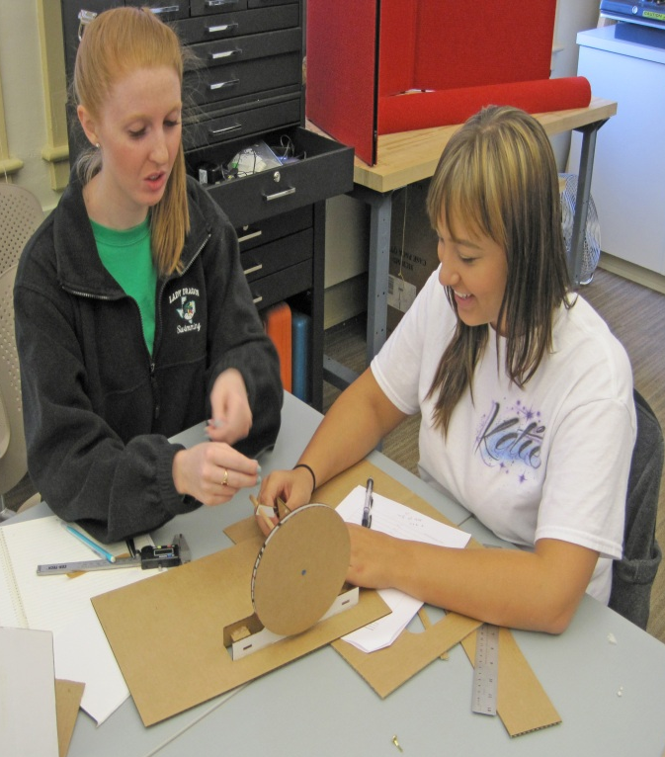
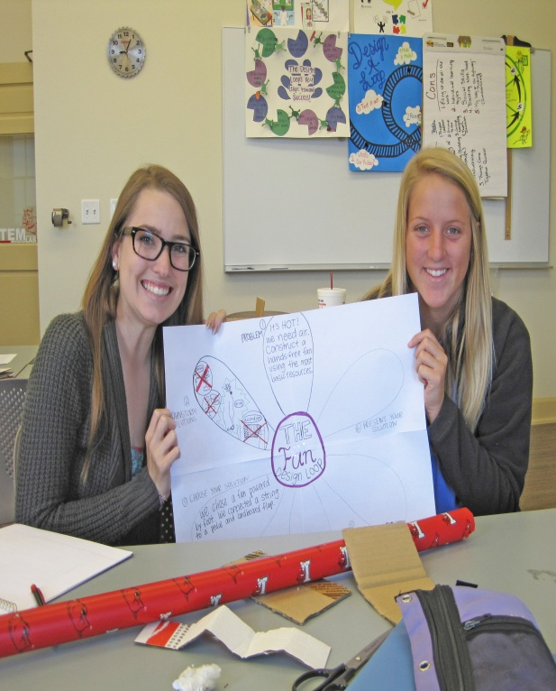
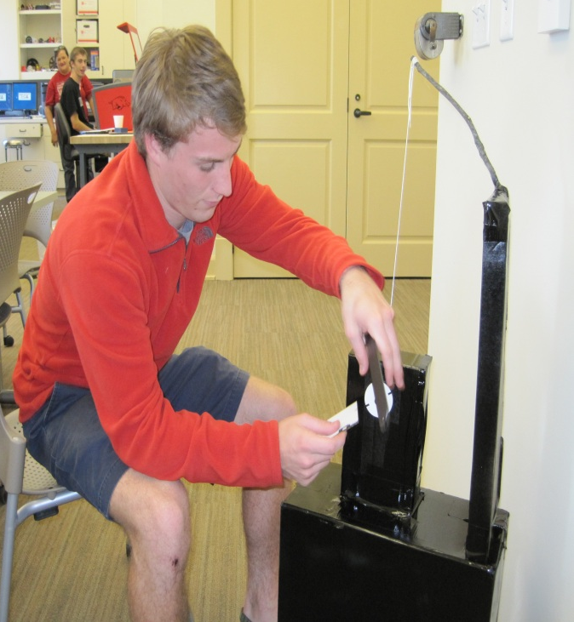
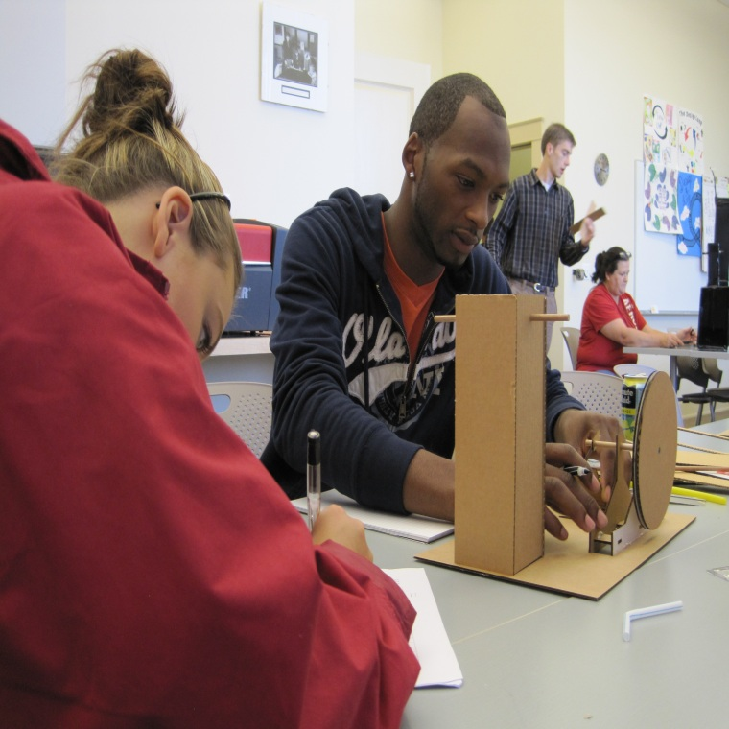

Slide 25
