Slide 1
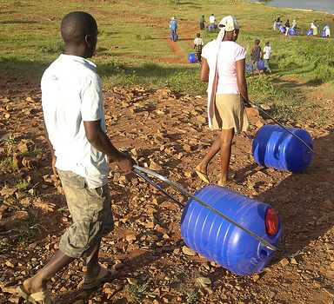
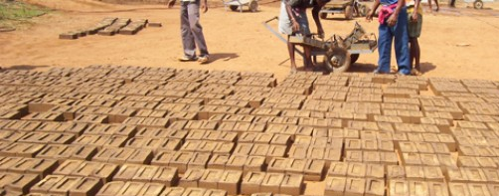
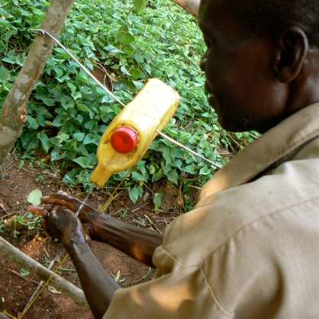
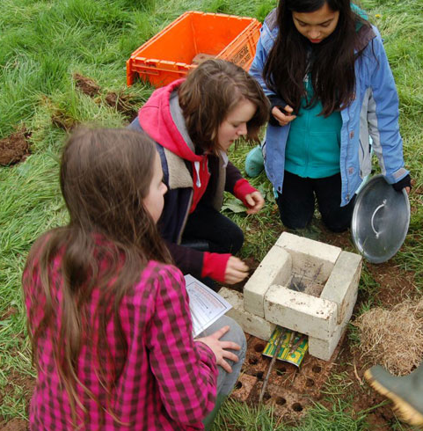
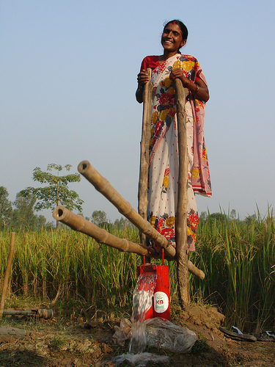
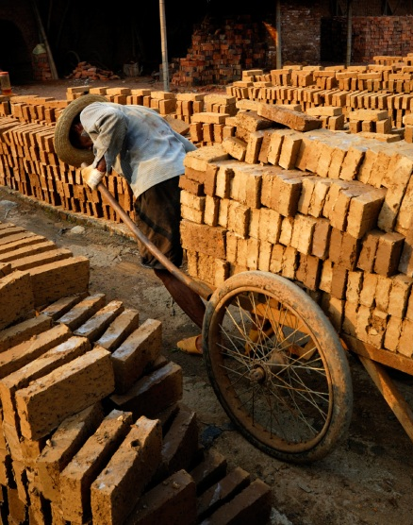
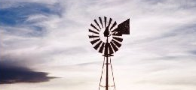
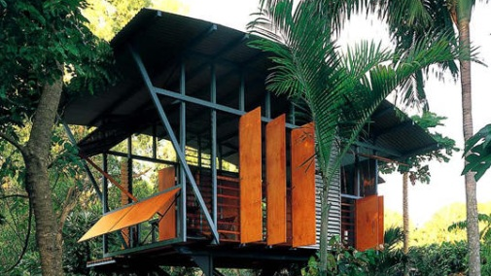

Delivering Sustainable Development
Through Integrated STEM Education
Mike Daugherty & Vinson Carter

Slide 2
How many of you use engineering design or problem solving in your classroom?
What is your goal or purpose for using this type of instruction?
Have you ever worried that your students might be ‘missing the point’ during these types of instructional activities?

Slide 3
Objectives
Today we are going to……
  discuss ways in which traditional engineering design and problem solving might be augmented with a sustainable development focus.

Slide 4
Engineering Design and Problem Solving
Clarity on our position on engineering design and problem solving instruction....it must be….
  standards based
  utilize backward design
  deliver at least one ‘big idea’
  measureable (driven by assessment)
  include an engaging scenario
  project-based
  deliver STEM content (real-world )
  deliver a final product

Slide 5
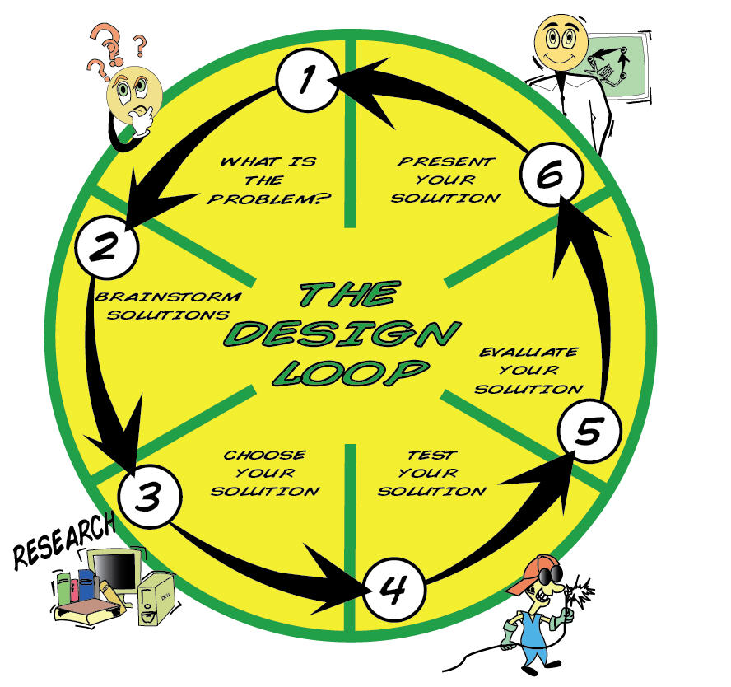


Slide 6
One Approach to Enrich Content
Sustainable Development (define )
  offers a rich context for engineering design and problem solving
  has the potential to engage students, especially female students
  adds a real-world flavor
  provides avenues for delivering core concepts in science and mathematics
  offers students an opportunity for service learning

Slide 7
Sustainable Development
The majority of real world problems and their solutions do not require “high tech” applications nor would they be successful.
The problems that most humans face daily are best solved using much lower levels of technology than typically used in the classroom.
80% of the earth's population live and work in environments where high tech solutions would be inappropriate.
The need exists for technology education to address engineering design and problem solving at a more holistic and appropriate level (Wicklein, 2001).

Slide 8
Sustainable Development Problems Are:
  simple
  use minimal, local resources
  can be implemented and maintained by the local population
  are truly appropriate/sustainable, having the least negative and societal and environmental impact

Slide 9
Kinds of problems
exploring a question
investigating a historical event
A timely problem solving situation
examining a controversial issue
designing an artifact
creating a piece of writing, art, or multimedia

Slide 10
Where to start?
standards/frameworks
your community (recycling, community history, pets, etc.)
items relevant to students (cars, games, etc.)
what people do outside of school (farmers, construction workers, engineers, dentists, etc.)
colleagues, and on-line resources

Slide 11
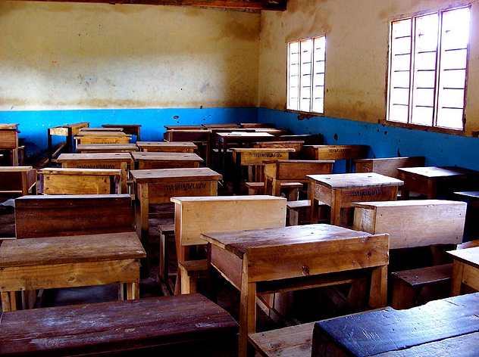
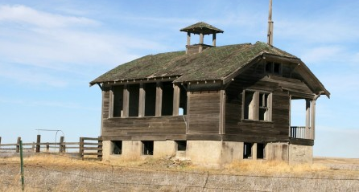
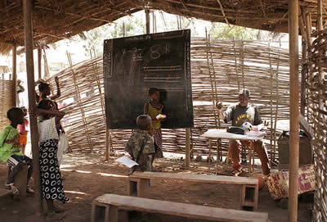
Build a Fan
Design Challenge
Essential Question:
Can an efficient foot-operated fan be designed to cool students in areas where electricity is not available?

Slide 12
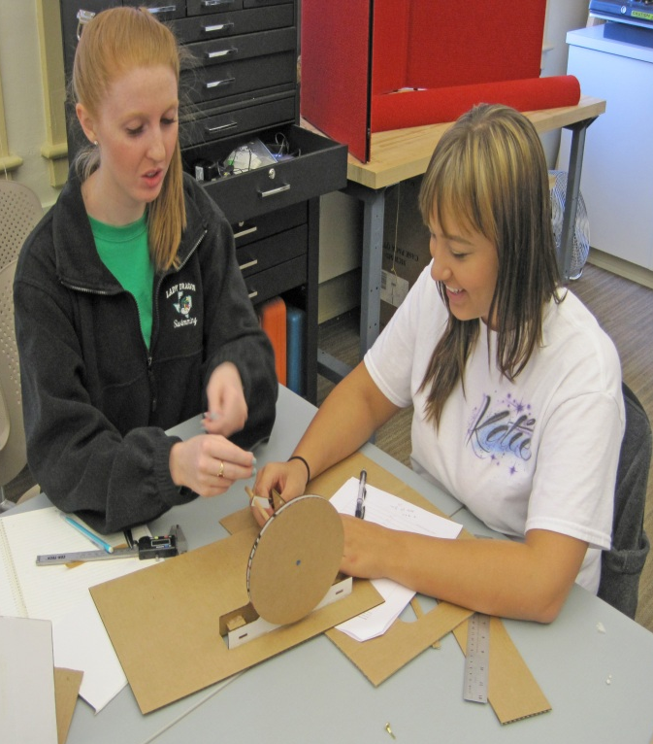
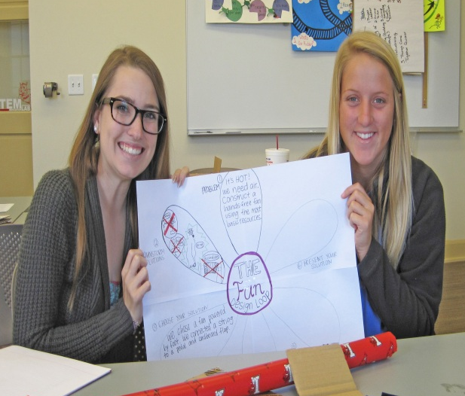
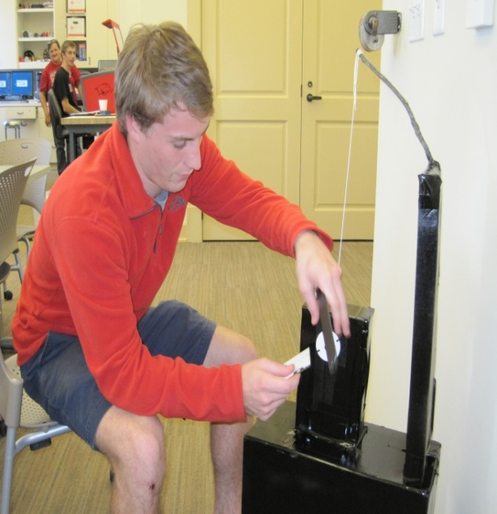
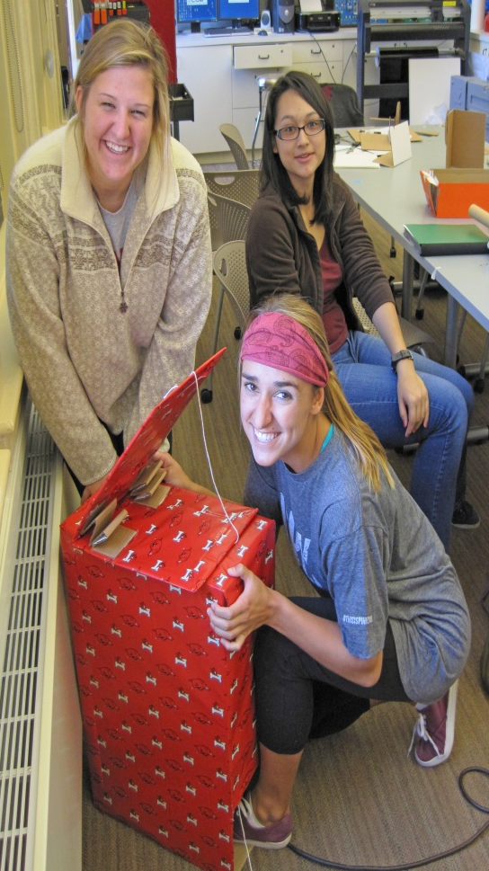
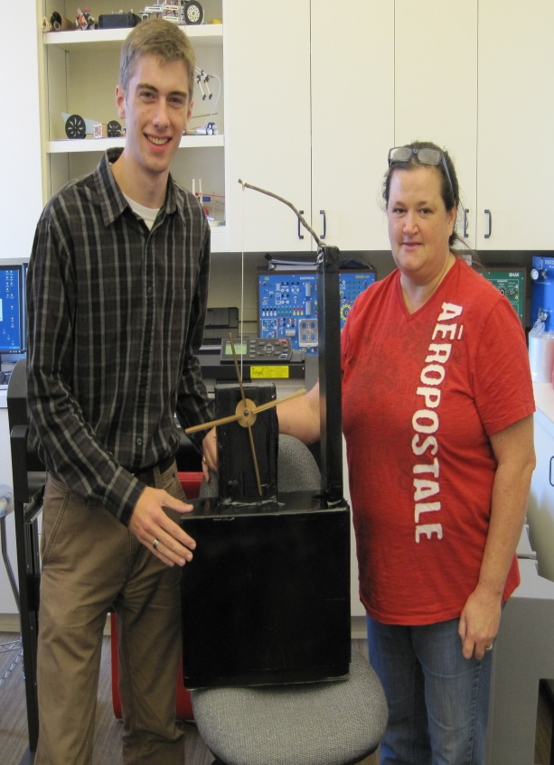
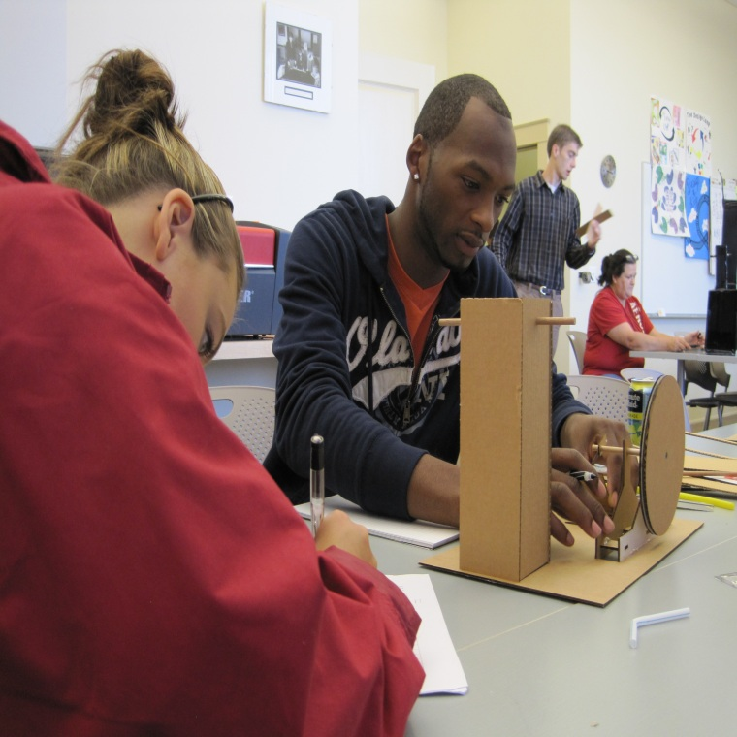

Slide 13
Mechanical Systems (hook activity)
A Cool Breeze: Mechanically-operated Fan Design Challenge

