Slide 1
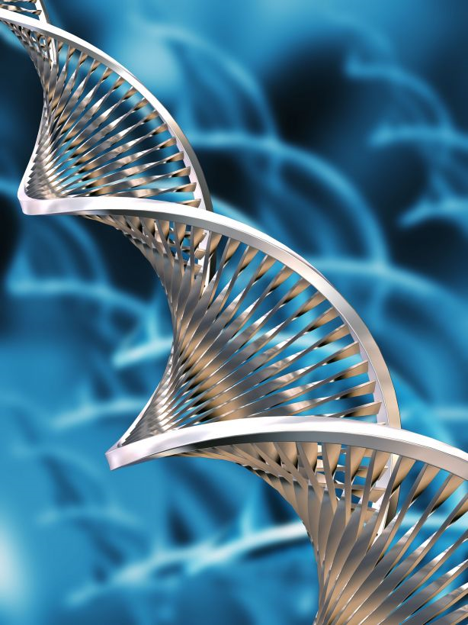
Biotechnology
The manipulation of living things to make products benefiting human beings.

Slide 2
Biotechnology Timeline
1910 - the term was first used
1950’s - DNA discovered
1970’s – Today
  birth of the biotech industry
    transfer of genes between organisms
    stem cell research
    cloning

Slide 3
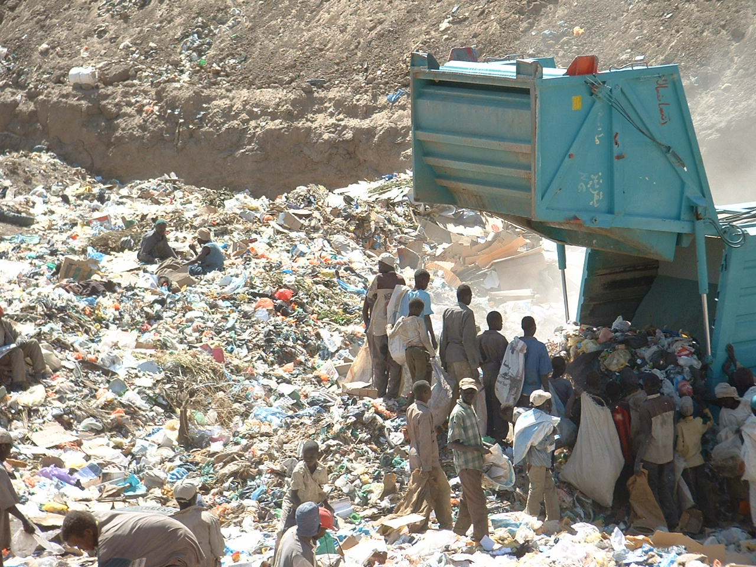
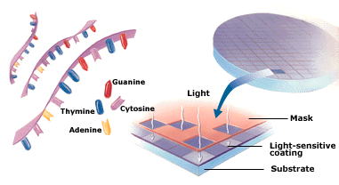
Industrial Uses of Biotechnology
Waste Management
Biomining
DNA Chips

Slide 4
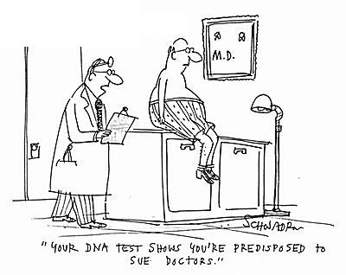
Biotechnology for Health
Human Genome Project (HGP)
Genetic Testing
Human Gene Therapy
Xenotransplantation

Slide 5
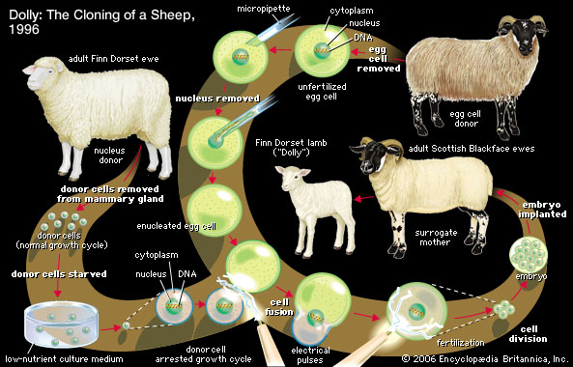

Cloning
Medical Uses of Cloning
Ethical Concerns

Slide 6
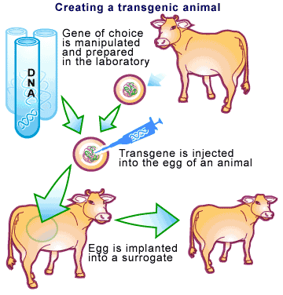
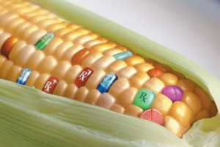
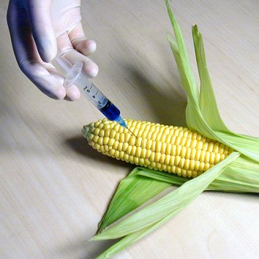
Biotechnology and Agriculture
Genetically Engineered Crops
Transgenic Animals and Plants
Internationally Concerns with GM Foods

Slide 7
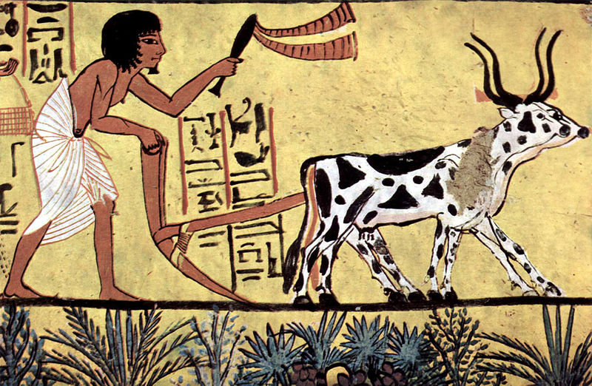
History of
Agricultural Technology:
From Domestication Through Today

Slide 8
What have you eaten today?
Fruit
Coffee/Tea
Grains

Slide 9
Center of Origins
North America
Seeds
  1. Sunflower
  2. Acorns
Fruits
  1. Blueberries
  2. Strawberries
History of Horticulture © 2002 Jules Janick, Purdue University

Slide 10
Center of Origins
South America
Root Tubers
  1. Andean potato, Solanum andigenum (96 chromosomes)
  2. Other endemic cultivated potato species.
Grains and Legumes
  1. Starchy maize, Zea mays amylacea
  2. Lima bean, Phaseolus lunatus (secondary center)
  3. Common bean, Phaseolus vulgaris (secondary center)
Vegetable Crops
  1. Pepino, Solanum muricatum
  2. Tomato, Lycopersicum esculentum
  3. Pumpkin, Cucurbita maxima
  4. Pepper, Capsicum frutescens
History of Horticulture © 2002 Jules Janick, Purdue University

Slide 11
Center of Origins
India
Cereals and Legumes
  1. Rice, Oryza sativa
  2. Chickpea or gram, Cicer arietinum
  3. Pigeon pea, Cajanus indicus
  4. Urd bean, Phaseolus mungo
  5. Mung bean, Phaseolus aureus
  6. Rice bean, Phaseolus calcaratus
  7. Cowpea, Vigna sinensis
Vegetables and Tubers
  1. Eggplant, Solanum melongena
  2. Cucumber, Cucumis sativus
  3. Radish, Raphanus caudatus (pods eaten)
  4. Taro, Colocasia antiquorum
  5. Yam, Dioscorea alata
Fruits
  1. Mango, Mangifera indica
  2. Orange, Citrus sinensis
  3. Tangerine, Citrus nobilis
  4. Citron, Citrus medica
  5. Tamarind, Tamarindus indica
Sugar, Oil, and Fiber Plants
  1. Sugar cane, Saccharum officinarum
  2. Coconut palm, Cocos nucifera
  3. Sesame, Sesamum indicum
  4. Safflower, Carthamus tinctorius
  5. Tree cotton, Gossypium arboreum
  6. Oriental cotton, Gossypium nanking
  7. Jute, Corchorus capsularis
  8. Crotalaria, Crotalaria juncea
  9. Kenaf, Hibiscus cannabinus
Spices, Stimulants, Dyes, and Miscellaneous
  1. Hemp, Cannabis indica
  2. Black pepper, Piper nigrum
  3. Gum arabic, Acacia arabica
  4. Sandalwood, Santalum album
  5. Indigo, Indigofera tinctoria
  6. Cinnamon tree, Cinnamomum zeylanticum
  7. Croton, Croton tiglium
  8. Bamboo, Bambusa tulda
History of Horticulture © 2002 Jules Janick, Purdue University

Slide 12
Center of Origins
Middle-East:
Grains and Legumes
  1. Einkorn wheat, Triticum monococcum (14 chromosomes)
  2. Durum wheat, Triticum durum (28 chromosomes)
  3. Poulard wheat, Triticum turgidum (28 chromosomes)
  4. Common wheat, Triticum vulgare (42 chromosomes)
  5. Oriental wheat, Triticum orientale
  6. Persian wheat, Triticum persicum (28 chromosomes)
  7. Triticum timopheevi (28 chromosomes)
  8. Triticum macha (42 chromosomes)
  9. Triticum vavilovianum, branched (42 chromosomes)
  10. Two-row barley, Hordeum distichum, H. nutans
  11. Rye, Secale cereale
  12. Mediterranean oats, Avena byzantina
  13. Common oats, Avena sativa
  14. Lentil, Lens esculenta
  15. Lupine, Lupinus pilosus, L. albus
Forage Plants
  1. Alfalfa, Medicago sativa
  2. Persian clover, Trifolium resupinatum
  3. Fenugreek, Trigonella foenum graecum
  4. Vetch, Vicia sativa
  5. Hairy vetch, Vicia villosa
Fruits
  1. Fig, Ficus carica
  2. Pomegranate, Punica granatum
  3. Apple, Malus pumilo (one of the centers)
  4. Pear, Pyrus communis and others
  5. Quince, Cydonia oblonga
  6. Cherry, Prunus cerasus
  7. Hawthorn, Crataegus azarolus
History of Horticulture © 2002 Jules Janick, Purdue University

Slide 13
The Value of Food
A ratio that links the number of calories per obtained per serving to the amount of energy required in the production.
  Wheat
  Rice
  Corn
  Potato

Slide 14
Distribution of the global population
How does this influence the population density's?
  North vs. South America
  Middle East vs. Europe
  Western vs. Eastern Hemisphere

Slide 15
History of food
Transition from Hunter-gatherer to Agriculture specialization, population increases, culture, etc….
These early farmers unknowingly changed he plants they grew.

Slide 16
Agricultural Improvements
Irrigation
Domestication of animals.
Plows
Mechanization
Diesel engine
Fertilizer

Slide 17
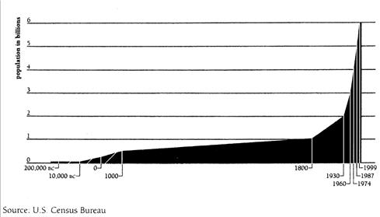
Human
Population Growth

Slide 18
Intended Consequences

Slide 19
Unintended Consequences
Irish Potato Famine
  2 million starved
  2 million emigrated to the US
Dust Bowl
  Deep soil tilling
  Residents migrated west

Slide 20
Modern Agriculture
Organic vs. Conventional production
  Cost
  Environmental Concerns
  Regulation
  Popular

Slide 21
Modern Agriculture
Gene Revolution
-GM foods
-patent laws
Current Agricultural Practices
-big seed companies
-global market

Slide 22
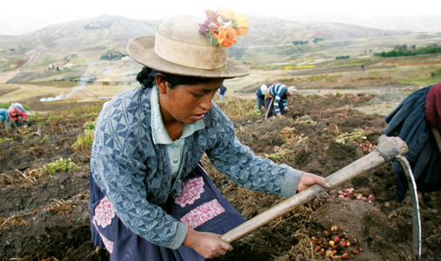

Slide 23
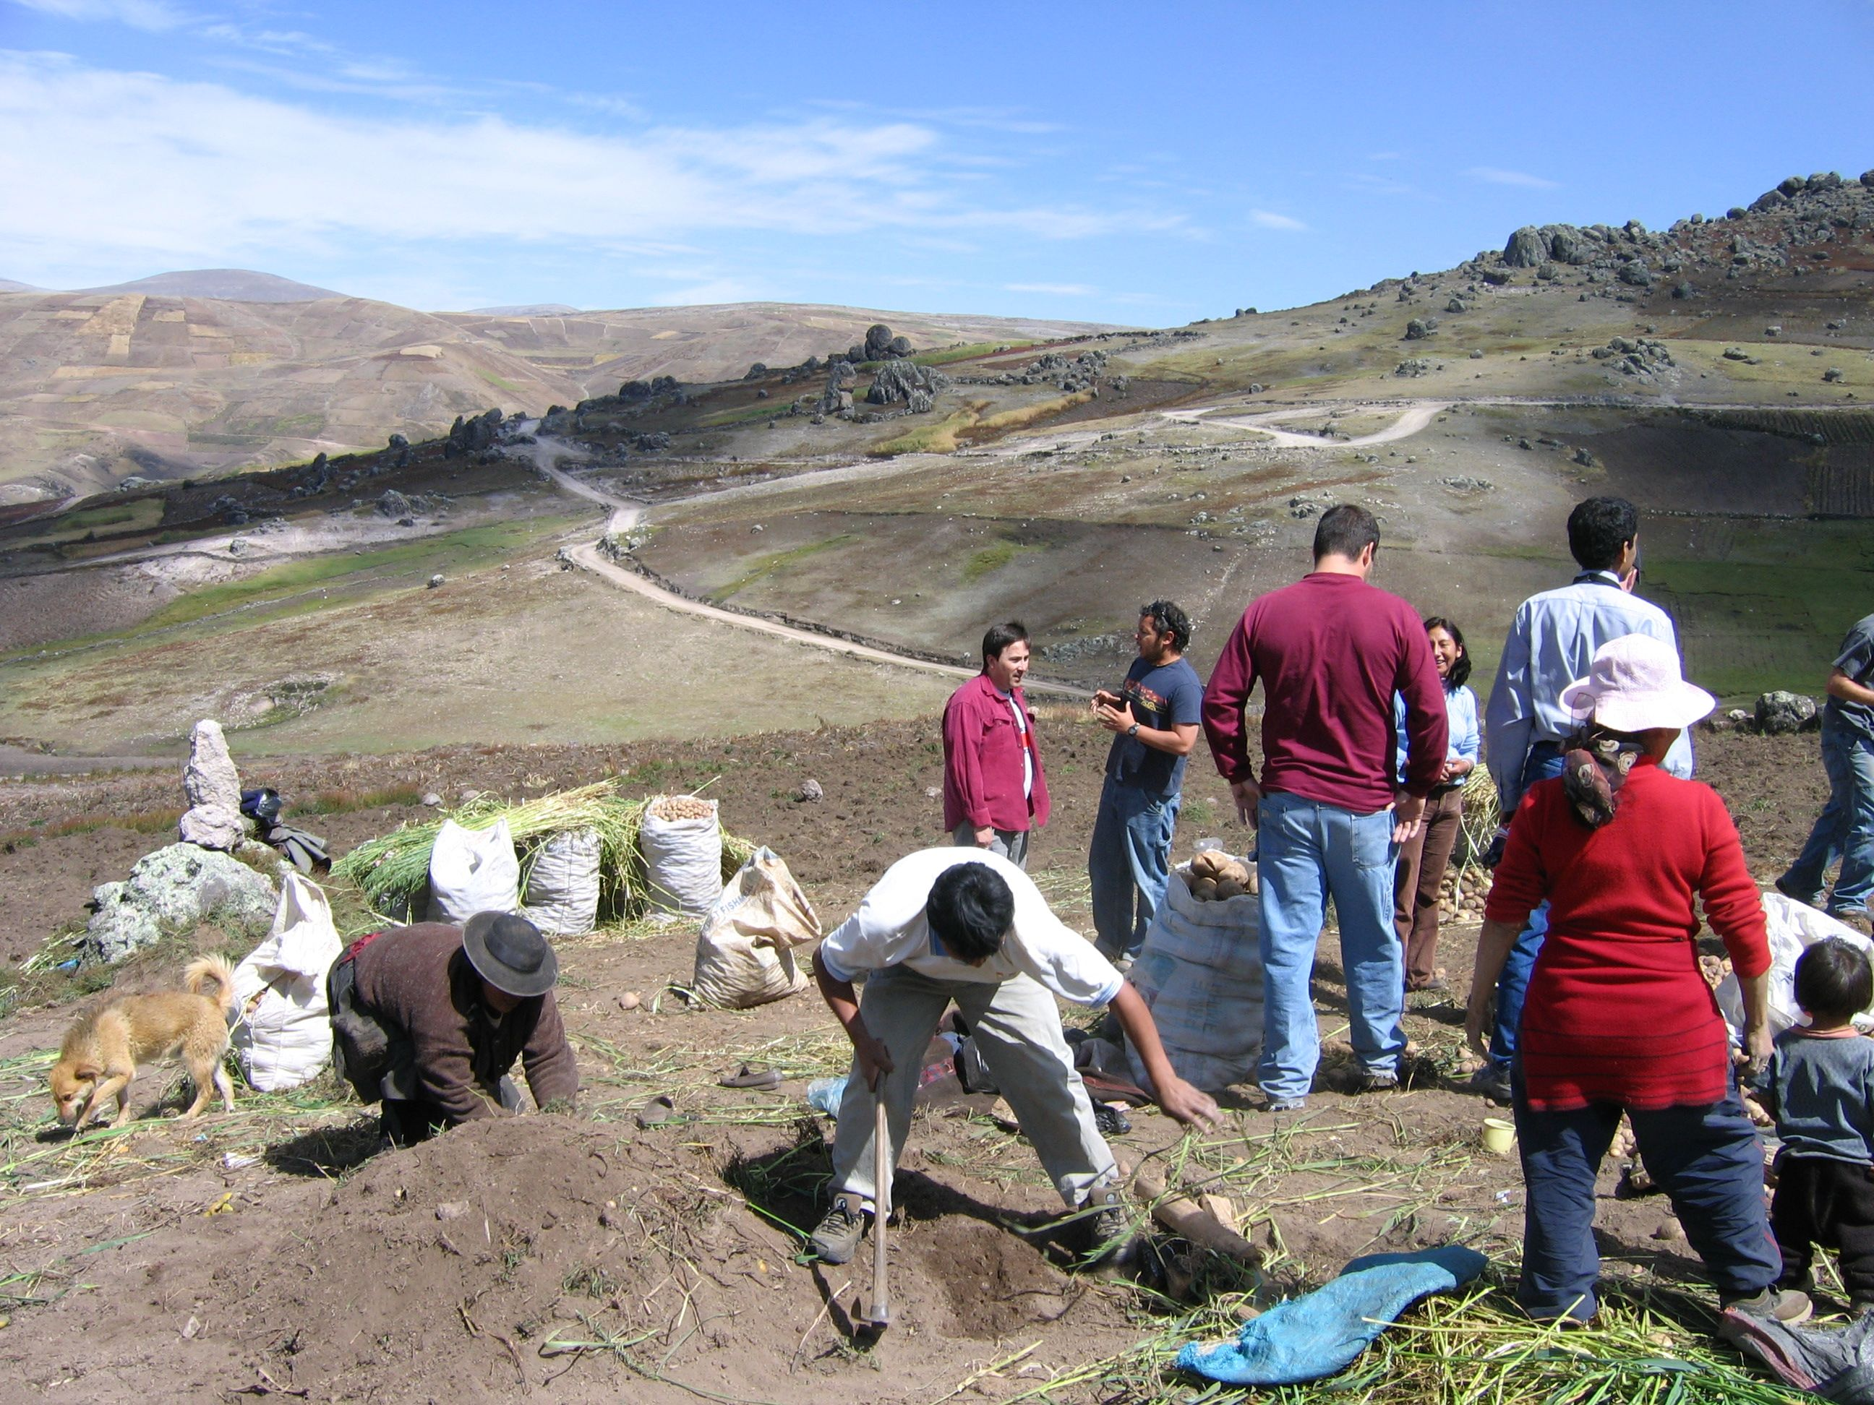

Slide 24
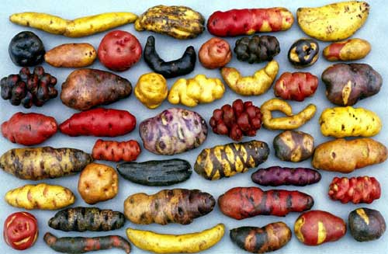

Slide 25
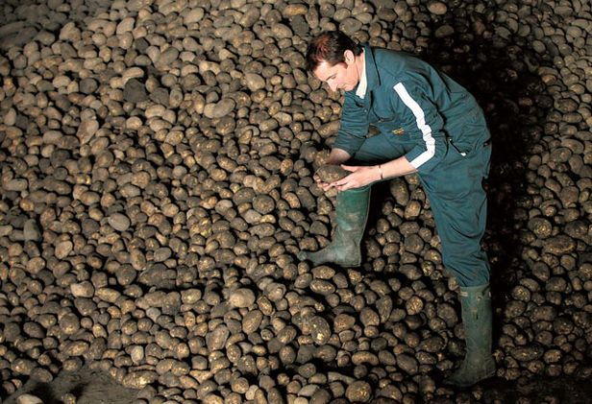

Slide 26
Modern Agriculture
Food miles
Urbanization
Food Security

Slide 27
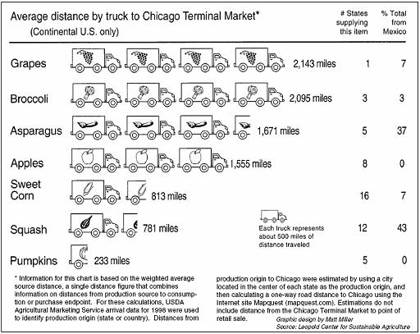

Slide 28
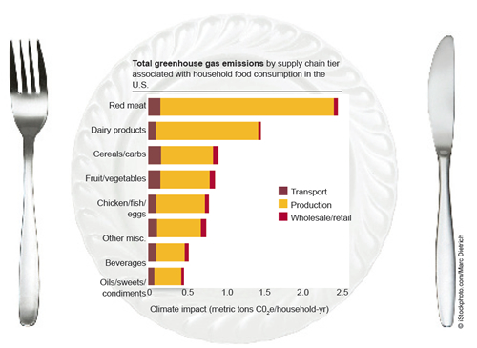

Slide 29
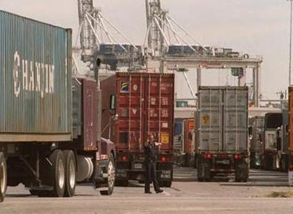
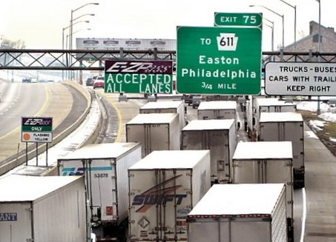

Slide 30
Human Population Growth

Slide 31
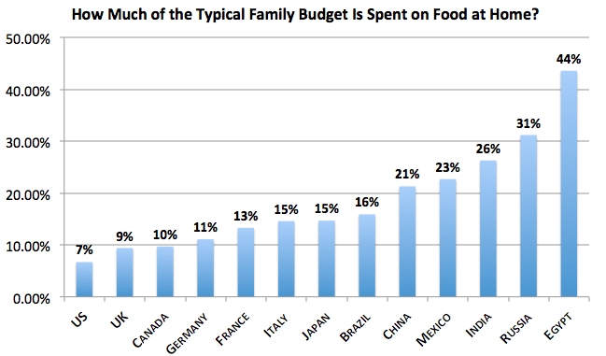

Slide 32
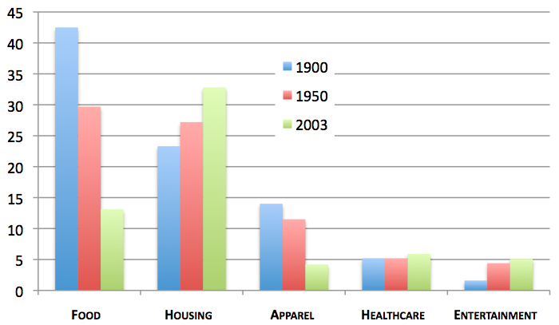

Slide 33
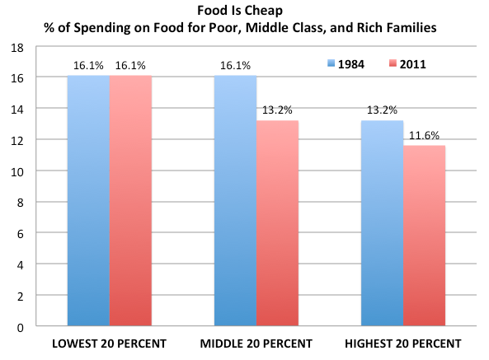

Slide 34
