Slide 1
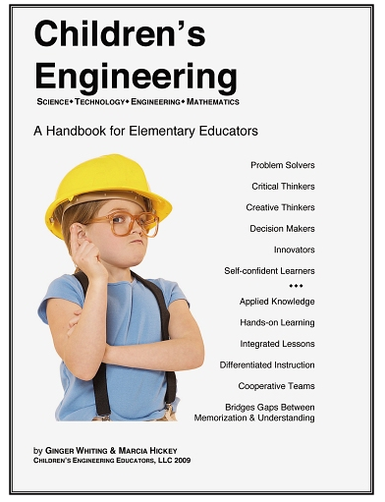
We believe that children's engineering can and should be integrated into the material that is already being taught in the elementary classroom -it does NOT need to be an add-on,
We hope that this handbook will educate teachers on how to make this happen.
Ginger Whiting & Marcia Hickey

Slide 2
What is Technology?
Why Should Elementary Children Study Technology?
How Do Children Benefit?
Are There Benefits for the Teacher?
What Is the Teacher's Role?
How Is Children's Work Assessed?

Slide 3
What is Technology?
Broadly speaking, technology is how people modify the natural world to suit their own purposes. From the Greek word techne, meaning art or artifice or craft, technology literally means the act of making or crafting, but more generally it refers to the diverse collection of processes and knowledge that people use to extend human abilities and to satisfy human wants and needs.

Slide 4
"A technologically literate person understands, in increasingly sophisticated ways that evolve over time, what technology is, how it is created, and how it shapes society, and in turn is shaped by society."
(2007, International Technology Education Association)

Slide 5
What is Children's Engineering?
Children's engineering is the common name given to technology education in the elementary classroom.
It integrates STEM education into the elementary classroom.
Children's engineering includes hands-on, age-appropriate technology based activities that enhance, not add to, any local, state, or national curriculum.
The activities are designed to extend and to promote mastery of required standards.
Taught skills are applied, not just to one content area, but across the curriculum in authentic integrated learning lessons.

Slide 6
TECHNOLOGY
Focuses on practice
Concerned with ‘how to’ or ‘what makes’
Deals with doing and making
Is immediately practical and useful
SCIENCE
Focuses on theory
Concerned with ‘what is’ or ‘why’
Deals with knowing and understanding
Is theoretical and conceptual

Slide 7
Why should children study technology at the elementary level?
Historically, in a industrialized society, children learned about new technology from their parents working on the farm or in a factory.
Today, we are an information society. Learning about processes and materials is not common conversation around the dinner table.
Many adults consider technology a mystery.
The gap between information and true understanding appears to be widening.
Technology defined our past and will define our future.

Slide 8
How do children benefit from children's engineering?
With the emphasis on multiple choice competency tests, children often miss out on developing the critical and creative thinking skills that are necessary to become proficient problem solvers and decision makers.
As lecture replaces hands-on learning activities, opportunities for children to learn to work together in cooperative learning settings decrease.
Children's engineering bridges the gap between memorization of facts and the understanding of skills and processes through meaningful hands-on activities that often motivate even the most reluctant students.
When included in the elementary curriculum, children's engineering results in self-confident learners, the ownership of essential knowledge, and the ability to apply classroom instruction when collaborating with peers.

Slide 9
Are there benefits for the teacher?
Differentiating instruction is necessary in the heterogeneous elementary classroom.
Not all children come with the same set of skills or background. By offering a variety of avenues for learning, more children are likely to gain ownership of the skills taught.
For English Language Learners, the language rich communication that takes place during the engineering activity promotes language acquisition.
For learners who "need more time," hands-on activities enhance their skills mastery.
Students with varying disabilities often are successful in showing skill acquisition through design and technology activities when more traditional methods have failed.
Students who tend to master skills quickly will frequently "go to the next level" with design and technology activity.
Teachers are able to reach different ability learners-linguistic, kinesthetic, visual, audio, and social.

Slide 10
What is the teacher's role as facilitator?
Be sure that students have been taught the background and prior knowledge needed to begin the activity.
As facilitators, teachers do not solve or answer children's questions, but instead ask questions to promote problem solving abilities.
  asks stimulating, thought provoking, and open-ended questions, leaving options open for students to explore and learn through doing.
  try to share their comments in the form of questions.
  observe students and take anecdotal notes while they work.

Slide 11
The Ultimate Goal of Children’s Engineering
  Children will gain independence and develop into risk takers in a safe and nurturing environment where teachers and students learn from each other.

Slide 12
How is children's work assessed?
Sharing projects - oral assessment possibilities.
Peer work groups - social interactive assessments
Written guided portfolio or engineering journal - written assessment opportunities
Following directions - another avenue for assessment
Rubrics - designed to confirm that projects meet the challenge criteria as well as evaluating the students' application of the design process. The rubric can be adapted to the teacher's particular assessment goals.
  Teachers should review the rubric prior to introducing the design brief and add to or extend the criteria to meet their needs
  Projects are not rated on artistic merit unless clearly stated in the criteria
  Teachers may add criteria for appearances, but need to be aware that putting too much pressure on the visual appearance of a project might limit the risks students are willing to take with the design because they might be concerned if their solution will "look good."

Slide 13
It is important to remember that the greatest learning often takes place from the ideas that might fall short of the stated goal.
Teachers and students quickly learn that there is no such thing as one correct answer-that there are many solutions to the problems presented in this book and that some solutions are more appropriate than others.

Slide 14
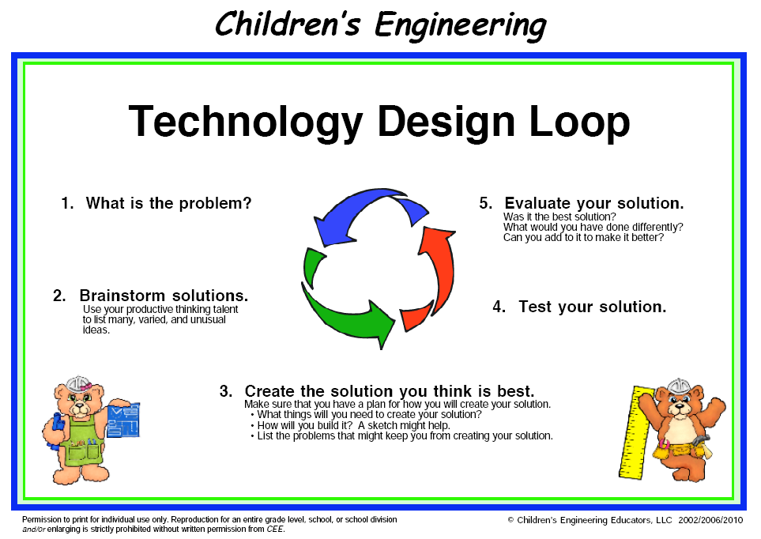
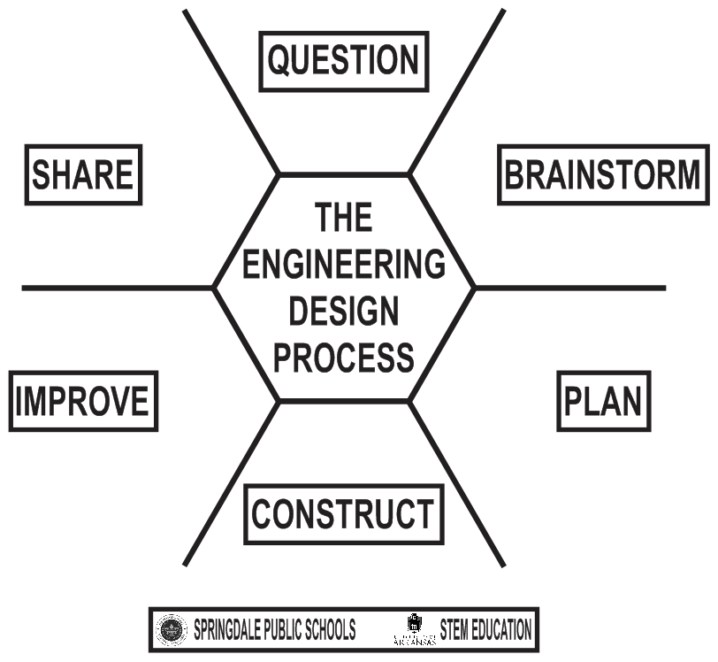
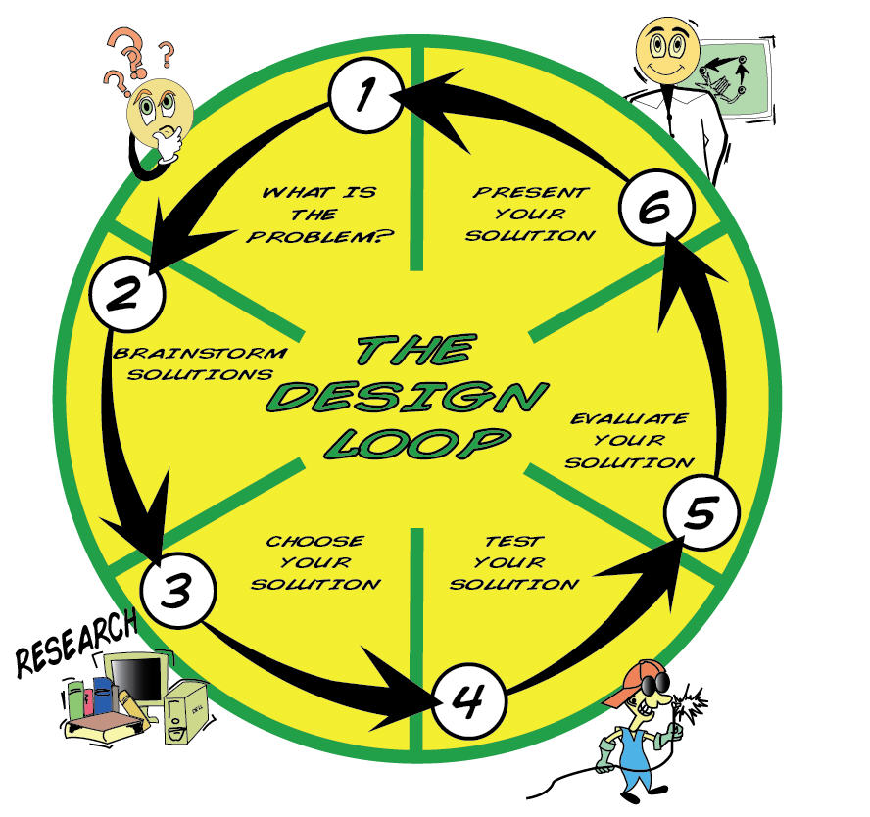
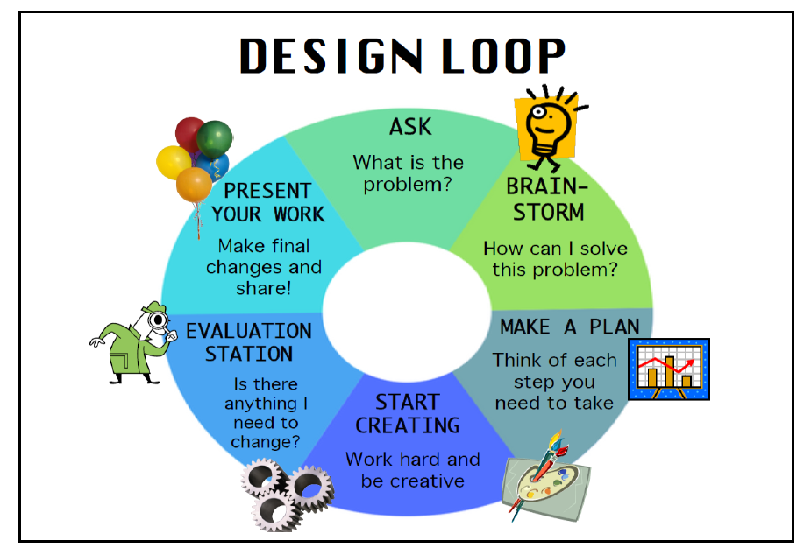

Slide 15
Understanding the Design Brief
  “Design” is to Technology as “Inquiry” is to Science and as “Reading/Writing” are to Language Arts
Design is the core problem solving process
Design problem solving extends learning beyond the classroom

