Slide 1
Creativity
STEM 5023- Creativity and Innovation
Angela Watson

Slide 2
My Motivation
Why bother with STEM when kids can’t read?
  Structures to attach learning to
  Field trip research
What does this prepare kids for?
  We don’t know what jobs or life will look like in 10-20+ years
  Life is not always black-and-white, right answer driven
  Creative thinking and problem solving skills are important

Slide 3
Creativity
Creativity- the use of the imagination or original ideas, especially in the production of an artistic work… inventiveness, innovation, originality.
Can be nurtured
Can be measured

Slide 4
Torrance Test
We will take a test of creativity often given to children.
Once I hand out the assessment, you will have 3 minutes to draw as many pictures as you can. The goal is to draw as many, and as many creative pictures as you can in the time allotted. Pictures should also have a title or description.

Slide 5
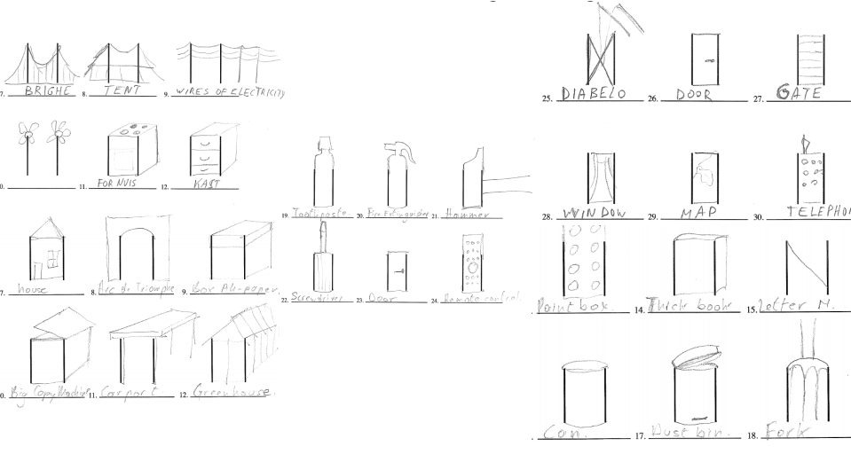

Slide 6
Creativity- Four Categories of Divergent Thinking
Fluency- how many ideas you can come up with in a short period of time
Originality- how uncommon your ideas are
Flexibility- how many areas your ideas cover
Elaboration- level of detail in responses

Slide 7
What does this have to do with STEM Ed?
The ideas of Fluency and Flexibility = Brainstorming
These are skills that can be practiced
Tension between fluency and originality

Slide 8
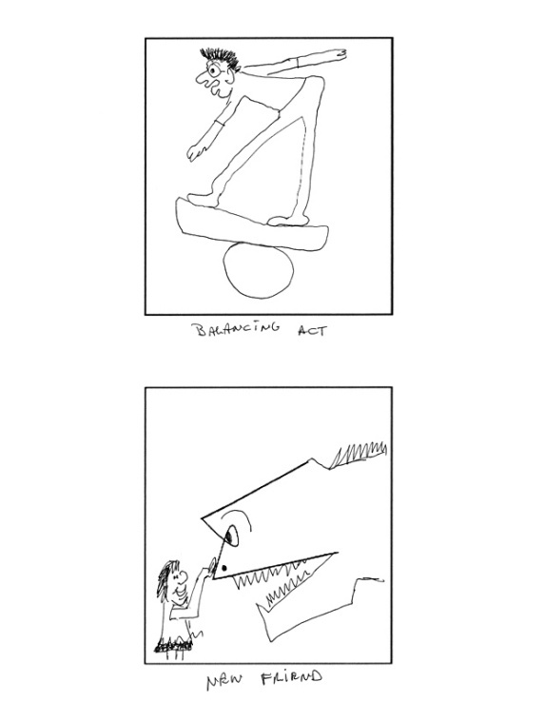
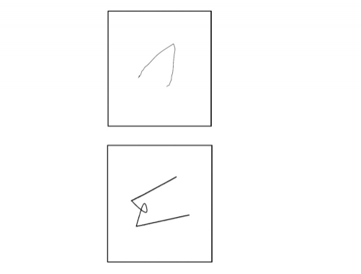
Other Fun Exercises
Guilford Alternative Uses Test- 2 min. to think of as many uses as possible for a paper clip
Incomplete Figures- these are on GT screens

