Slide 1
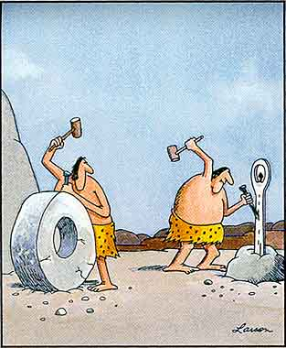

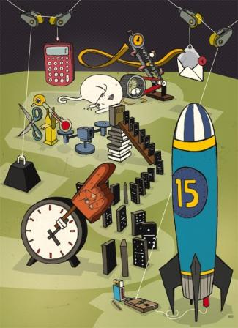
Invention and Innovation
Technological Design

Slide 2
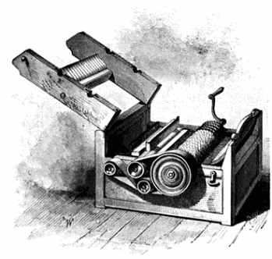
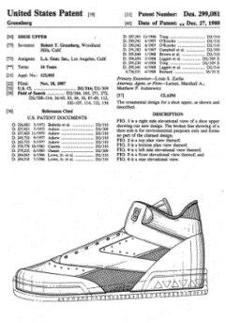

Intellectual Property
Utility Patents – processes, machines, products, and composition of matter (medicines)
20 years
Design Patents – new, original, or ornamental designs for products
20 years
Plant Patents – invented or discovered plant varieties
20 years

Slide 3


Intellectual Property
Trademarks – words, names, symbols, sounds, or colors distinguishing goods and services
Can be renewed forever
Copyrights – writings, music, and works of art
Life of the author, plus 70 years

Slide 4

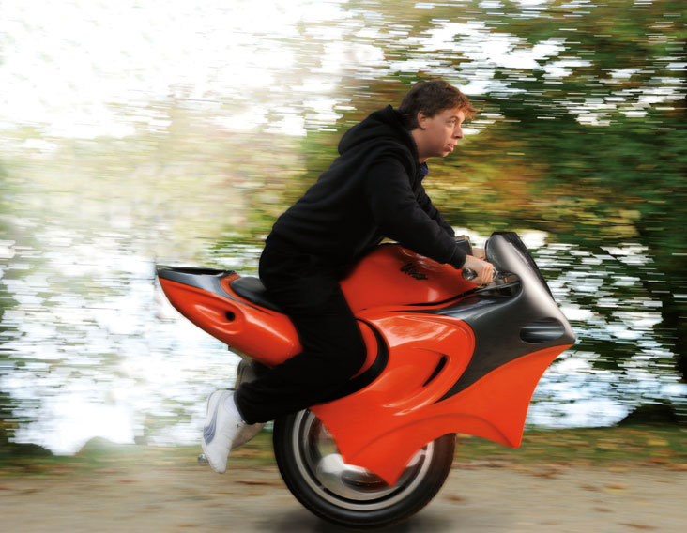
Discovery vs. Invention
Discovery – is made when something that naturally occurs is first noticed – scientific discoveries
Invention – is a new idea, process, or device
Devices and machines
Products
Processes

Slide 5

Invention & Innovation
Invention
Developing products/systems to solve human problems
Meeting human wants and needs
Innovation
Improving existing products/systems
Improving technological methods
Adaptation – developed when inventions are used for something other than the purpose for which they were intended

Slide 6

Why Design?
Design is to technology what inquiry is to science and reading is to language arts
Uses critical thinking
Promotes teamwork
Mirrors “real” world
Applies technical knowledge
Expands/utilizes creativity
Examines the technological impacts on society, cultures, and environment

Slide 7
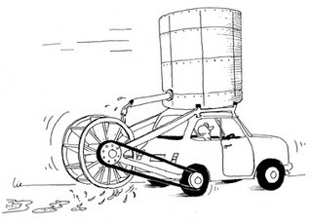
Research & Development
Pre-market innovation/development
Refining the product/system prior to marketing
Addressing wide-range of problems concurrently
Is the product reliable?
Is the product safe?
Does the product have market appeal?
Does the product add social value?
What are the potential harmful impacts
Ethical, environmental, social, political, ecological

Slide 8
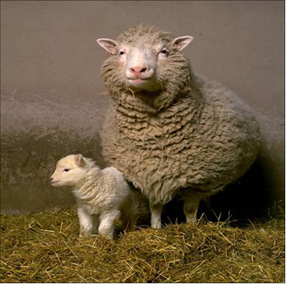
Experimentation
Following established procedures to solve a problem
Developing hypotheses, testing procedures, documentation procedures, etc.

Slide 9
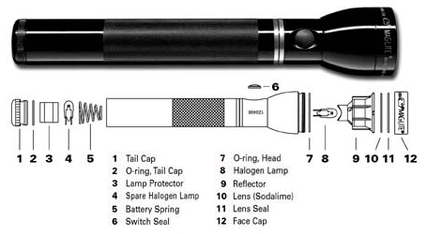
Troubleshooting
Identify faults/malfunctions in technological systems
Applying specialized knowledge to isolate causes
Repairing faults
Testing results of action

Slide 10
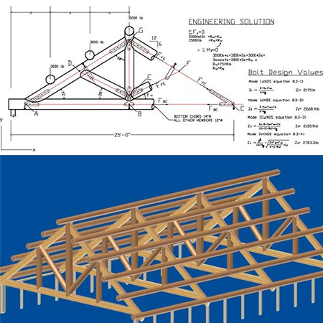
Engineering Design
Making products/systems under constraints
Ethics, safety, risks/benefits, reliability, etc.
Making compromise
Applying critical analysis
Applying technical knowledge
Using technological creativity
Developing teamwork skills

Slide 11
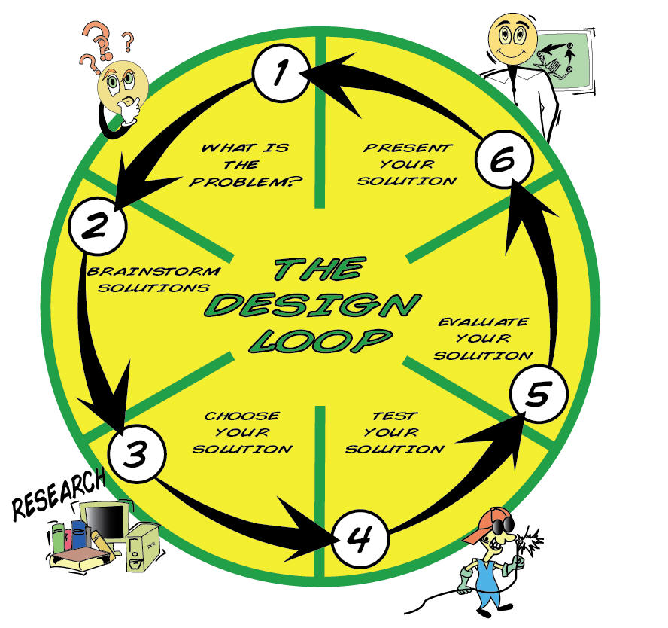
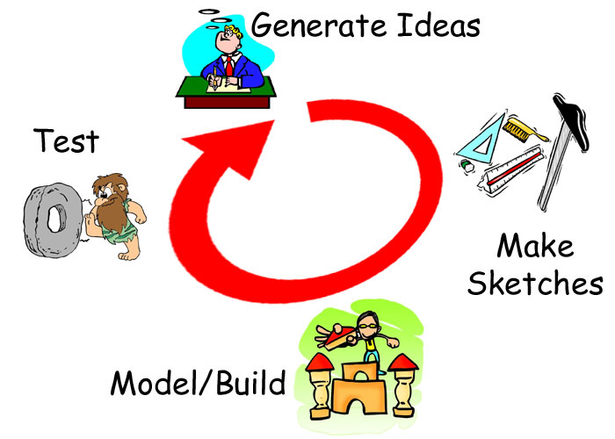
Design Process
Identify the Problem
Collect Information
Think Creatively
Experiment
Review

Slide 12

Why Invent?
Social Invention – created to help the inventor or others
make our life better and easier
Financial Invention – created to make money
Leisure Invention – created for the pleasure of inventing
games and toys

Slide 13

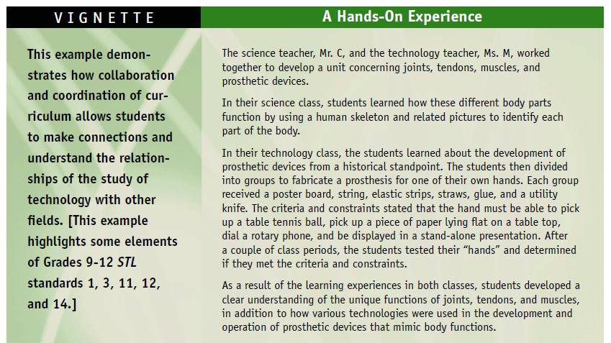

Slide 14
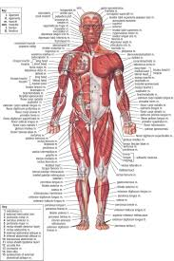
Joints – the location at which bones connect. Joints are constructed to allow movement and provide mechanical support both structurally and functionally.
Muscles – the tissue that functions to produce force and motion.
Tendons – the tissue that connects muscle to bone. Tendons and muscles work together to move bones and withstand tension.
Prosthesis - an artificial limb (an artificial substitute) that replaces a missing leg or arm due to disease, accidents, or congenital defects.
Main types of artificial limbs:
Transtibial prosthesis – occurring across or involving the tibia
Transfemoral prosthesis – occurring across or involving the femur
Transradial prosthesis - occurring below the elbow
Transhumeral prosthesis - occurring across or involving the humeris

Slide 15
Design Challenge:
Working as a member of an engineering design team, design a prosthesis for your hand that is capable of picking up a tennis ball and a sheet of paper laying flat on a table. Your prosthesis must fit on one of your design team member’s hand and be operated with the use of no more than one finger.
Materials and Tools:
Poster Board
String
Rubber Bands
Elastic Strips
Masking Tape
Straws
Popsicle Sticks
*addition recycled materials approved by the instructor
Teams will have access to all tools within the STEM lab including a hot-glue gun.

Slide 16
Design Teams:
Team 1 – Avery, Allison, Russell, Hannah R.
Team 2 – Justin, Dawn, Nicolas
Team 3 –Doug, Lyndsey , Aaron
Team 4 – Caitlin, Cullen, David
Team 5 – Renee, Sawyer, Hannah P.

Slide 17
Upcoming Assignments
Individual Invention Project (15 points)
Appropriate technological solution or original invention
Reuse a product container/packaging
Relate it to something in your own life
Final Exam/Project (10 points)
Present your design to the class
You will have 5 minutes to sell your invention to the class and demonstrate your prototype/teaching model. This can be in the form of a video/commercial, brochure/advertisement, or other appropriate demonstration of your invention
9:30-10:45 – Thursday, May 7 – 8:00-10:00

