Slide 1
STEM Lab Design Project (15pts)
To help guide elementary schools in developing and setting up a K-6 STEM laboratory.

Slide 2
General Guidelines
The STEM Lab Design booklet will contain 5 parts/chapters
The Introduction
Description of the Space
A detailed digital drawing of the room including dimensions and labels
Storage considerations
Tools & Materials
Safety
Resources

Slide 3
Introduction
What is STEM education?
The acronym STEM has various connotations and denotations among teachers, researchers, politicians, and government agencies.
Many educators use the STEM acronym when describing initiatives, projects, and curricula without clearly addressing all four disciplines of science, technology, engineering, and mathematics in an integrated effort.
There is confusion among stakeholders about the meaning of STEM education (Salinger and Zuga (2010).

Slide 4
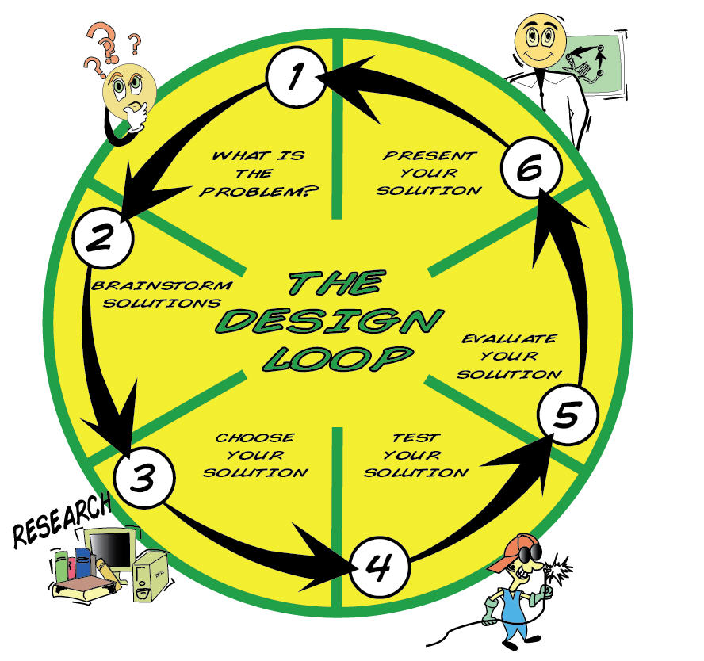
Science – discover and describe
A better understanding of life (What is)
Technology – Invent and innovate
Improving the natural world
Engineering – control, modify, or design materials, processes, and systems
What could be
Mathematics –symbolic language for representing reality

Slide 5
Introduction
Why is STEM education important?
STEM education is influential in driving national economic growth & innovation
Every person depends on elements of STEM daily
Those who pursue careers in STEM are shaped as early as elementary school

Slide 6
Introduction
Why the addition of a STEM laboratory is important?
Opportunities to…….
*Create
*Design
*Construct
*Expand
What would be required to outfit a regular classroom to teach integrated STEM education?

Slide 7
Skills Developed in a STEM Lab
Generalizable Skills
Measuring
Safety
Tool usage
Troubleshooting
Reverse engineering
Choosing the right tool
Testing
Using instruments
Programming
Reading schematics
Sketching
Documentation
Following patterns
Research
Product assessment
Teamwork
Observation
How machines work
Presentation skills

Slide 8

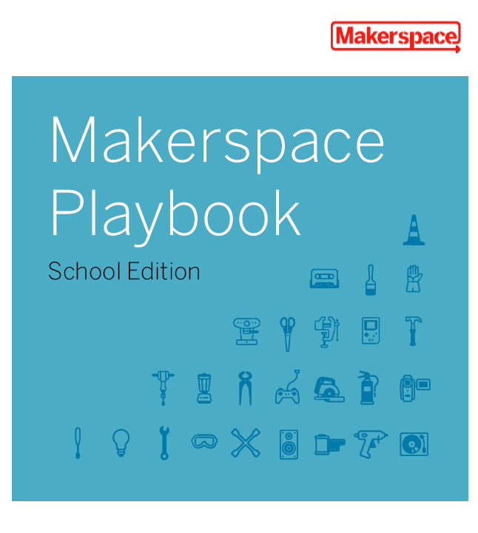
Introduction
Why the addition of a STEM laboratory is important?
What would be required to outfit a regular classroom to teach integrated STEM education?

Slide 9
Description of the Space
Written Description of the Space
A detailed digital drawing of the room including dimensions and labels
Classroom Architect - http://classroom.4teachers.org/
Word
Storage considerations

Slide 10
Tools & Materials
A list of tools needed (essential, nonessential – would be nice to have) including vendor names and prices for ordering
A list of materials (found materials, materials often found in classrooms, additional materials) including vendor names and prices for ordering
Specialty furniture that you might want to include
*hint – it might be easier to create this section using tables

Slide 11
Tools & Materials
http://www.pitsco.com/
http://www.kelvin.com/
http://www.thesciencesource.com/
http://iasco-tesco.com/

Slide 12
Safety
Description of the Importance of Safety in the STEM Lab
General Safety Rules
Tool Specific Safety Rules
Letter to Parents

Slide 13
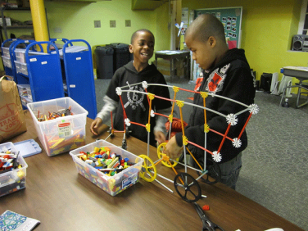
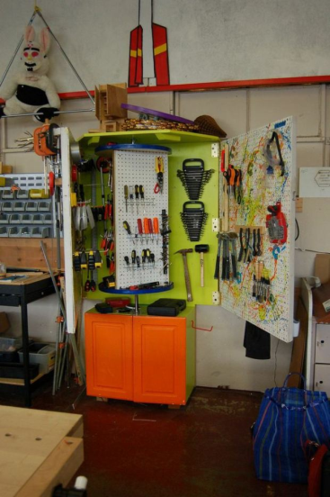
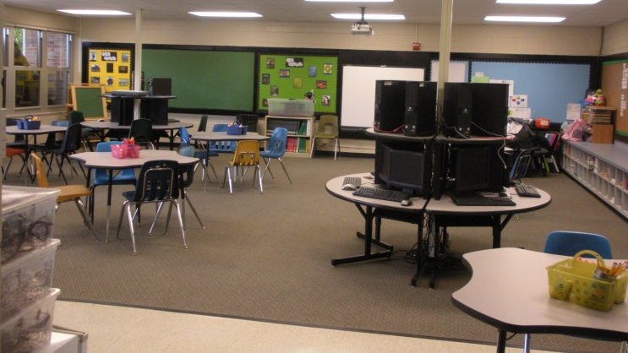
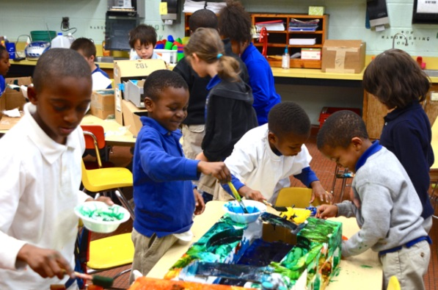
Teacher Resources
Links to free resources
Descriptions and pictures of exemplary STEM laboratories/classrooms
STEM professional organizations

Slide 14
Presentation
A 7-8 minute presentation including a PowerPoint or Prezi of the STEM education laboratory design and proposal.
During Final Examinations on Thursday, May 8, 3:15-5:15pm

