Slide 1
The Play is the Thing! The Power of Theater for Learning
Angela Watson

Slide 2
Engineering a Play
What is the idea behind integrating Social Studies in this way?
What is Social Studies?

Slide 3
Social Studies
Define Non-Cognitive Skills/ SEL
Tolerance
Social perspective taking
Empathy
Grit, Growth Mindset

Slide 4

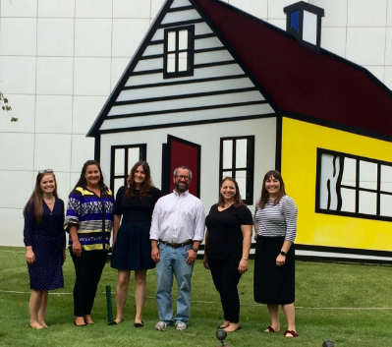
U of A NEA Research Lab

Slide 5
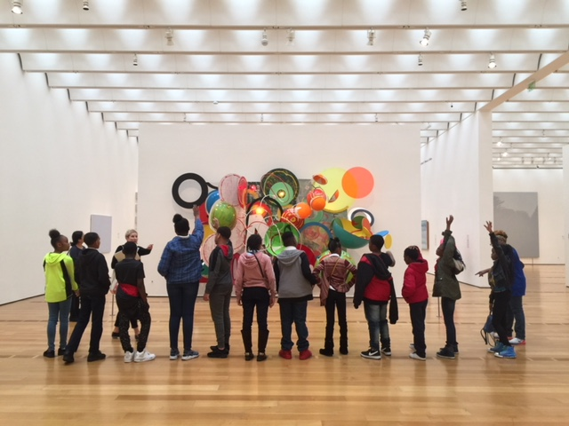
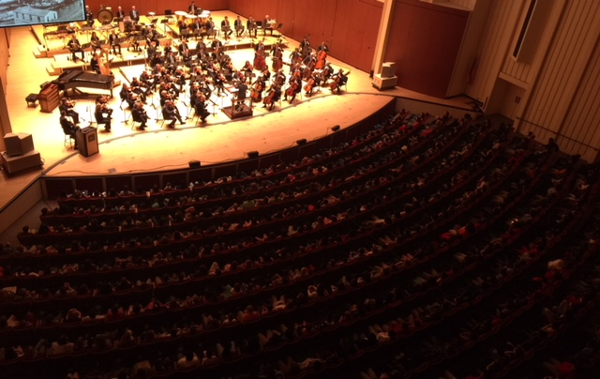
Atlanta Woodruff Project
Study looking at value of three arts field trips
Symphony
Theater
Art Museum

Slide 6
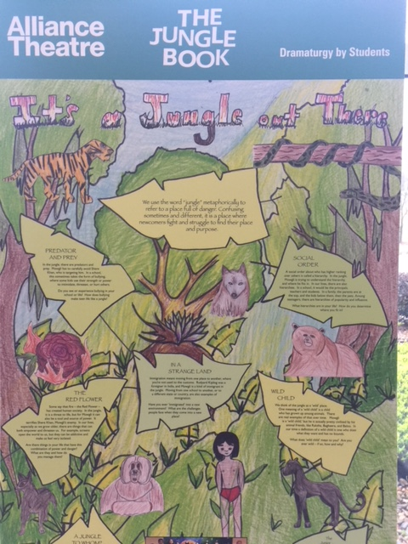
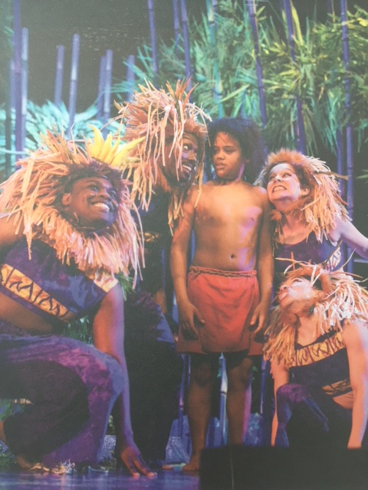

Slide 7
Greene Theater Study
Random assignment of 1000
students to…
See a play
See a movie
Business as usual
Play students= higher tolerance
Social perspective taking, plot, vocabulary.

Slide 8
Engineering a Play
Your design challenge…
Engineer your own play!
Good Luck and Happy Social-Emotional Learning

