Slide 1


Technological
Literacy
For All Students

Slide 2
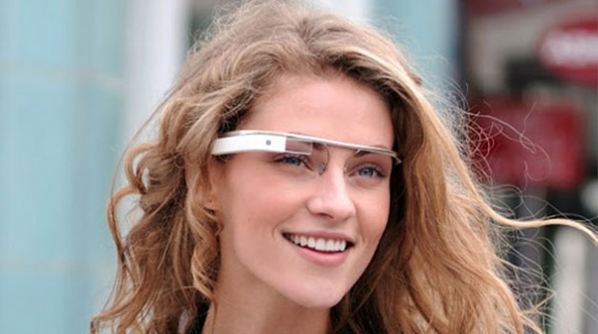

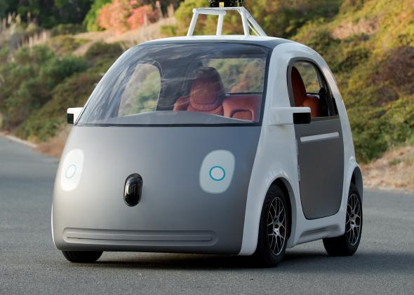
Technology Shapes Our Lives
We are all doing things we never imagined
We are absolutely “hooked” on technology
Few people understand technology

Slide 3
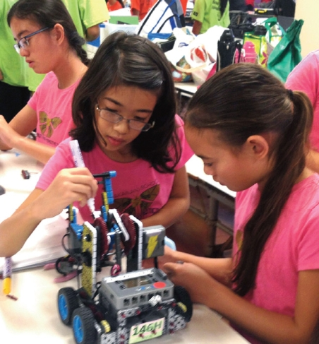
The Problem
Graduating technologically illiterate students
“Haves” and “have-nots”
Global competition
Competition for careers
High-stakes testing
Escalating rate of
change
Isolated classrooms

Slide 4
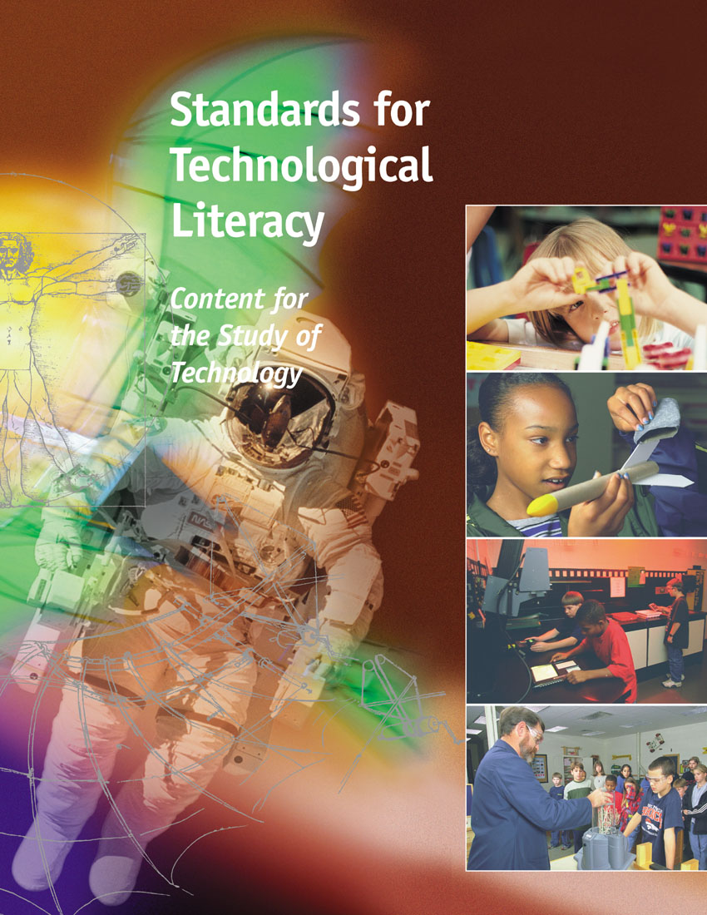

Standards for Technological Literacy: Content for the Study of Technology

Slide 5
Some Clarification
Technology is the modification of the natural environment in order to satisfy perceived human needs and wants.
Technological literacy is the ability to use, manage, assess, and understand technology.
Is Technological Literacy Possible?

Slide 6
What Can Technologically Literate People Do?
Evaluate technological information
Form opinions about technology
Assess technological value (or the lack of value)
Exhibit a level of comfort with technology
  Neither afraid, nor infatuated
Understand how technology is created
Understand how technology shapes society and is shaped by society

Slide 7
What’s The Focus?
The Nature of
Technology
The characteristics and scope of technology
The core concepts of technology
The relationships among technologies and the connections between technology and other fields of study
The cultural, social, economic, and political effects of technology
The effects of technology on the environment
The role of society in the development and use of technology
The influence of technology on history
Technology
and Society
Design
The attributes of design
Engineering design
The role of troubleshooting, research and development, invention and innovation, and experimentation in problem solving

Slide 8
What’s The Focus?
Abilities for
A Technological
World
Apply the design process
Use and maintain technological products and systems
Assess the impact of products and systems
The Designed
World
Medical technologies
Agricultural and related biotechnologies
Energy and power technologies
Information and communication technologies
Transportation technologies
Manufacturing technologies
Construction technologies

Slide 9
Why use engineering design to teach about technology?
Design is to technology as inquiry is to science and reading is to language arts
Delivers critical thinking and innovation
Allows for the application of technical knowledge
Expands levels of creativity
Examines the technological impacts on society, cultures, and environment

Slide 10
What are the primary concepts taught through the use of engineering design in the classroom?
Working as a Team
Defining the problem
Brainstorming
Conducting Researching
Generating Ideas
Identifying Criteria
Specifying constraints
Exploring possibilities
Selecting Approaches
Developing Proposals
Making a Model/prototype
Evaluating a design using specifications
Assessing a Solution
Refining a design
Creating or making products
Communicating results

Slide 11
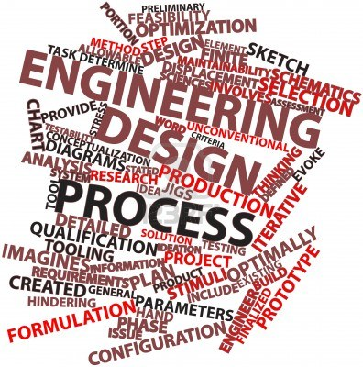
Methods Used to Deliver Engineering Design
Engineering design is delivered in the classroom using technological problem solving.
  Design Problem Solving
  Invention/Innovation
  Research & Development
  Experimentation
  Troubleshooting

Slide 12
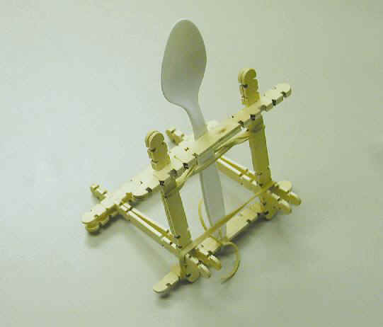
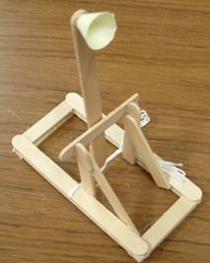
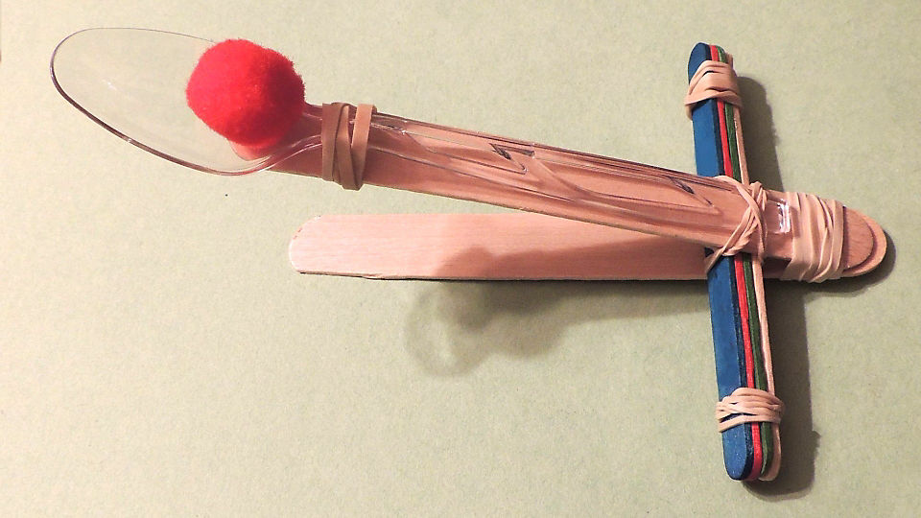
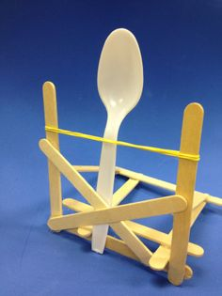

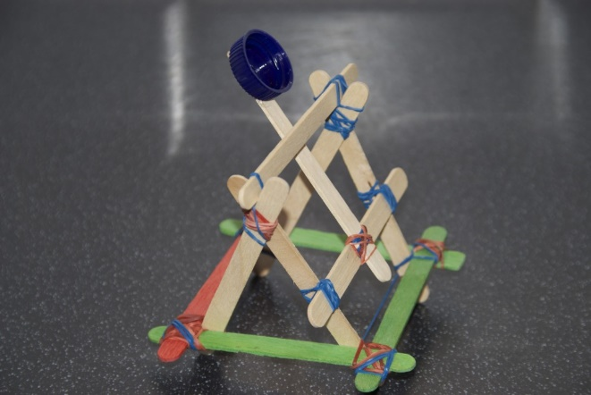

Building a Simple Catapult

