Slide 1
Setting Goals and Objectives

Slide 2
How will you set goals and objectives for student learning?
As a teacher you will decide…
what you want students to learn
how they will learn it
how you will know they have learned it
How will you set goals and objectives for student learning? What resources will guide your decisions?

Slide 3
Limited English Proficiency (LEP) Students
It is not uncommon for more than half the students to come from homes where the first language in not English.
By 2026, it is projected that about ¼ of all students will come from homes in which the primary language is not English.

Slide 4
Limited English Proficiency (LEP) Students (cont.)
Terms
LEP-limited English proficiency
ELL-English language learners
Strategies
Cooperative learning
Demonstrations
Communication that is encouraging and positive
Communication through gestures and pictures

Slide 5
Objectives
…can be defined as a clear and unambiguous description of instructional intent. It is finite and measurable. The accomplishment of objectives can be verified.
…are statements of what your students should be able to do after instruction.
…should place emphasis on student outcome or performance.

Slide 6
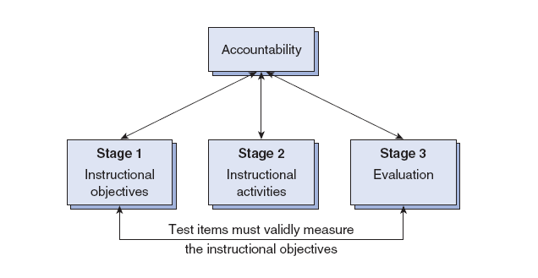
Teacher Accountability Model

Slide 7
Objectives (cont.)
Educational goals
give direction to our instructional intent and describe what
the teacher wishes to accomplish in the broadest sense
Instructional objectives
precisely communicate learning intent
4 elements include: performance, product, conditions, criteria
Informational objectives
an abbreviate version of instructional objectives that omits the conditions and criteria
Language objectives
are embedded into the content objectives

Slide 8

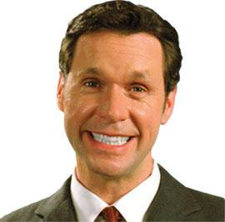


Domains of Learning
Cognitive
Affective
Psychomotor

Slide 9
Bloom’s Taxonomy for the Cognitive Domain
Original Bloom’s
Knowledge
Comprehension
Application
Analysis
Synthesis
Evaluation
Revised Bloom’s
Remembering
Understanding
Applying
Analyzing
Evaluating
Creating

Slide 10
Krathwohl’s Taxonomy for the Affective Domain
Receiving
Responding
Valuing
Organization
Characterization by a Value or Value Complex

Slide 11
Taxonomy for the Psychomotor Domain
Fundamental Movement – grasping/walking
Generic Movement – basic rudiments of a skill
Ordinative Movement – competence of performing a skill
Creative Movement - performance based changes based upon individual strengths.
-based on Harlow (1972) and Jewett and Mullan (1977)

Slide 12
Linking Standards and Objectives
Under No Child Left Behind, states must implement accountability systems that are aligned with state standards.
Teachers must clearly link
state expectations
classroom objectives
instruction
assessment

Slide 13
Backward Design Approach
Identify what knowledge is worth understanding
Develop essential questions that cover the full range of understanding
Focus essential questions on the key knowledge and skills students should acquire.

Slide 14
What are the 3 domains of learning? How can teachers best meet the needs of the LEP/ELL student? Why is it important to link state expectations, objectives, and assessment?

